Slide 1

WELCOME
Numan Talukder
172139064
&
This Week’s Commits
Issues
Github
Front Page
Al-Amin Ahmed
Milestones
Github Board
Project UI
1712249042

Slide 2
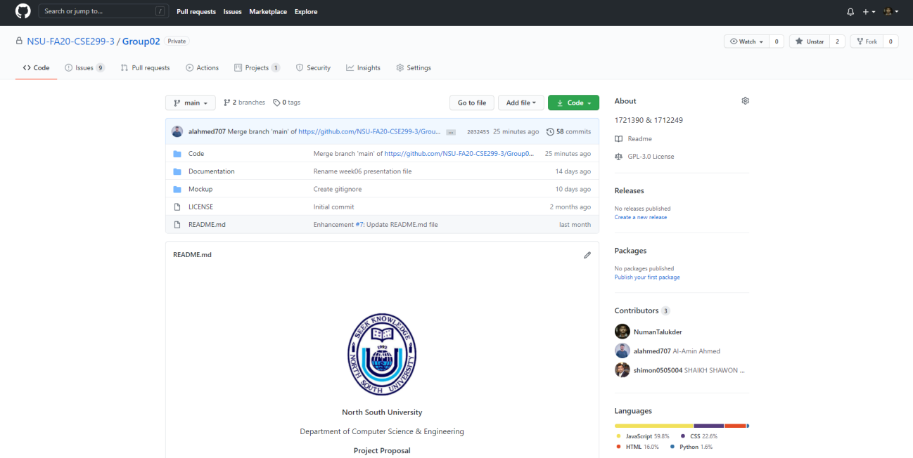
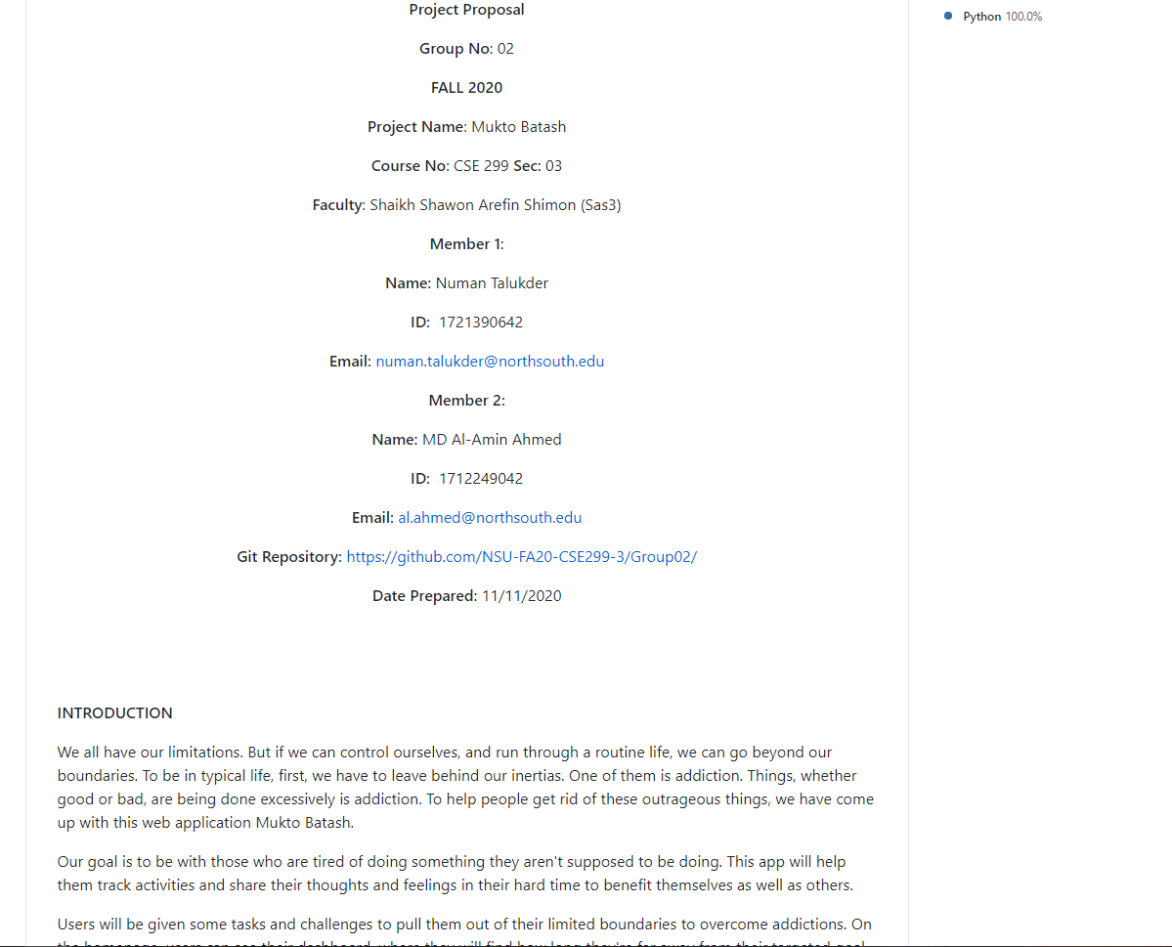
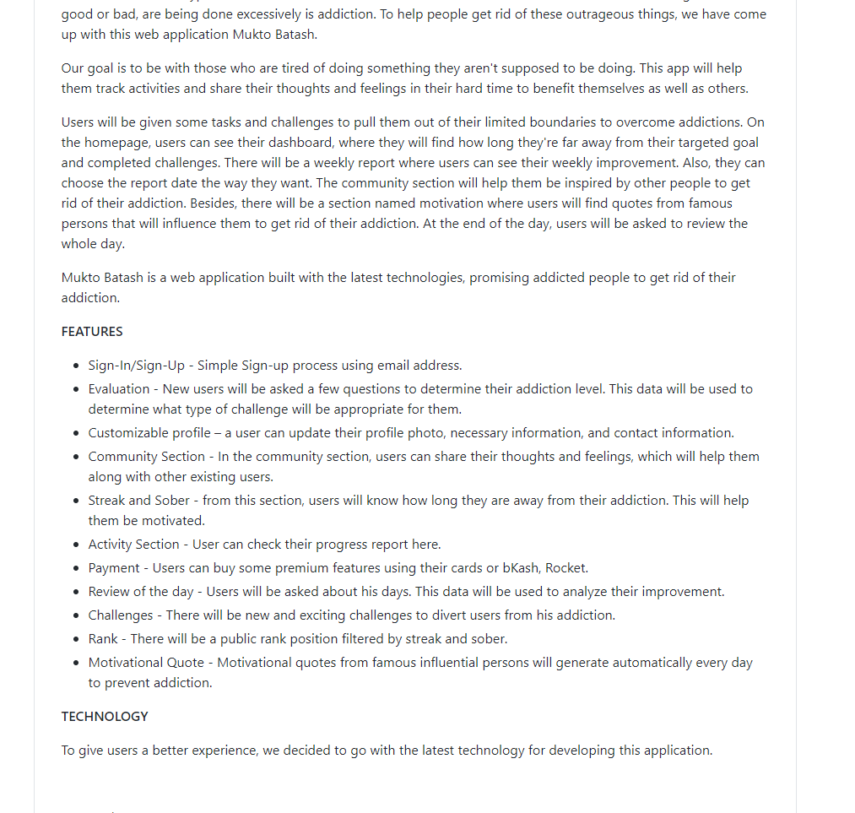
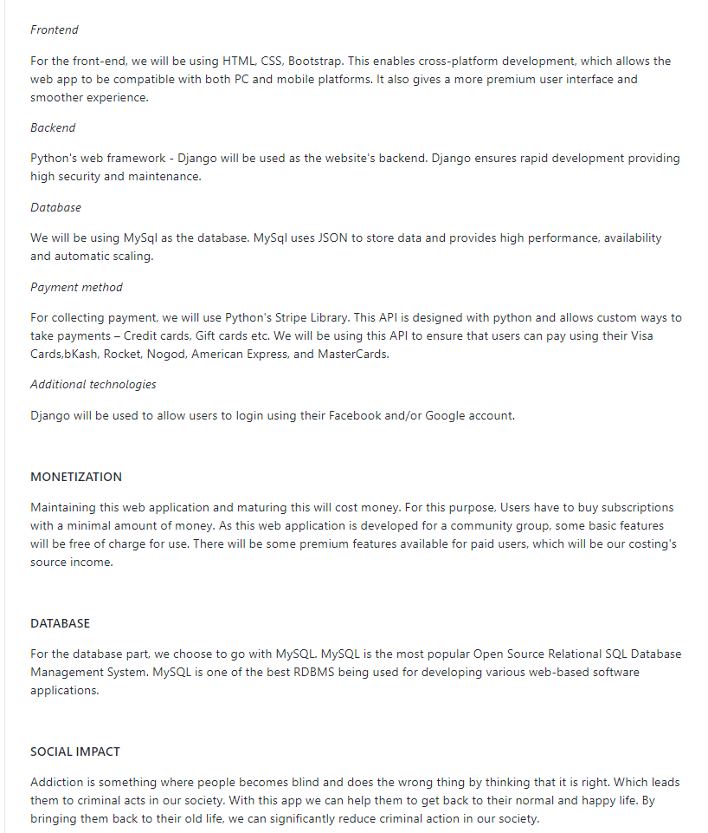
This Week’s Commits
Github
Front Page
Issues
Github Board
Milestones
Project UI

Slide 3
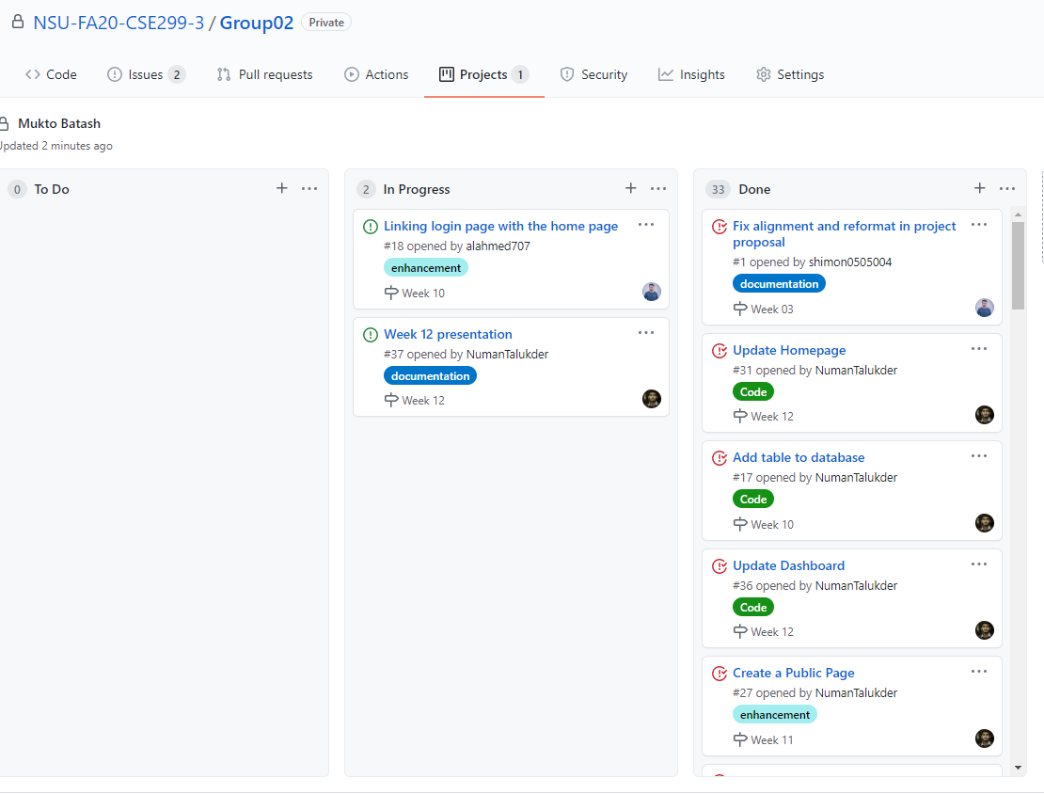
This Week’s Commits
Github
Front Page
Issues
Milestones
Github Board
Project UI

Slide 4
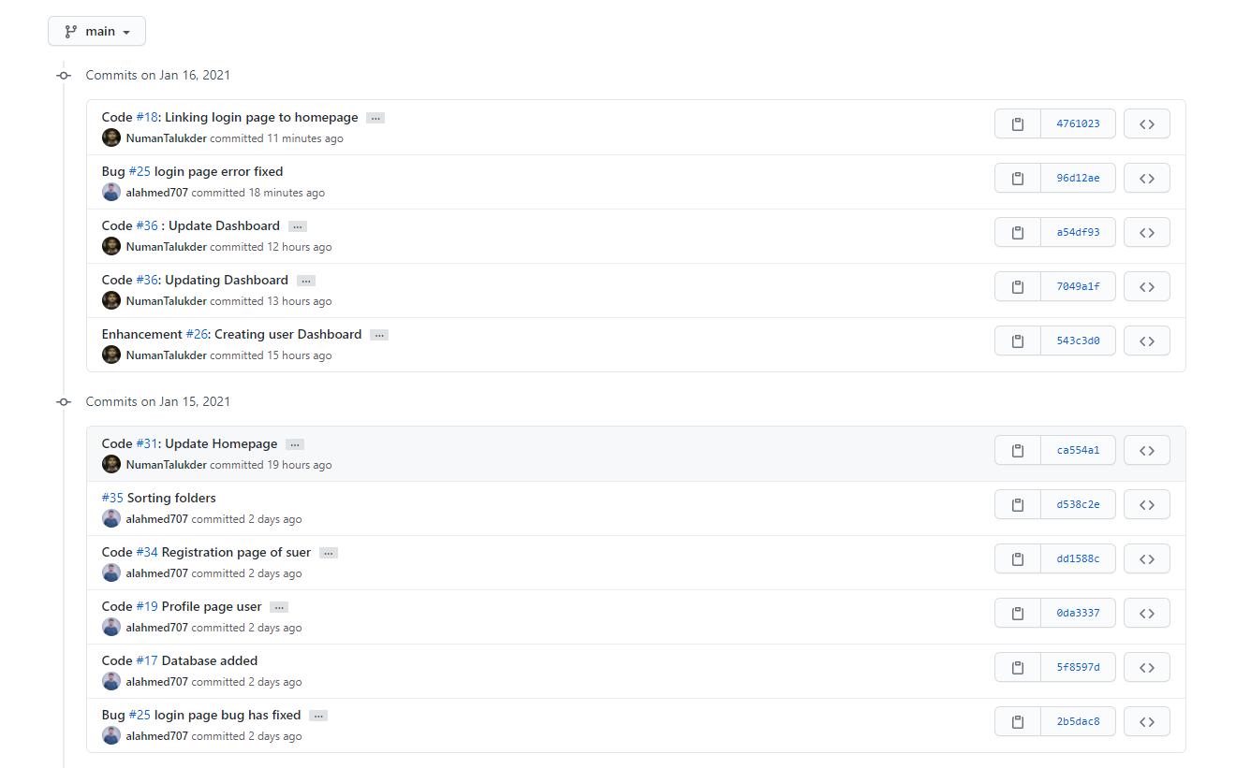
This Week’s Commits
Issues
Github
Front Page
Milestones
Github Board
Project UI

Slide 5
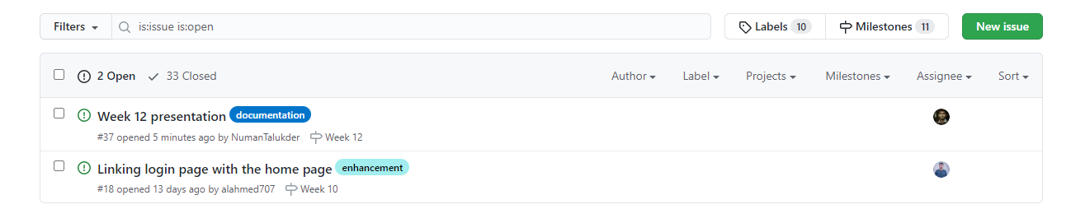
This Week Commits
Github
Front Page
Milestones
Issues
Github board
Project UI

Slide 6
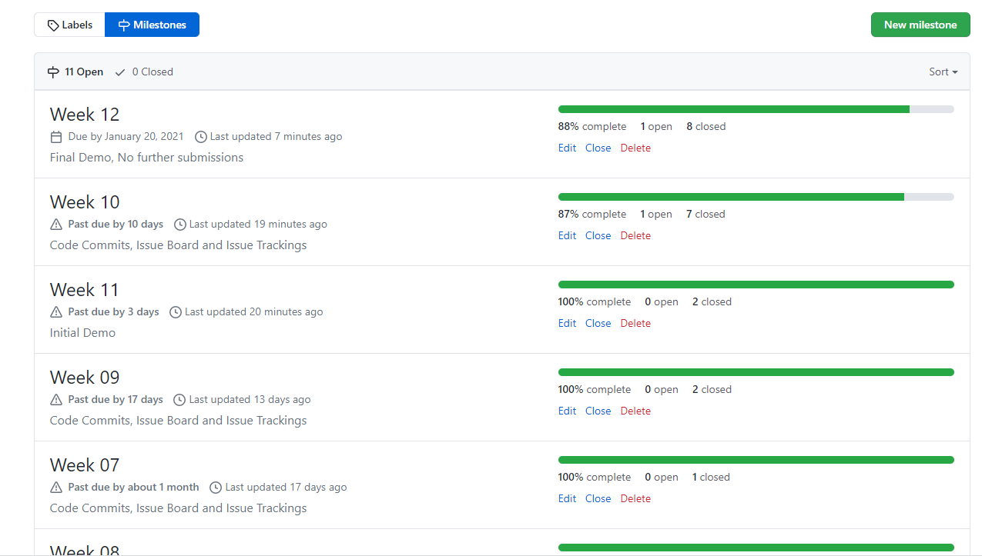
This Week’s Commits
Github
Front Page
Issues
Github Board
Project UI
Milestones

Slide 7
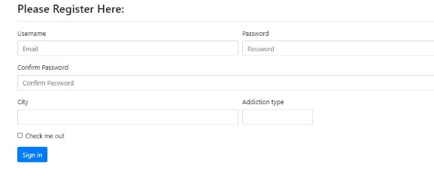
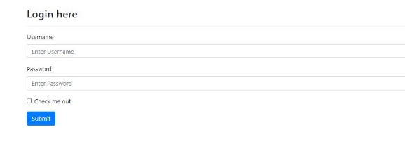
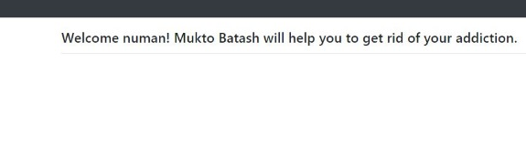
This Week’s Commits
Github
Front Page
Issues
Github Board
Milestones
Project UI

Slide 8
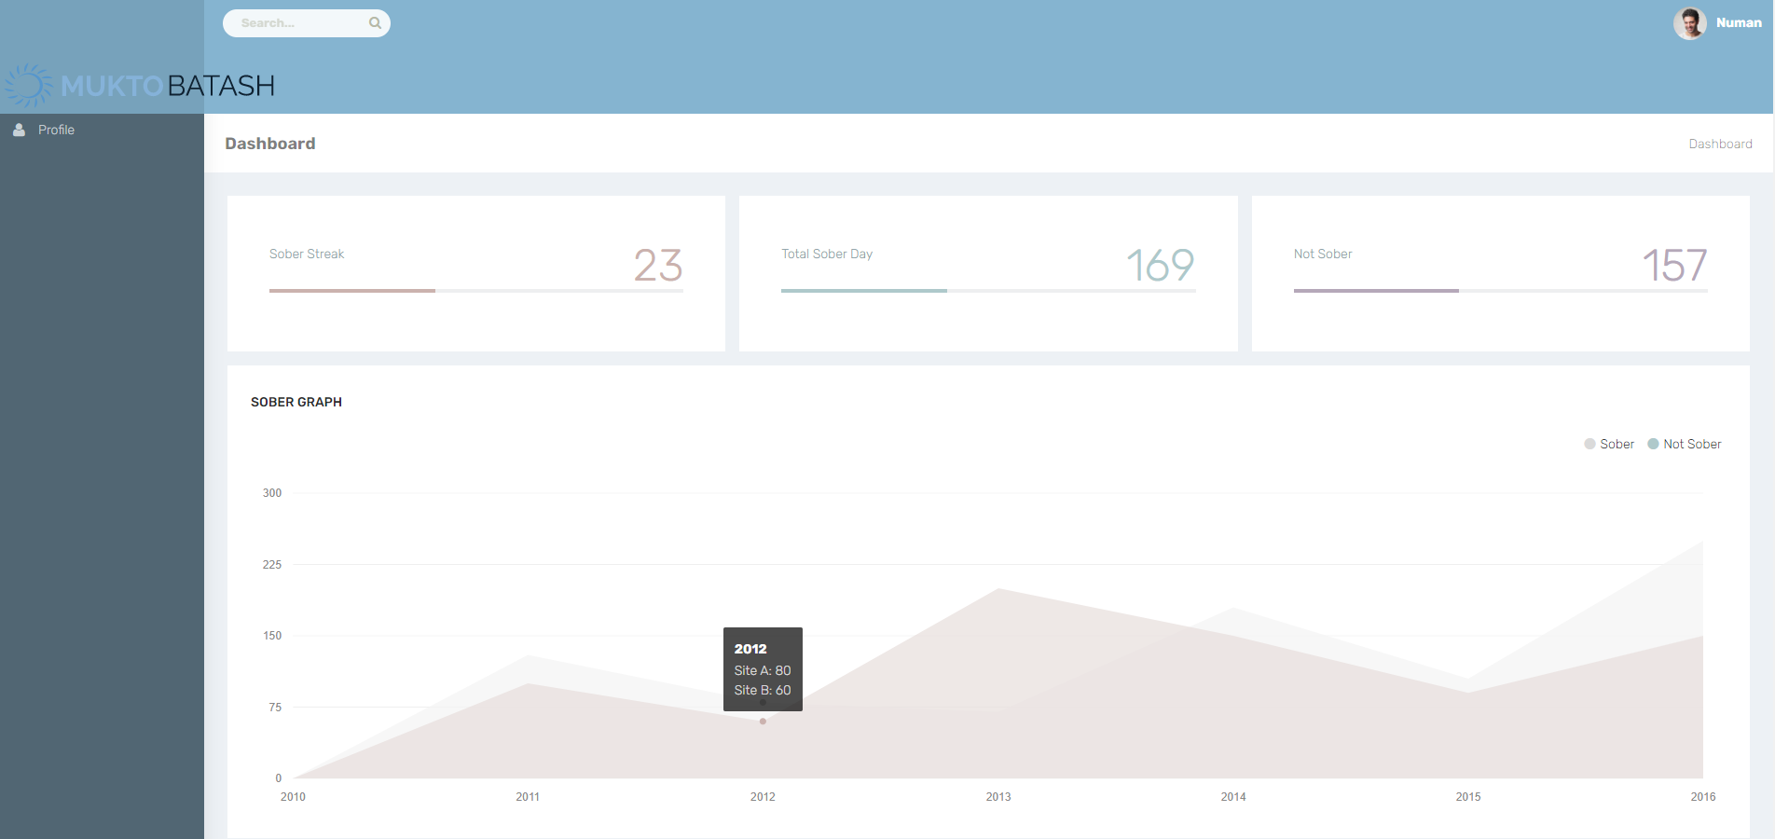
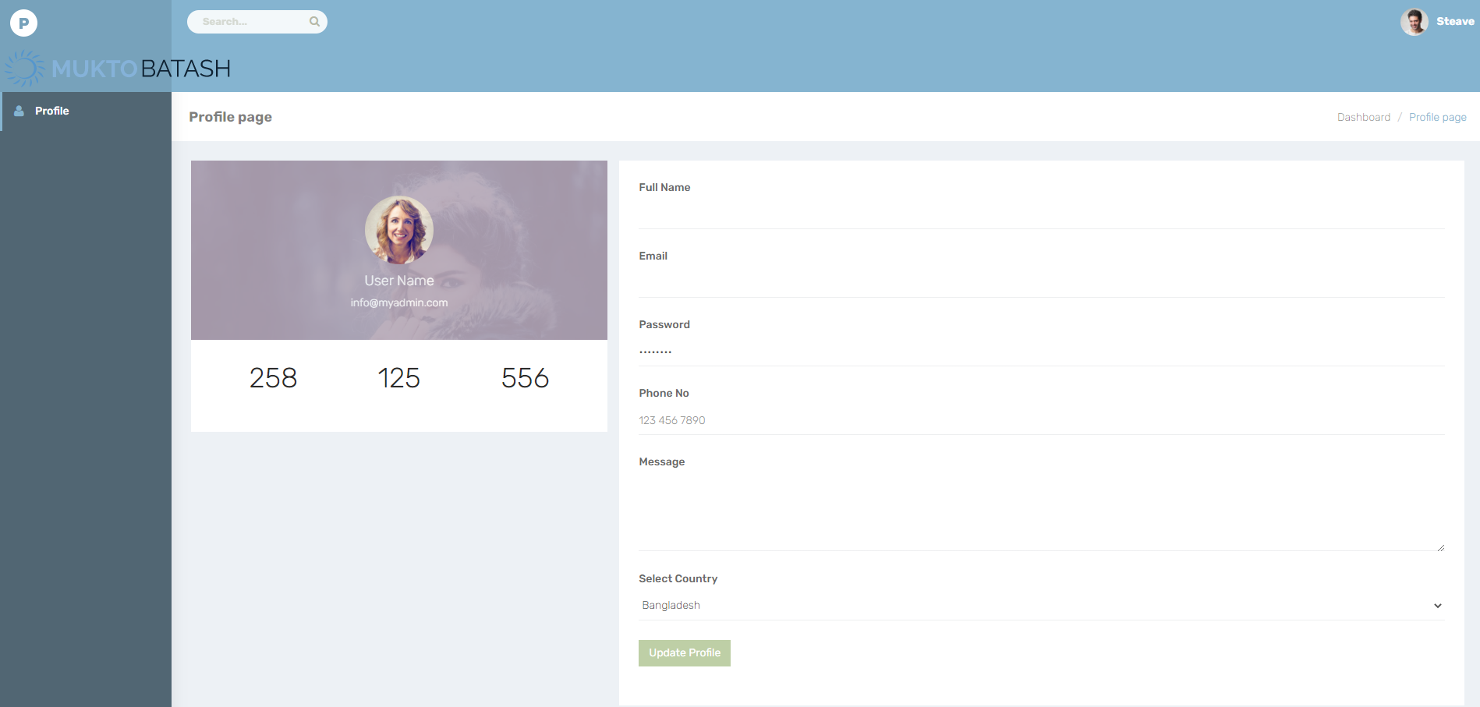
This Week’s Commits
Github
Front Page
Issues
Github Board
Milestones
Project UI

