Slide 1
CSE299
Week: 06
Sec: 03
Group: 03
Member Name: MD Abir Hossain
ID: 1731597042

Slide 2
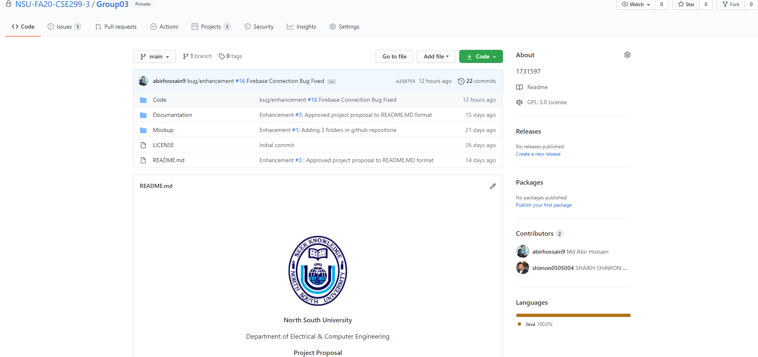
Github front page

Slide 3
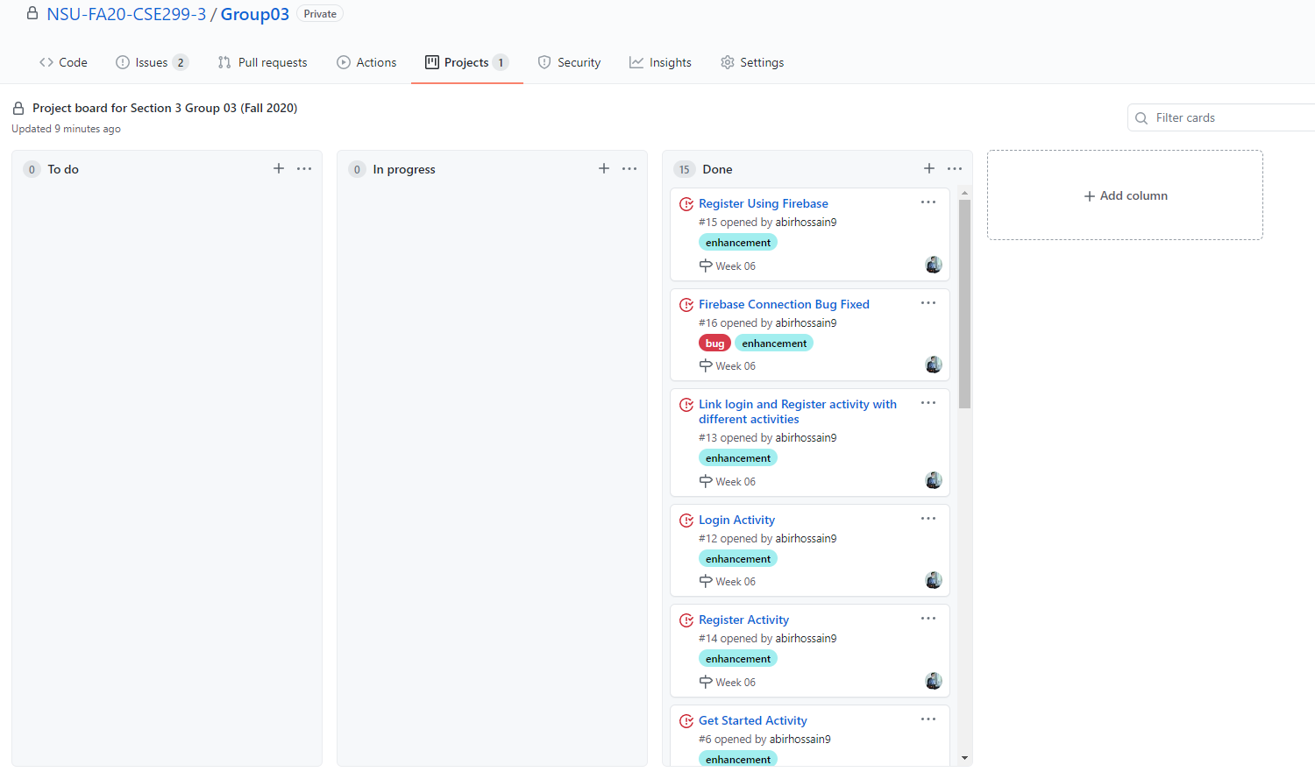
Github board

Slide 4
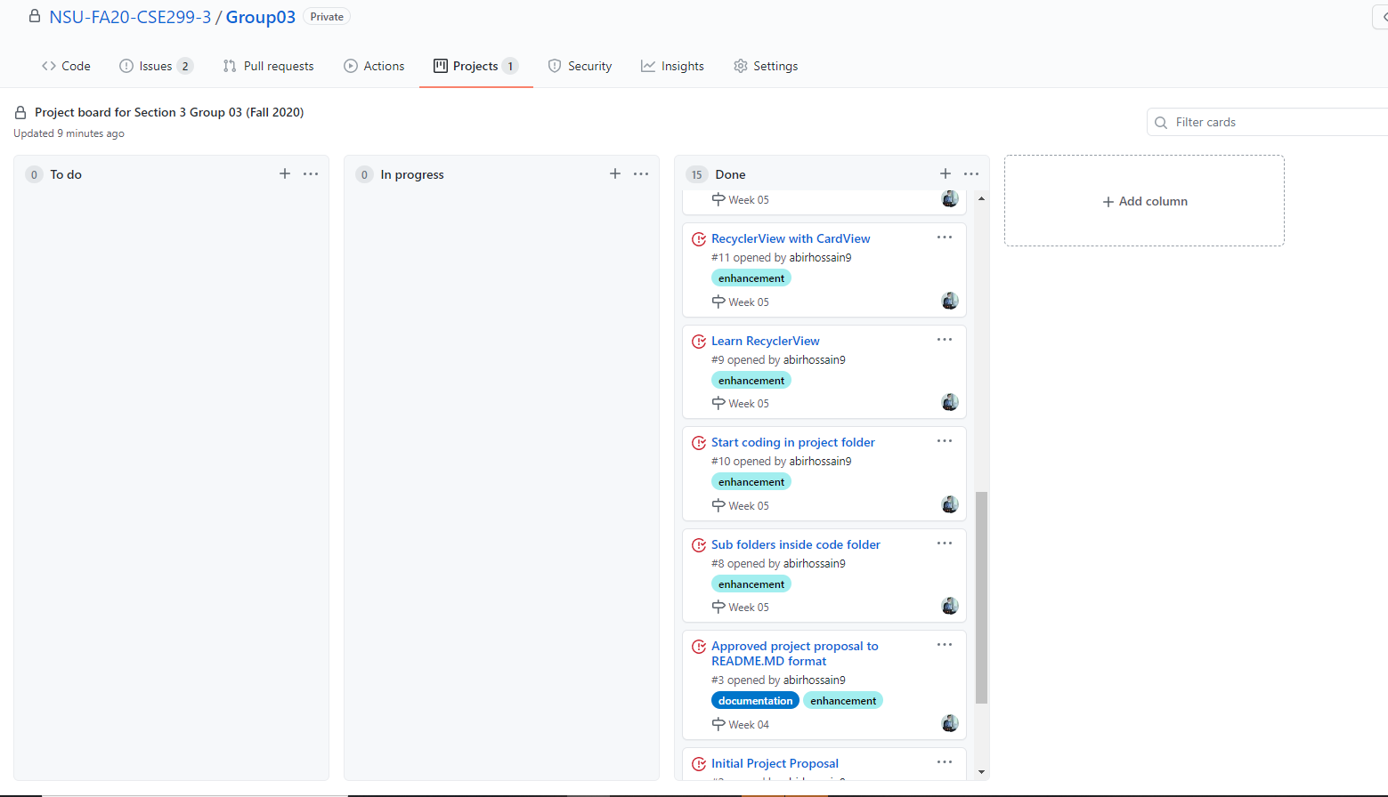
Github board

Slide 5
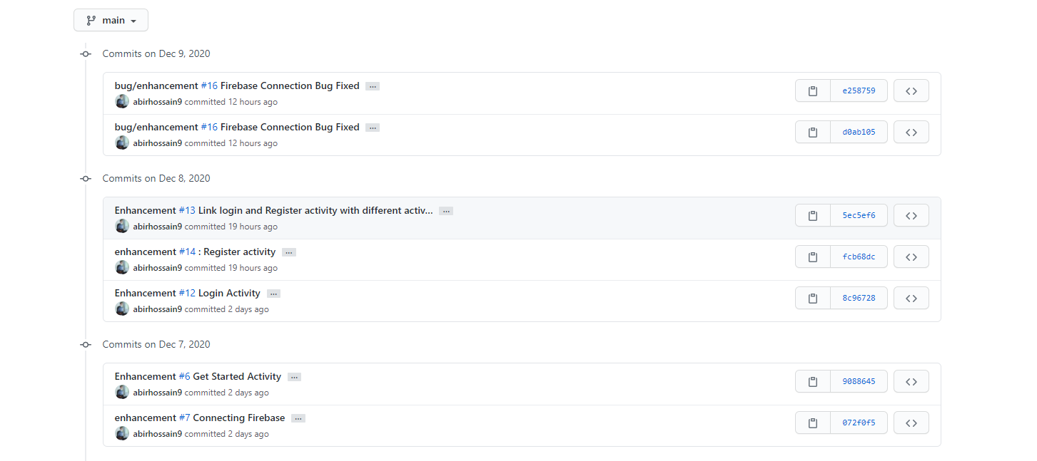
This week's commits

Slide 6
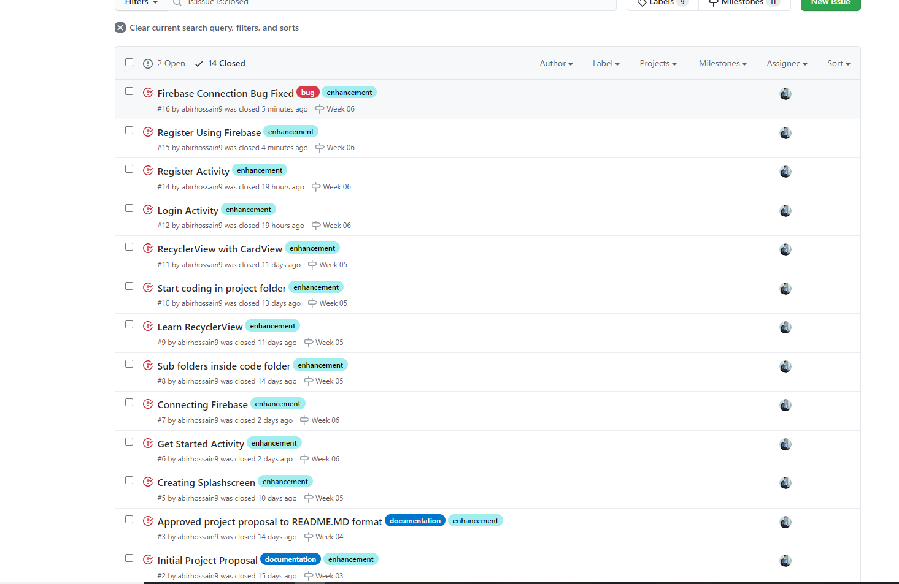
Issues

Slide 7
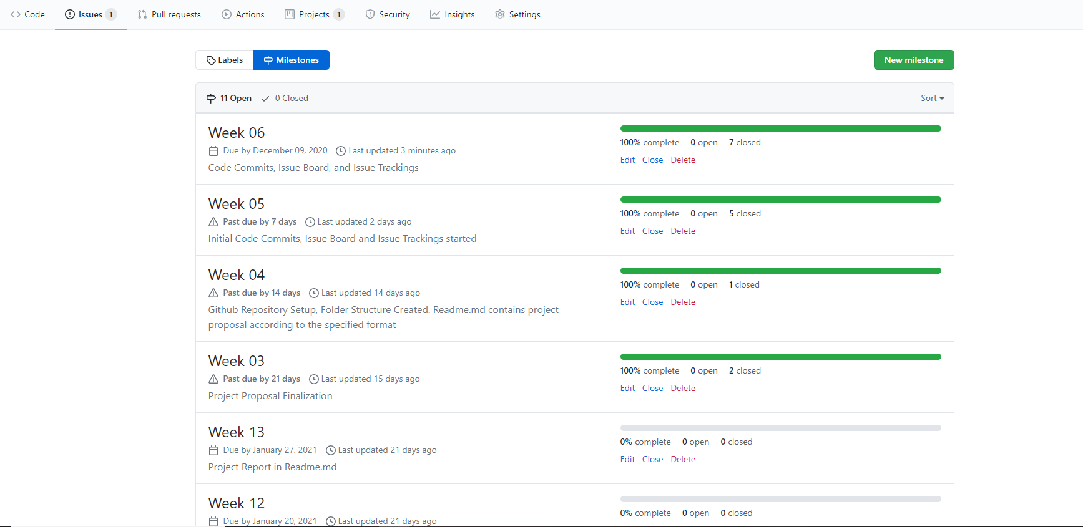
Milestones

Slide 8
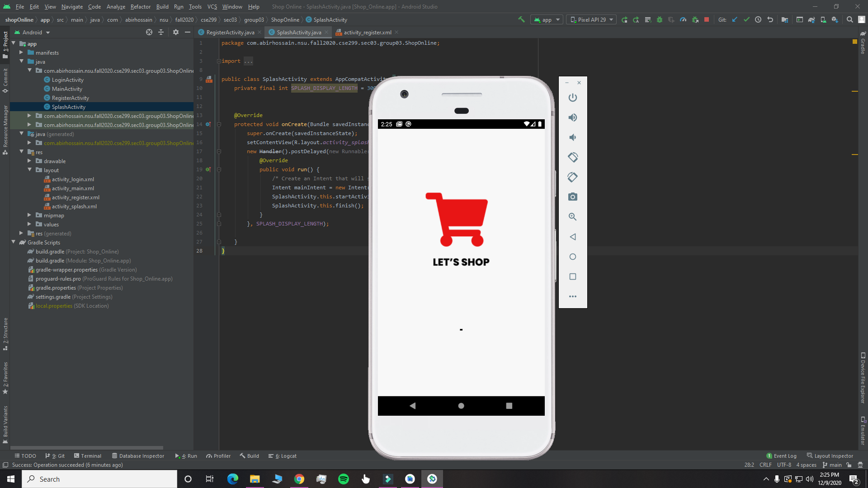
Local repository snapshot (Splash Screen)

Slide 9
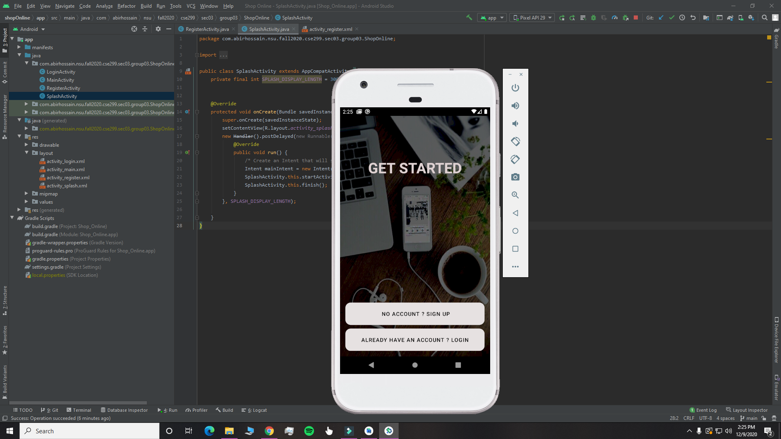
Local repository snapshot (Get Started Page)

Slide 10
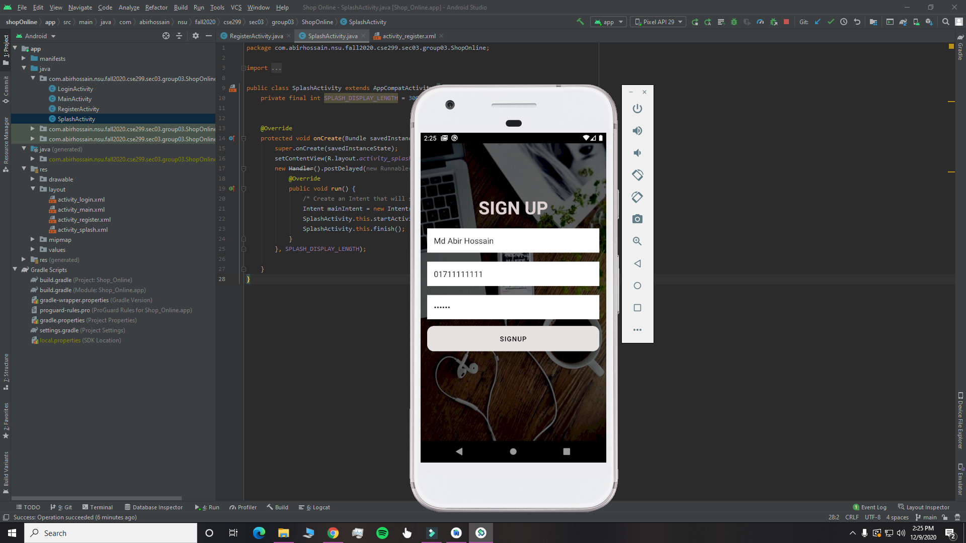
Local repository snapshot (SignUp Page)

Slide 11
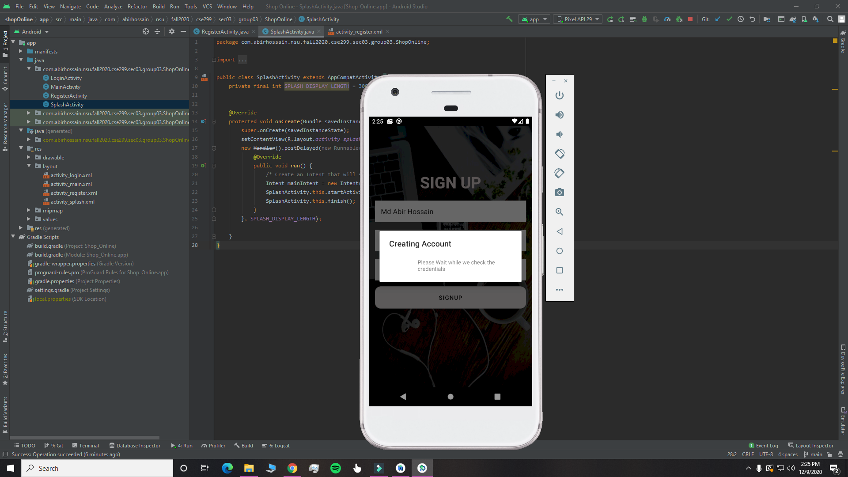
Local repository snapshot (Creating Account Dialog)

Slide 12
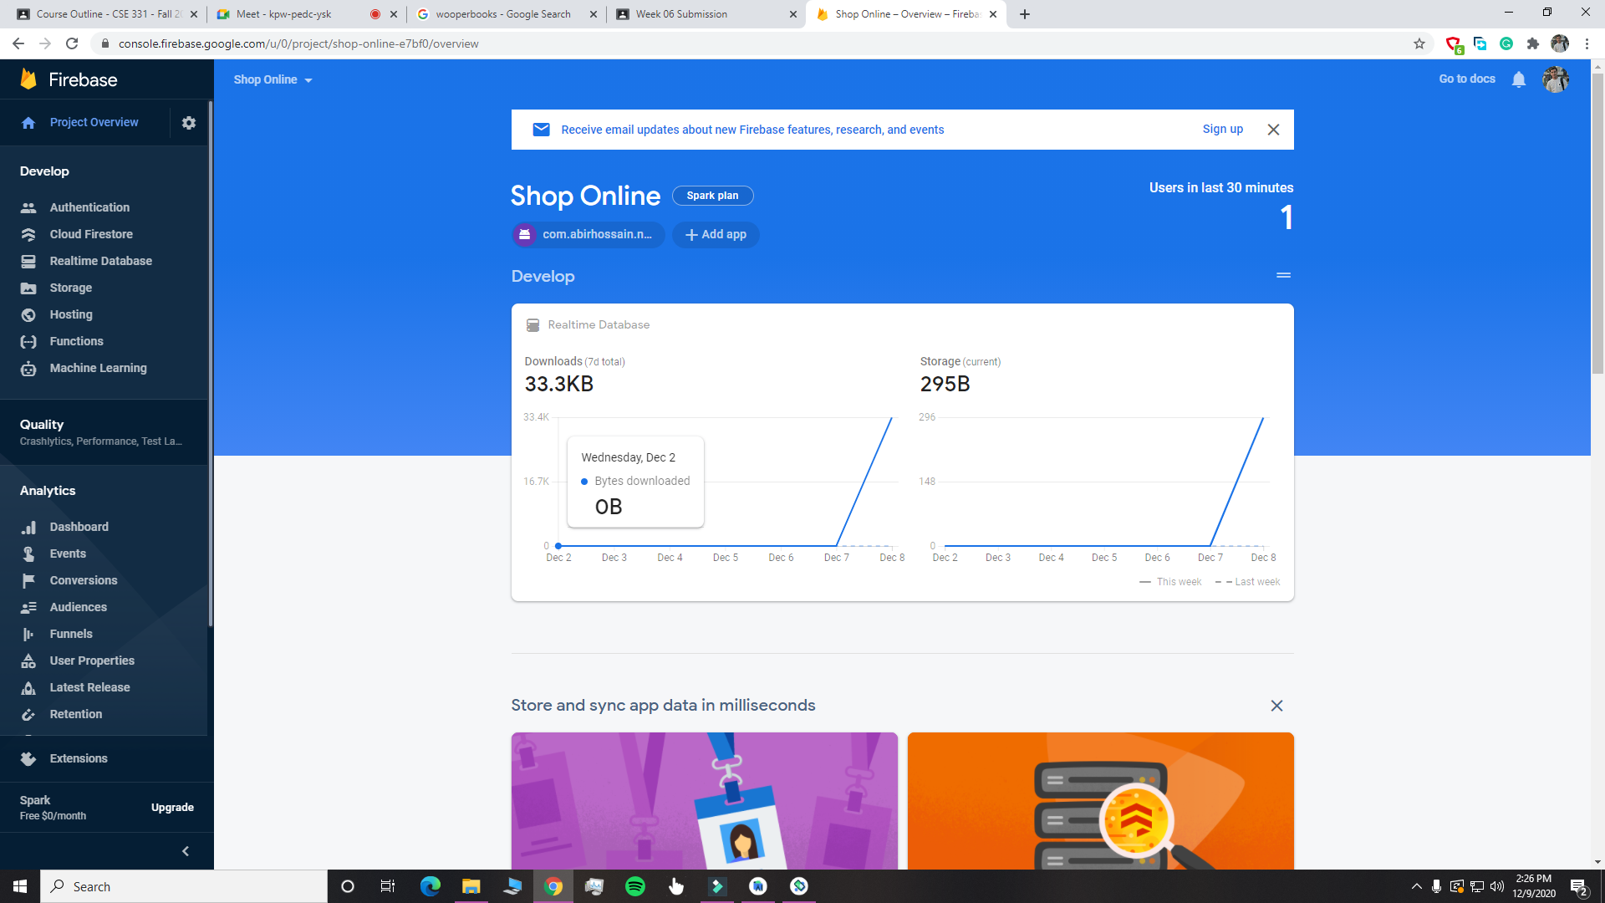
Local repository snapshot (Firebase Analytics)

Slide 13
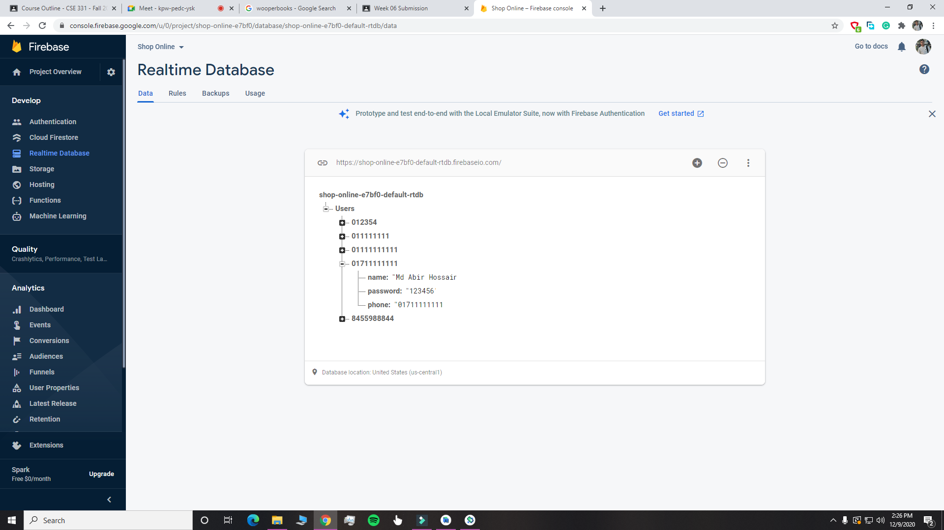
Local repository snapshot (Realtime Database)

Slide 14
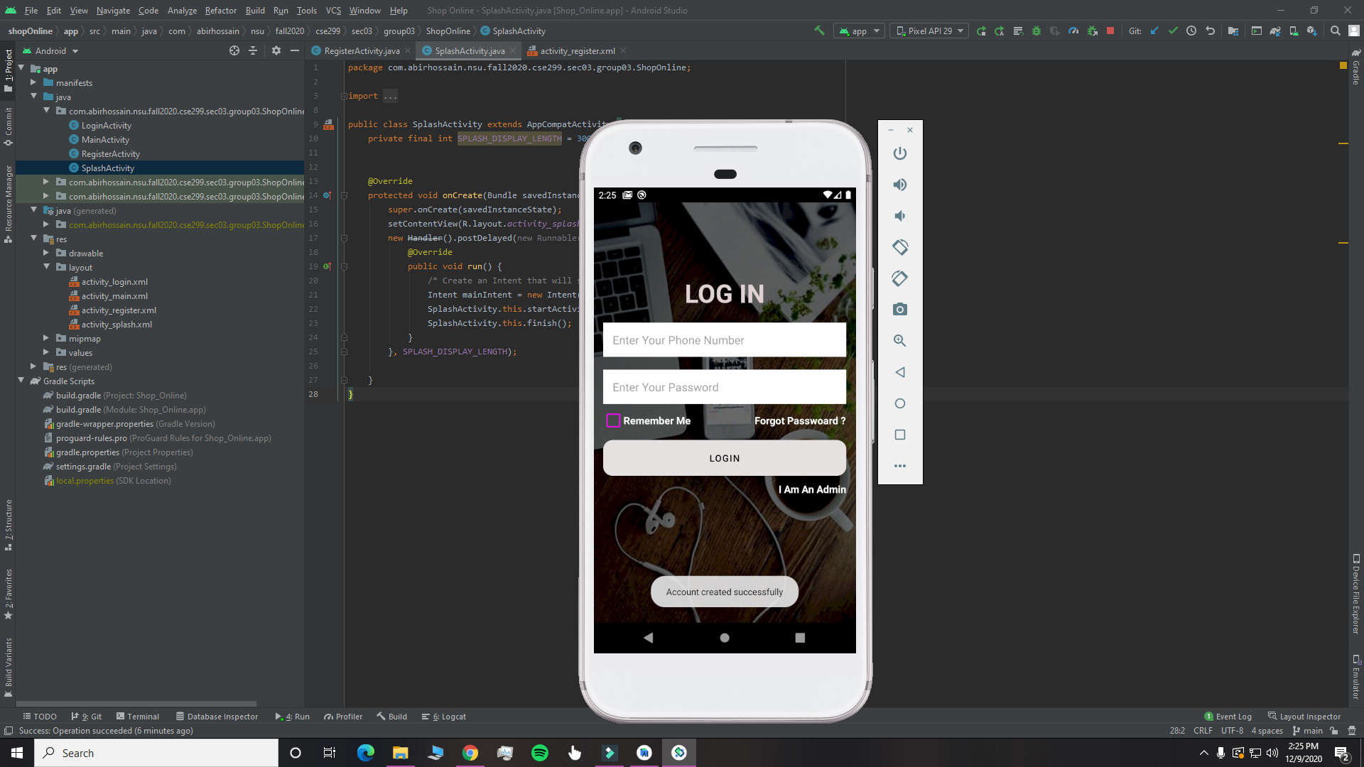
Local repository snapshot (Redirect to login Page after successful registration)

