Slide 1
CSE299
Final Presentation
Sec: 03
Group: 03
Member Name: MD Abir Hossain
ID: 1731597042

Slide 2
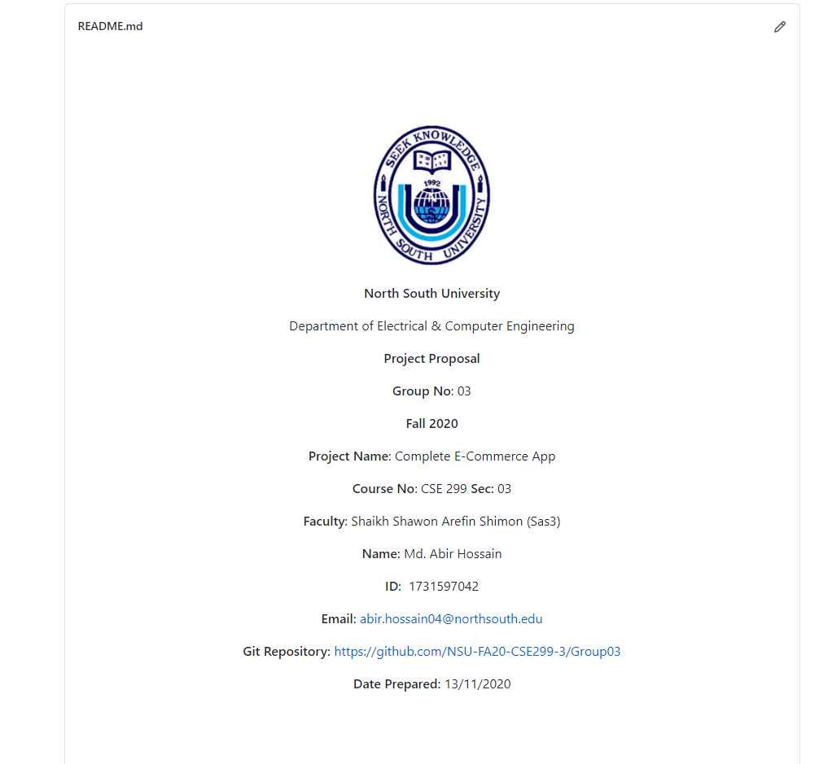
Project Readme

Slide 3
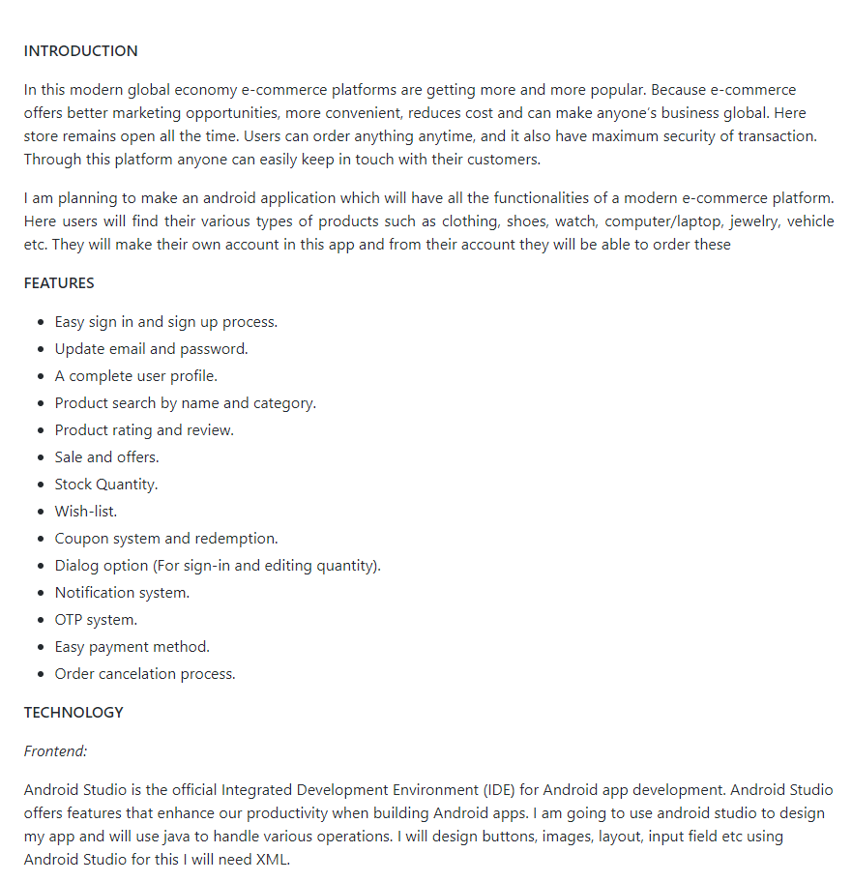
Project Readme

Slide 4
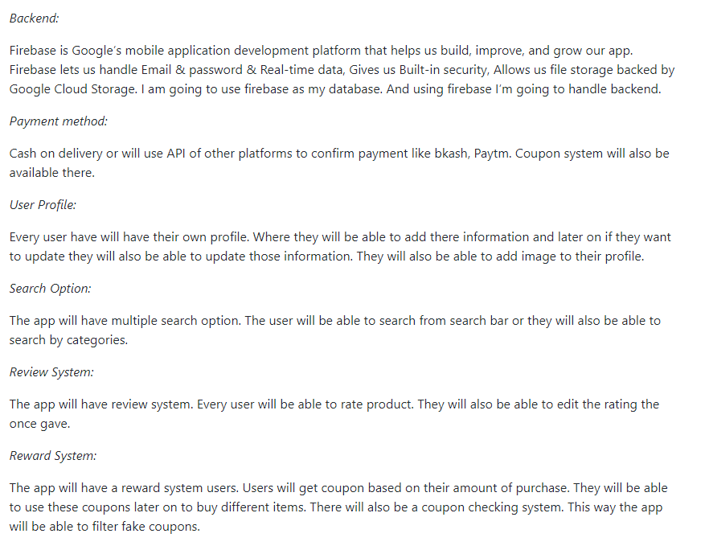
Project Readme

Slide 5
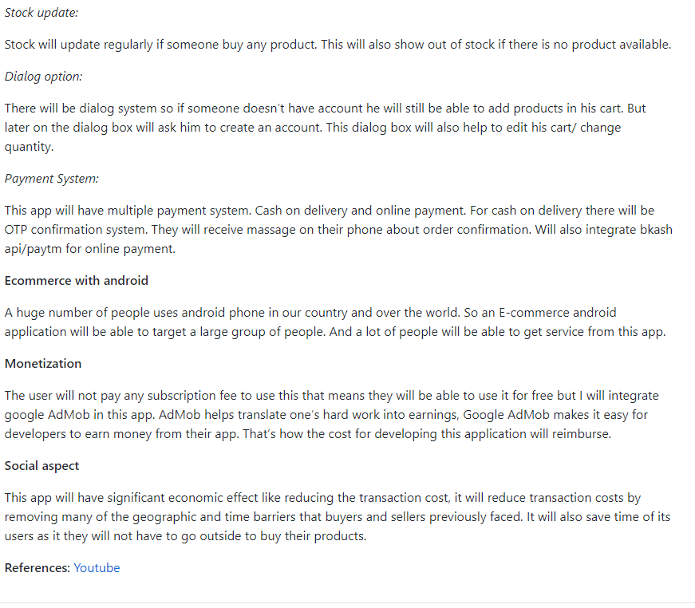
Project Readme

Slide 6
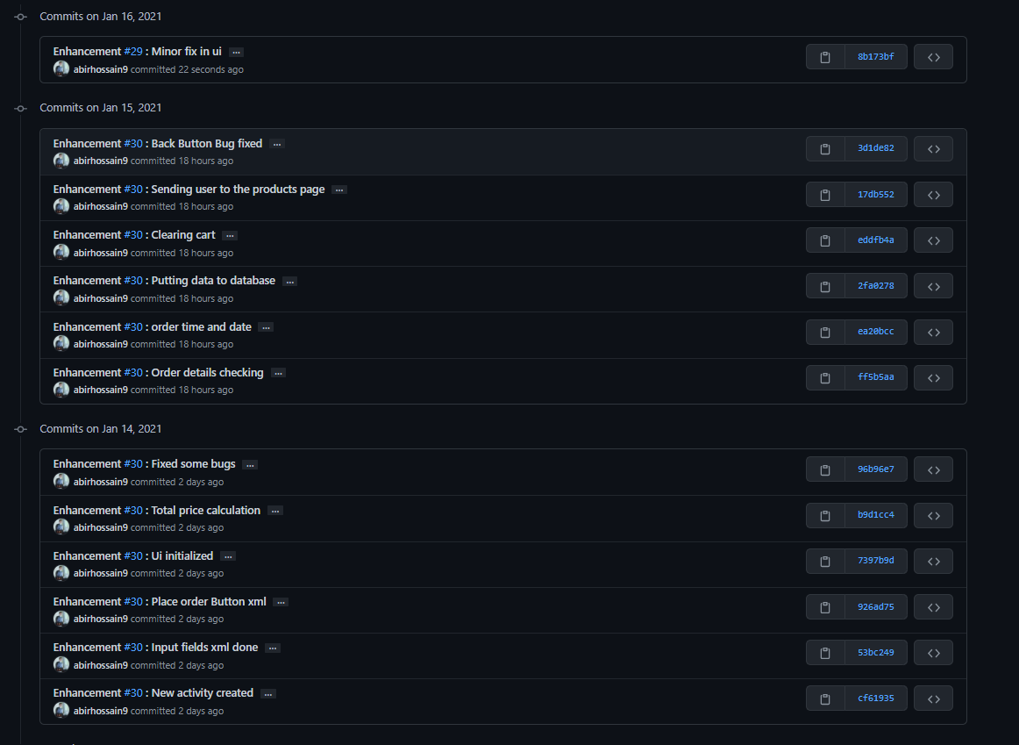
This week's commits

Slide 7
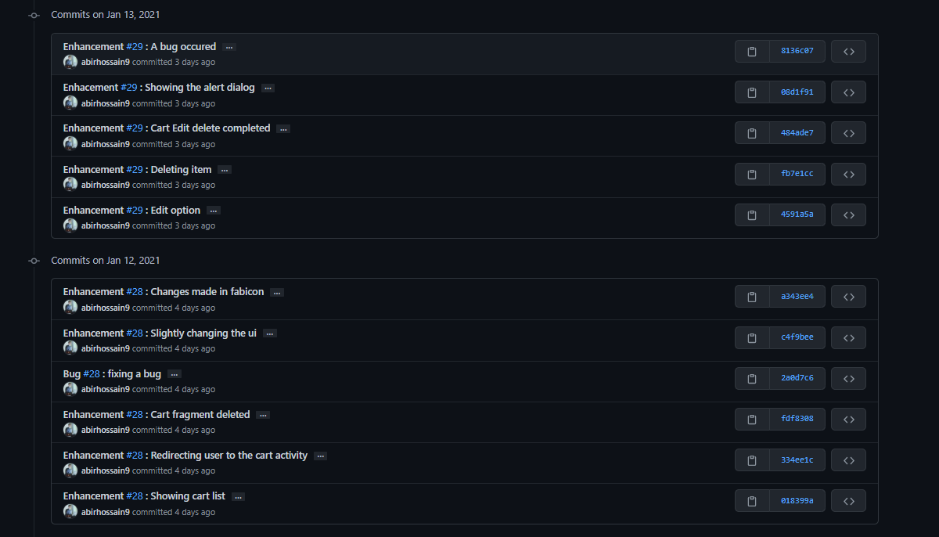
This week's commits

Slide 8
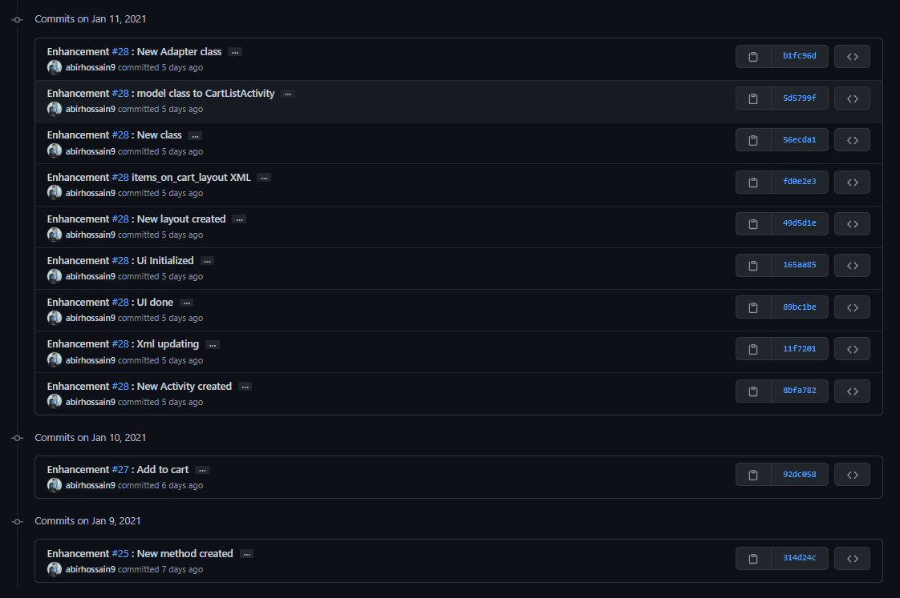
This week's commits

Slide 9
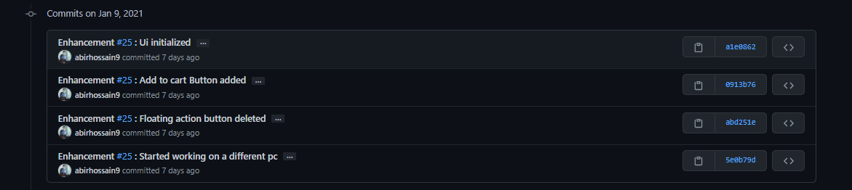
This week's commits

Slide 10
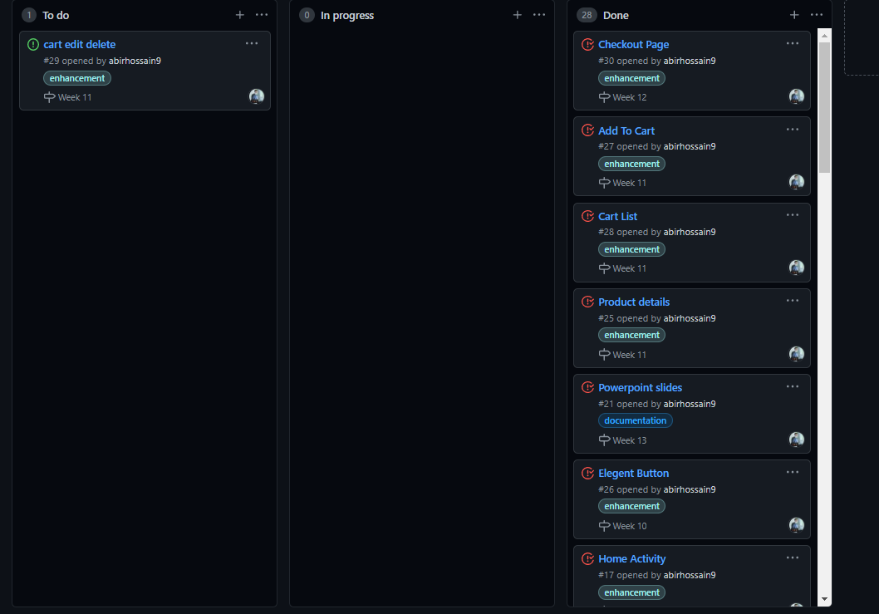
Board

Slide 11

Splash Screen

Slide 12

Get Started

Slide 13
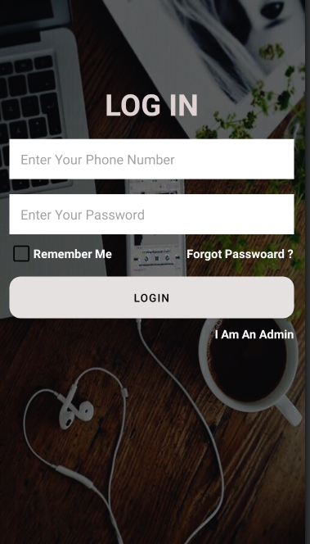
Login Page

Slide 14


Category Chooser & Add Product (Admin)

Slide 15
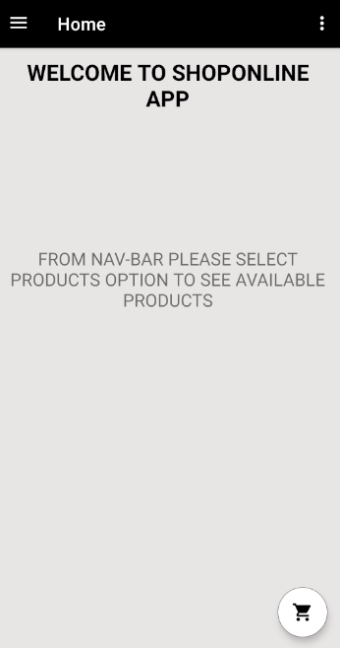
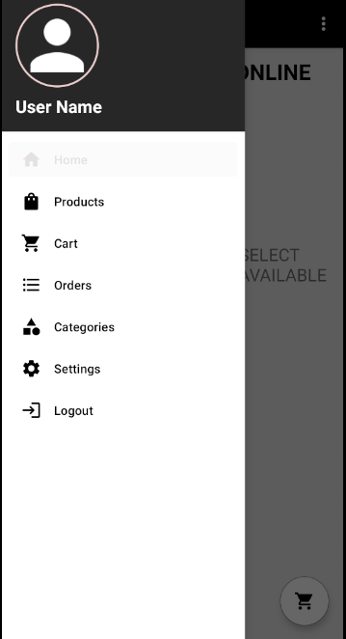
Home Activity & Navbar (Client)

Slide 16
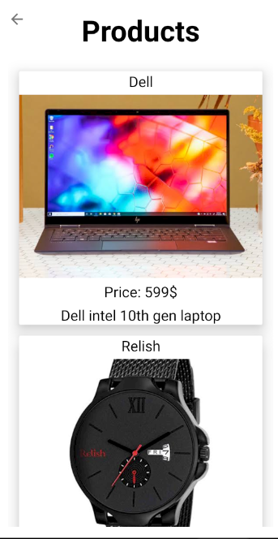
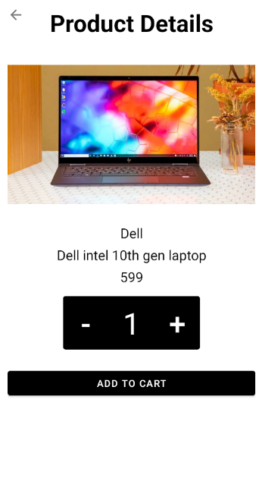
Product & Product details & Add to cart (Client)

Slide 17
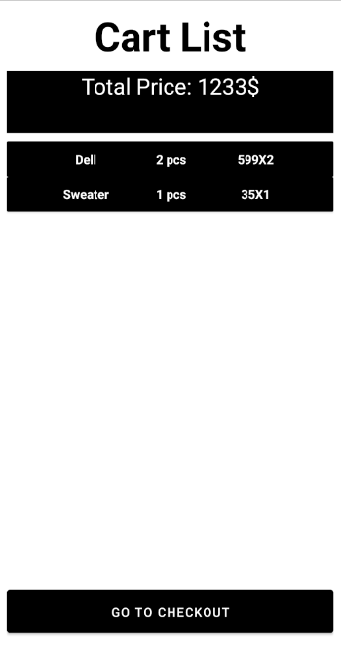
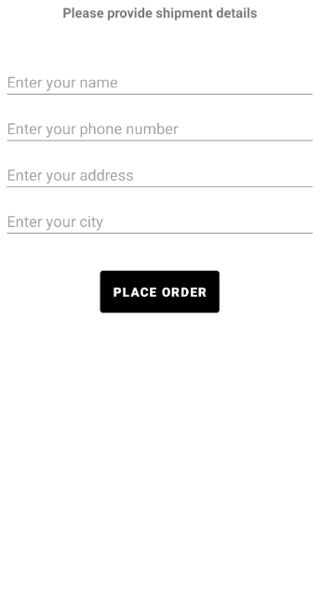
Cart List & Checkout(Client)

