Slide 1
CSE299
Week: 06
Sec: 03
Group: 03
Member Name: MD Abir Hossain
ID: 1731597042

Slide 2
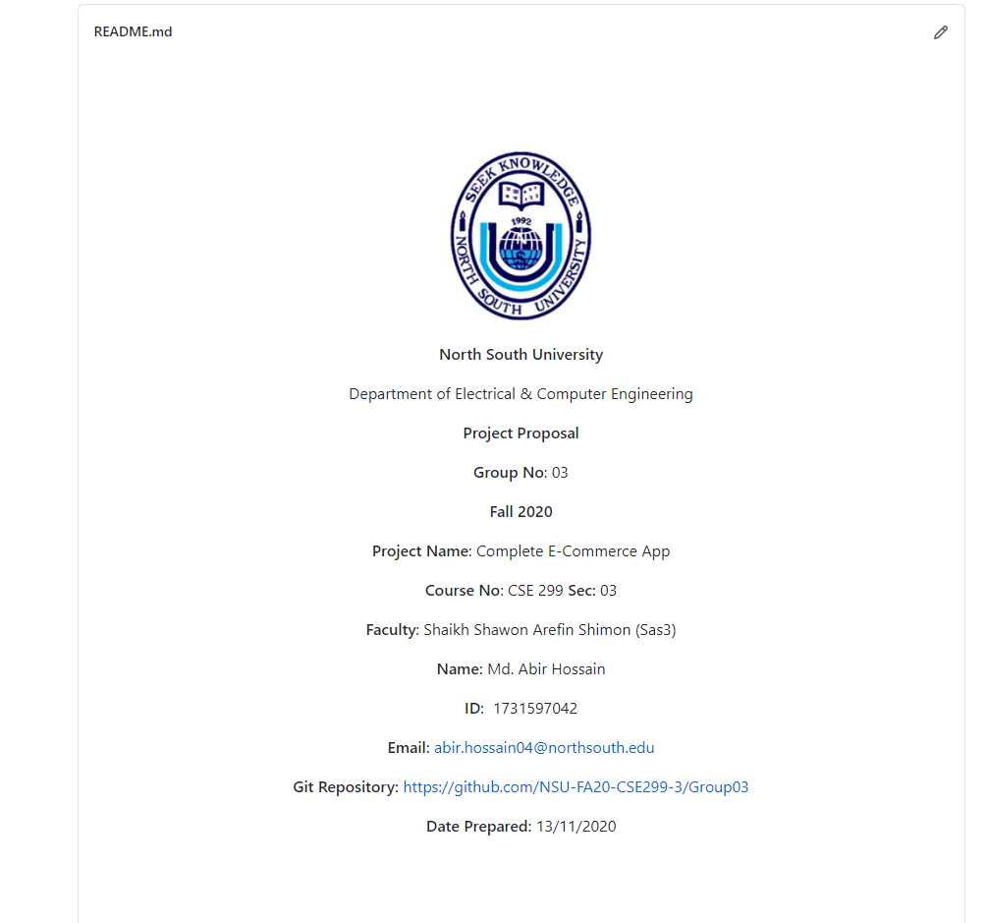
Project Readme

Slide 3
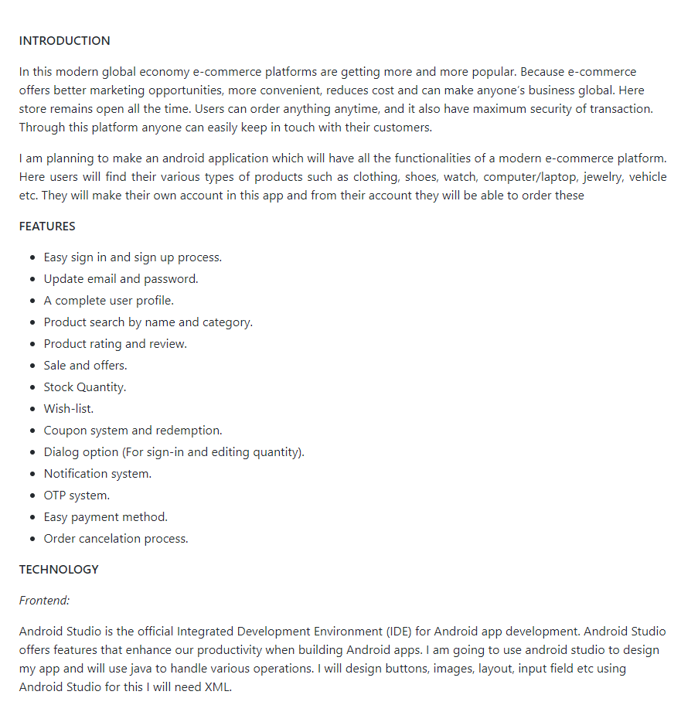
Project Readme

Slide 4
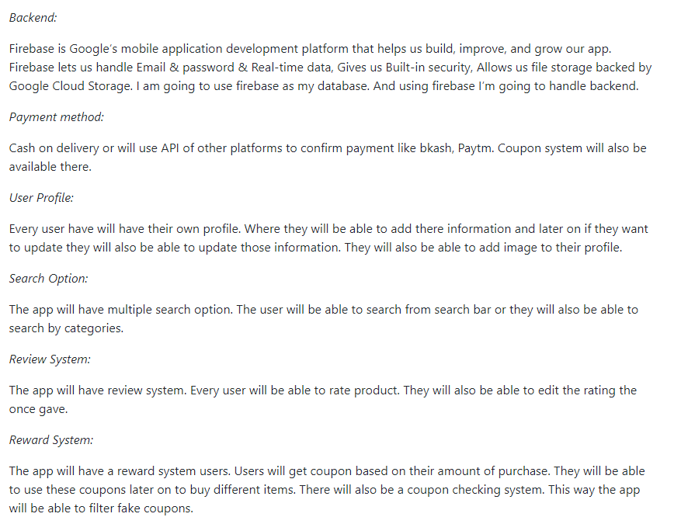
Project Readme

Slide 5
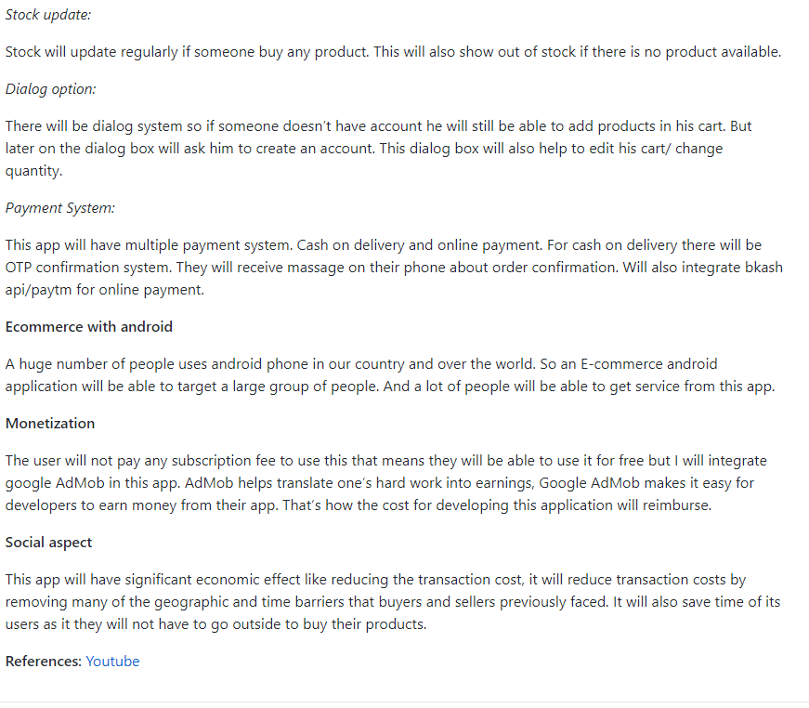
Project Readme

Slide 6
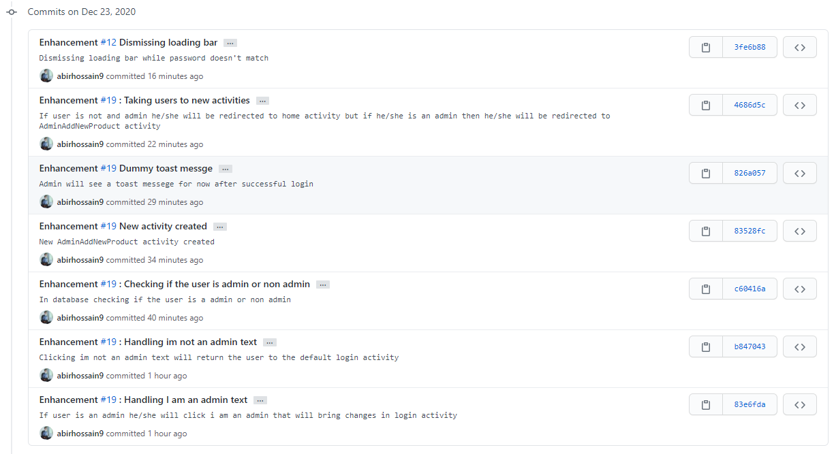
This week's commits

Slide 7
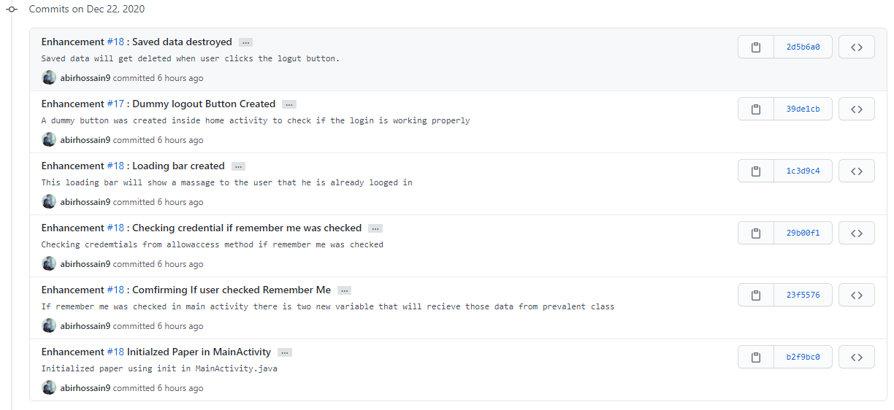
This week's commits

Slide 8
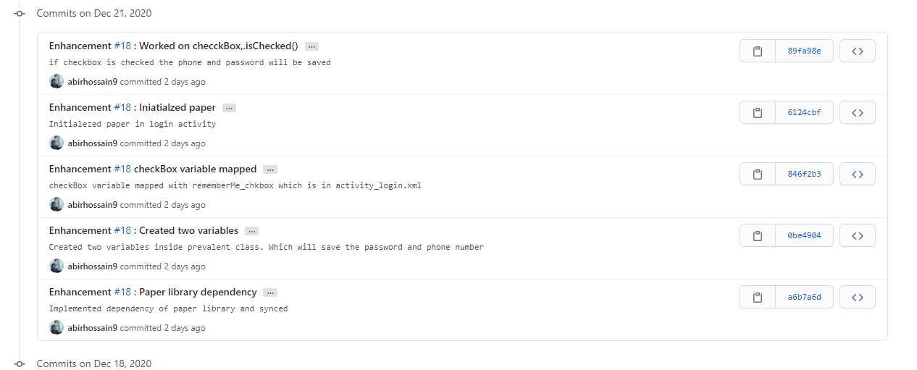
This week's commits

Slide 9
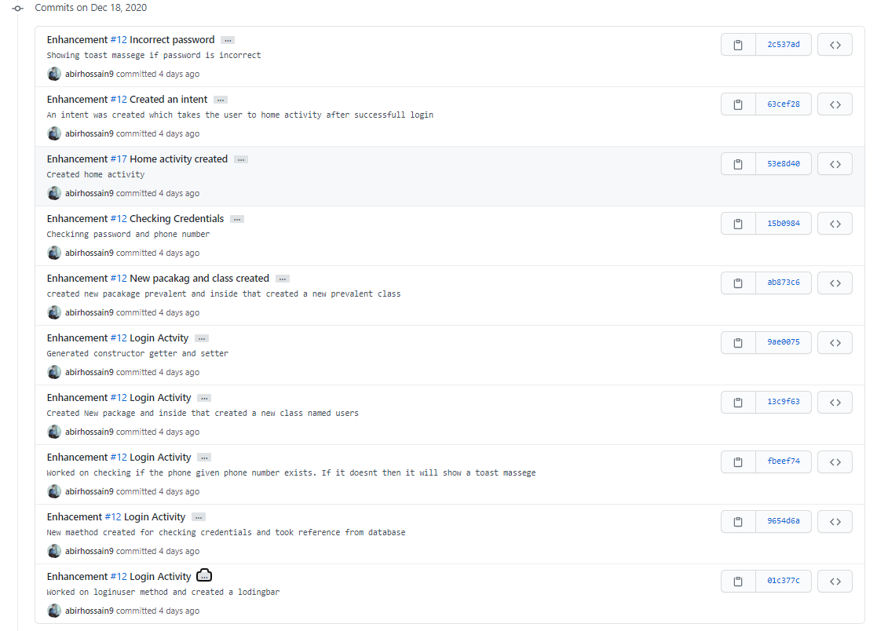
This week's commits

Slide 10
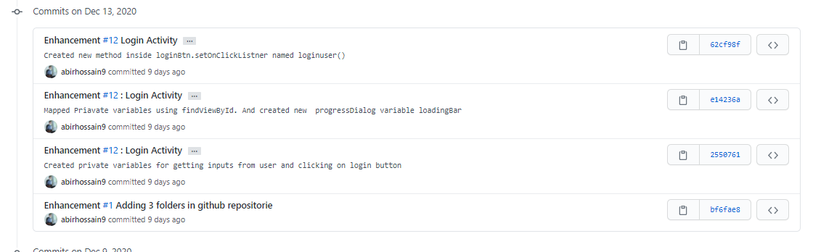
This week's commits

Slide 11
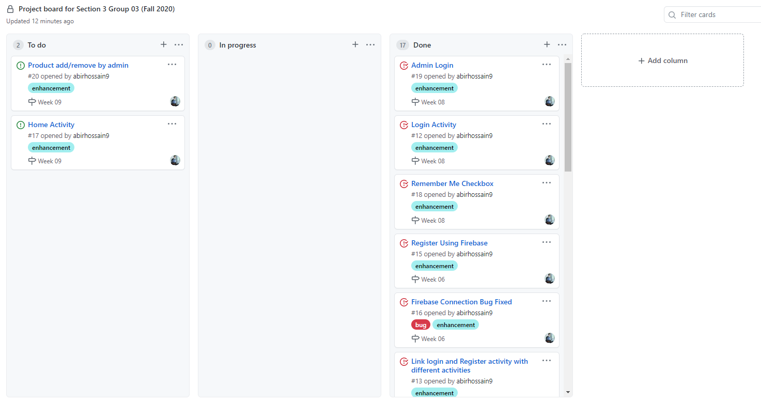
Board

Slide 12
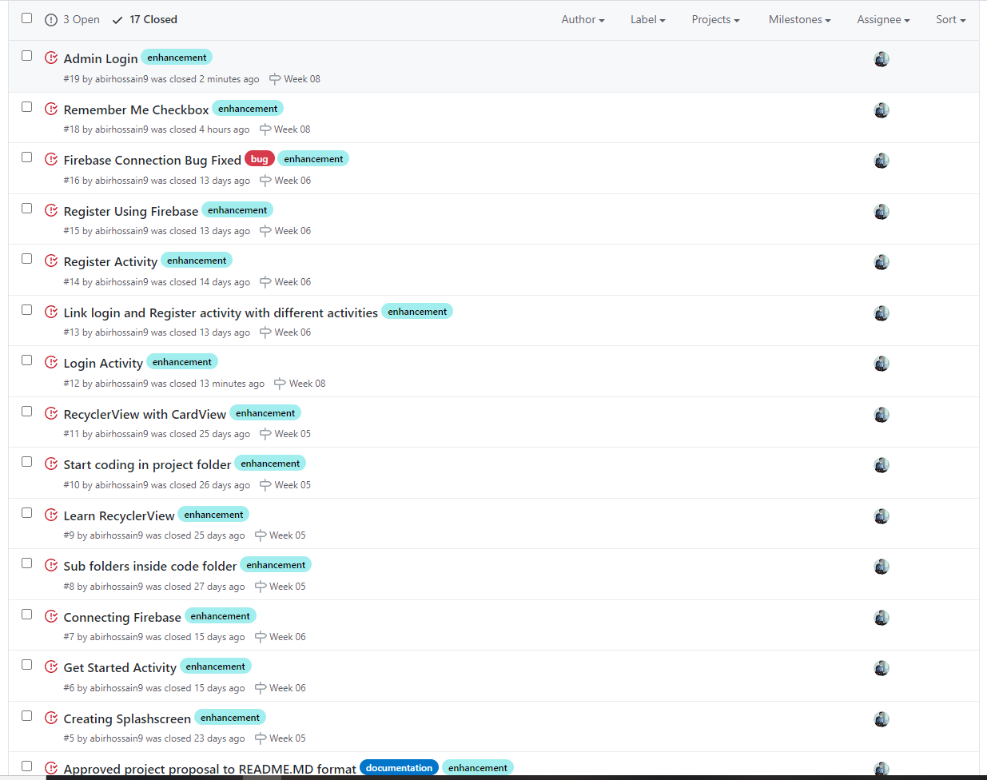
Issues

