Slide 1
Name: Emamul Hassan ID: 1731250642 Course: CSE299 Section: 3 Group: 4
Week 9 Submission

Slide 2
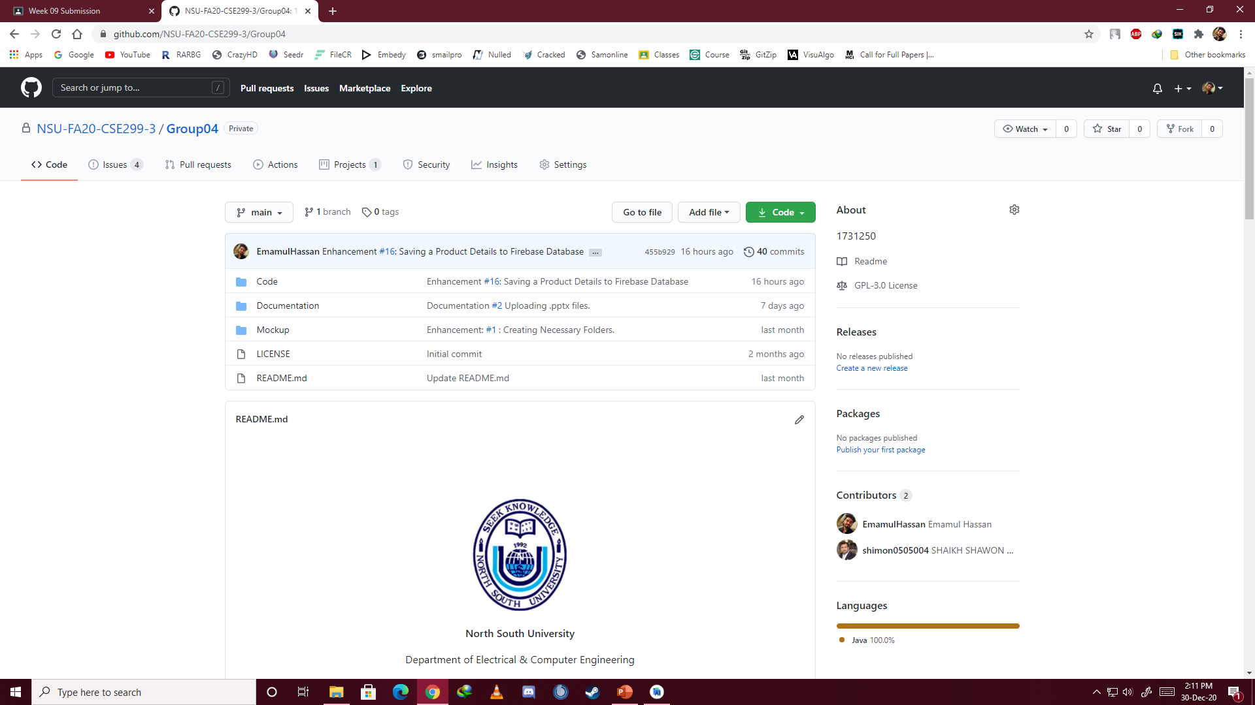

Slide 3
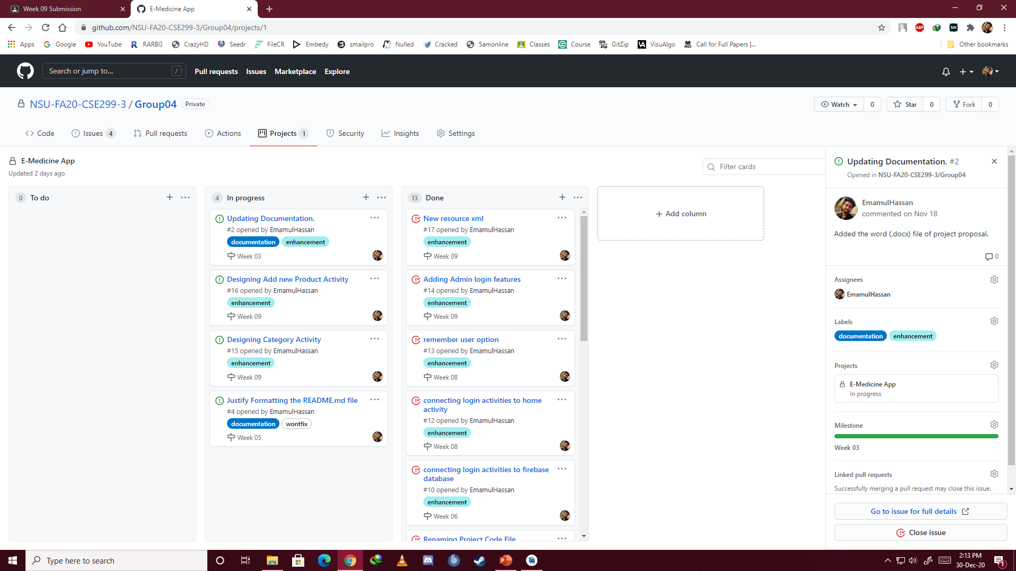

Slide 4
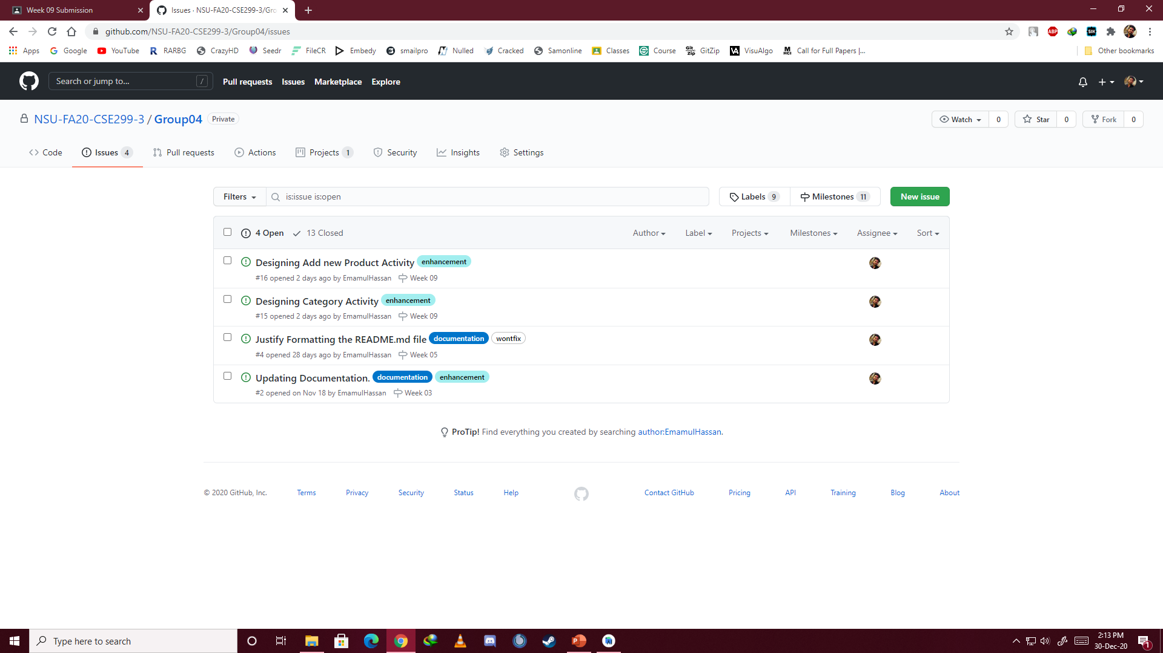

Slide 5
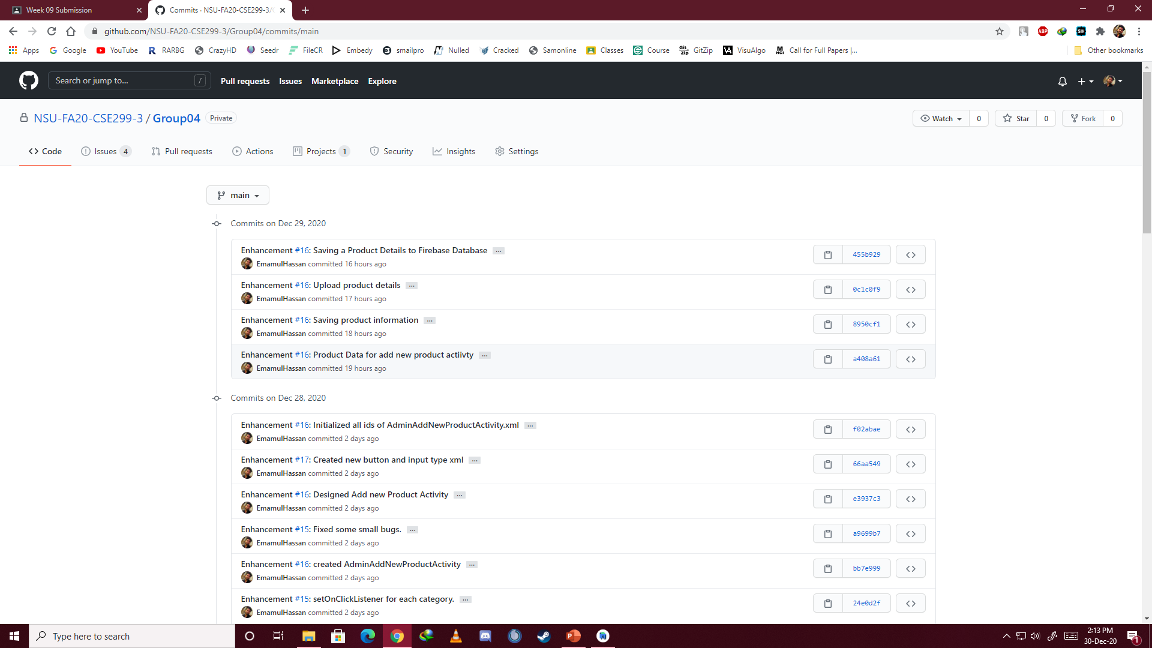

Slide 6
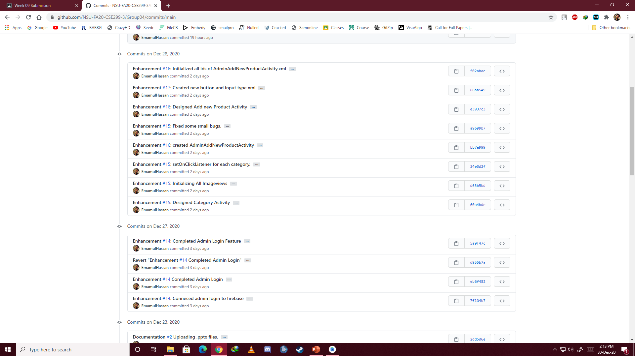

Slide 7
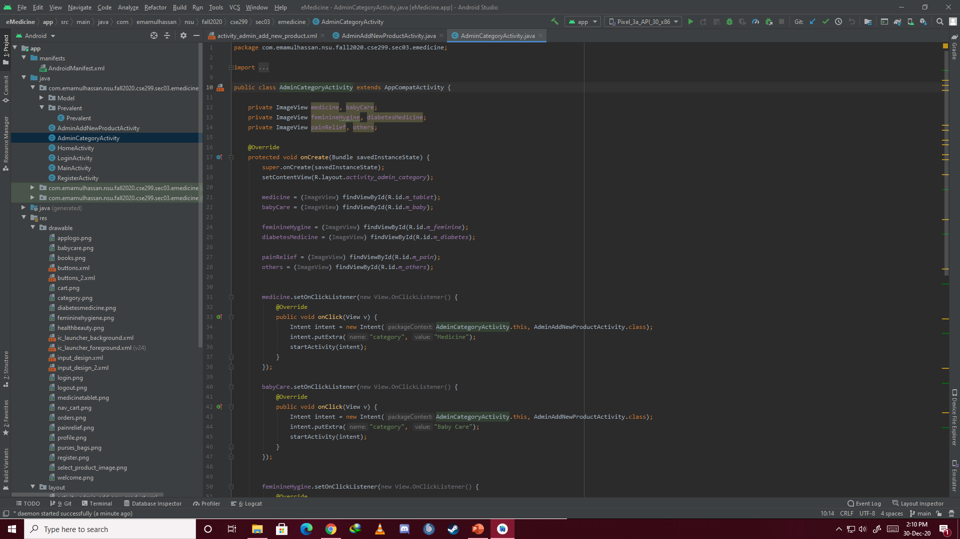

Slide 8
