Slide 1
CSE299 Final Project Submission
Name: Samiya Kazi
ID: 1711620642
Section: 3
Group: 7

Slide 2
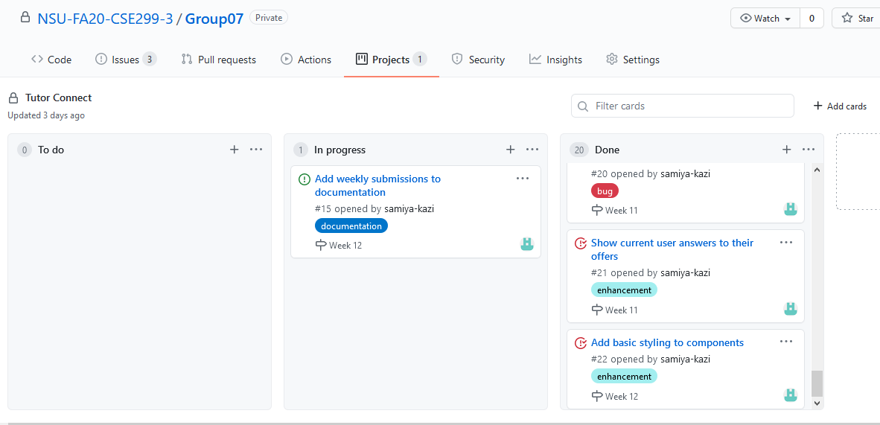
Project Board

Slide 3
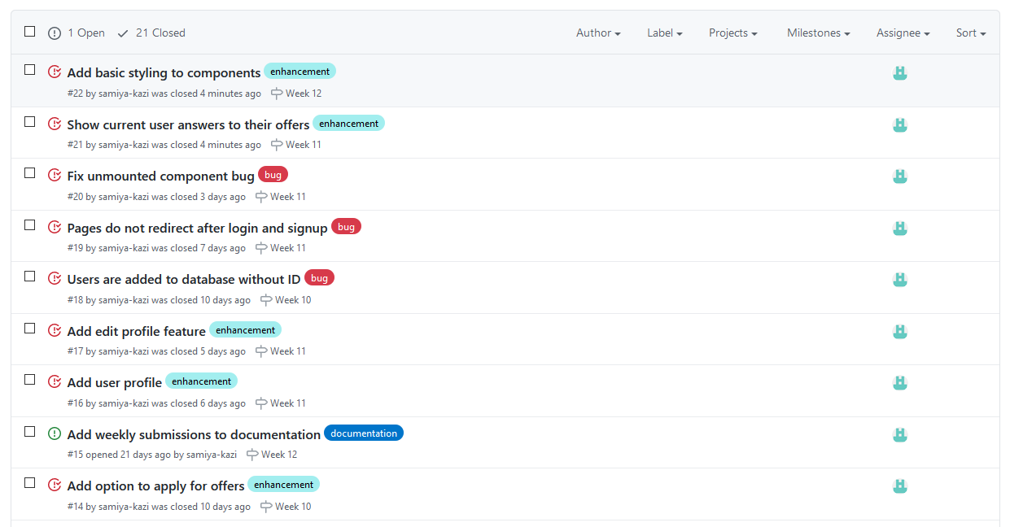
Issues

Slide 4
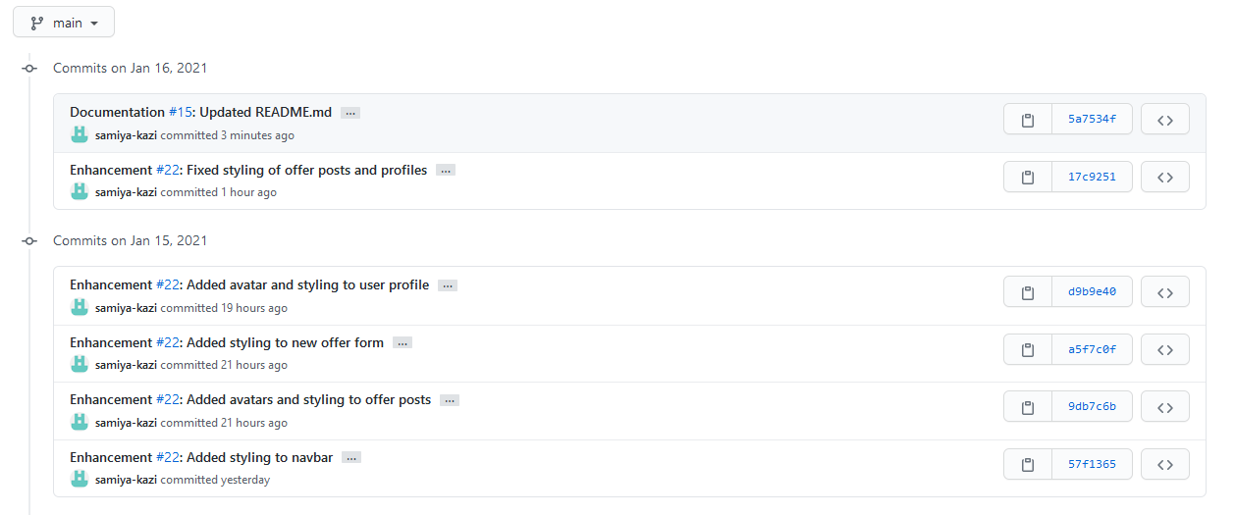
Commits

Slide 5
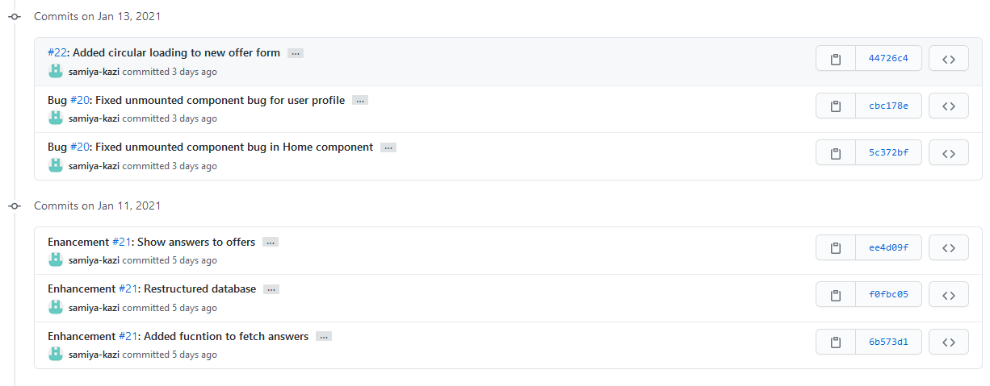
Commits

Slide 6
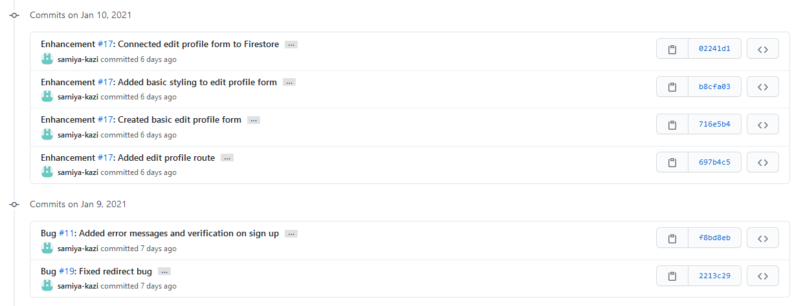
Commits

Slide 7
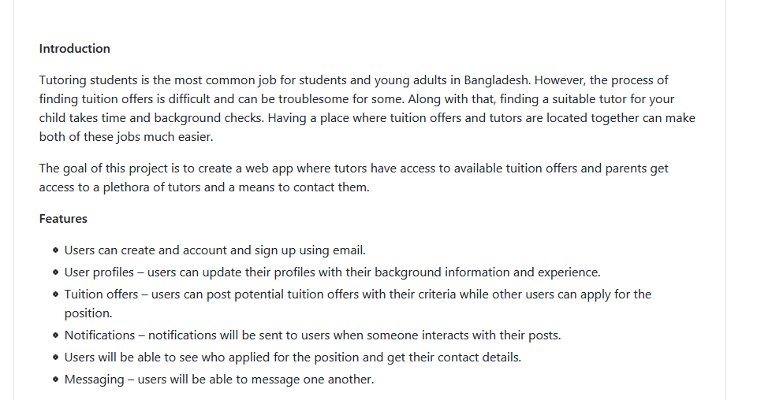
README.md

Slide 8
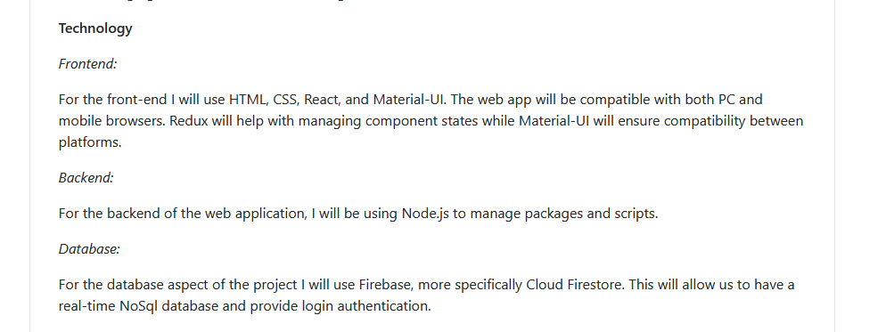
README.md

Slide 9
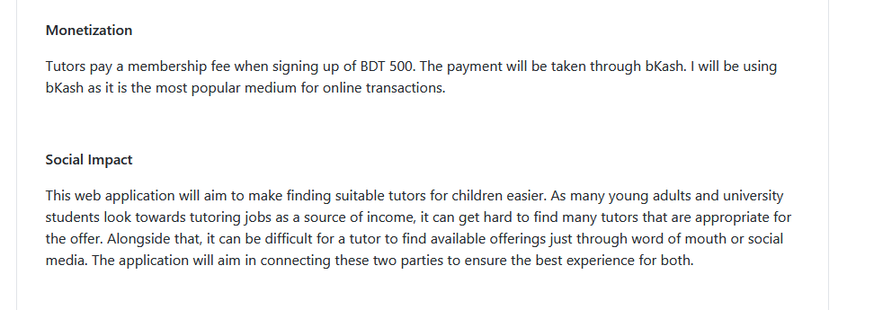
README.md

Slide 10
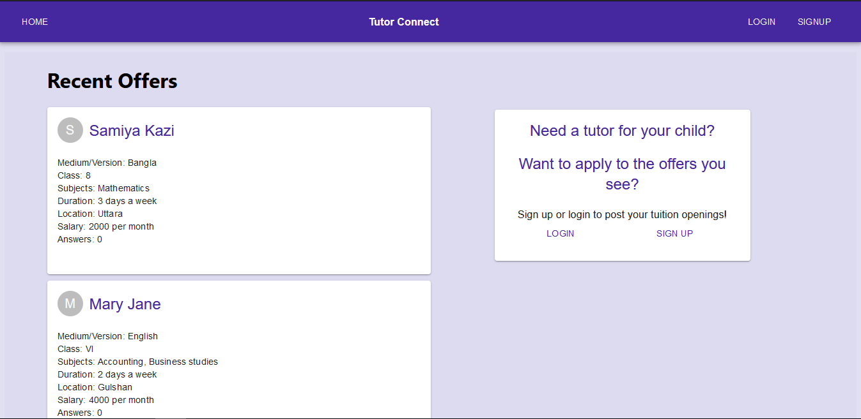
Project UI – Landing Page

Slide 11
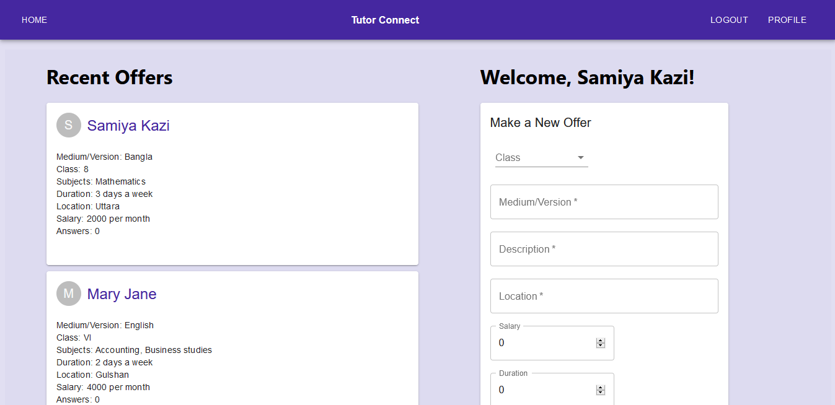
Project UI – Logged in homepage

Slide 12
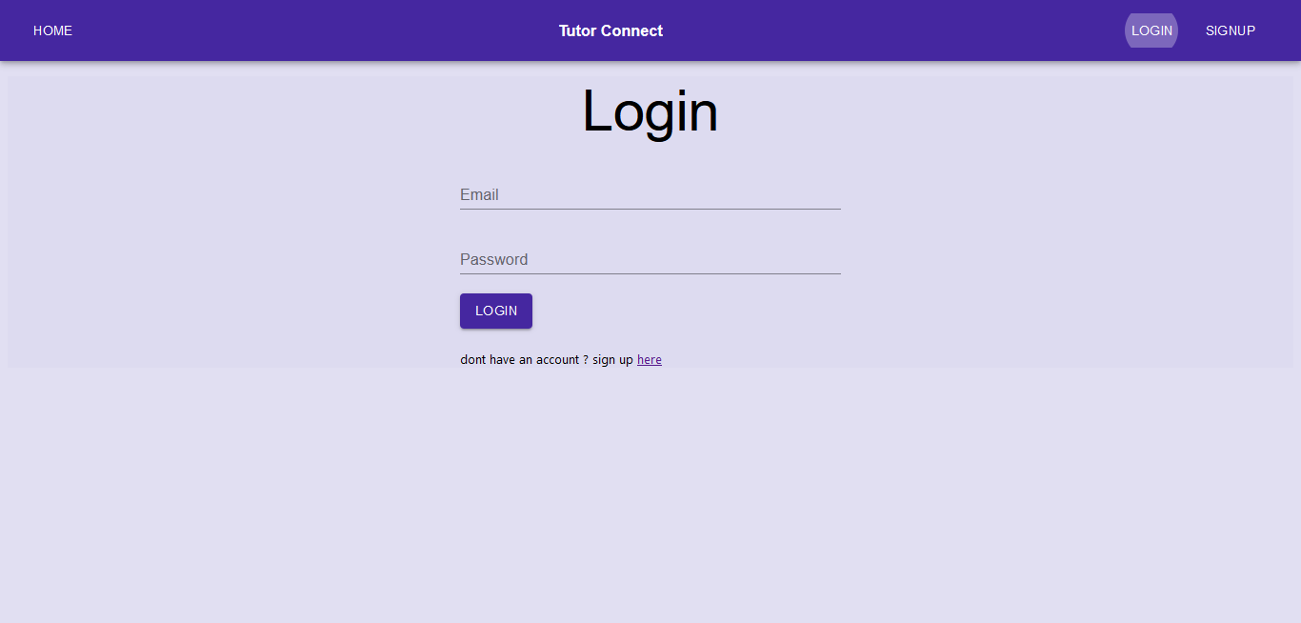
Project UI – Login Page

Slide 13
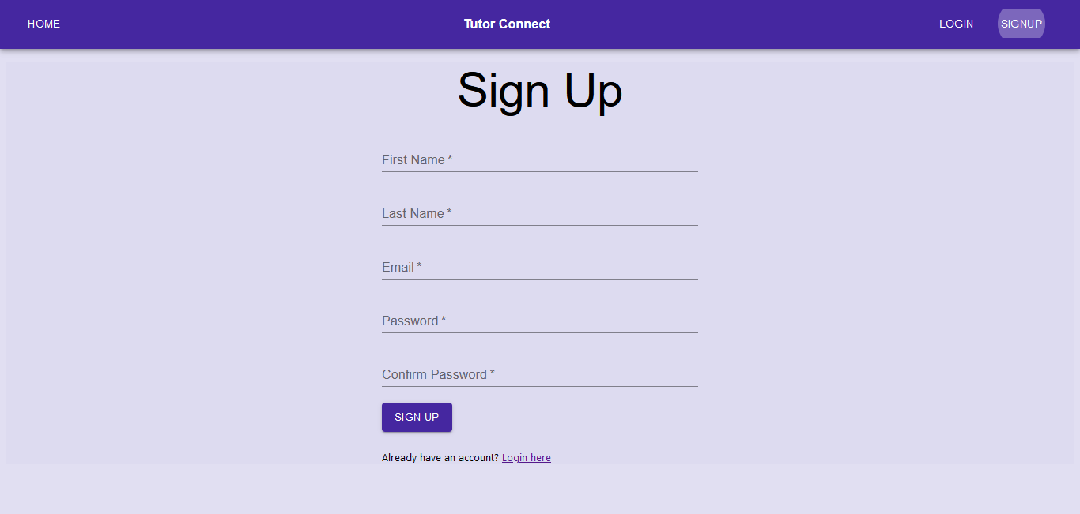
Project UI – Sign Up Page

Slide 14
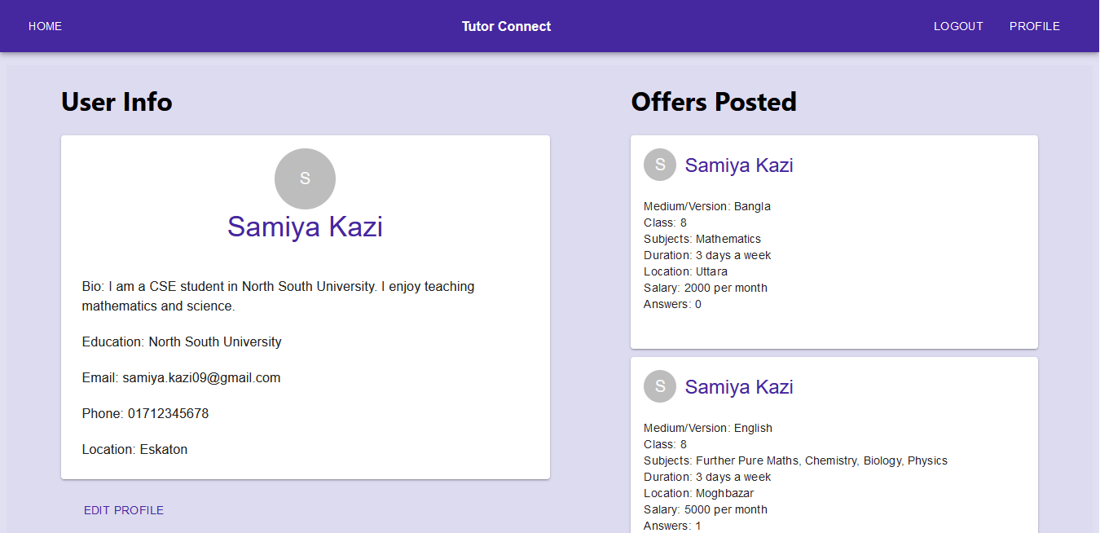
Project UI – Profile Page

Slide 15
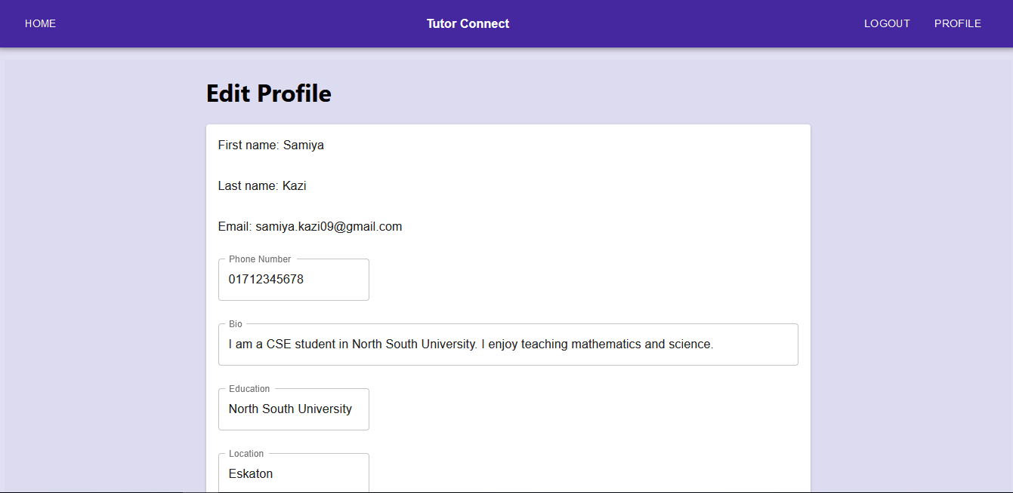
Project UI – Edit Profile Page

Slide 16
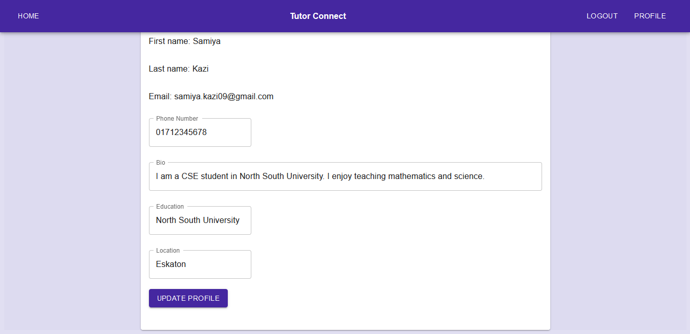
Project UI – Edit Profile Page

