Slide 1
CSE299 Week 06 Submission
Name: Samiya Kazi
ID: 1711620642
Section: 3
Group: 7

Slide 2
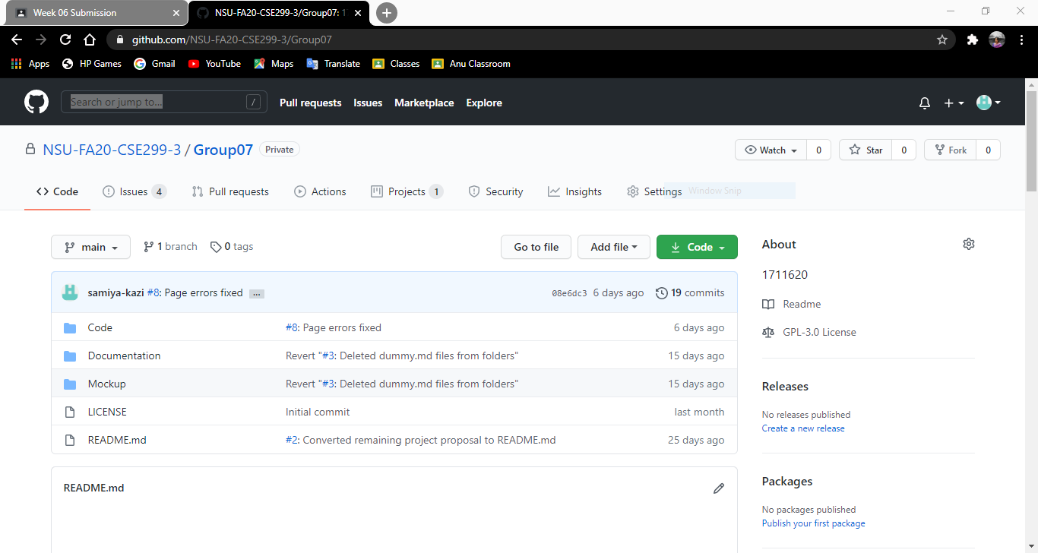
Github Front Page

Slide 3
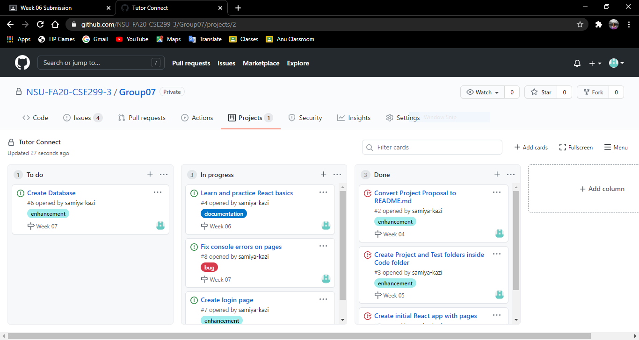
Github Board

Slide 4
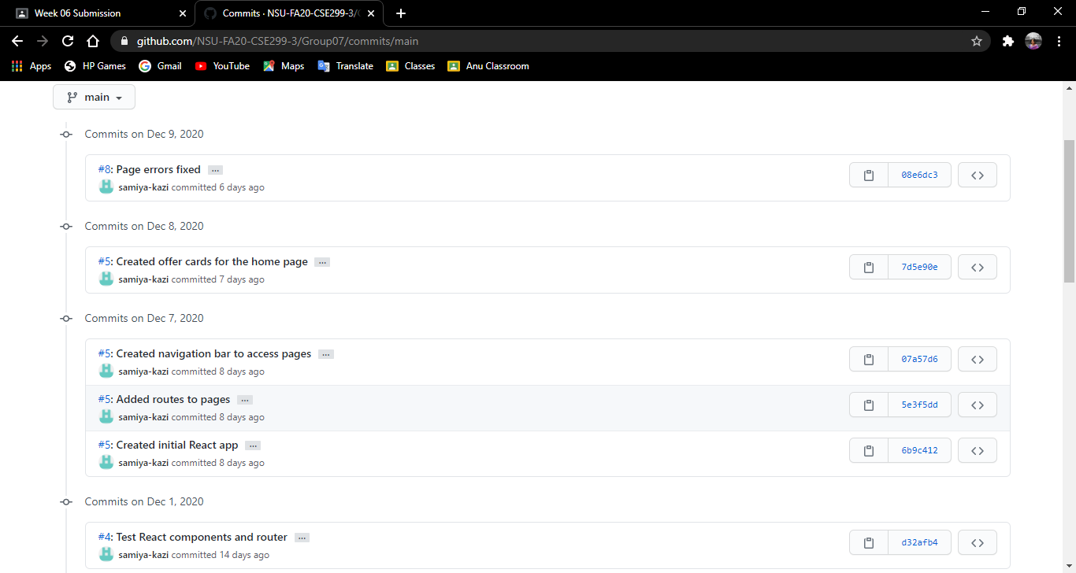
Commits

Slide 5
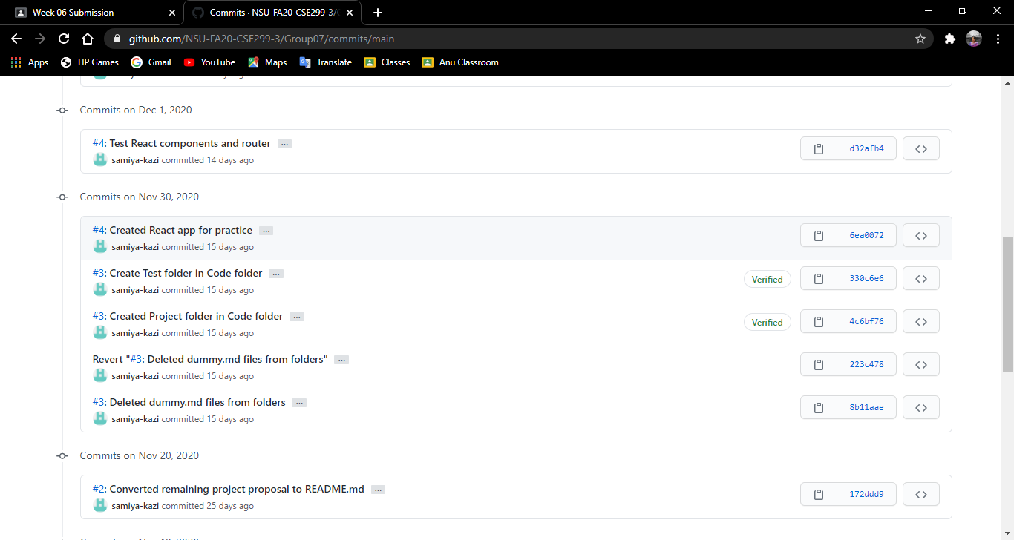
Commits

Slide 6
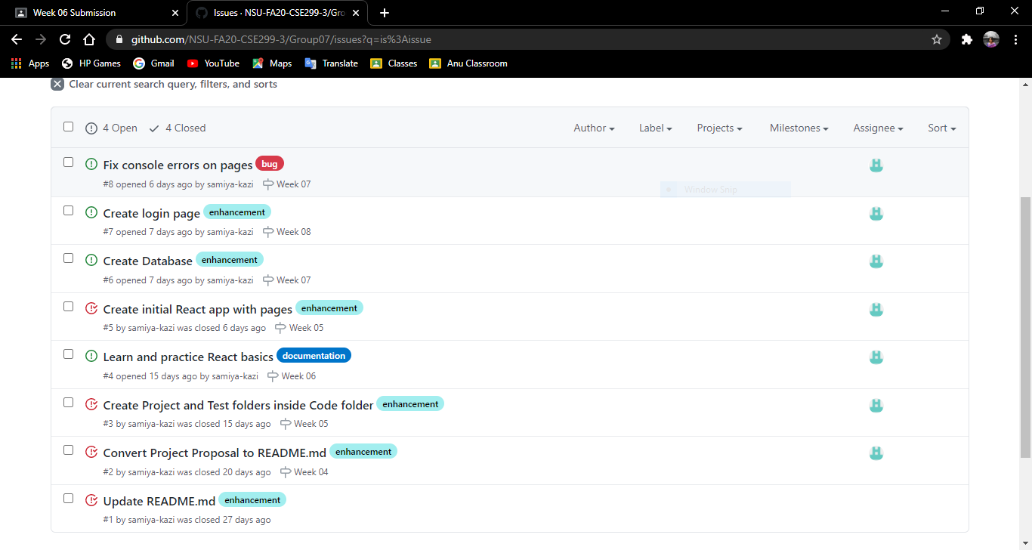
Issues

Slide 7
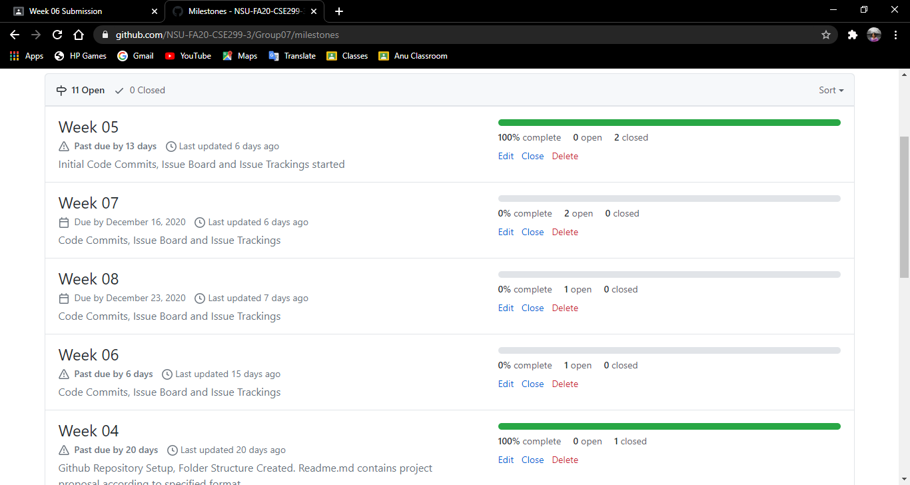
Milestones

Slide 8
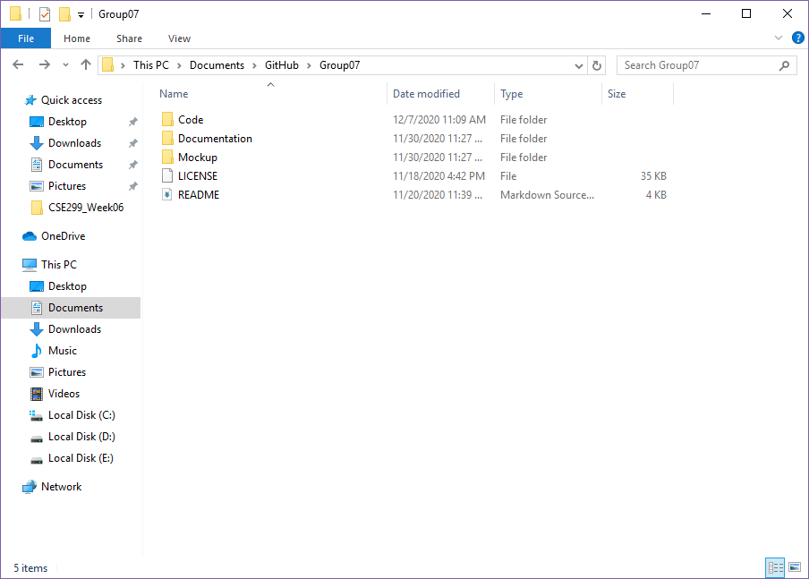
Local Repository

Slide 9
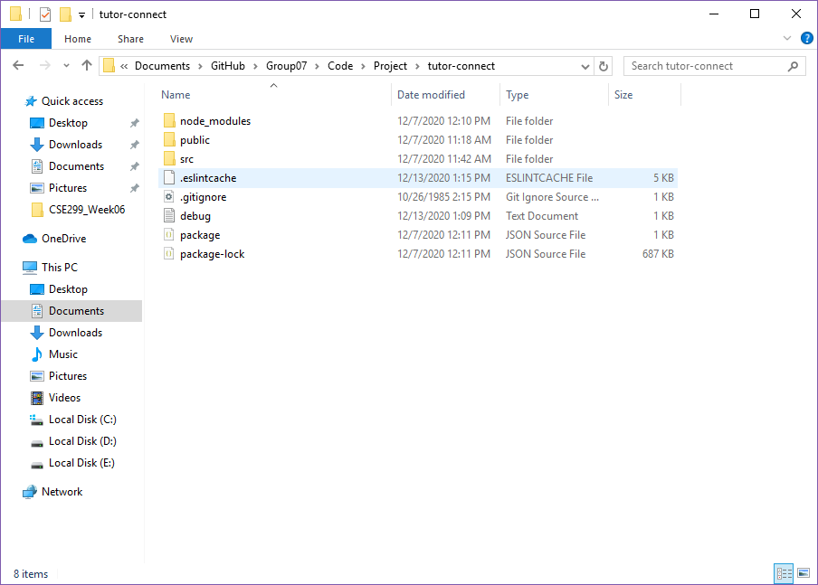
Local Repository

