Slide 1
CSE299 Week 08 Submission
Name: Samiya Kazi
ID: 1711620642
Section: 3
Group: 7

Slide 2
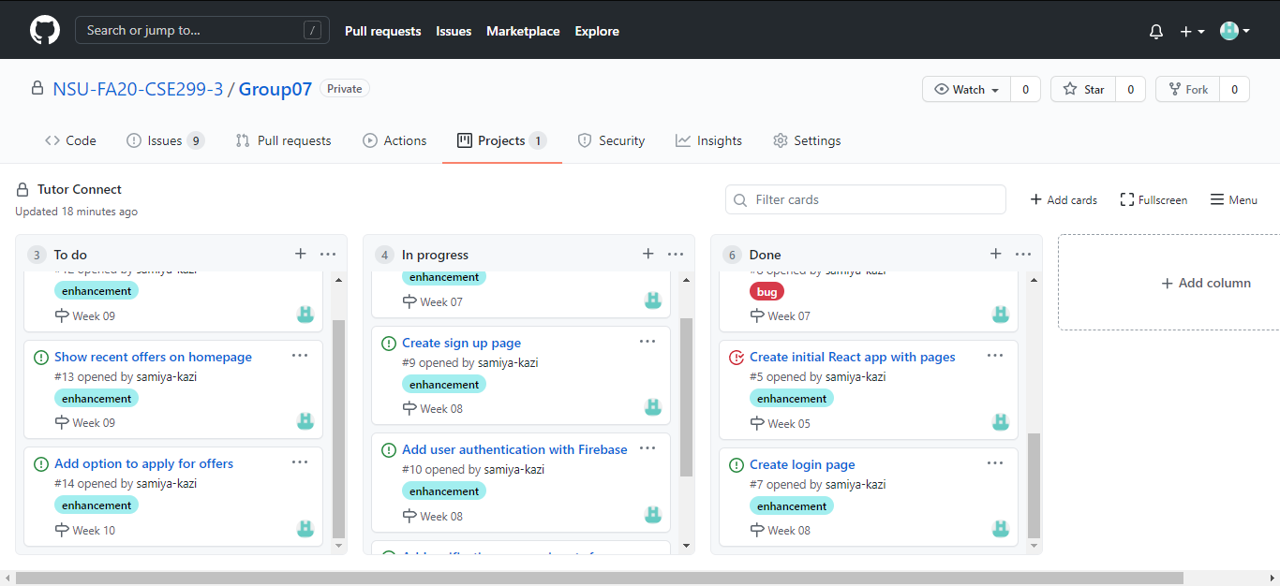
Project Board

Slide 3
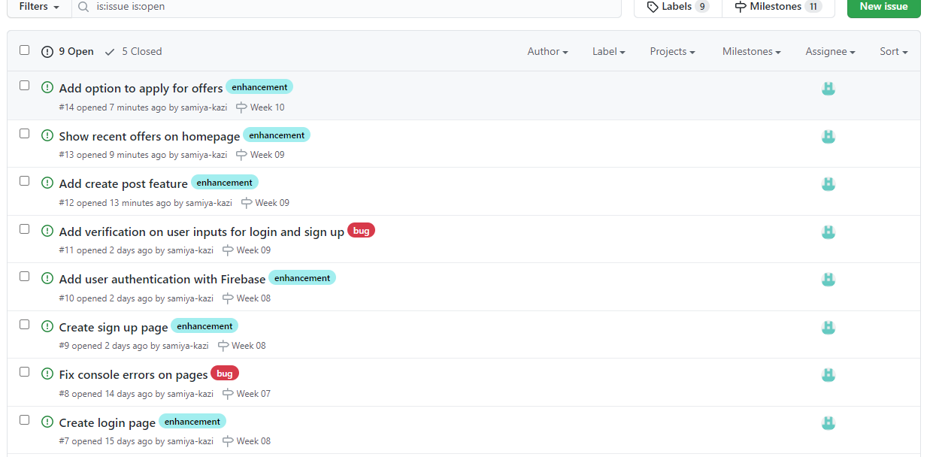
Issues

Slide 4
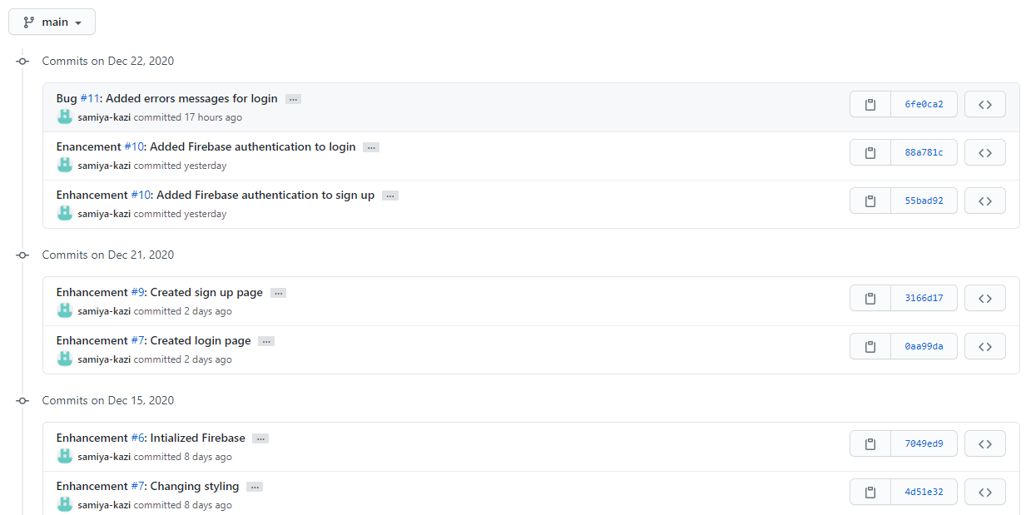
Commits

