Slide 1
CSE299 Week 09 Submission
Name: Samiya Kazi
ID: 1711620642
Section: 3
Group: 7

Slide 2
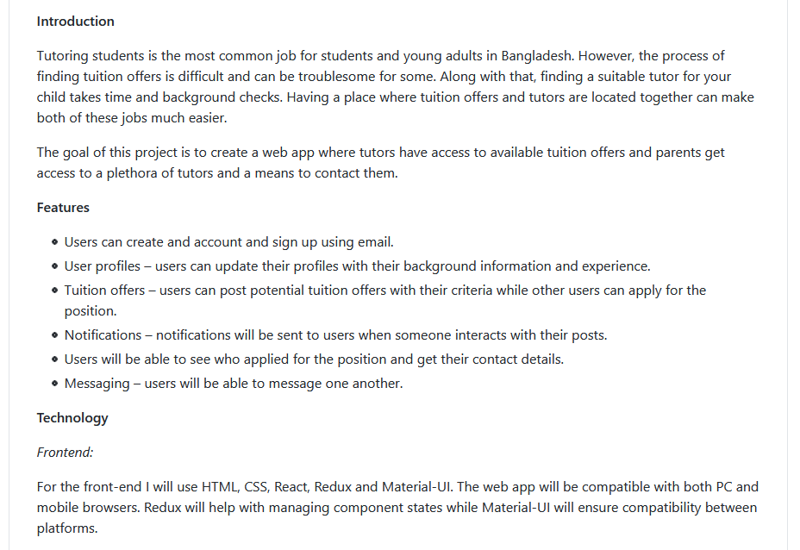
README.md

Slide 3
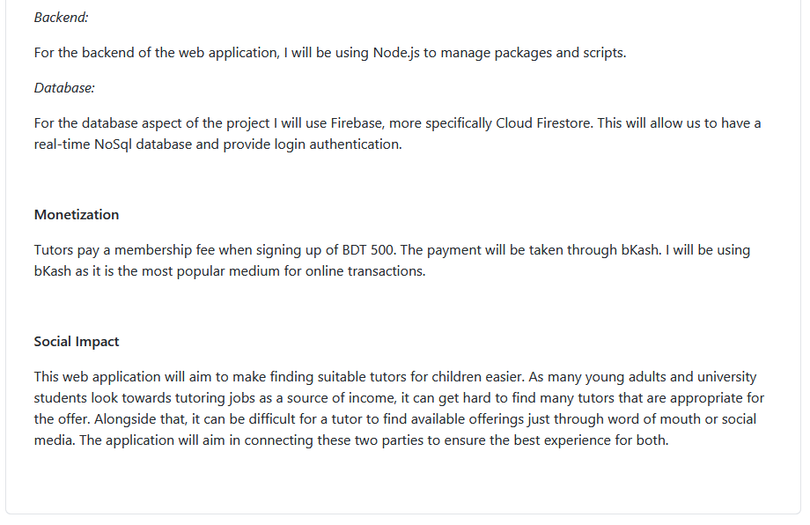
README.md

Slide 4
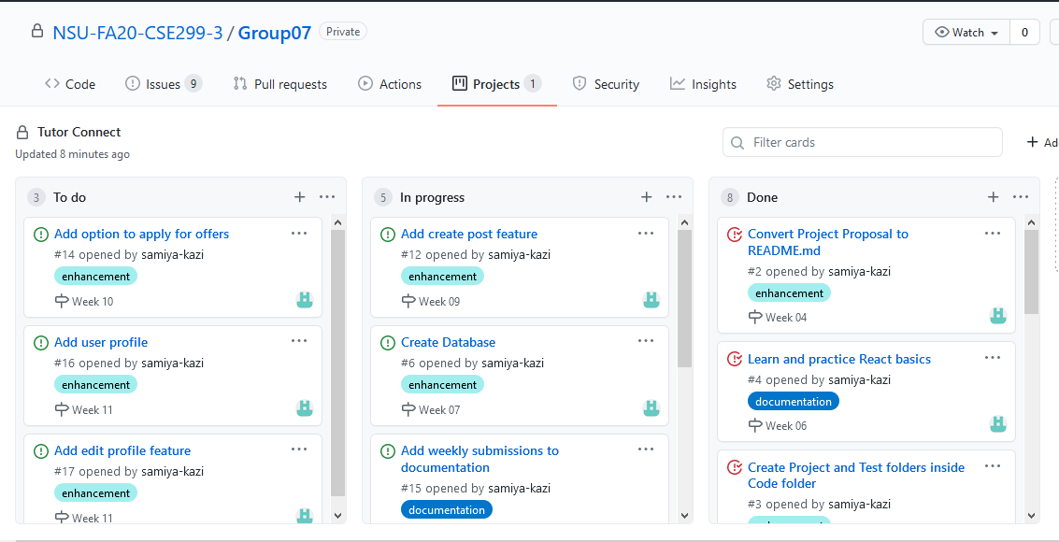
Project Board

Slide 5
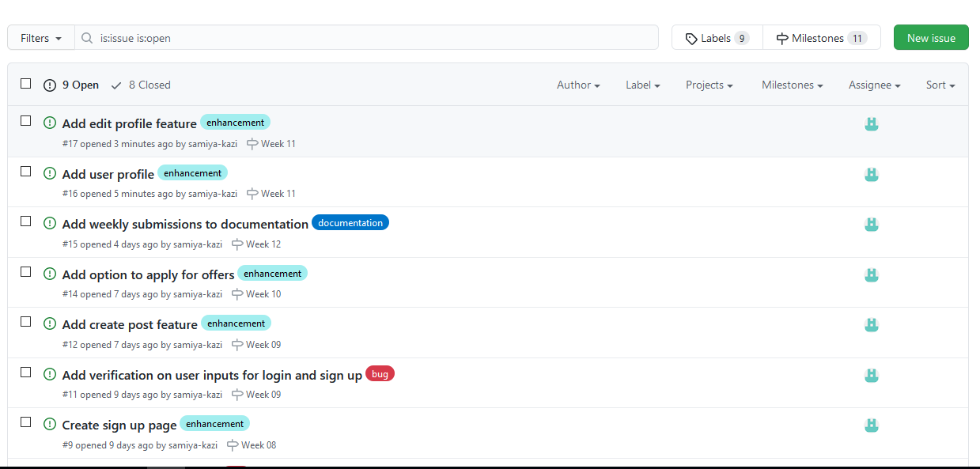
Issues

Slide 6
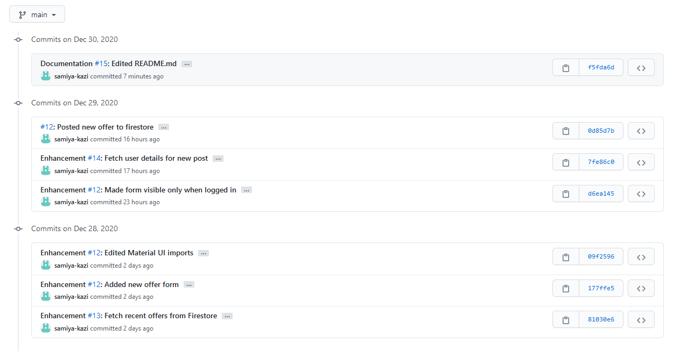
Commits

