Slide 1
CSE299 project
CSE299 project weekly progress

Slide 2
Project Group member
Member 1:
Name: Antu saha
Id:1722104642
Member 2:
Name:Ashdsin Huq
ID:1632482042

Slide 3
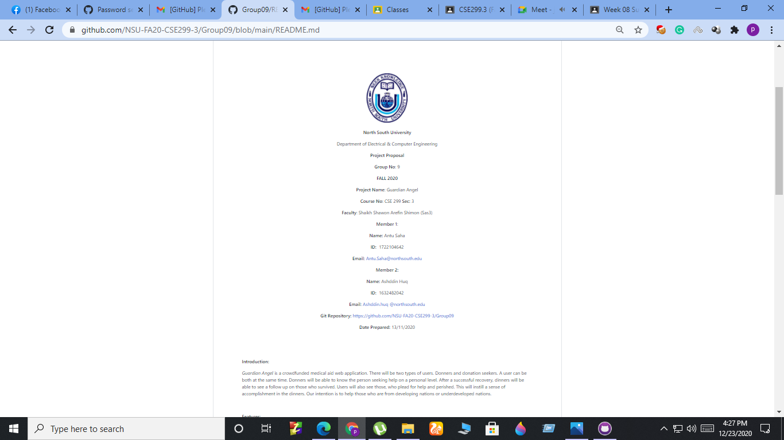
Project Readme

Slide 4
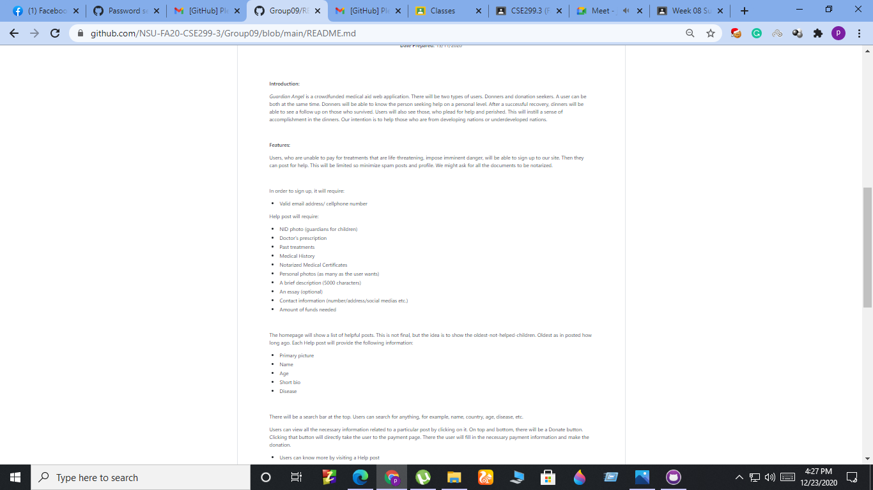
Project Readme(cont)

Slide 5
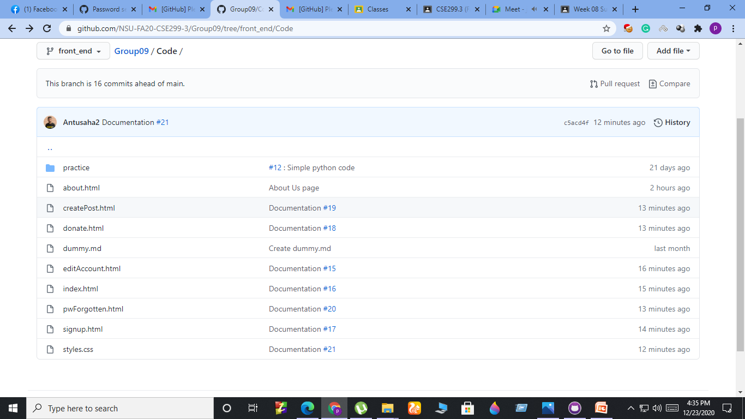
Commits

Slide 6
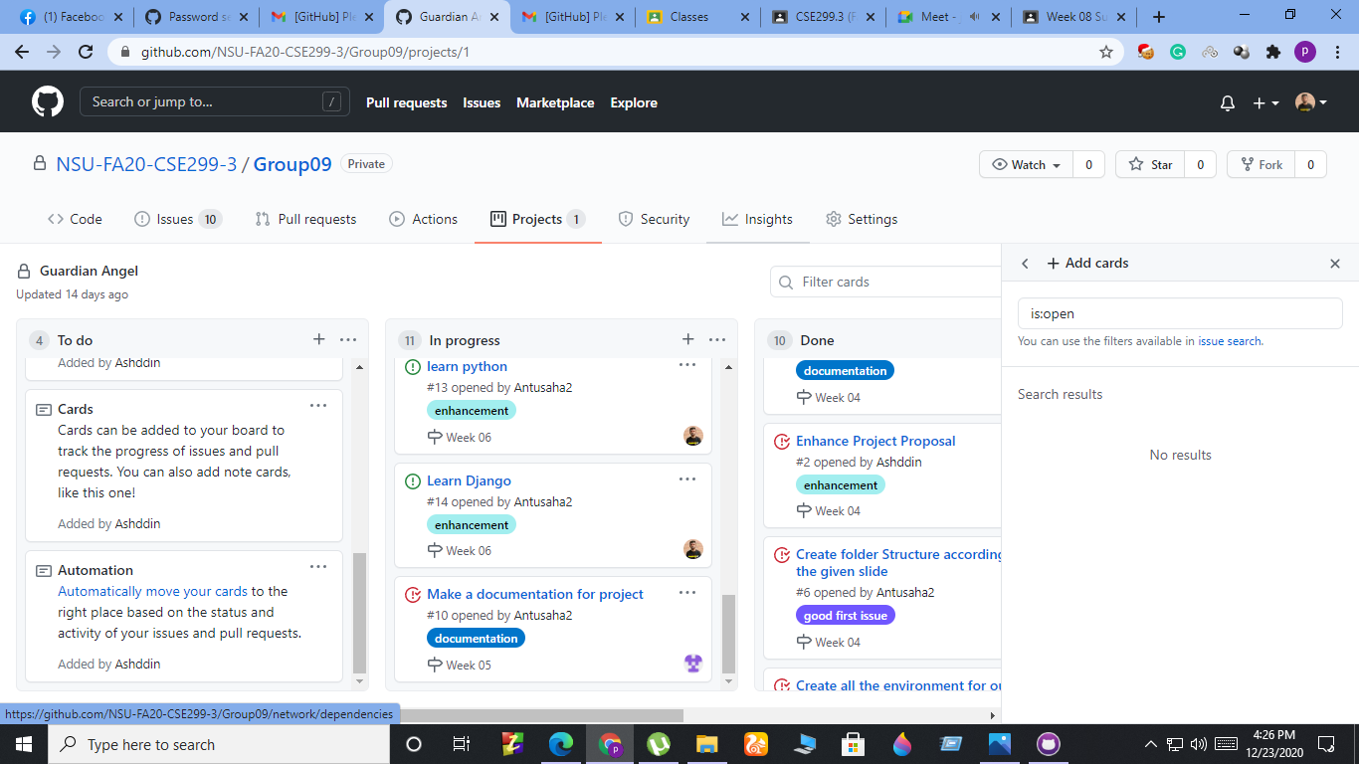
Issue Board

