Slide 1
CSE299 project
CSE299 project weekly progress

Slide 2
Project Group member
Member 1:
Name: Antu saha
Id:1722104642
Member 2:
Name:Ashdsin Huq
ID:1632482042

Slide 3
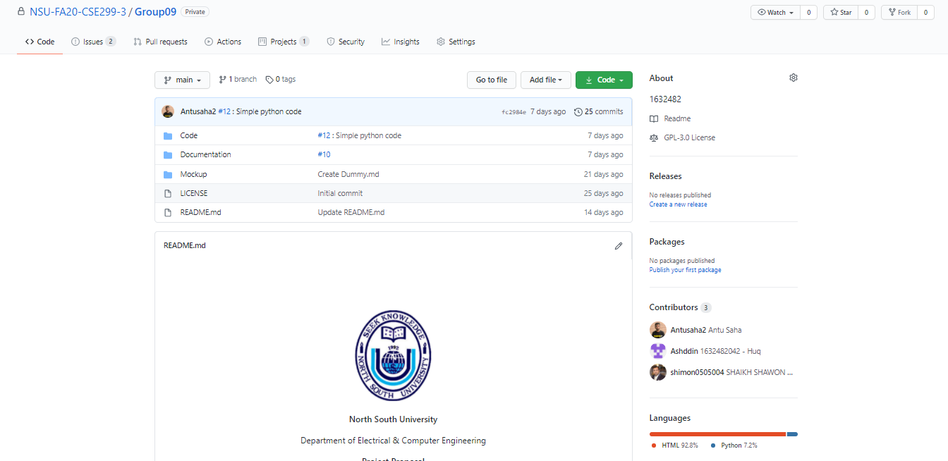
Github Front page

Slide 4
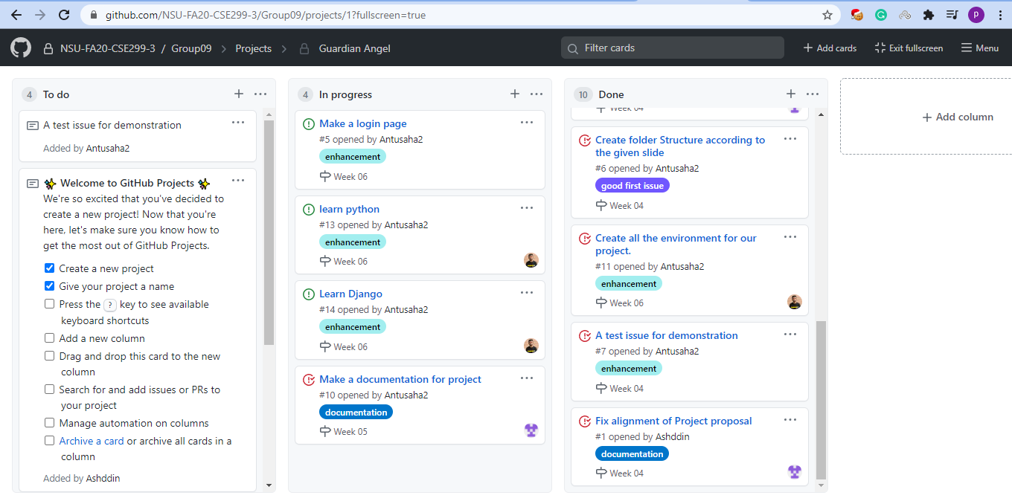
Github Board

Slide 5
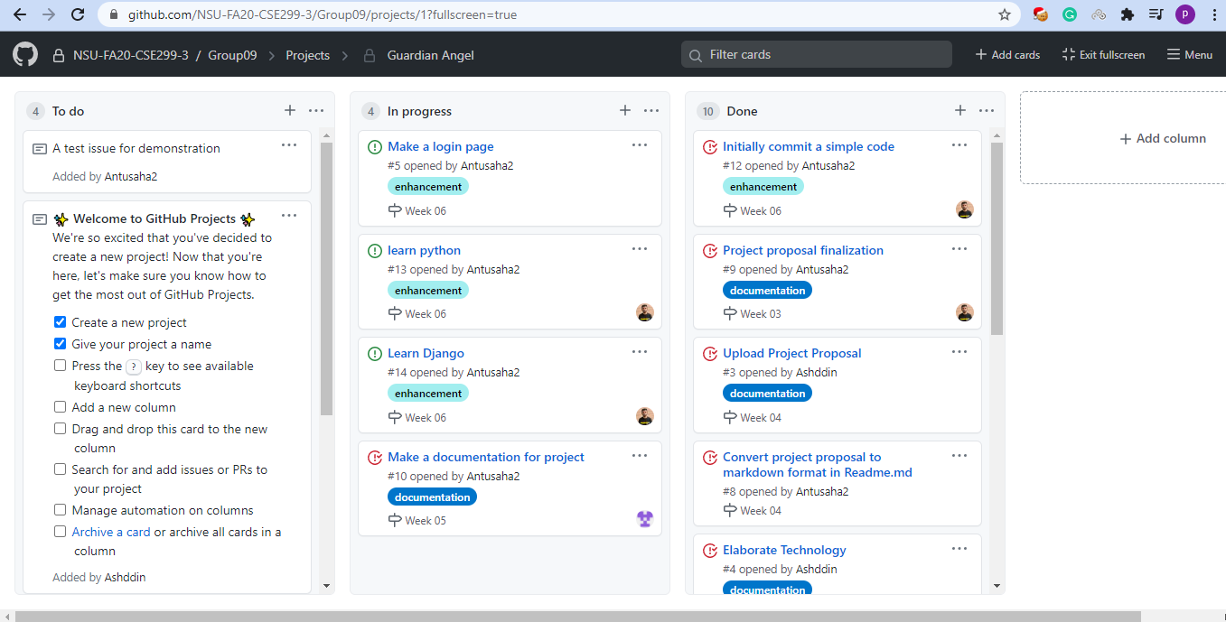
Github Board(cont)

Slide 6
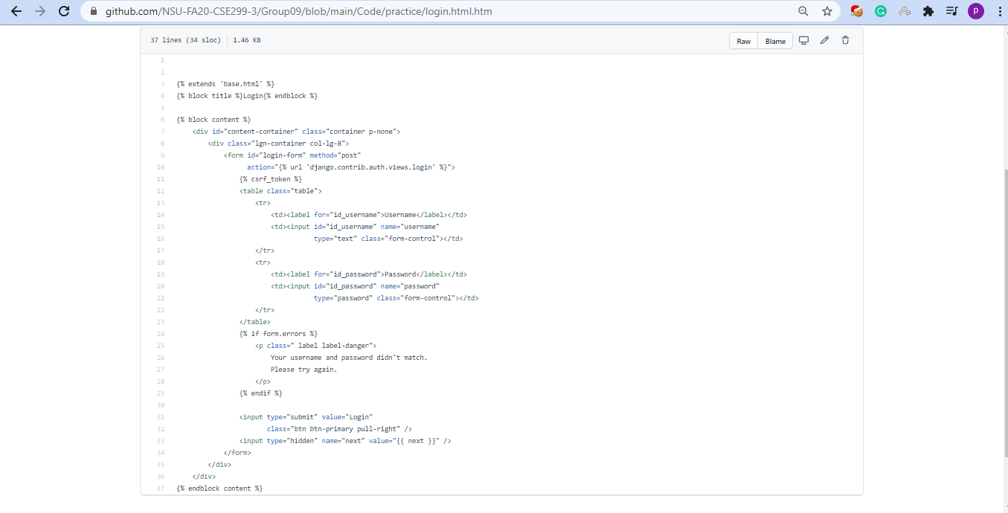
This Week’s commits

Slide 7
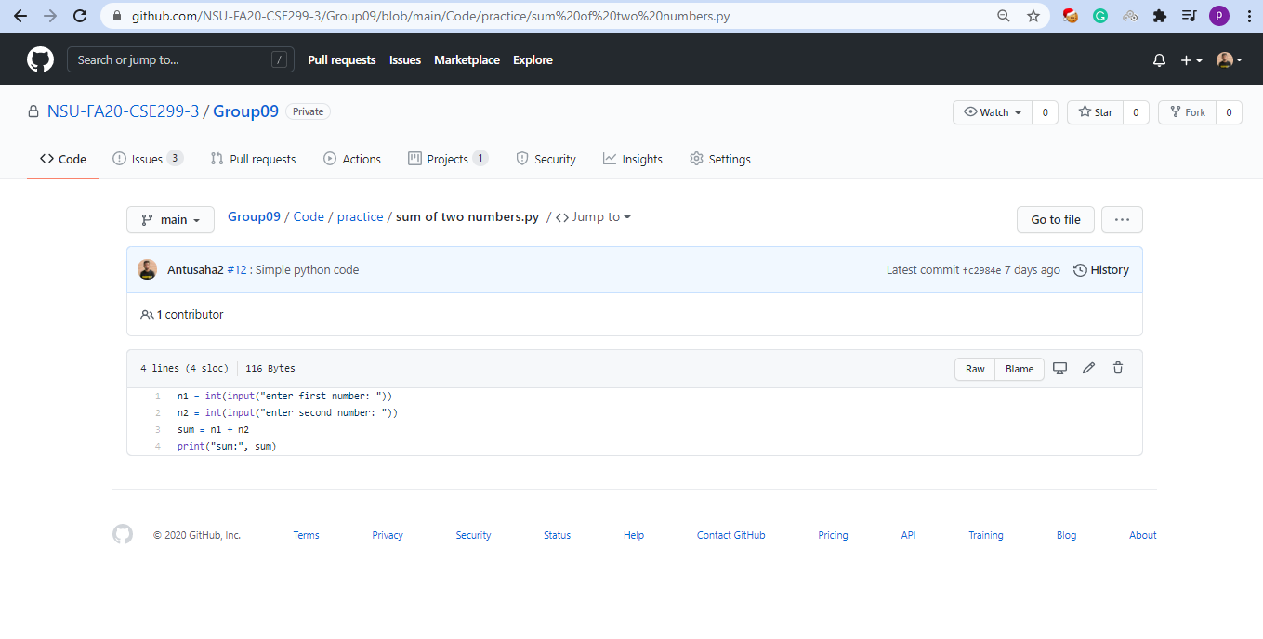
This Week’s commits(Cont)

Slide 8
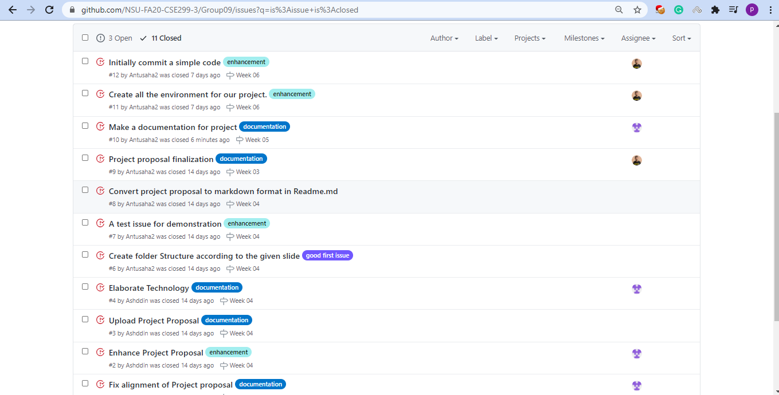
Issues

Slide 9
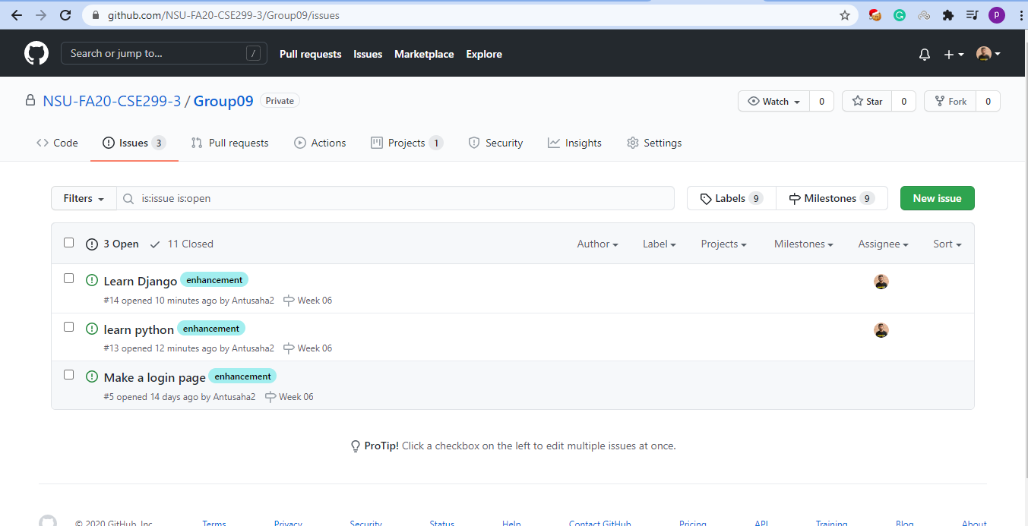
Issues(Cont)

Slide 10
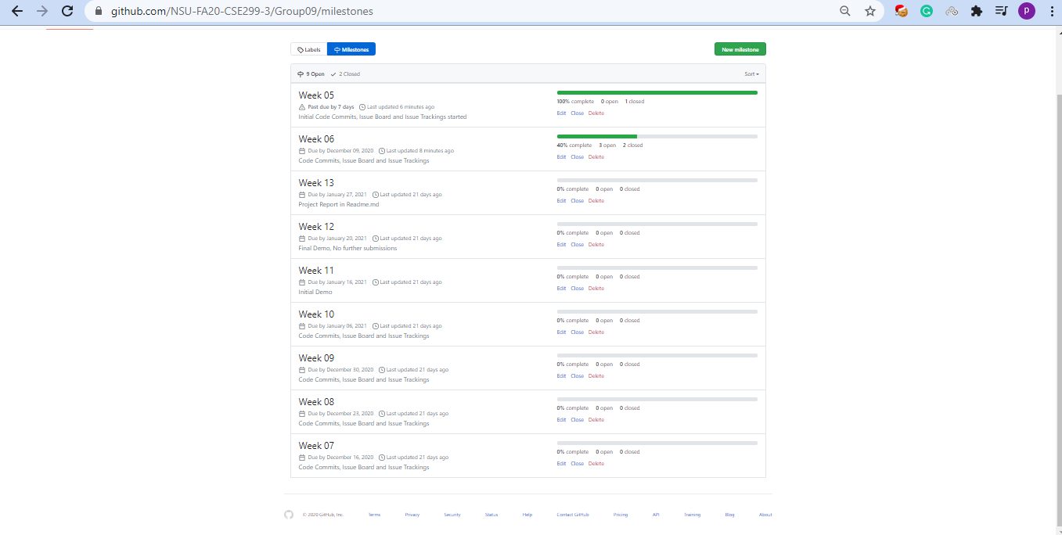
Milestones

Slide 11
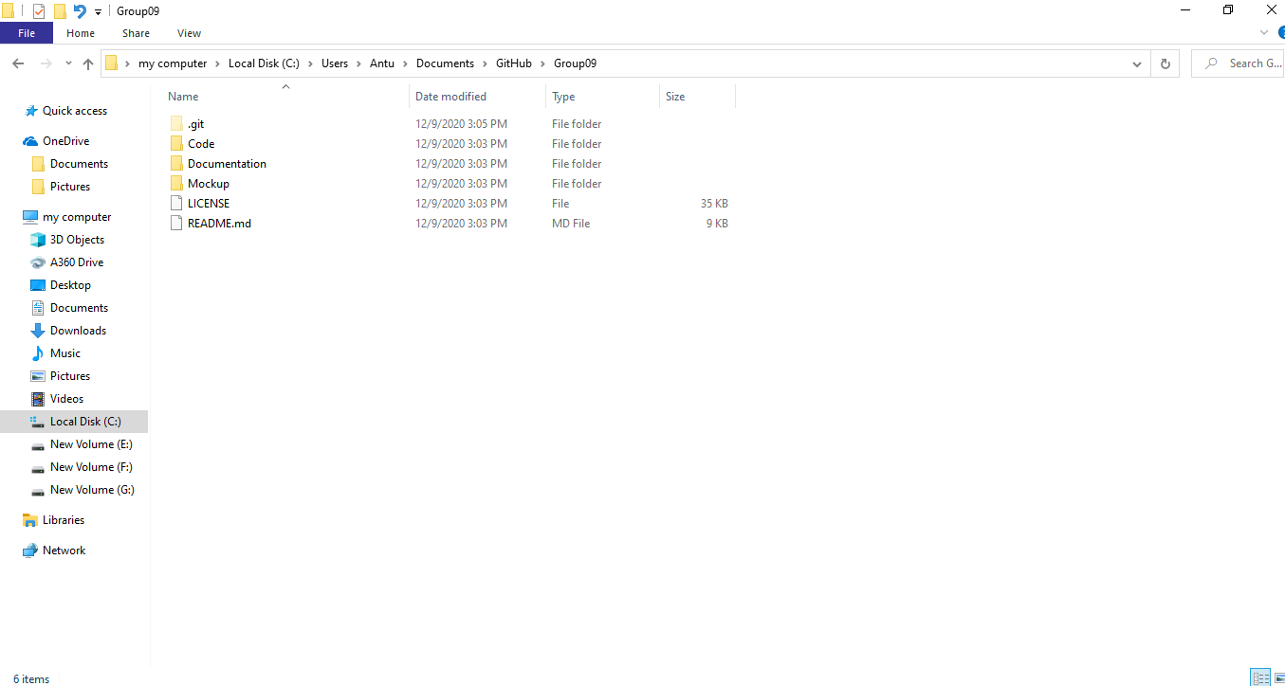
Local repository snapshot

