Slide 1
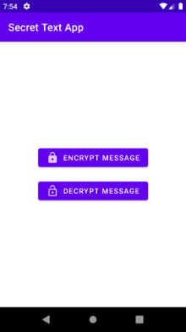
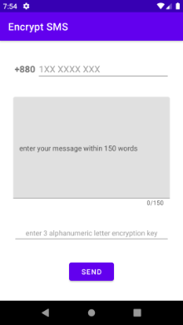
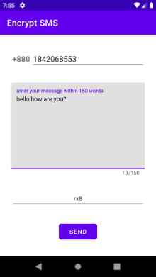
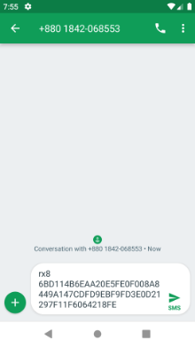
Secret Text App (1)
Home screen
Send encrypted message
via default SMS app
Enter phone number, message and encryption key.

Slide 2
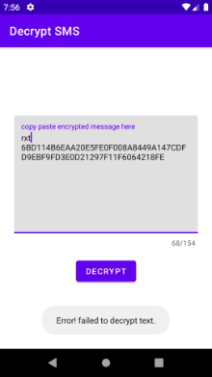
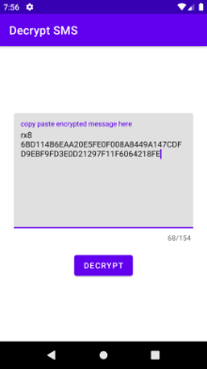
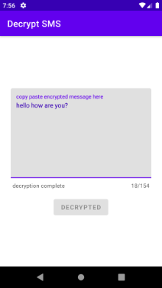
Secret Text App (2)
Attempt to decipher
message with invalid key
Attempt to decipher
message with correct key
View deciphered message

