Slide 1
Digit Recognition in EAT
指導教授:陳嘉平
學生:陳柏含

Slide 2
Experiment
Digit recognition system
EAT database
  16khz, 16-bit PCM microphone data
  8khz, 16-bit PCM gsm+pstn data
Four acoustic models
  Model 1 :training on microphone data
  Model 2 :training on gsm+pstn data
  Model 3&4 :training on micro and gsm+pstn data

Slide 3
Detail data setup
Mixed-data train1: 40% sentences of mic16k data and 40% sentences of gsm+pstn data used for training
Mixed-data test1: 10% sentences of mic16k data and 10% sentences of gsm+pstn data used for test
Mixed-data train2: 80% sentences of mic16k data and 80% sentences of gsm+pstn data used for training
Mixed-data test2: 20% sentences of mic16k data and 20% sentences of gsm+pstn data used for test

Slide 4
Baseline
test\train | mic16k | gsm +pstn | mixed-data train1 | mixed-data train2
mic16k | 93.8% | 16.1% | 91.0% | 91.8%
gsm+pstn | 21.5% | 91.5% | 86.5% | 89.5%
mixed-data test1 | 59.9% | 49.4% | 85.9% | 88.2%
mixed-data2 test2 | 60.1% | 51.2% | 88.9% | 90.7%
Baseline
test(CMN)\train(CMN) | Mic16k | gsm +pstn | mixed-data train1 | mixed-data train2
mic16k | 95.2% | 23.2% | 92.0% | 93.4%
gsm+pstn | 29.9% | 92.5% | 89.2% | 91.0%
mixed-data test1 | 64.8% | 53.1% | 88.9% | 90.7%
mixed-data test2 | 64.8% | 55.4% | 90.7% | 92.3%
CMN

Slide 5
Downsample procedure
test\train | mic8k | gsm +pstn | mixed-data train1 | mixed-data train2
mic8k | 94.0% | 81.0% | 91.0% | 93.5%
gsm+pstn | 78.9% | 91.5% | 89.0% | 90.2%
mixed-data test1 | 86.0% | 83.4% | 87.5% | 90.0%
mixed-data2 test2 | 87.00% | 85.9% | 90.0% | 91.9%
test(MVA)\train(MVA) | mic8k | gsm +pstn | mixed-data train1 | mixed-data train2
mic8k | 95.4% | 92.1% | 93.8% | 95.6%
gsm+pstn | 91.4% | 93.0% | 90.9% | 93.2%
mixed-data test1 | 92.3% | 90.8% | 90.7% | 93.6%
mixed-data test2 | 93.5% | 92.5% | 92.5% | 94.7%

Slide 6
test\train | mic8k | gsm | PSTN
mic8k | 94.0% | 79.4% | 78.2%
gsm | 81.4% | 92.1% | 91.0%
PSTN | 77.8% | 92.2% | 92.0%
Test (CMN) \train (CMN) | mic8k | gsm | PSTN
mic8k | 95.1% | 88.9% | 91.3%
gsm | 90.7% | 93.6% | 92.8%
PSTN | 92.8% | 92.9% | 92.8%

Slide 7
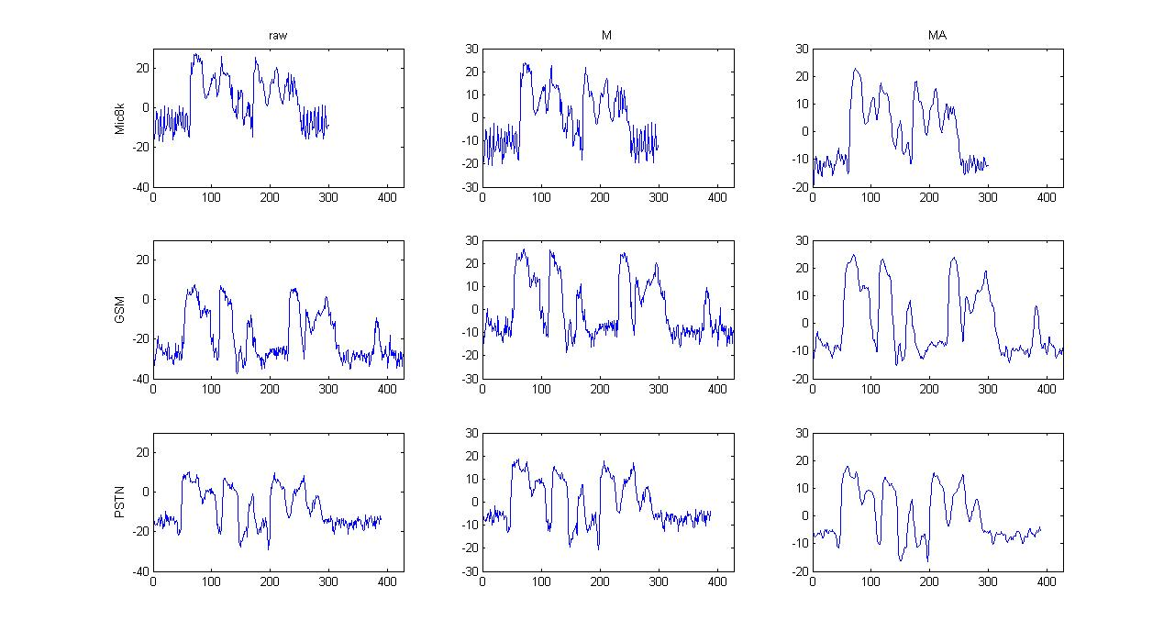
MFCC
MFCC(c1)
filename:10027201.wav
Digit string: 2146291

Slide 8
Low bit rate codecs
  RPE-LPC (Regular pulse excitation LPC)
  GSM Full rate codec
  13kbps
CELP (Code-excited linear prediction coder)
  Codebook generate excitation signal
  4800 bps
  240 sample/frame (30 ms)

Slide 9
AbS-LPC with different excitation types
Vecotr 1
Vecotr 2
Vecotr 3
…..
Vecotr C
CELP
Time varying filter
Output speech
MPLPC
RPELPC

Slide 10
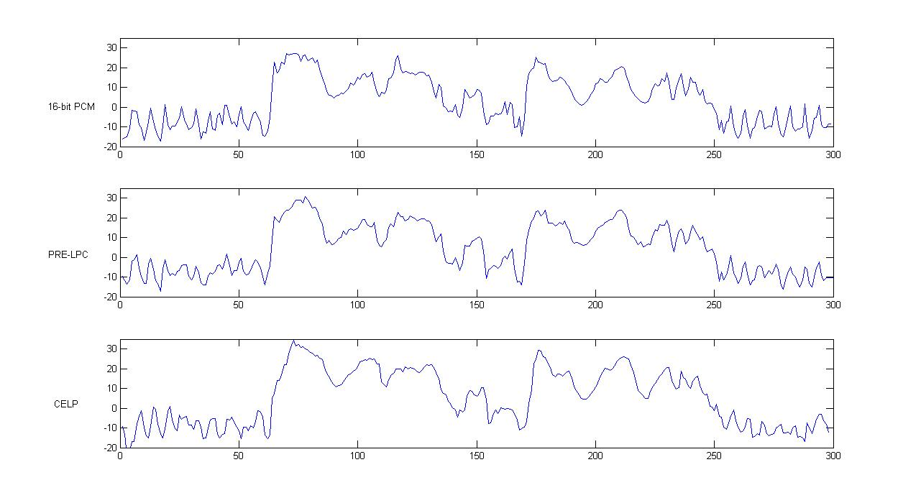
Result with different codecs
MFCC (c1)
Filename:10027201.wav

Slide 11
Microphone result
test\train | Raw_mic8k | GSM Full rate | CELP | LPC-10
Raw_mic8k | 94.0% | 93.0% | 91.4% | 80.9%
GSM Full rate | 93.6% | 93.7% | 92.4% | 82.8%
CELP | 88.0% | 88.3% | 92.5% | 79.7%
LPC-10 | 80.6% | 78.5% | 84.0% | 88.5%
 | SNR(dB)
GSM | 15.04
CELP | -2.57
LPC-10 | -2.88

Slide 12
PSTN result
test\train | raw_PSTN | GSM Full rate | CELP | LPC-10
raw_PSTN | 92.0% | 89.9% | 89.6% | 82.9%
GSM Full rate | 91.5% | 91.0% | 89.1% | 81.5%
CELP | 89.8% | 88.5% | 89.2% | 78.6%
LPC-10 | 87.5% | 87.07% | 87.5% | 87.5%

