Slide 1
A Study on Detection Based Automatic Speech Recognition
Author : Chengyuan Ma
Yu Tsao
Professor:陳嘉平
Reporter :許峰閤

Slide 2
Outline
Introduction
Word detector design
Hypotheses combination
Experiment

Slide 3
Introduction
The current ASR system is top-down and this is a bottom-up system.
It include:
1.word detector.
2.word hypothesis verification and false
alarm pruning.
3.Hypothesis combination.

Slide 4
Word detector design
We have separate detector for each lexical item in the vocabulary.
HMM model are used for detector design.
The key issue is how to choose an appropriate grammer network.

Slide 5
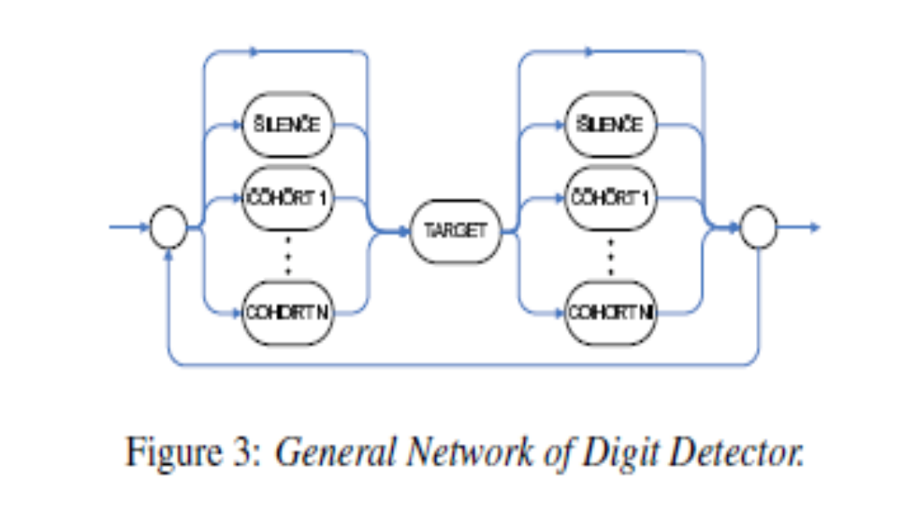
Word detector design

Slide 6
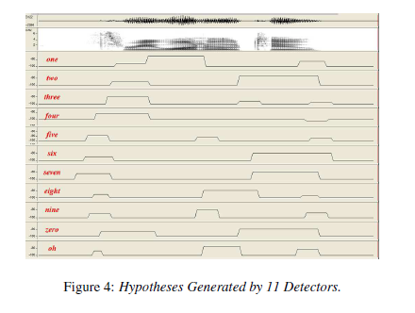
Word verification and pruning

Slide 7
Word verification and pruning
It’s obvious that these detectors generate a lot of false alarms.
Here are three pruning strategies will be presented.

Slide 8
Word verification and pruning
Temporal information based pruning:
For example, the duration of the word “one” should be greater than 150 ms.
Attributes model based pruning:
Each word has its own attribute sequence pattern.
Signal based pruning:
Signal feature based pruning.
For example, we know the energy of a nasalsound is often concentrated on the low frequency region.

Slide 9
Hypotheses combination
We investigate hypothesis combination strategies using outputs from all detectors to generate a word string.
The weighted directed graph is one of the methods that can be used to combine the detector output into a digit string.

Slide 10
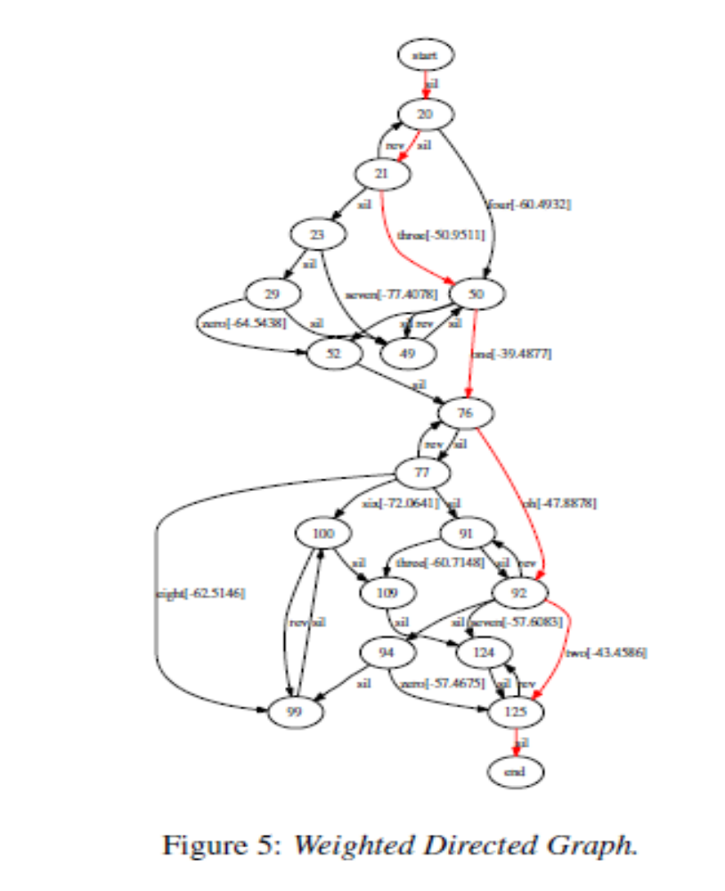

Slide 11
Hypotheses combination
Each node in the graph is a detected digit boundary.
The number in the node is the time stamp.
The number beside each edge is the frame average log-likelihood.
We can use the Dijkstra’s algorithm to find the shortest path.

Slide 12
Experiment
Conduct on the TIDIGITS corpus.
Digit vocabulary is made of 11 digits, one to nine, plus oh and zero.
12-dimensional MFCC is used for frond-end processing.

Slide 13
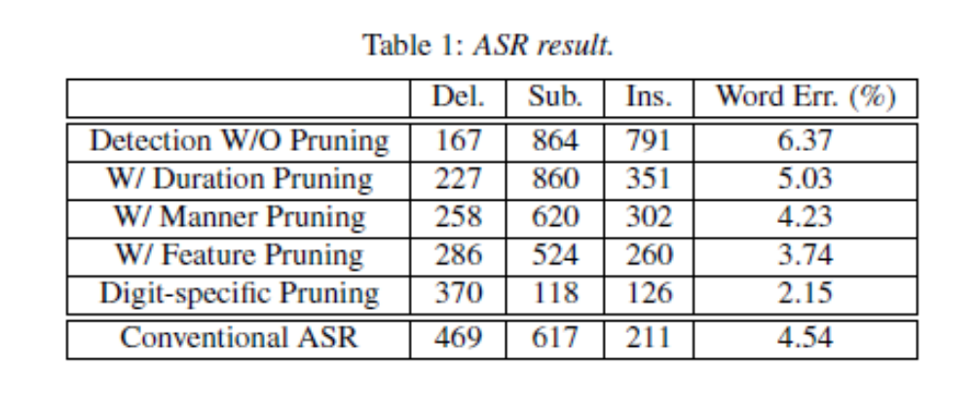
Experiment

