Slide 1
Rule-based Machine Translation in Limited Domain for PDAs
應用於智慧型行動裝置之特定領域機器翻譯系統
Reporter: 江欣倩
Professor: 陳嘉平

Slide 2
Outline
Introduction
Related Works
Fundamental Theory
  grammars for parsing
  grammars for transfer and generation
System Architecture
  Rule Building
  Translation Engine
Experiments
  Environment
  Preparation

Slide 3
Outline
Introduction
Related Works
Fundamental Theory
  grammars for parsing
  grammars for transfer and generation
System Architecture
  Rule Building
  Translation Engine
Experiments
  Environment
  Preparation

Slide 4
Motivation
Different Viewpoints
  On academic side
    move systems on desktops into handheld devices
    Mobile translation in Wikipedia
  On business side
  On medical side
We adopt rule-based machine translation (MT) systems
  On handheld devices, rule-based systems do not compare with statistical systems.
  Due to rule-based methods in limited domain and bilingual rules can do better than statistical one on PCs.

Slide 5
Goal
A rule-based Chinese-to-English MT system for travel domain on PDAs
  collect bilingual training data
  build monolingual and bilingual rules
  design a compact data structure
  devise monolingual and bilingual parsers

Slide 6
Outline
Introduction
Related Works
Fundamental Theory
  grammars for parsing
  grammars for transfer and generation
System Architecture
  Rule Building
  Translation Engine
Experiments
  Environment
  Preparation

Slide 7
Lexicalized grammar
In lexicalized grammar, each constituent has an anchor
  anchor: the core word in a constituent. Other words in a constituent are dependent on anchor
For example: transfer CFG into lexicalized CFG
  NT: a set of non-terminal symbols
  Σ: a set of terminal symbols
  A belongs Σ: a set of anchors
  P: a set of productions. All derivations in P are with at least an anchor.
    NT(x): NT associate anchor x
    x and y belong A
      NT(x) → x
      NT(x) → NT(x)NT(y) | NT(y)NT(x)

Slide 8
Outline
Introduction
Related Works
Fundamental Theory
  grammars for parsing
  grammars for transfer and generation
System Architecture
  Rule Building
  Translation Engine
Experiments
  Environment
  Preparation

Slide 9



Lexicalized Tree Automaton Grammar
Lexicalized tree automaton grammar (LTA Grammar)
  Definition
    Σ: a set of terminal symbols (words)
    NT: a set of non-terminal symbols
    T: a set of trees associated with a word. w₁…w_{n} belong Σ.
    A: a set of the tree automaton associated with the word
    S: a set of non-terminal symbols on tree root associated with the word

Slide 10
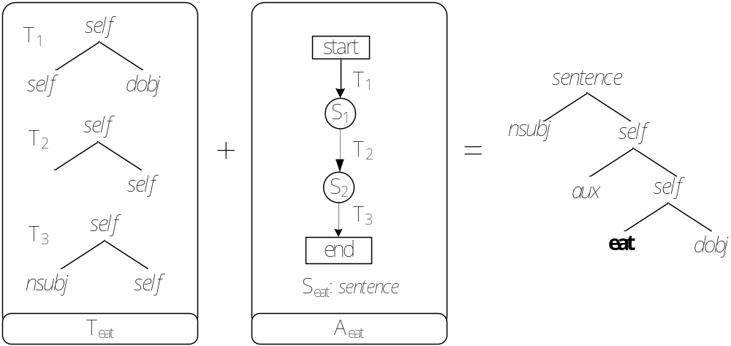
A LTA Example
Λ_{w}={T_{w,} A_{w,} S_{w}}

Slide 11
Outline
Introduction
Related Works
Fundamental Theory
  grammars for parsing
  grammars for transfer and generation
System Architecture
  Rule Building
  Translation Engine
Experiments
  Environment
  Preparation

Slide 12
Tree Adjoining Grammar
Tree Adjoining Grammar (TAG)
  G=(Σ, NT, S, I, A)
    Σ : the finite set of terminal symbols
    NT: the finite set of non-terminal symbols
    S: distinguished non-terminal symbols of initial tree roots
    I: the finite set of initial trees
    A: the finite set of auxiliary trees
Auxiliary trees
  foot node: a leaf node with a non-terminal label is identical to the label of the root node
Initial trees
  Otherwise

Slide 13
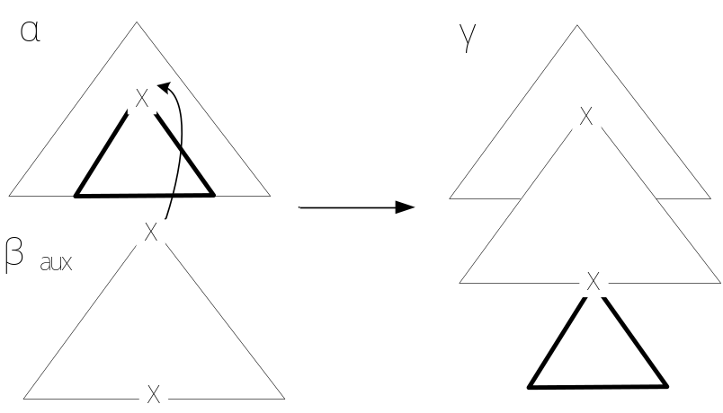
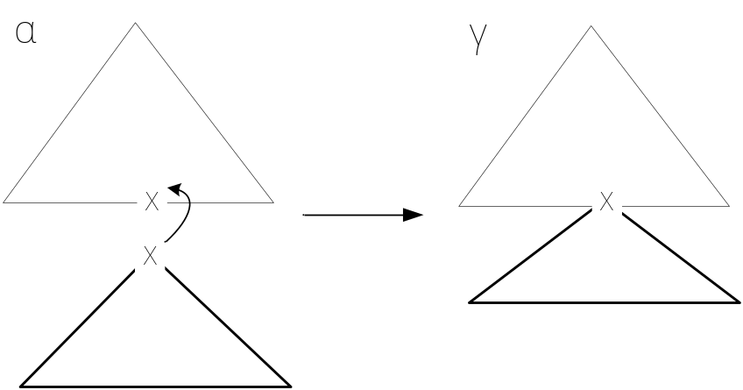
Tree Adjoining Grammar
Two operations
  Adjoining
  Substitution

Slide 14
Synchronous Lexicalized Tree-Adjoining Grammars
Bilingual rules
  Characterize correspondences between languages
A derivation step from a pair of trees (α₁, α₂)
  choose a link where node n₁ link node n₂ (n₁ in α₁, n₂ in α₂)
  choose a meet tree pair (β₁, β₂)
  composite (β₁, β₂) into (n₁ in α₁,n₂ in α₂), and the derived tree is (β₁(α₁, n₁), β₁(α₁, n₁))

Slide 15
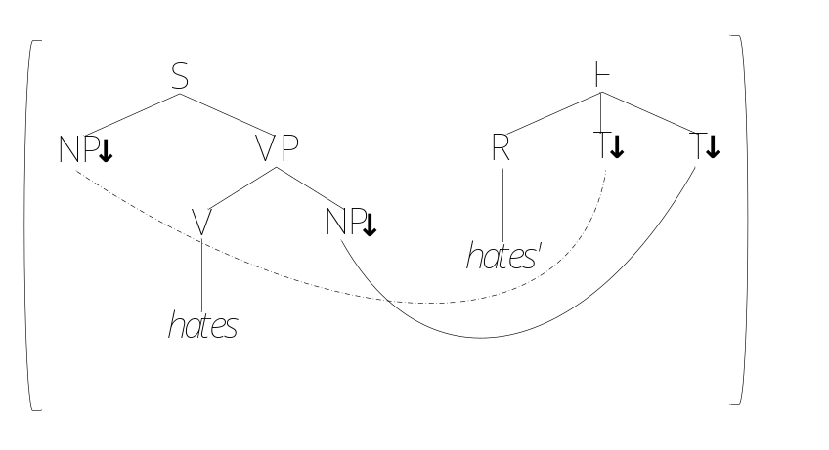
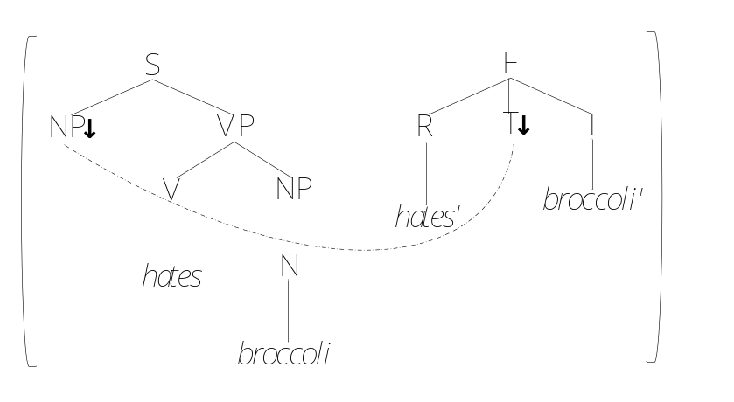
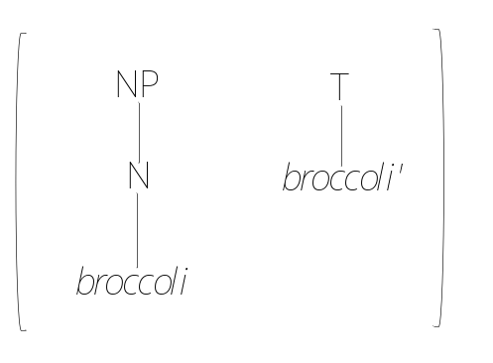
Synchronous Lexicalized Tree-Adjoining Grammars

Slide 16
Outline
Introduction
Related Works
Fundamental Theory
  grammars for parsing
  grammars for transfer and generation
System Architecture
  Rule Building
  Translation Engine
Experiments
  Environment
  Preparation

Slide 17
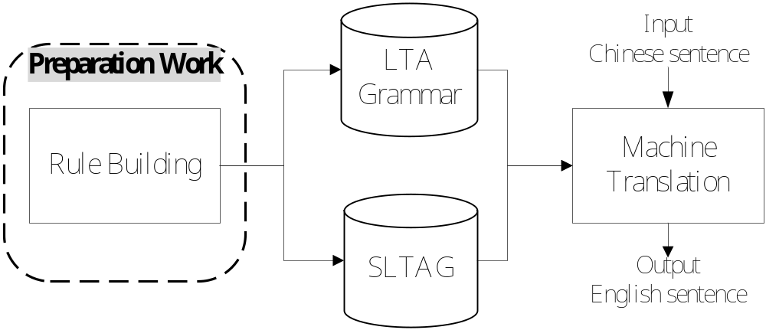
System Architecture

Slide 18
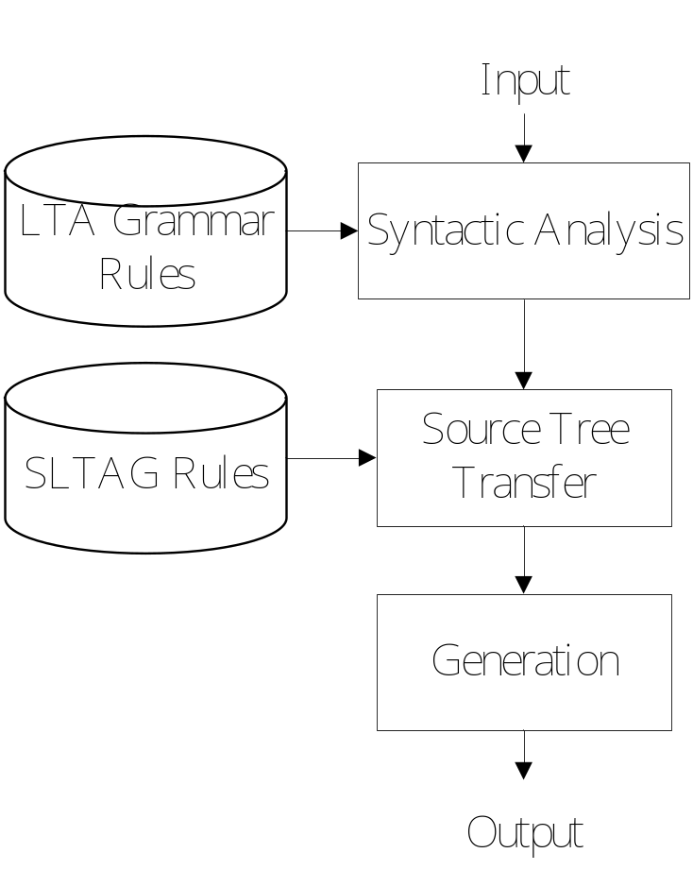
Rule-based MT System

Slide 19
Outline
Introduction
Related Works
Fundamental Theory
  grammars for parsing
  grammars for transfer and generation
System Architecture
  Rule Building
  Translation Engine
Experiments
  Environment
  Preparation

Slide 20
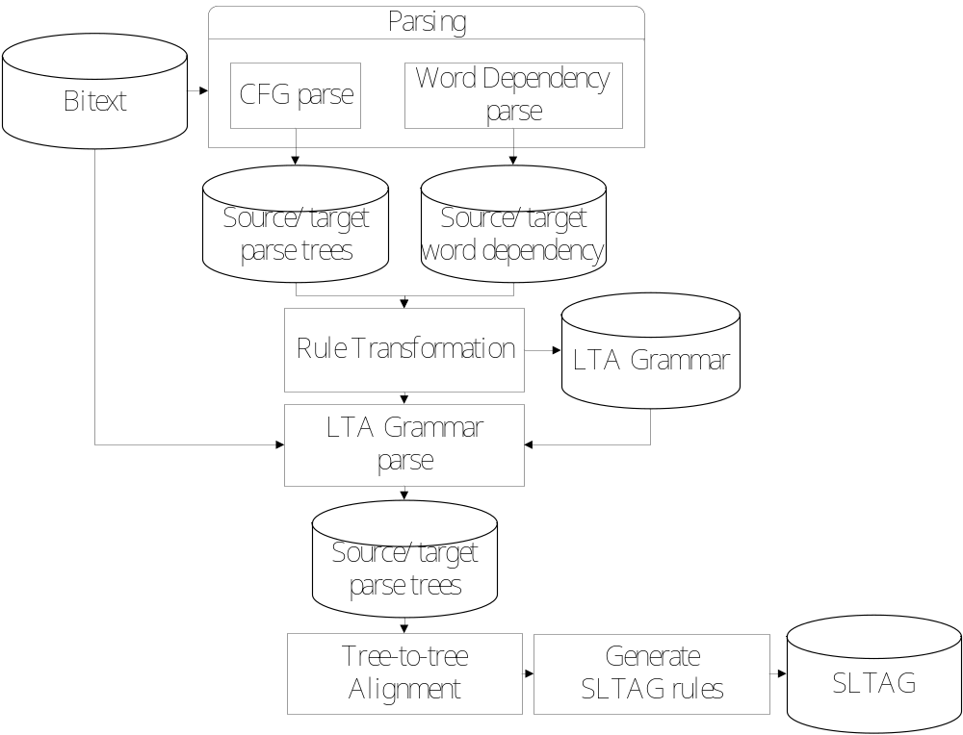
Rule Extracting Flow

Slide 21
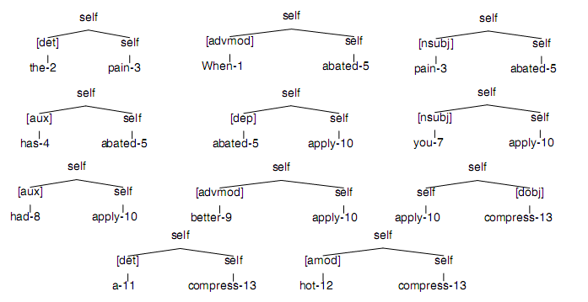
Corpus Parsing
Dependency trees

Slide 22
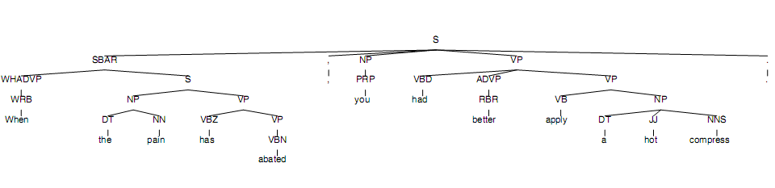
Corpus Parsing
CFG parse tree

Slide 23
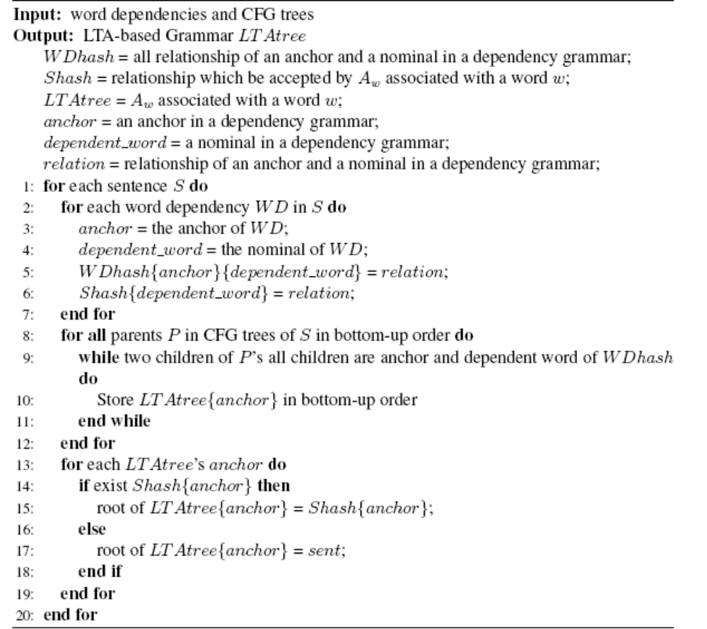
Rule Transformation

Slide 24
Rule Transformation

Slide 25
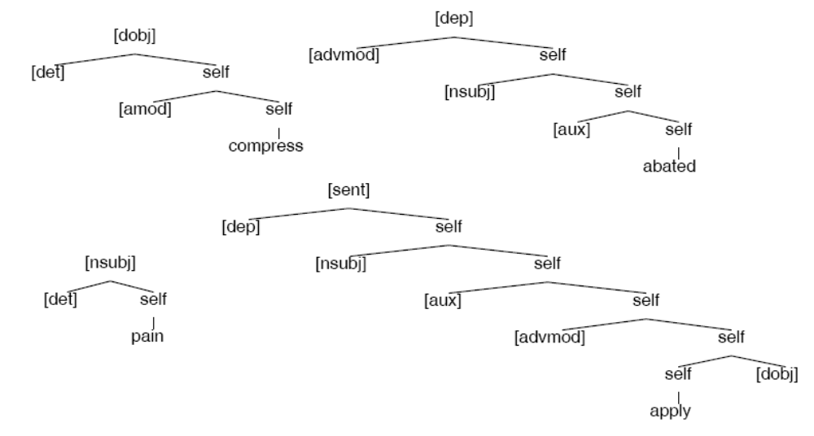
LTA Grammar

Slide 26
Tree-to-Tree Alignment
Parse-parse-match
LTA sub-tree
  sub-trees whose root is not self
Source sentence:
  T(S)
    s_{i}: subtree of T(S)
      The root of s_{i} is non-terminal and not self
      s₁~s_{m}
      the number of s_{i}’s leave is p
      s_{i1}~s_{ip}
Target sentence:
  T(T)
    t_{j}: subtree of T(T)
      The root of t_{j} is non-terminal and not self
      t₁~t_{n}
      the number of t_{j}’s leave is q
      t_{j1}~t_{jq}

Slide 27
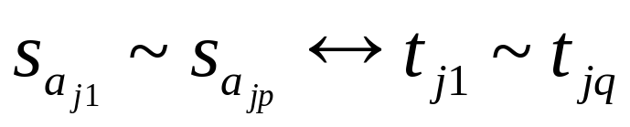
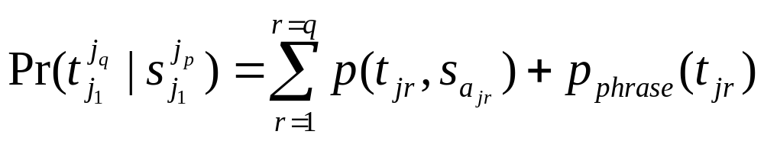
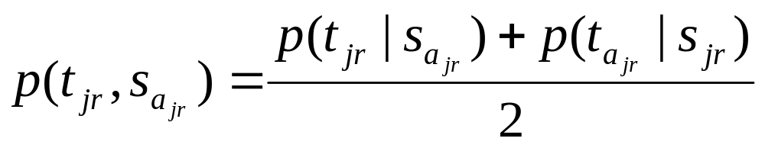
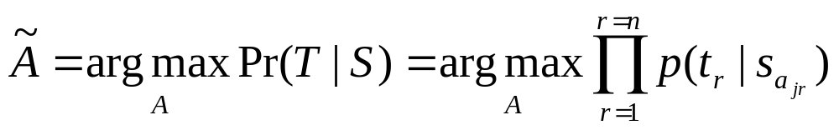
Tree-to-Tree Alignment
Translation probability of each LTA sub-tree
Alignment result

Slide 28
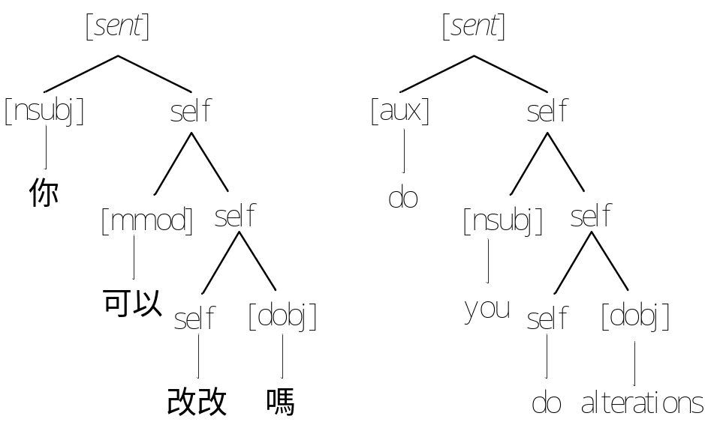
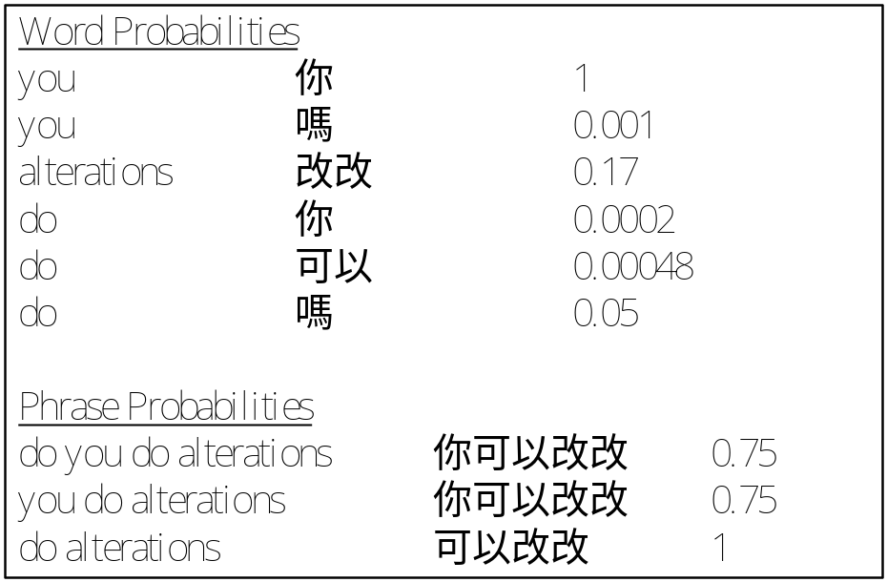
An Example of Tree-to-Tree Alignment

Slide 29
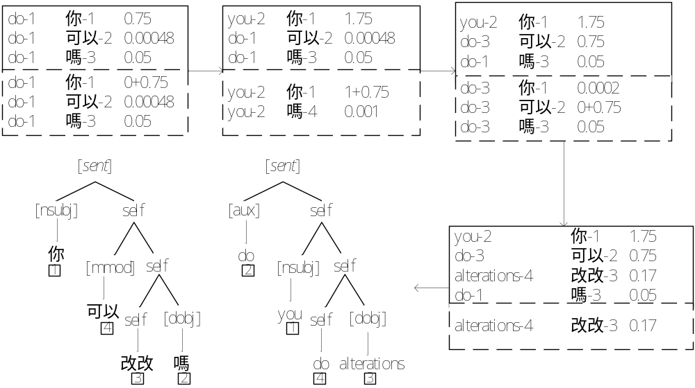
An Example of Tree-to-Tree Alignment

Slide 30
SLTAG Rule Extraction
Operations
  Combine
    Combine two different LTA sub-trees into one
  Separate
    Separate a LTA sub-trees into two parts
    The part that does not include anchor records the location of anchor by A

Slide 31
SLTAG Rule Extraction
Three cases
  1-1 case: all aligned words of English LTA sub-tree can correspond to single Chinese sub-tree
  1-m case: all aligned words of English LTA sub-tree correspond to m Chinese sub-trees
  m-m case: all aligned words of m English sub-trees can correspond to m Chinese sub-trees

Slide 32
Outline
Introduction
Related Works
Fundamental Theory
  grammars for parsing
  grammars for transfer and generation
System Architecture
  Rule Building
  Translation Engine
Experiments
  Environment
  Preparation

Slide 33
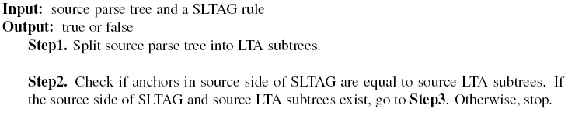
Match Algorithm in SLTAG Parser

Slide 34
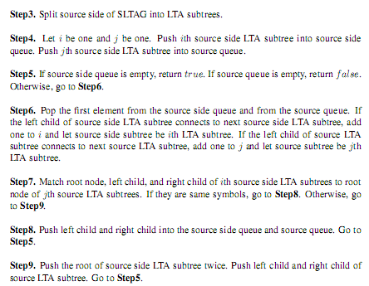
Match Algorithm in SLTAG Parser

Slide 35
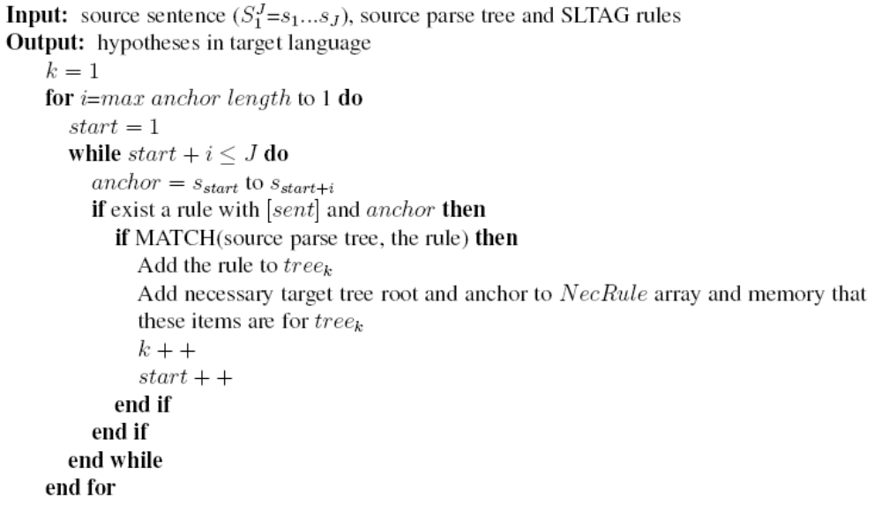
Parse Algorithm in SLTAG Parser

Slide 36
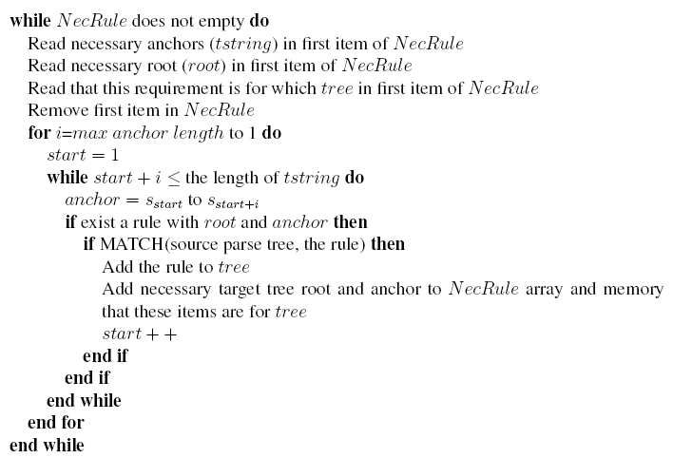
Parse Algorithm in SLTAG Parser

Slide 37
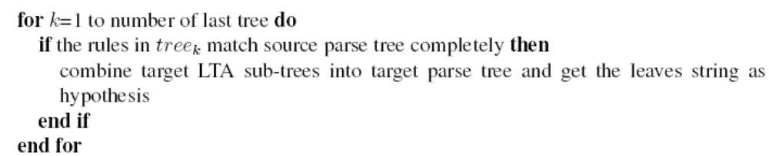
Parse Algorithm in SLTAG Parser

Slide 38
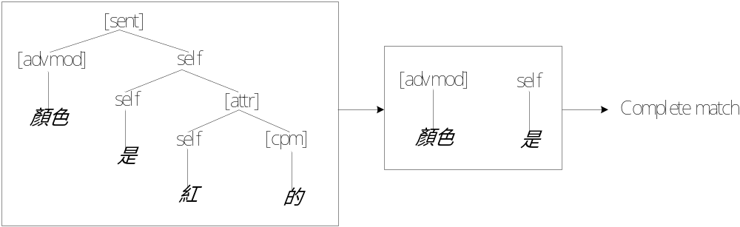
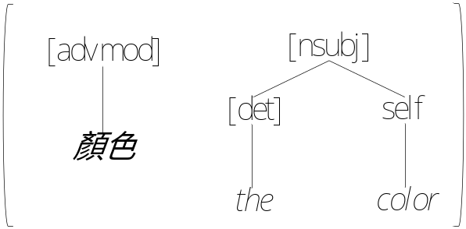
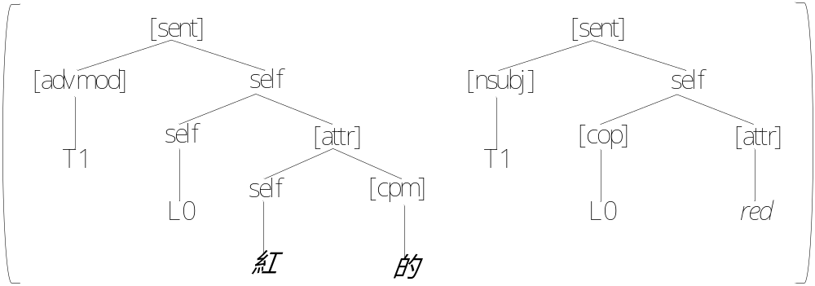
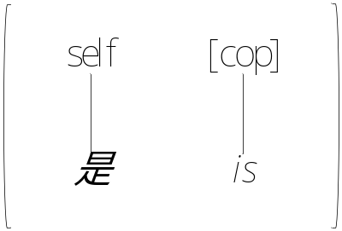
An Example of SLTAG Parser

Slide 39
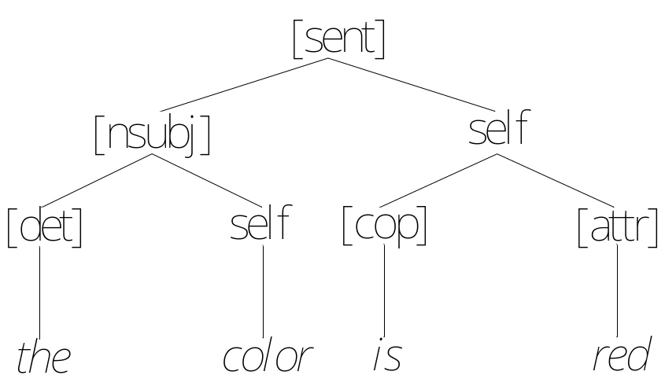
An Example of SLTAG Parser

Slide 40
Outline
Introduction
Related Works
Fundamental Theory
  grammars for parsing
  grammars for transfer and generation
System Architecture
  Rule Building
  Translation Engine
Experiments
  Environment
  Preparation

Slide 41
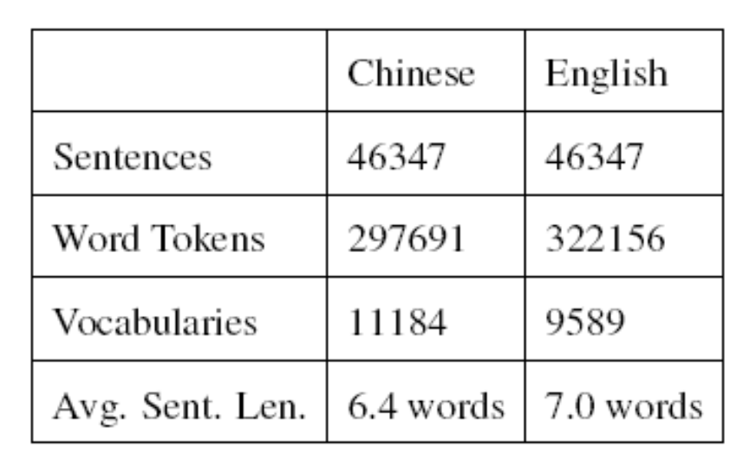
Environment
PDA
  ASUS P565 smart phone
  CPU: Marvel TavorP 800MHz
  User available persistent storage memory:104 MB
Basic Traveling Expression Corpus(BTEC 2007)

Slide 42
Outline
Introduction
Related Works
Fundamental Theory
  grammars for parsing
  grammars for transfer and generation
System Architecture
  Rule Building
  Translation Engine
Experiments
  Environment
  Preparation

Slide 43
Preparing Work
Bitext: BTEC 2007
LTA Grammar
  Chinese:48339
  English: 45407
Dictionary
  LangDao English-Chinese dictionary
  Statistical bi-directional dictionary trained by Giza++
  Phrase translation probabilities trained by Moses

