Slide 1
A Tree-to-Tree Alignment-based Model for Statistical Machine Translation
Authors: Min ZHANG, Hongfei JIANG, Ai Ti AW, Jun SUN, Sheng LI, Chew Lim TAN
Reporter: 江欣倩
Professor: 陳嘉平

Slide 2
Introduction
The motivation
  exploit syntactic structure features to model translation process
two major benefits of our STSG-based tree-to-tree alignment model
  It is possible to explicitly model the syntax of the target language, thereby improve the grammaticality of target sentence.
  this model has more expressive power and flexibility since it allows multi-level global structure distortion of the tree typology and fully utilizes source and target parse tree structure features.

Slide 3

Synchronous TSG
Synchronous TSG (STSG)
    Σ_{s} and Σ_{t}: source and target terminal alphabets (POSs or lexical words)
    N_{s} and N_{t}: source and target non-terminal alphabets
    S_{s}∈N_{s} and S_{t}∈N_{t}: the source and target start symbols
    P: a production rule set
      a pair of elementary tree (ξ_{s} ↔ξ_{t} ) with linking relation between leaf nodes in source elementary tree (ξ_{s} ) and leaf nodes in target elementary tree (ξ_{t} )

Slide 4
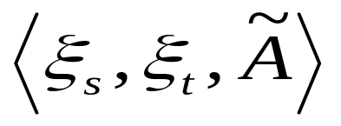
PET
PET: a production or a rule is a pair of elementary tree with alignment information
    ξ_{s}: a source elementary tree
    ξt: a target elementary tree
    A: the alignments between leaf nodes of two elementary trees
      A ⊆ {(i, j) :i is the position of i_{th} leaf node of ξ_{s} ; j is the position of j_{th} leaf node of ξ_{t} }

Slide 5




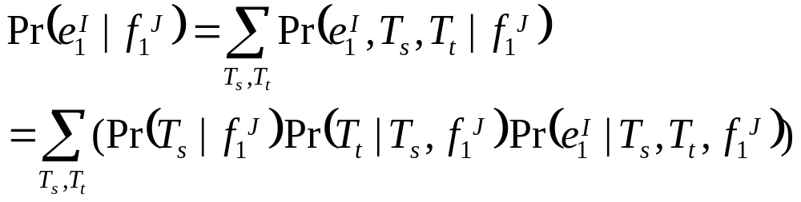
STSG-based Tree-to-Tree Alignment
source sentences
target sentences
source and target parse trees

Slide 6
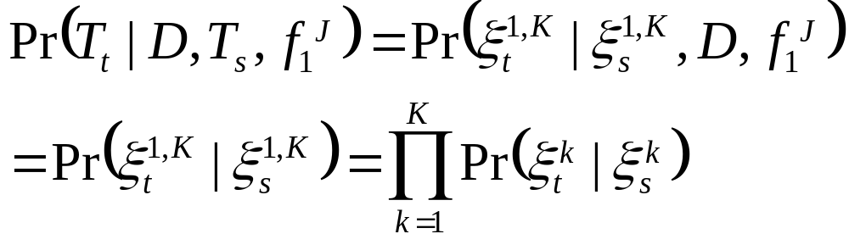
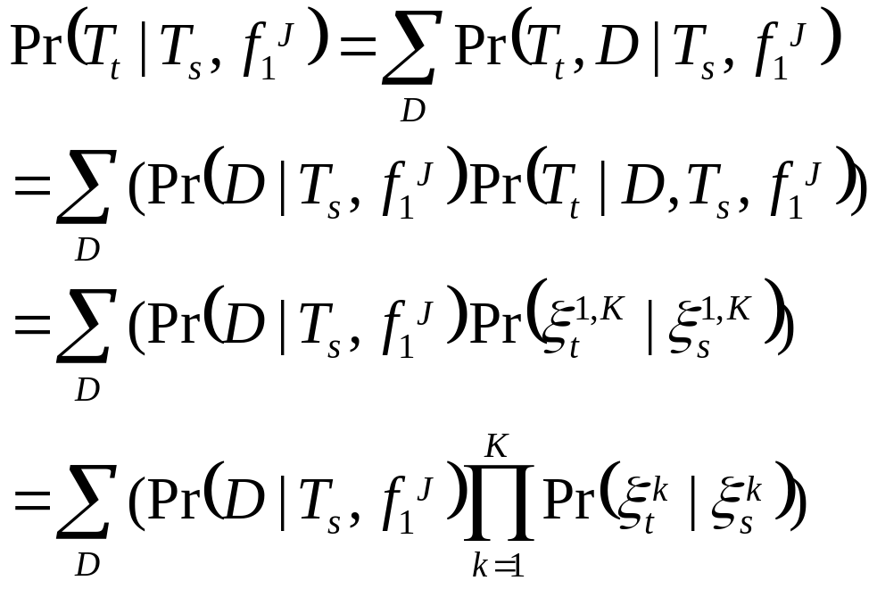
STSG-based Tree-to-Tree Alignment
hidden variable D

Slide 7
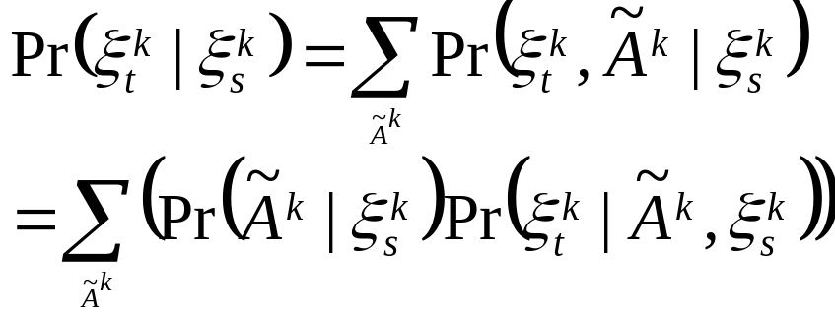
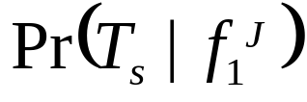

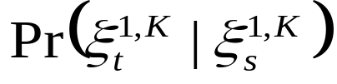

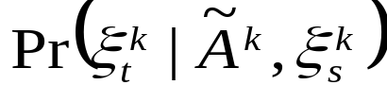
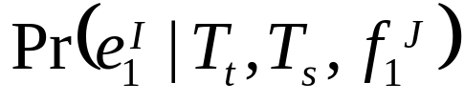
STSG-based Tree-to-Tree Alignment
Four sub-models
  Parse model
  Detachment model
  Translation model
    Tree alignment selection model
    Structure transfer model
  Generation model

Slide 8
Tree-to-tree translation model works
The source sentence is parsed in a source parse tree T_{s}
The parse tree T_{s} is detached into three elementary trees
The three PETs are selected to map the three source elementary trees to three target elementary threes, which are combined to T_{t}
A target translation is generated from the target parse tree

Slide 9
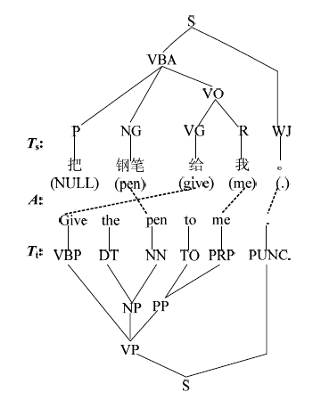
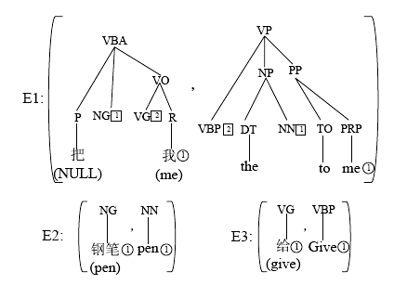
Tree-to-tree translation model works

Slide 10
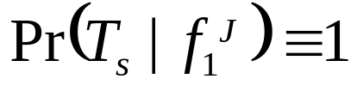

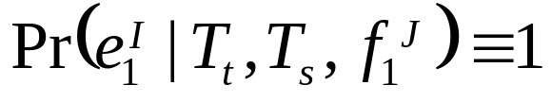
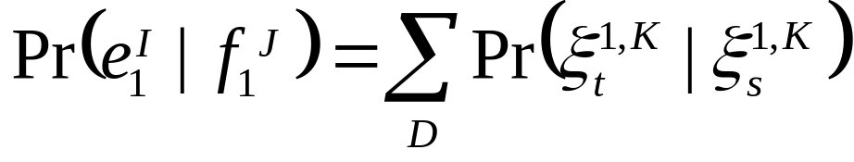
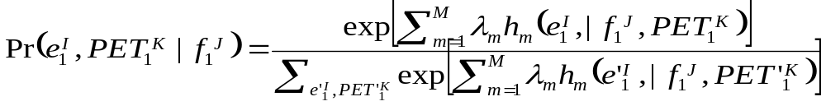
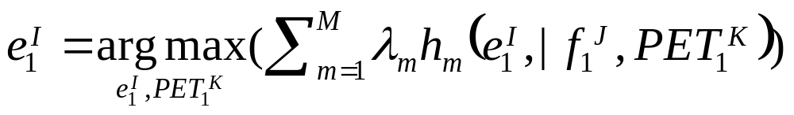
Features
Simplify the model
  Parse model
  Detachment model
  Generation model
After model simplification

Slide 11
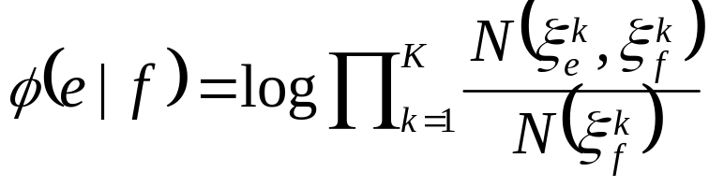
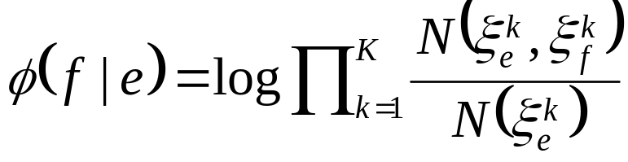
Features
Bidirectional elementary tree mapping probability
Bidirectional elementary tree lexical translation probability
Language model
Number of elementary tree pairs used: K
Number of target words: I

Slide 12

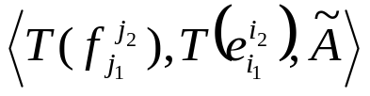
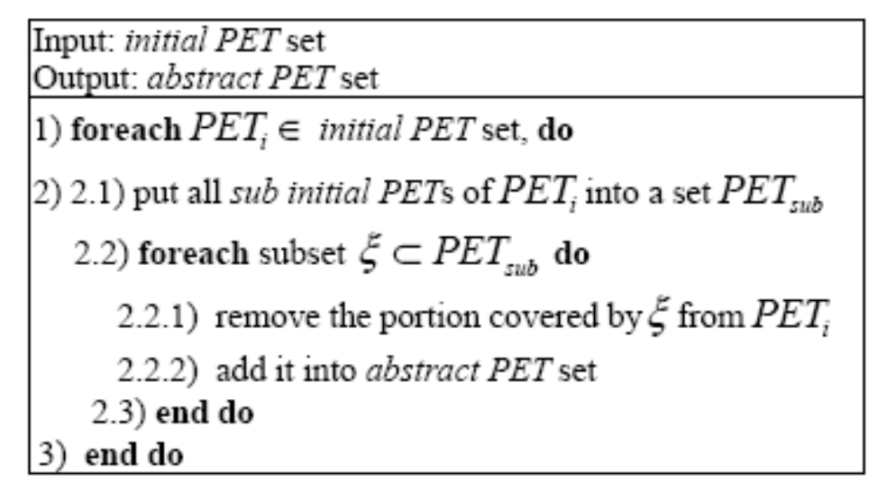
Rule Extraction
  T(z): a parse tree covering string z
  Two categories
    initial PET ( ): all leaf nodes in both source and target elementary trees of a PET are terminals
      ∀(i, j)∈A: i₁≤i≤i₂↔j₁≤j≤j₂
    abstract PET

Slide 13
Decoding
Two main steps
  Use a CFG-based chart parser to parse input sentence
  A STSG-based bottom-up beam search algorithm

Slide 14
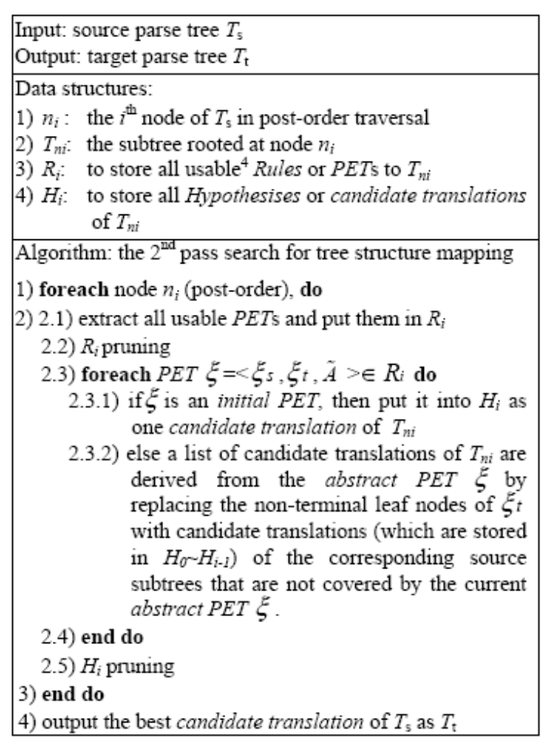
A STSG-based bottom-up beam search algorithm

Slide 15
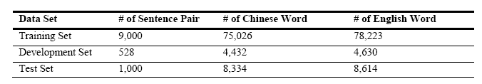
Experiment
Dataset
  Chinese-to-English translation
  HIT Chinese-English corpus
    Only one reference
  LM: 9k English sentences
Threshold
  c=5
  pTableLen=30
  pTablePro=-100 (log probability)
  hTableLen=100
  hTablePro=-100

Slide 16
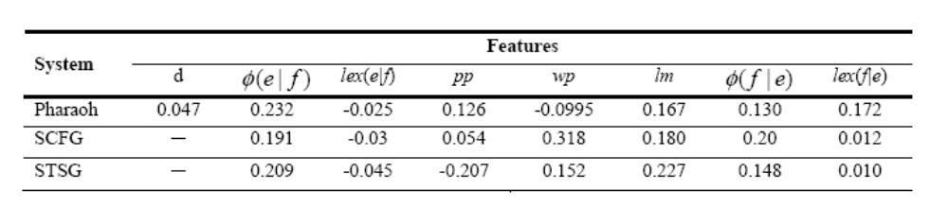
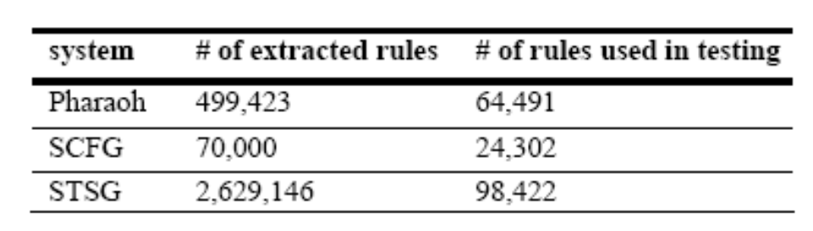
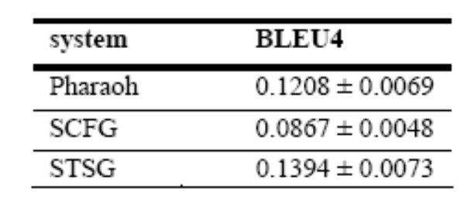
Results

Slide 17
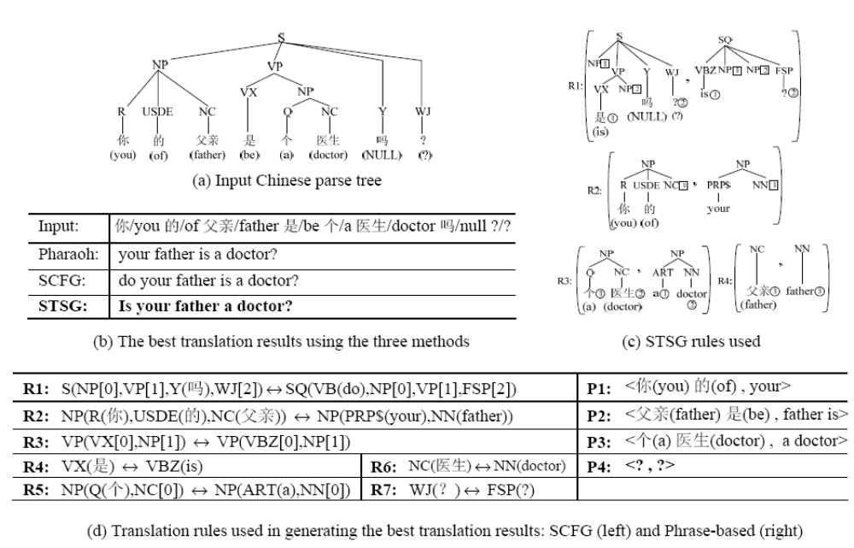
Results

Slide 18
Conclusion
Show how to utilize linguistic syntax structure features for SMT.
STSG-based tree-to-tree alignment method is much more effective in modeling global reordering and structure transfer than phrase-based and SCFG-based methods.

