Slide 1
Progress Report

Slide 2
Machine Translation on PDAs
Lexicalized Tree Automata-based Grammars
  Tree Adjoining Grammar
  Stanford parser
  Data from Stanford parser into XTAG
Synchronous Tree-Adjoining Grammars
  Rule Extraction

Slide 3
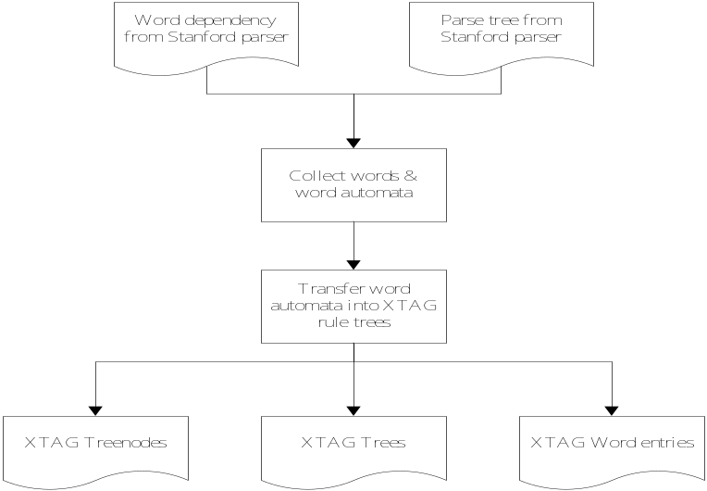
Flow Chart

Slide 4
Rule Pre-process
Punctuation marks
Check if conjunction rules are right.

Slide 5
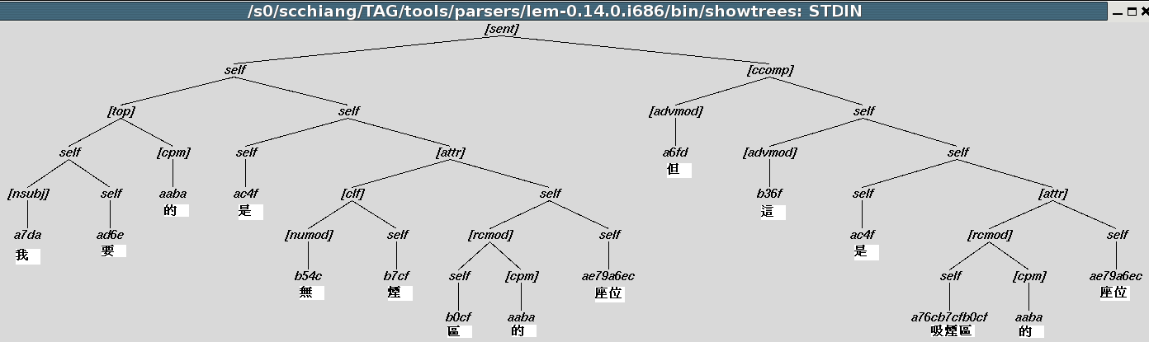
Chinese Parse Tree

Slide 6
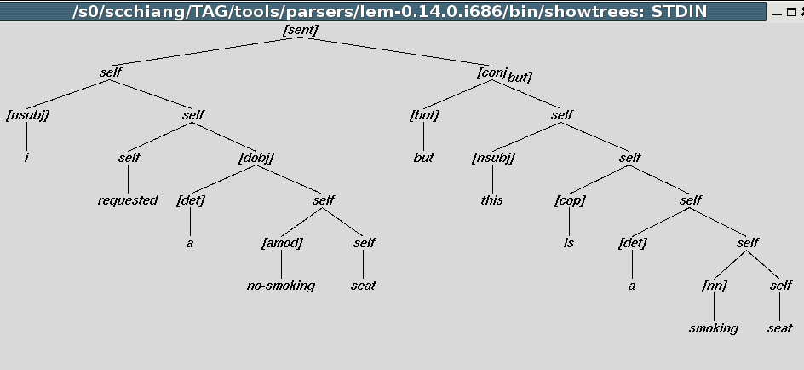
English Parse Tree

