Slide 1
Example

Slide 2
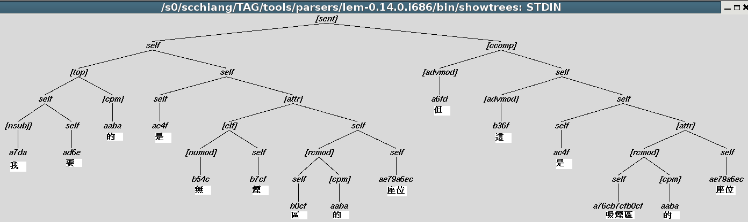
Chinese Parse Tree

Slide 3
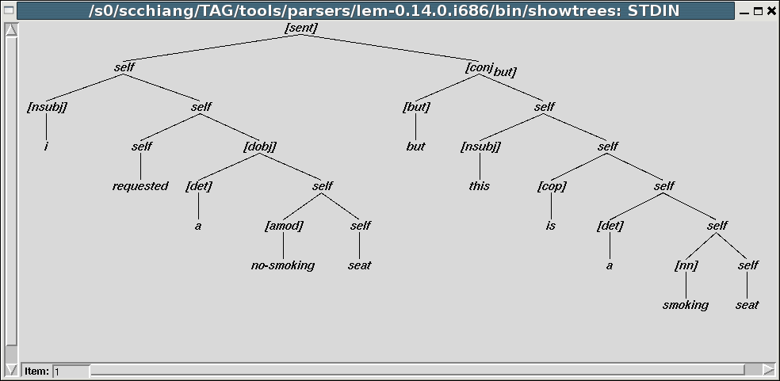
English Parse Tree

Slide 4
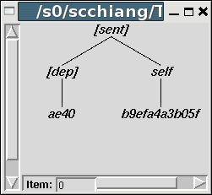
Chinese Parse Tree
sentence: 哦 ， 對不起 。
  Delete the period and generate rules again
  Delete the comma during parsing

