Slide 1
LTAG
Reporter: 江欣倩
Professor: 陳嘉平

Slide 2
Lexicalized grammar
Definition
  a finite set of structures to be associated with lexical items
    Each lexical item will be called the head (anchor) of the corresponding structure
  an operation or operations for composing the structures.
Property
  Lexicalized grammars are finitely ambiguous.

Slide 3





Tree-adjoining Grammar
Definition
  : a finite set of terminal symbols
  : a finite set of non-terminal symbols
  : a distinguished non-terminal symbol
  : a finite set of finite trees, called initial trees
  : a finite set of finite trees, called auxiliary trees
    root node and foot node
  L : a finite set of finite trees, called lexical trees
Operation
  Adjoining
  Substitution
    The trees derived from initial trees
    The tree derived from a lexical tree rooted by the same label
    Notation: ↓
T(G)
  tree set
L(G)
  string language is defined to be the set of all terminal strings of the trees in T(G)

Slide 4
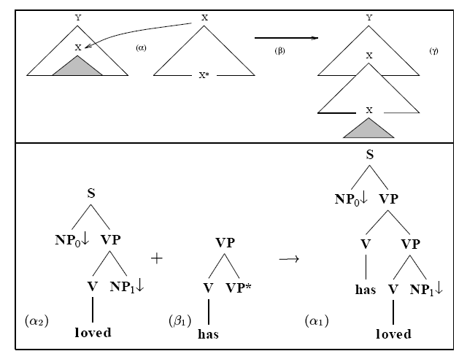
Adjoining (Adjunction)

Slide 5
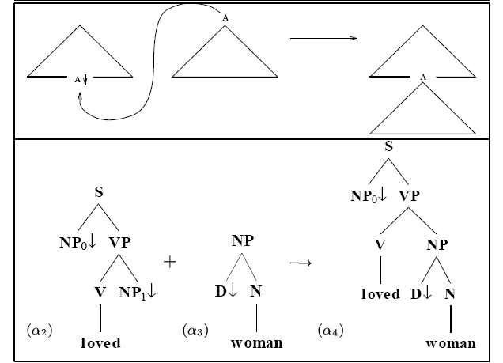
Substitution

Slide 6
Lexicalization of CFGs
Tree-Substitution Grammar
Lexicalization of CFGs with TAGs

Slide 7
Tree-Substitution Grammar
Definition
  : a finite set of terminal symbols
  : a finite set of non-terminal symbols
  : a distinguished non-terminal symbol
  : a finite set of finite trees
Finitely ambiguous context-free grammars cannot be lexicalized with a tree-substitution grammar
  TSGs do not permit the distance between two nodes in the same initial tree to increase
Recursive chain rules are disallowed
No give the freedom to choose the head of each structure

Slide 8
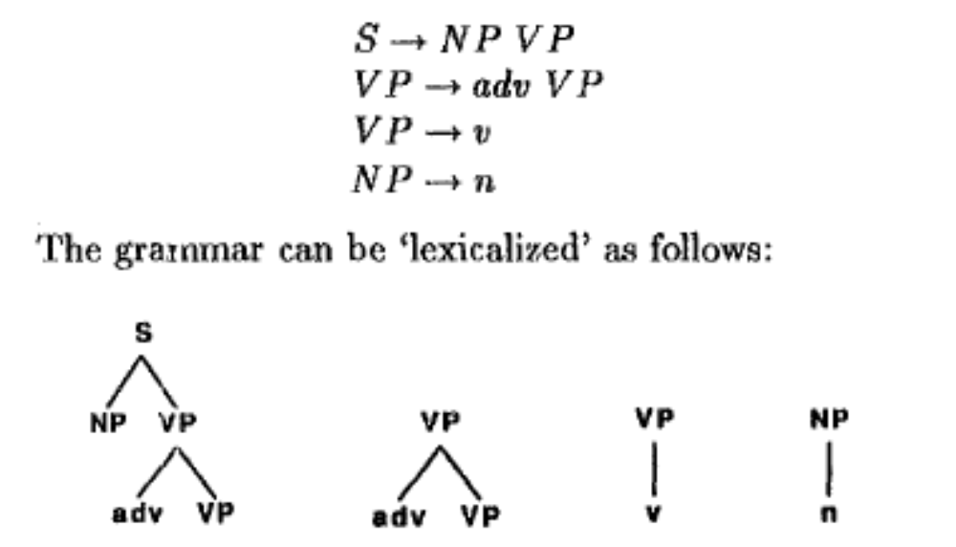
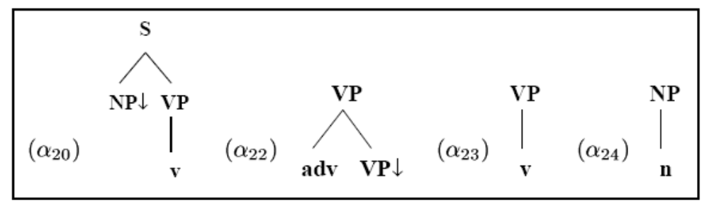
Example
TSG

Slide 9

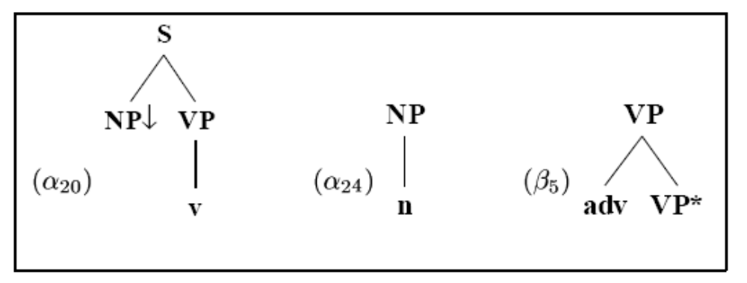
Lexicalization of CFGs with TAGs
Additional operation: adjunction
Definition of Tree-adjoining grammars
CFGs into TAGs
  Non–recursive part in CFGs generates a finite number of initial trees
  Recursion part in CFGs (form ) create an B-type auxiliary tree

Slide 10
TAGs vs. CFGs
TAGs are more powerful than CFGs
  TAGs not only generate more languages (strings) than CFGs but also generate more structural descriptions than CFGs.
  Extended domain of locality (EDL)
  Factoring recursion from the domain of dependencies (FRD)
TAGs carry over all formal properties of CFGs

Slide 11
Parser rule
A set of rules
    a lexical item
      Realization in the input sentence and position in the sentence
      heads
        If a structure has only one terminal, the terminal is the head of the structure
        If there are several terminals, the choice of the head is linguistically motivated
    structures
      category structures
      argument structures

Slide 12
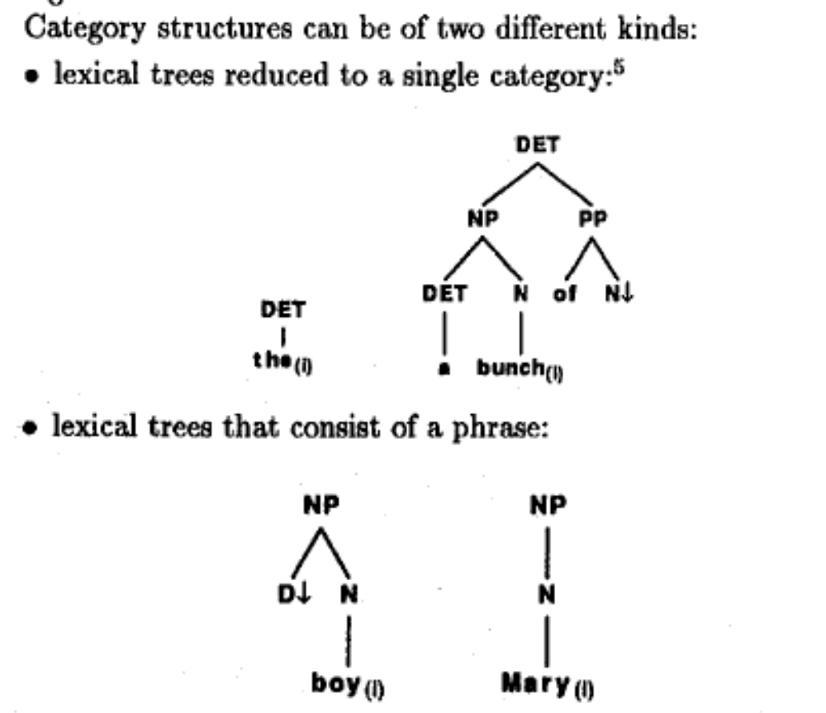
Category structure
A single category
A simple phrase

Slide 13
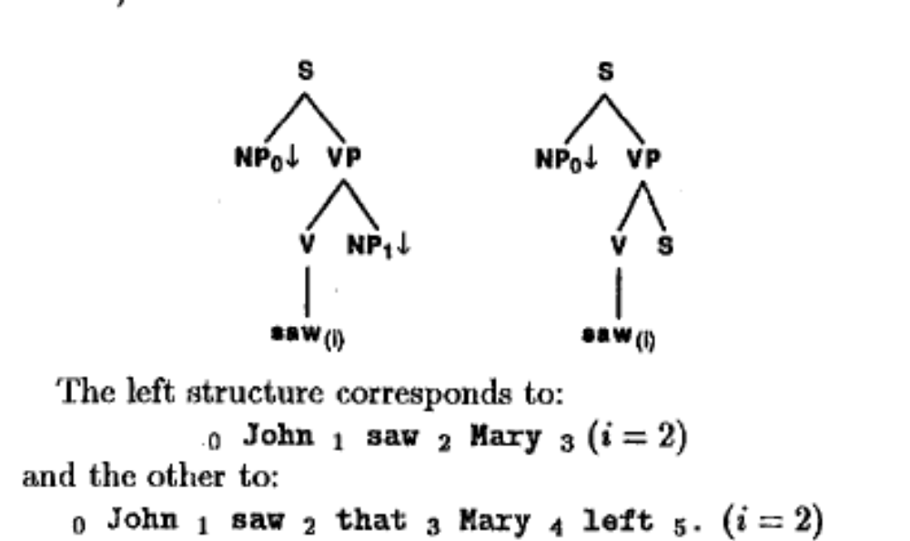
Argument structure
A predicate
₀ John ₁ saw ₂ Mary ₃. (i=2)
₀ John ₁ saw ₂ that ₃ Mary ₄ left ₅. (i=2)

Slide 14
Parsing lexicalized grammars
Two main steps
  morphological analysis
  modified syntactic analysis
an input string of finite length cannot be syntactically infinitely ambiguous

Slide 15
Tree automaton
An automaton accepts trees as input
Example
  Finite automata
    Σ={a,b}
    A word: abb
  Finite tree automata
    The ranked alphabet: F={a(),b(),#}
    A unary term: a(a(b(#)))

Slide 16
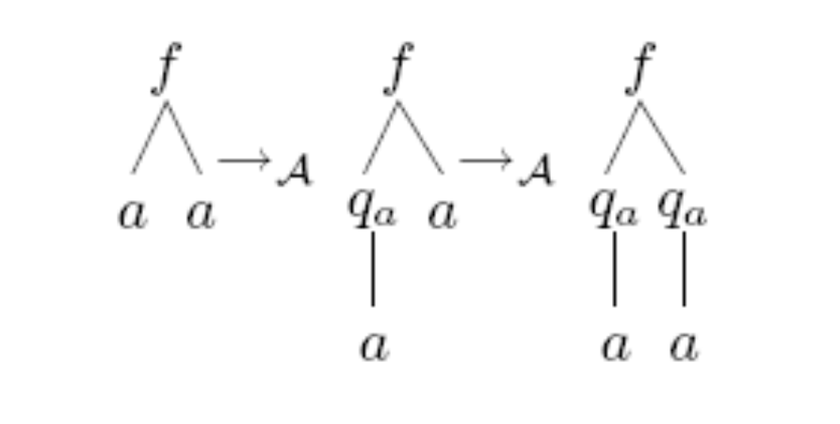
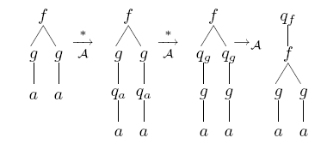
Finite Tree automaton
Definition
  Q: a set of (unary) states
  Q_{f}: a set of final states
  F: the ranked alphabet
  Δ: a set of transition rules
Example
  F = {f(, ), g(), a}
  Q = {q_{a}, q_{g}, q_{f} }
  Q_{f} = {q_{f} }
  Δ
    a → q_{a}(a)
    g(q_{a}(x)) → q_{g}(g(x))
    g(q_{g}(x)) → q_{g}(g(x))
    f(q_{g}(x), q_{g}(y)) → q_{f} (f(x, y))

Slide 17
LTA-based Grammars
Basic idea
  Associate a tree automaton to each word that defines the set of local trees anchored to the word, instead of associating the trees themselves
vs. LTAG
  Non-finiteness of local trees
Definition
  Σ: a set of terminal symbols (words)
  NT: a set of nonterminal symbols disjoint Σ
  T_{w}: a set of trees (elementary trees) associated with a word
    node: terminal or nonterminal symbols
    Root and one of its leaves are marked by self in NT
  A_{w}: the tree automaton lexicalized to the word w
  S_{w}: a set of root nonterminal symbols associated with the word w as the tree accepted

Slide 18
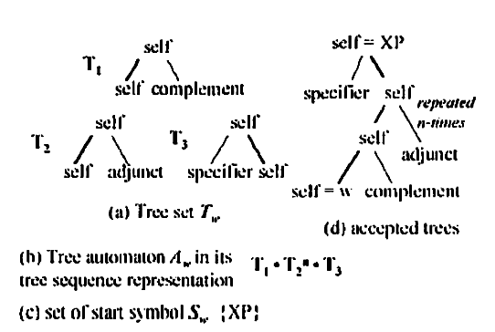
LTA-based Grammars
Λ_{w}={T_{w,} A_{w,} S_{w}}
  The set of local trees associated with w
Example

Slide 19
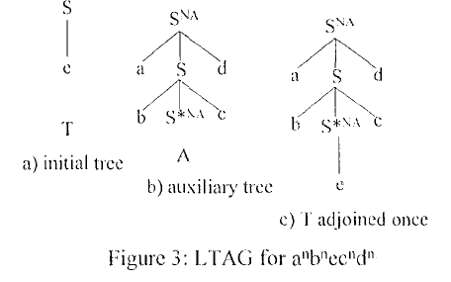
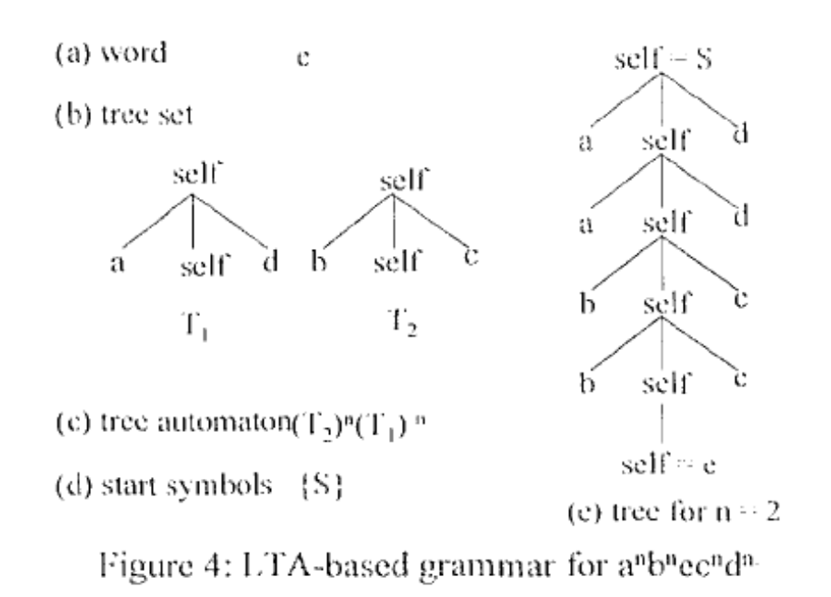
LTAG and LTA-based Grammar
LTAG
LTA-based Grammar

Slide 20
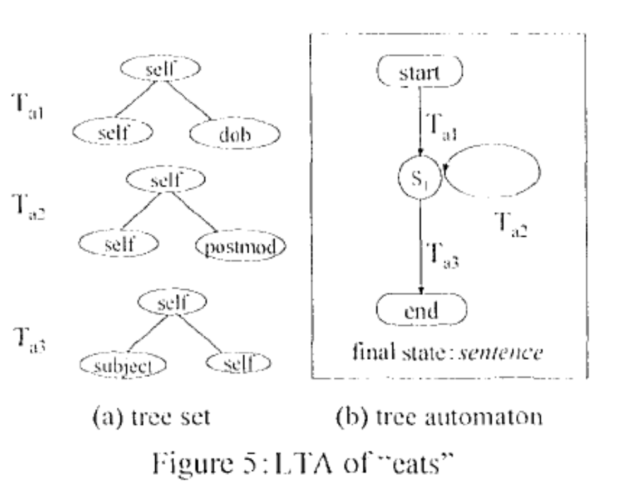
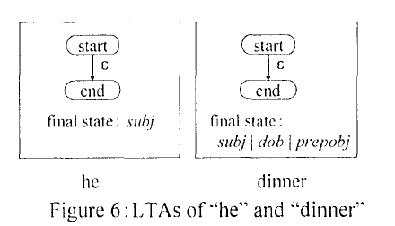
Parsing LTA-based Grammars

Slide 21
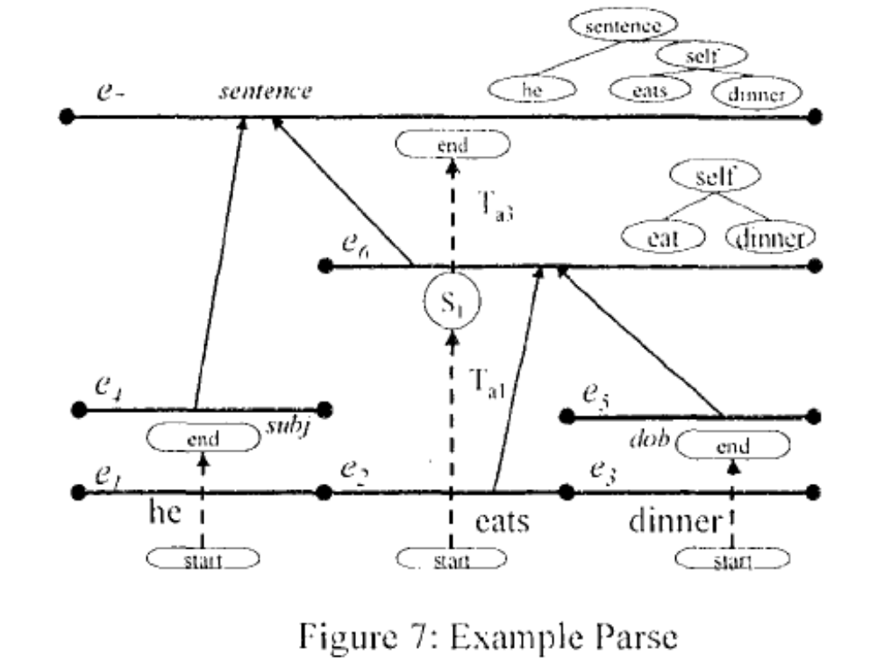
Parsing LTA-based Grammars

