Slide 2
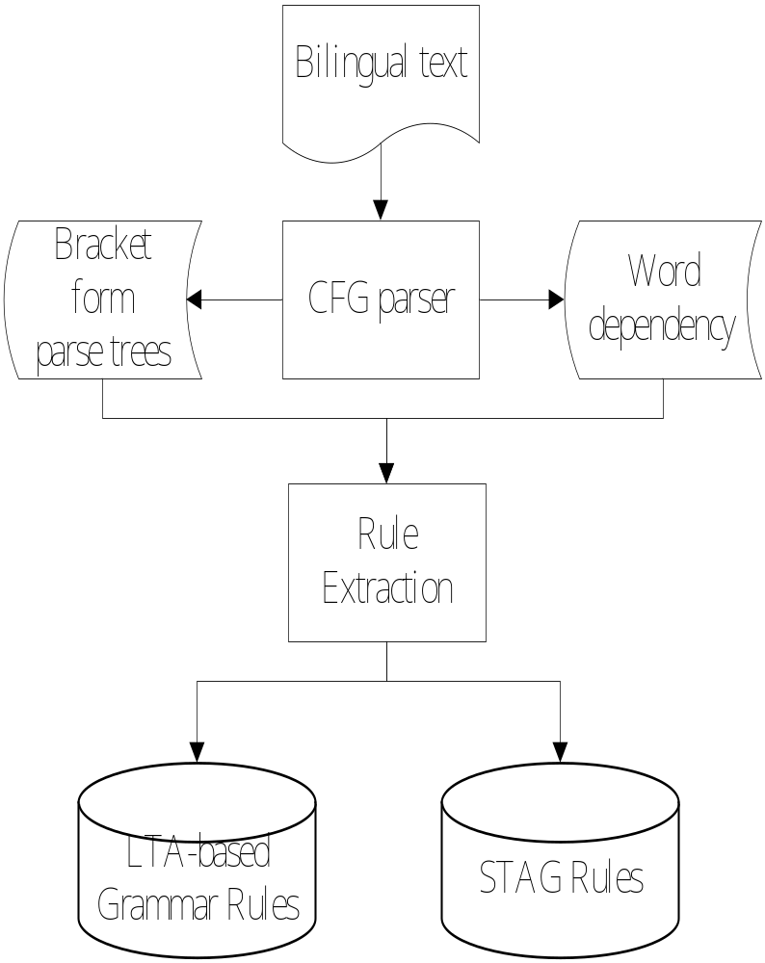
Preparing Rule Database

