Slide 1
Machine Translation Using Probabilistic Synchronous Dependency Insertion Grammars
Authors: Yuan Ding and Martha Palmer
Reporter: 江欣倩
Professor: 陳嘉平

Slide 2
Motivation
The possible difficulties of inducing a synchronous grammar or a set of tree transduction rule
  The abilities of synchronous grammars and tree transducers to handle non-isomorphism are limited.
  The training and/or induction of a synchronous grammar or a set of transduction rules are usually computationally expensive if all the possible operations and elementary structures are allowed.
  The problem is aggravated by the non-perfect training corpora.
chose to build the synchronous grammar on the parallel dependency structures of the sentences.

Slide 3
Synchronous Dependency Insertion Grammars
A Dependency Insertion Grammars (DIG) is a generative grammar formalism that captures word order phenomena within the dependency representation
Synchronous Dependency Insertion Grammars (SDIG)
  Like STAG, STIG
  Basic units are elementary trees (ET)
    sub-sentential dependency structures containing one or more lexical items
  Handles non-isomorphism at sub-tree level

Slide 4
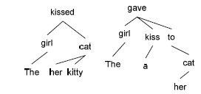
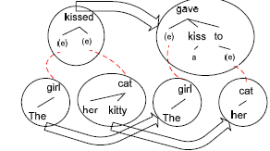
Tree to Tree transduction
Source: The girl kissed her kitty cat.
Target: The girl gave a kiss to her cat.

Slide 5
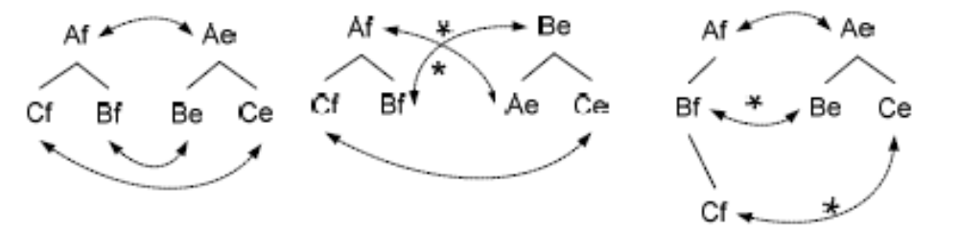
Inducing a SDIG
Cross-lingual inconsistencies are handled if they appear within basic units
  Crossing-dependency
  Broken-dependency

Slide 6
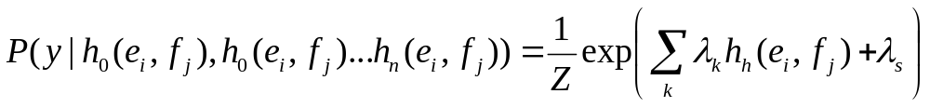
Induction of SDIG for MT as Synchronous hierarchical tree Partitioning
Train IBM Mode 1 scores for bitext
For each category of Node, starting with NP
Perform synchronous tree partitioning operations
  Compute Probability of word pair (e_{i},f_{j}) where operation can be performed
  Heuristic functions (Graphical model) guide the partitioning
    Inside-outside probabilities
    Inside-outside penalties
    Entropy
    Part-of-Speech mapping template:
    Word translation probability
    Rank

Slide 7
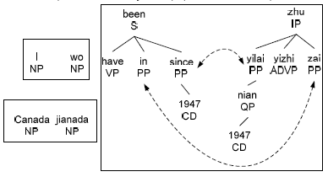
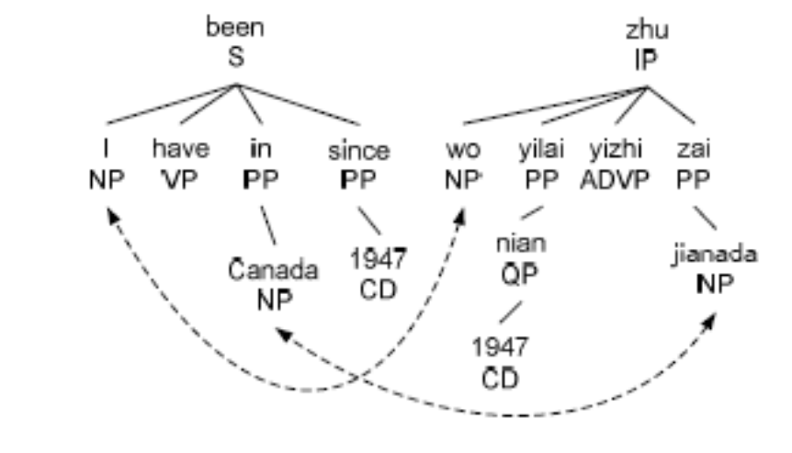
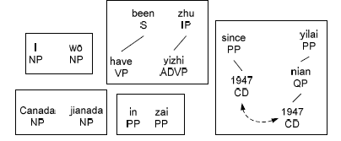
SDIG Example
English: I have been in Canada since 1947.
Chinese: Wo 1947 nian yilai yizhi zhu zai jianada.
Glossary: I 1947 year since always live in Canada

Slide 8
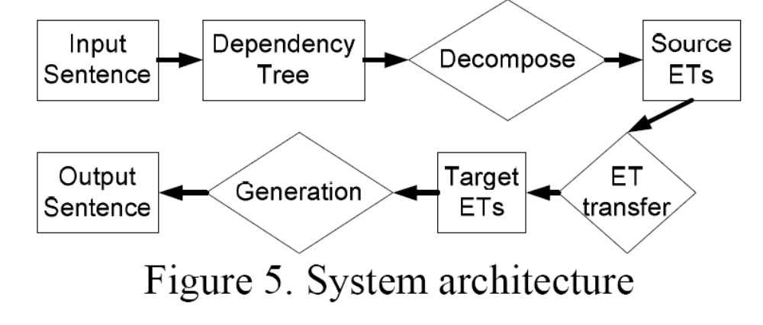
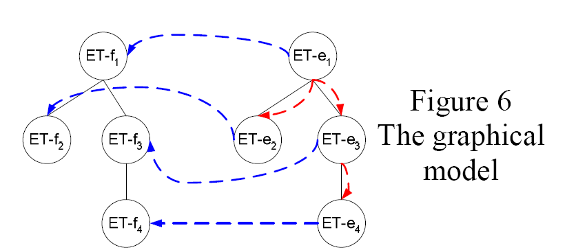
MT System

Slide 9
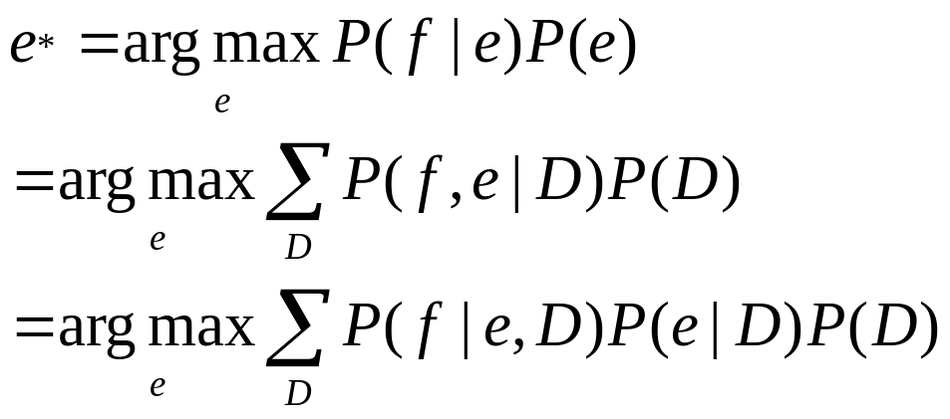
The Graphical Model
T(x): the dependency tree constructed from sentence x
D(t) is defined on a dependency tree t , and outputs a certain ET derivation tree of t , which is generated by decomposing t into ETs

Slide 10
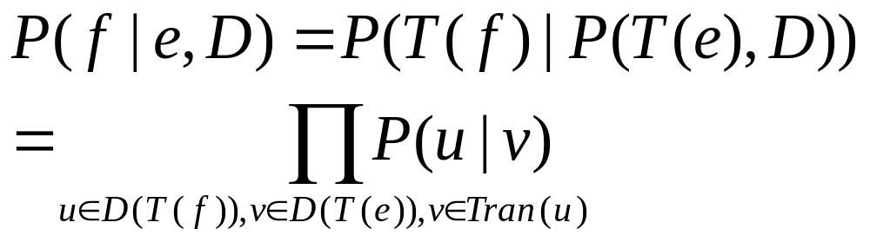
The Graphical Model
By definition, the ET derivation trees of the input and output trees should be isomorphic
  D(T(f)) ≅ D(T(e))
Tran(u): a set of possible translations for the ET u

Slide 11
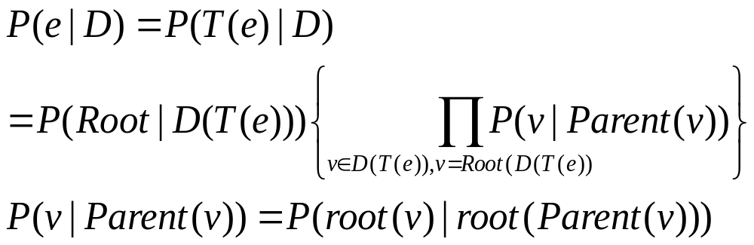
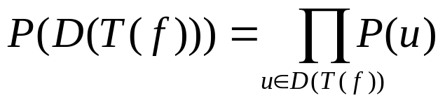
The Graphical Model
For any ET v in a given ET derivation tree d
  Root(d): the root ET of d
  Parent(v): the parent ET of v

Slide 12
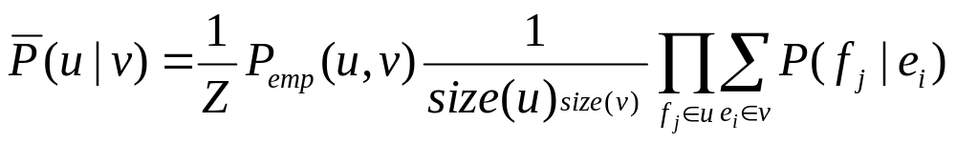
The Graphical Model
Smoothing the ET translation probabilities

Slide 13
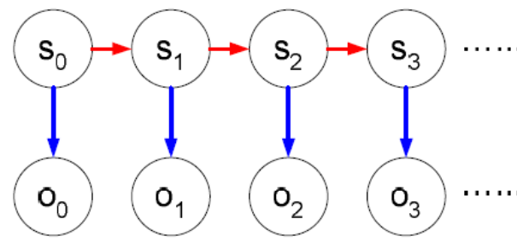
Decoding for MT
Translation is obtained by
  maximizing over all possible derivations of the source tree
  translation of the ‘elementary trees’
Analogous to HMM (Emission and Transition probability with elementary trees)
Decoding is similar to a Viterbi-style algorithm on the tree

Slide 14
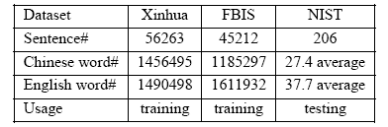
Evaluation
Chinese-English system
Dan Bikels parses for both Chi and En trained from Parallel treebanks
Test with 4 refs
Compared with
  ISI Rewrite Decoder
    GIZA++ MT modeling tool kit

Slide 15
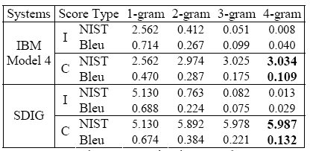
Evaluation
NIST increased 97%
BLUE increased 21.1%

