Slide 1
PanDoRA: A Large-scale Two-way Statistical Machine Translation System for Hand-held Devices
Source: the Proceedings of MT Summit XI
Authors: Zhang, Y. and Vogel, S.
Reporter: 江欣倩
Professor: 陳嘉平

Slide 2
Introduction
Advantages of statistical machine translation (SMT)
  translation quality
  new language pairs
Difficulties
  SMT needs large amount of data to train the statistical models
  hand-held devices have very limited dynamic memory
  the CPUs on most hand-held devices are weak

Slide 3
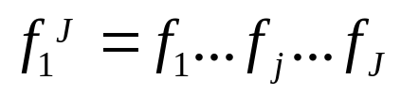
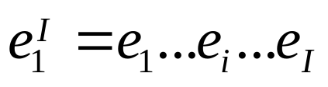
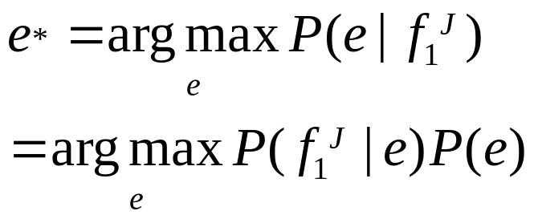
Phrase-based Statistical Machine Translation
a source language sentence
a target language sentence
the decoder

Slide 4
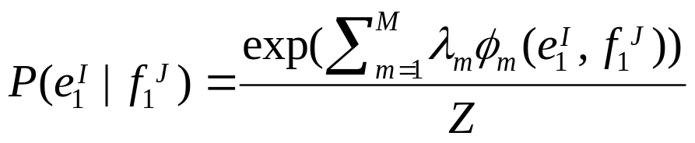
phrase pairs probability
log-linear model
the weights for each feature function are trained using the Minimum Error (MER) optimization on development set

Slide 5
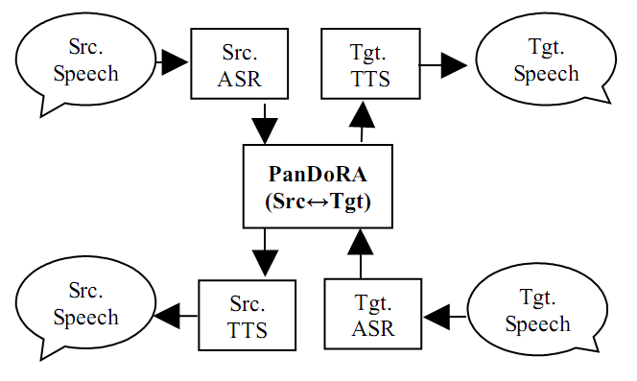
PanDoRA
Compact Data Structure
Integerized Computation

Slide 6
Compact Data Structure
The phrase translation model and language model are too large to be fit into the dynamic memory of a PDA
A compacted data structure
  the resulting models are small in size
  decoder can directly access the information without loading the model into the dynamic memory
Techniques
  converting words into integer symbol IDs (vocId)
  cross-indexing the phrase translation models to reduce the redundancy in model representation
  serializing the model structure to make it directly accessible from disk

Slide 7
Usage of Techniques
converting words into integer symbol IDs (vocId)
  The transcription output from the ASR is first mapped from text to a sequence of vocIds
  vocId of the translation result are mapped into words of the target language for Text-To-Speech module
cross-indexing the phrase translation models
  phrases are converted into integer Ids and phrase tables only need to store probability of translating from one phrase ID to another phrase ID
serializing the model structure to make it directly accessible from disk
  the fixed object size makes it possible to directly access an object through its index by visiting start address + index * sizeof(object)

Slide 8
Result of Compact Data Structure
Thai-English system
  corpus
    200k sentence pairs
 | Thai → English phrase translation table | English → Thai phrase translation table
Entry | 2.6 million | 3 million
Size | 585 MB | 585 MB
Compact binary format | 65.27 MB | 65.27 MB

Slide 9
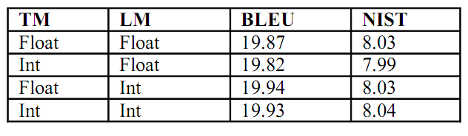
Integerized Computation
The translation quality does not degrade on PCs when all the probabilities are cast from float/double to integers.

Slide 10
Simple quantization method
convert all the probabilities into minus log probabilities and map the costs into integers ranging from 0 to 4095.
  4096 bins
  the decoder only needs to use the integer addition and multiplication operations

Slide 11
Language Model
Language model plays an important role in deciding the correct reordering pattern during decoding.
negative examples
  prevent ungrammatical n-gram from being generated
    “the” at the end of English sentences
  discriminative language model

Slide 12
Discriminative Language Model
SMT translates f into e’
  f: source sentences in training data
  e’: translation output
The n-grams is from the union of e and e’
  the n-gram weight increase if freq(e’) < freq(e)
  the n-gram weight decrease if freq(e’) > freq(e)

Slide 13
Decoding
Given a testing sentence, PanDoRA applies the translation model on the sentence and builds a translation lattice.
two types of search method in the decoder
  a left-to-right monotone decoding
  a bottom-up CKY-parsing using the Inverted Transduction Grammar

Slide 14
Monotone Decoding
a standard beam search
  a best hypothesis is stored based on the features used for hypothesis recombination
  all hypotheses which are worse by some margin are deleted
The translation lattice has translation costs and language model costs
decoding time in this mode: less than 10ms

Slide 15
ITG Reordering Decoding
Stochastic Inversion Transduction Grammar (ITG)
  a transduction grammar which assumes that a pair of source/target sentences are simultaneously generated in a context-free manner
  a non-terminal X
    X → <f₁f₂,e₁e₂>
    X → <f₁f₂,e₂e₁>

Slide 16
ITG Reordering Decoding
ITG is a CFG
  G=(N,W₁,W₂,R,S)
    N: a finite set of non-terminal
    W₁: alphabet of language 1
    W₂: alphabet of language 2
    R: a finite set of productions
    S belong to N: start symbols
  terminal in R is X=(W₁∪{e})x(W₂∪{e})
    e: empty
    x/y, x/e or e/y (x belong to W₁,and y belong to W₂)
    A → x/y
  R is straight or inversion
    A → BC or A → CB

Slide 17
ITG Reordering Decoding
The parser works bottom-up
  While moving up the parsing chart, the decoder adds new partial hypotheses to cell [j₁,j₂] in the chart table if:
    an entry in the translation table and add the corresponding translation as a partial hypothesis
    a partial hypothesis
      h₁: a translation of (j₁,k)
      h₂: a translation of (k+1,j₂)
      h₁h₂ and h₂h₁ are added into the parsing chart

Slide 18
Environment
IWSLT 2005
  Arabic → English
  Japanese-English
BLEU and NIST
HP iPAQ HX2700 series Pocket PC
  Intel PXA270 processor with a frequency at 624 MHz
  256 MB total memory that includes up to 144 MB user available persistent storage memory
  1GB SD card store the translation model and language model

Slide 19
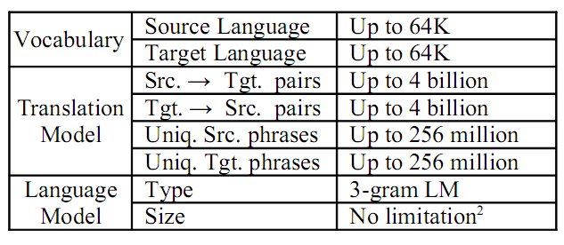
PanDoRA

Slide 20
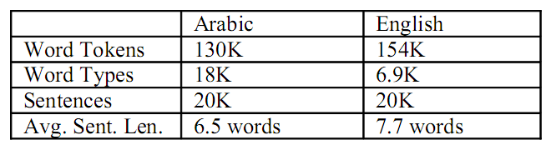
Arabic-English Experiments
Training data
Development data: 500 Arabic sentences
Test data: 506 sentences (16 reference translation)

Slide 21
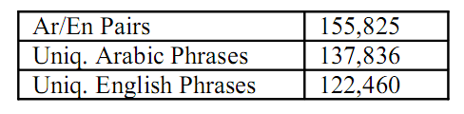
Arabic-English Experiments
The complete model is 6.2 MB
  phrase translation model
  LM: 3-gram

Slide 22
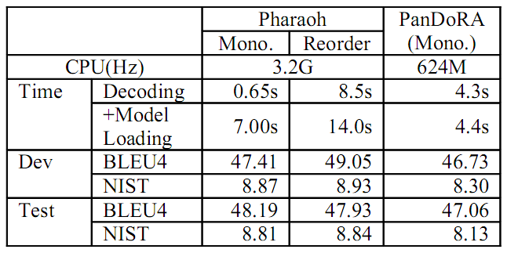
Arabic-English Results
monotone decoding
  less than 10ms per sentence

Slide 23
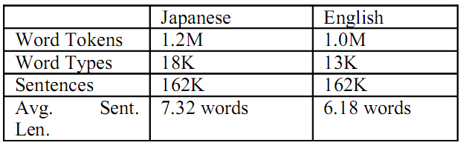
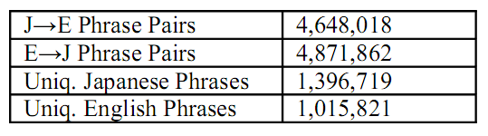
Japanese-English Experiments
Training data
The compact format of translation model is about 76.11 MB

Slide 24
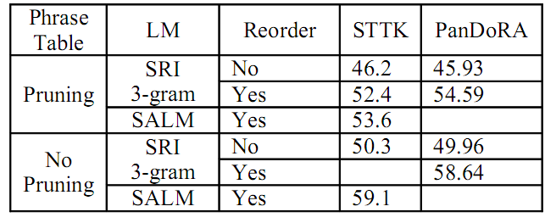
Japanese-English Results
0.5s for translating a sentence with reordoring
monotone translation needs only 10ms
STTK: statistical translation tool kit
SALM: suffix-array language model

Slide 25
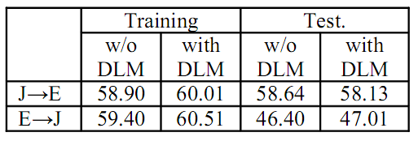
Japanese-English Results
DLM: discriminative language models
Human vs. BLEU

Slide 26
Conclusion
PanDoRA has been successfully applied in a PDA-based two-way speech-to-speech translation system for several language pairs.

