Slide 1
Status Report
Professor:陳嘉平
Reporter:陳柏含
<number>/3

Slide 2
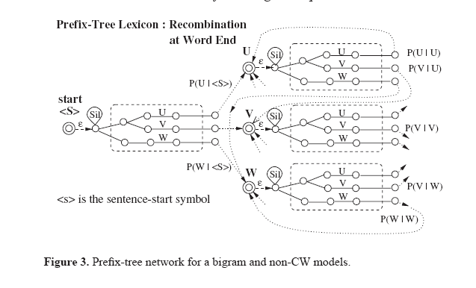
Implement
Incorporate with Silence model
Recombination at word End
ㄊㄞ
sp
ai
t_a
Per-state stack
ㄊㄞ ㄓㄨㄥ
ㄊㄞ ㄨㄢ
………
…
sil
ㄇㄜ
m_e
e
sp
<number>/3

Slide 3

Implement
Incorporate with Silence model
ㄊㄞ
sp
ai
<Sent_End>
t_a
………
<Sent_Start>
ㄇㄜ
m_e
e
sp
<Sent_End>
<number>/3

