Slide 1
Status Report
Professor:陳嘉平
Reporter:陳柏含
<number>/6

Slide 2
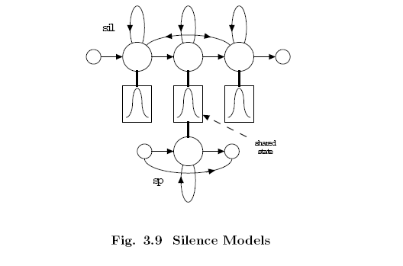
t=0
i=1
i=2
i=3
i=4
i=5
Q(t,S_{i};”sil”)=
(log)
0.0
-67.473
-∞
-∞
-∞
P(x_{t}|S_{i};”sil”)=
(log)
-67.473
Entry state
Exit state
-2.999
-3.51
-0.050
-0.089
Transition prob (log)
-2.999
-3.932
-0.051
-3.153
0.0
Q(t-1,S_{i};”sil”)=
(log)
0.0
-∞
-∞
-∞
-∞
<number>/6

Slide 3
t=1
i=1
i=2
i=3
i=4
i=5
Q(t,S_{i};”sil”)=
(log)
-∞
-139.417
-142.415
-146.157
-∞
P(x_{t}|S_{i};”sil”)=
(log)
-71.893
-71.008
-75.171
Entry state
Exit state
-3.147
-3.512
-0.050
-0.089
Transition prob (log)
-2.999
-3.932
-0.051
-3.153
0.0
Q(t-1,S_{i};”sil”)=
(log)
-∞
-67.473
-∞
-∞
-∞
<number>/3
<number>/6

Slide 4
t=2
i=1
i=2
i=3
i=4
i=5
Q(t,S_{i};”sil”)=
(log)
-∞
-232.305
-223.375
-224.354
-∞
p(x_{t}|S_{i};”sil”)=
(log)
-92.837
-80.909
-81.424
Entry state
Exit state
-3.147
-3.512
-0.050
-0.089
Transition prob (log)
-2.999
-3.932
-0.051
-3.153
0.0
Q(t-1,S_{i};”sil”)=
(log)
-∞
-∞
-139.417
-142.415
-146.157
<number>/3
<number>/3
<number>/6

Slide 5
Token propagation: word end
ㄊㄞ
sp
ai
t_a
………
sil
ㄇㄜ
m_e
e
sp
score
Path
time
word
s
t
ㄇㄜ
s
t-2
ㄊㄞ
s
t-5
ㄖㄜ
…..
Word link record
<number>/6

Slide 6
Current Progress
Not support N-best case
Not support state/model pruning
<number>/6

