Slide 1
Exploring Universal Attribute Characterization of Spoken Languages for Spoken Language Recognition

Slide 2
Outline
Introduction
UAR-FrondEnd
VSM-BackEnd
Experiment

Slide 3
Introduction
Here we focus on the token-based.
Propse an alternative universal acoustic characterization of spoken languages based on acoustic phonetic feature.
The advantage of using attribute-based unit is they can be define universally across all language.

Slide 4
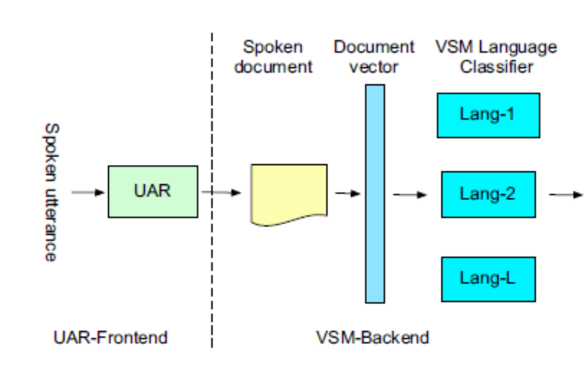
System Overview

Slide 5
UAR-FrondEnd
The frond-end processing module tokenize all spoken utterances into sequences of speech unit using a universal attribute recognizer.
Two phoneme-to-attribute table are created that are phoneme-to-manner and phoneme-to-place.

Slide 6
VSM-BackEnd
Each transcription is converted into a vector-based representation by applying LSA.

Slide 7
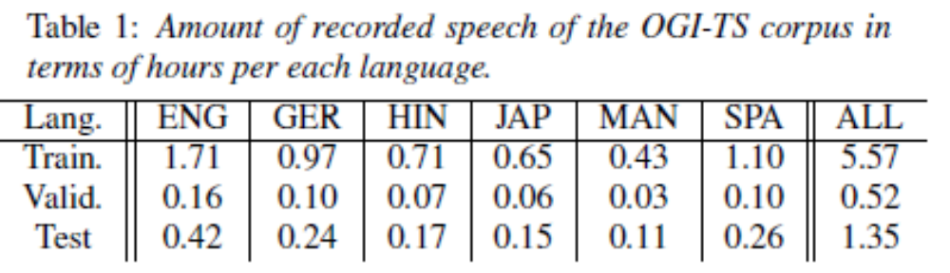
Experiment
The OGI-TS corpus is used to train the articulatory recognizer. This corpus has phonetic transcriptions for six language.

Slide 8
Experiment
CallFriend corpus is used for training the back-end language models.
Test are carried out on the NIST 2003 spoken language evaluation material.

Slide 9
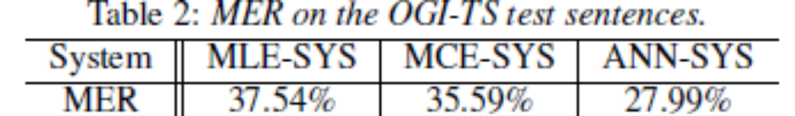
Experiment

