Slide 1
Discriminative Reranking for Machine Translation
Authors: Libin Shen, Anoop Sarkar, Franz Josef Och
Reporter: 江欣倩
Professor: 陳嘉平

Slide 2
Outline
Introduction
Reranking for MT
Two reranking algorithms
Experiments
Conclusion

Slide 3
Outline
Introduction
Reranking for MT
Two reranking algorithms
Experiments
Conclusion

Slide 4
Introduction
Reranking problem for natural language
  Classification problem
  Regression problem
  MT reranking
Reranking techniques are applied to MT
  Maximum entropy models
  Gradient methods
  Novel discriminative ranking algorithms
    Ordinal regression or ranking

Slide 5
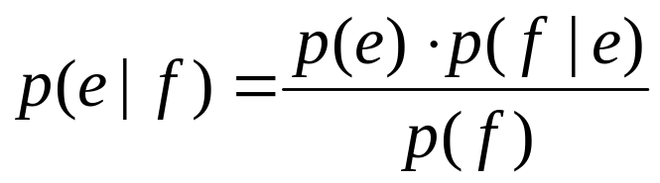
Generative Models for MT
Generative models
  a model for randomly generating observed data
  observe the source and target sentences
  alignments are hidden information learned form parallel texts
  Single-word based IBM models
  Phrase-based generative models

Slide 6

Discriminative Models for MT
Direct translation by with maximum entropy model
Rerank results (n-best list) generated by a baseline MT system with some features
  Alignment template feature function
This approach obtains significantly better results than using the maximum mutual information criterion on parameter estimation.

Slide 7
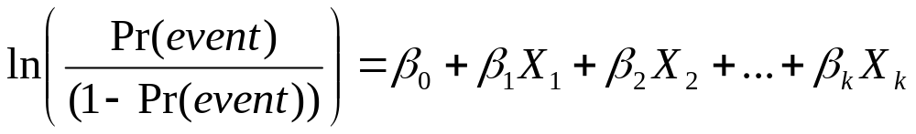
Ranking and Ordinal Regression
Quantify each categories
margin
  The distance between two consecutive ranks
  Two large margin approaches
    Prank algorithm
      Not work on the reranking tasks due to the introduction of global ranks
    Reduce the ranking problem to a classification problem by using the method of pairwise samples
      If ranking does not strongly distinguish between candidates, the ranks are unreliable.
The uneven margin technique has been used for the purpose of adapting ordinal regression to reranking tasks.

Slide 8
Discriminative Reranking for MT
A baseline system generates n-best candidates
Use features to discriminate good or bad translations form n-best candidates
New top ranked candidate in this n-best list is the new best candidate translation.

Slide 9
Advantages of Discriminative Reranking
Allows us to use global features and not to consider smoothing issues
Reranking enables rapid experimentaion with complex feature functions

Slide 10
Outline
Introduction
Reranking for MT
Two reranking algorithms
Experiments
Conclusion

Slide 11

Reranking to MT
Problem
  The result of conventional classifiers is one good.
  The gold standard translations are not always single.
Solution
  Separate top r of n-best translation are good translations and bottom k are bad translations

Slide 12
Outline
Introduction
Reranking for MT
Two reranking algorithms
Experiments
Conclusion

Slide 13
Reranking Algorithms
Margin
  Insensitive ordinal regression is more desirable
  Penalizing scoring function
    Example
  Pairwise samples
Two perceptron-like algorithms
  A splitting algorithm
  An ordinal regression algorithm

Slide 14
A splitting algorithm
Goal
  Separates translations of each sentence into two parts
    top r translations
    bottom k translations
  Share same weight vector : w

Slide 15
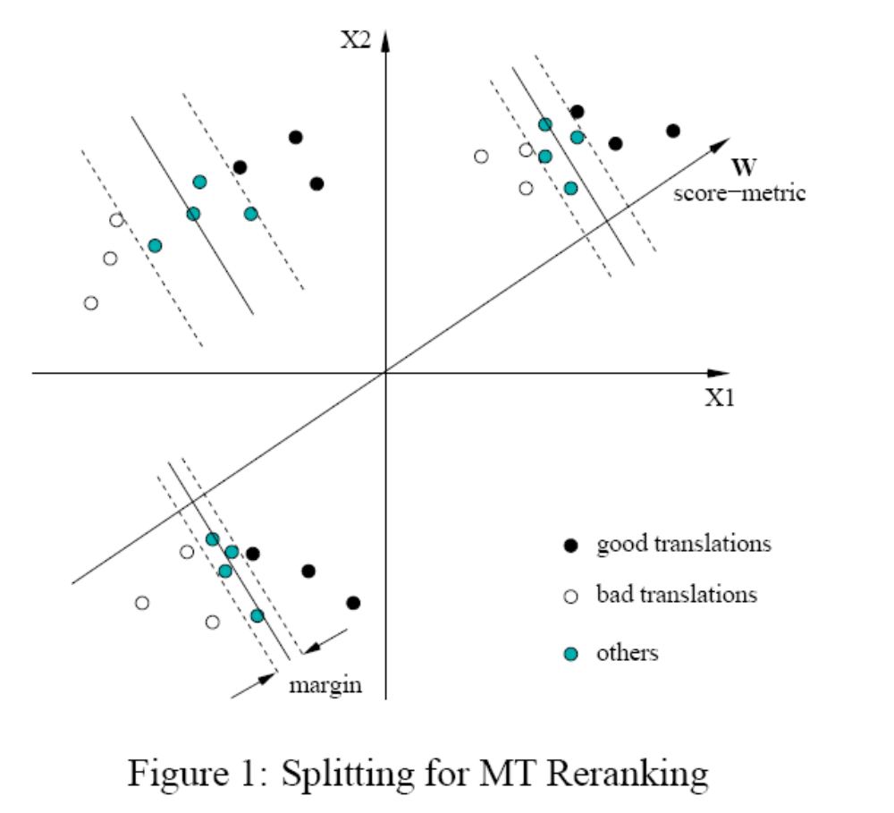
A splitting algorithm
n=10
r=3
K=3

Slide 16
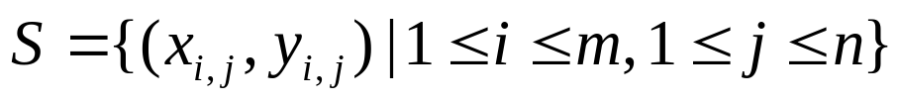
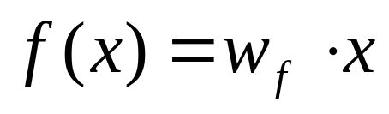
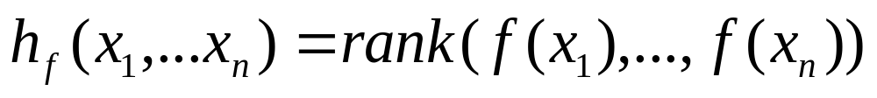
A splitting algorithm
The set of training samples
  x : the feature vector of the jth translation of the I the sentence
  y: the rank for this translation among all the translations for the ith sentence
  m: the number of clusters
  n: the length of ranks for each cluster
a hypothesis function

Slide 17
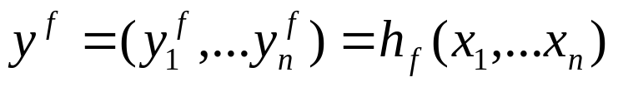
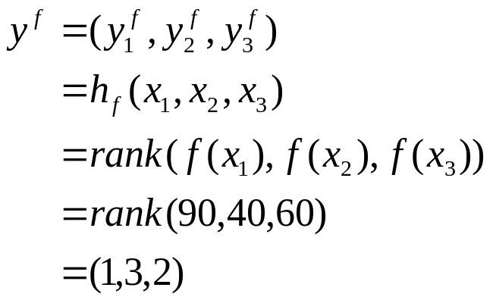
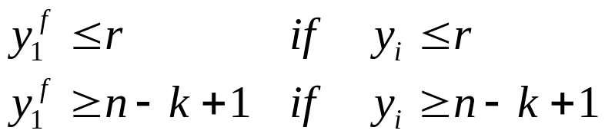
A splitting algorithm
  example
find function f that satisfies

Slide 18
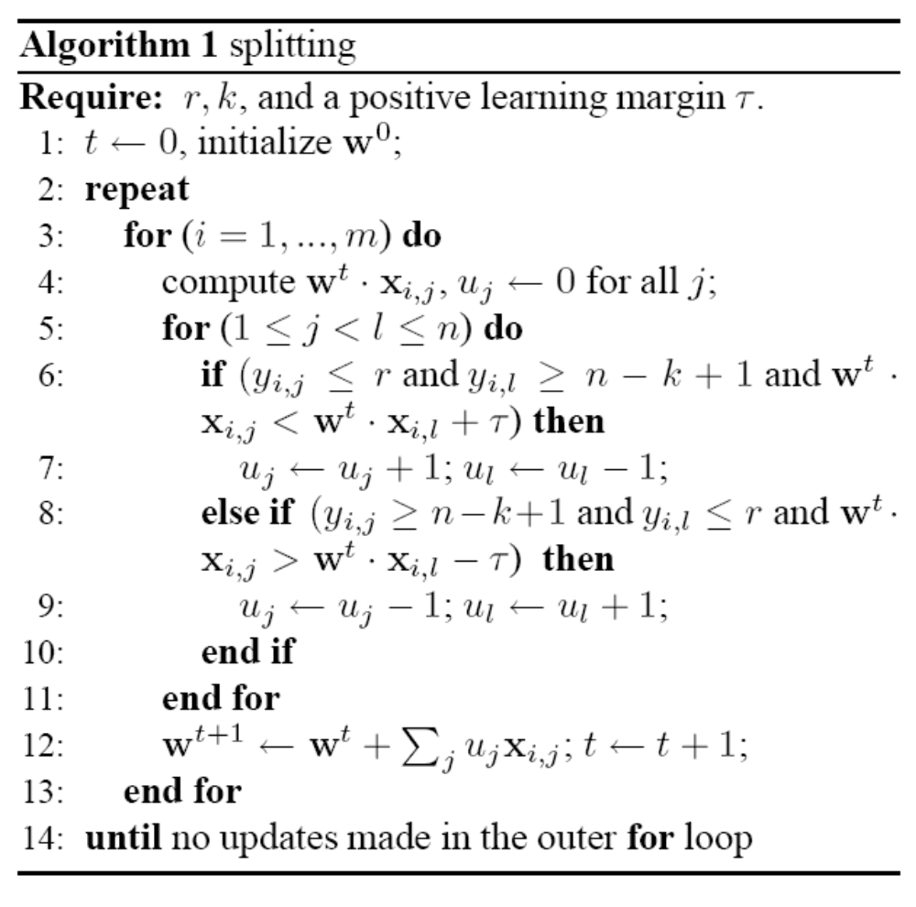
A splitting algorithm
O(mn²+mnd)

Slide 19
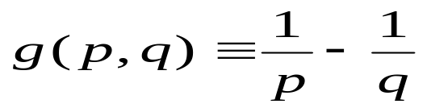
Ordinal Regression
dis: control the level of insensitivity
g : control the learning margin between pairs of translations with different ranks

Slide 20
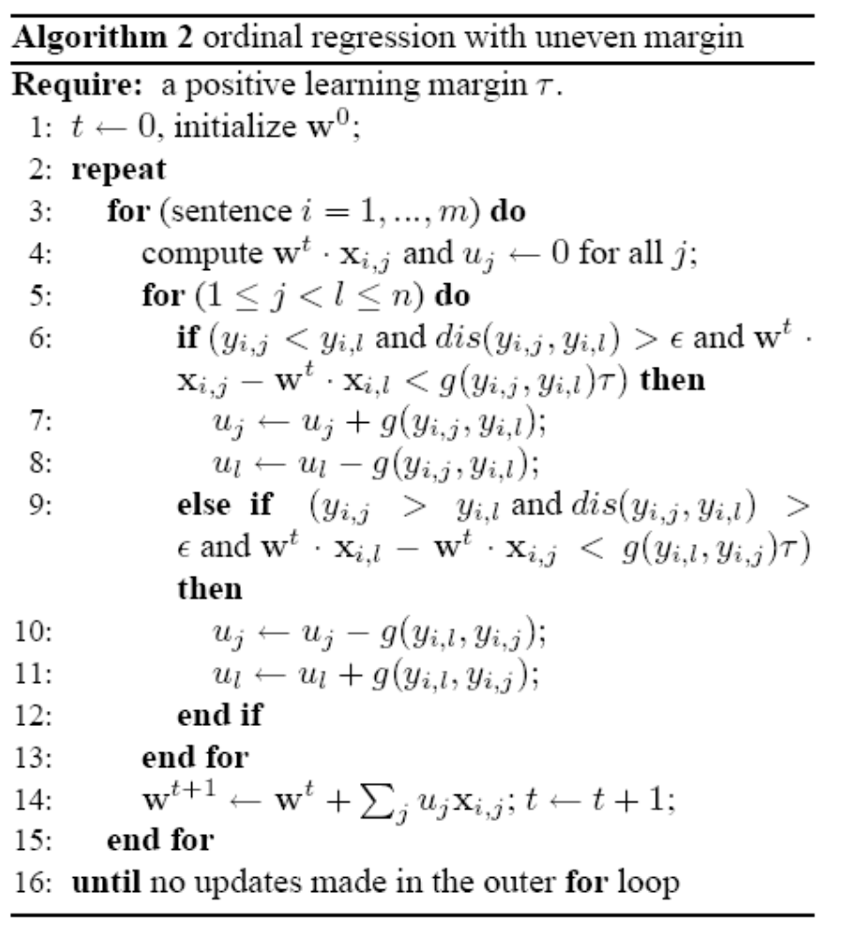
Ordinal Regression

Slide 21
Outline
Introduction
Reranking for MT
Two reranking algorithms
Experiments
Conclusion

Slide 22
Data
NIST 2003 Chinese-English large data track evaluation
Training data
  170M English words
development data
  993 Chinese sentences
  1000-best English translations
Test data
  878Chinese sentences
  1000-best English translations

Slide 23
four different kinds of feature combinations
Baseline
  6 baseline features
Best Feature
  6 baseline features + IBM Model 1+matched parentheses + matched quotation marks+ POS language model
Top Twenty
  6 baseline features + 14 features with individual BLEU score no less than 31.9% with the minimum error training
Large Set
  6 baseline features + 50 features with individual BLEU scroe no less than 31.7% with the munimum error training

Slide 24
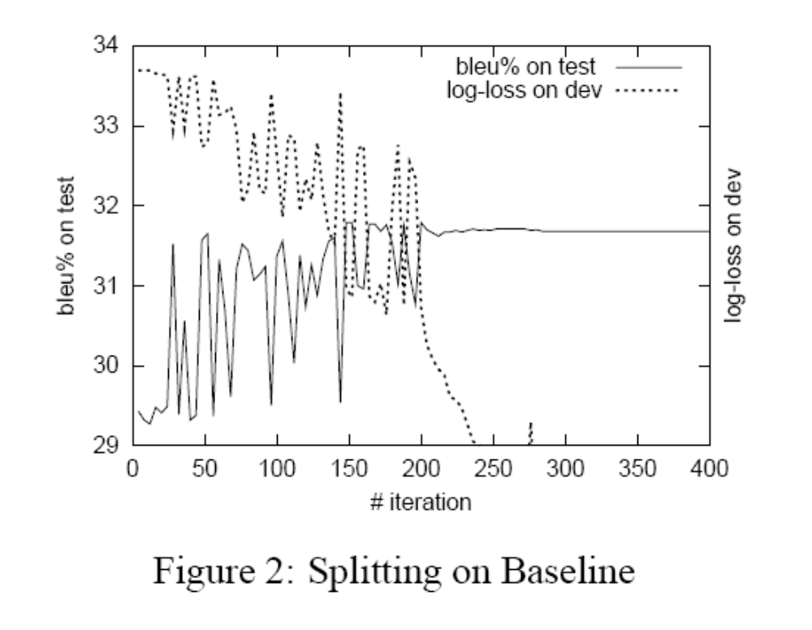
Experiments for Algorithm 1
k=300, 1000-best

Slide 25
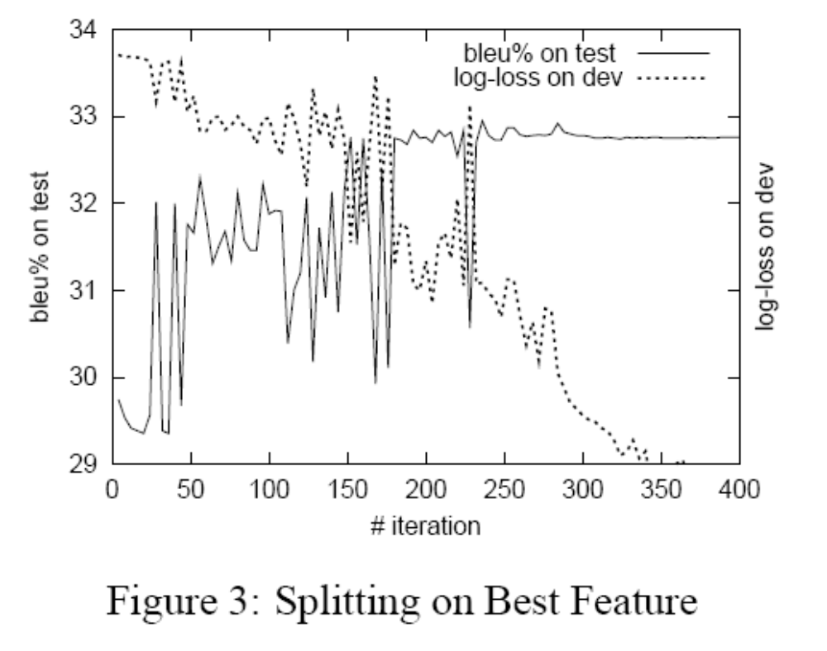
Experiments for Algorithm 1
k=300, 1000-best

Slide 26
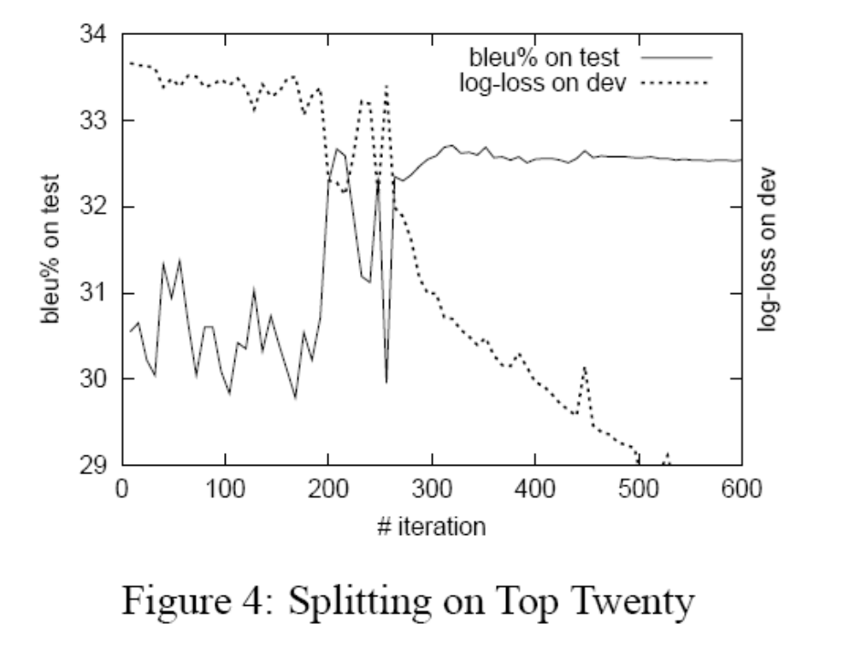
Experiments for Algorithm 1
k=300, 1000-best

Slide 27
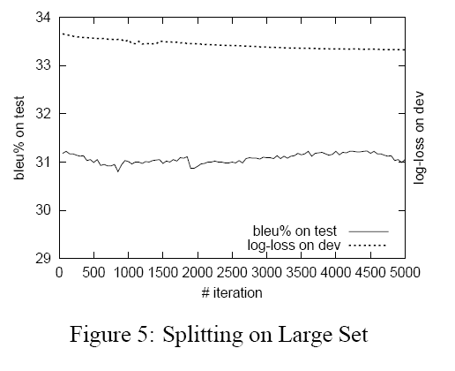
Experiments for Algorithm 1
k=300, 1000-best

Slide 28
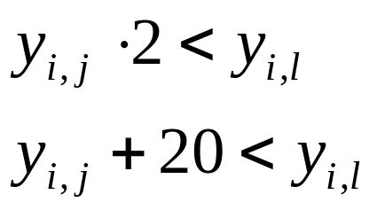
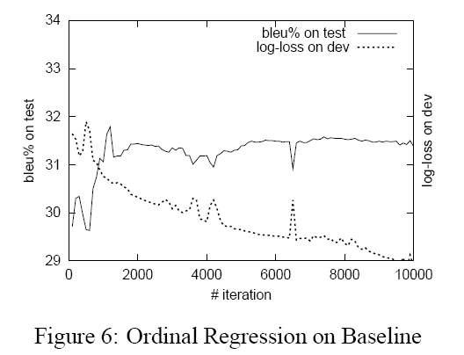
Experiments for Algorithm 2
update condition as

Slide 29
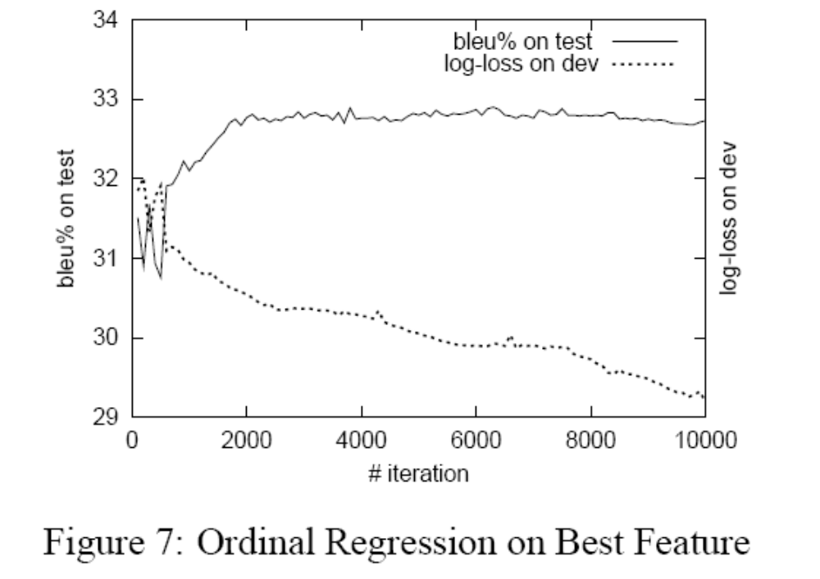
Experiments for Algorithm 2
update condition as

Slide 30
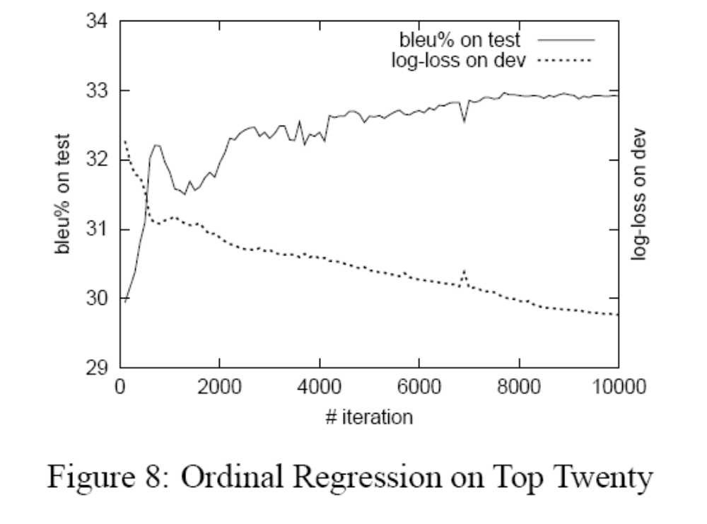
Experiments for Algorithm 2
update condition as

Slide 31
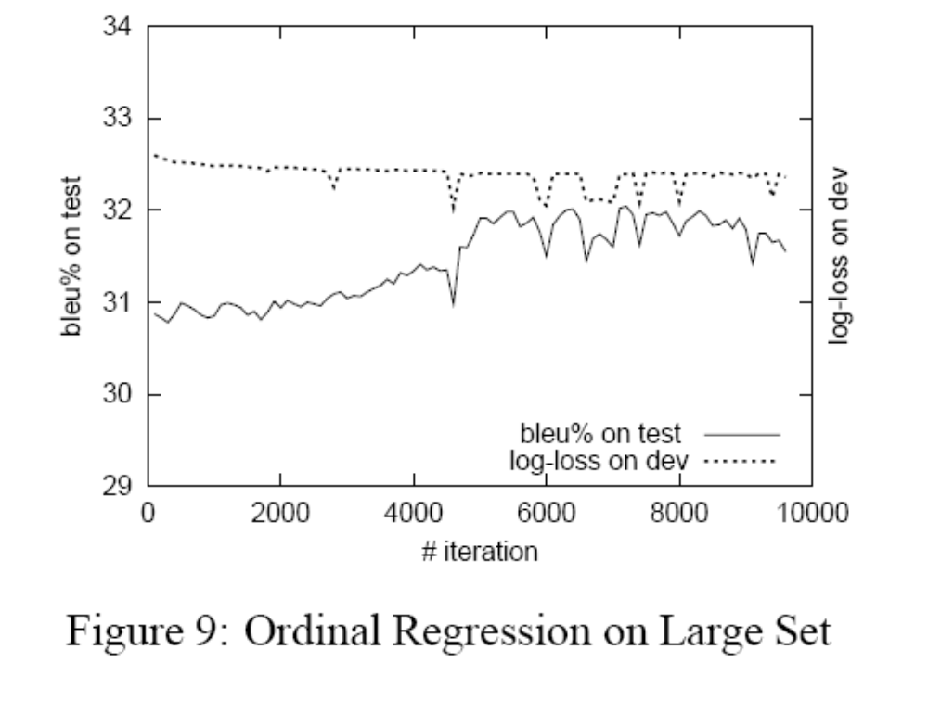
Experiments for Algorithm 2
update condition as

Slide 32
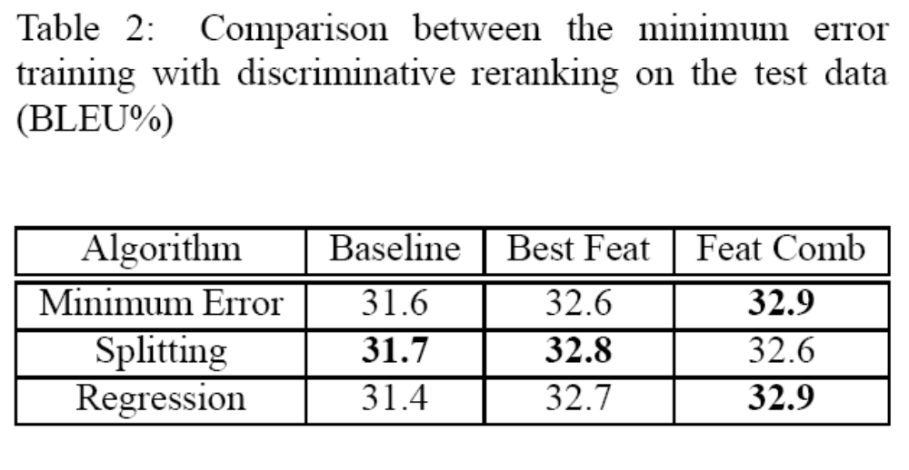
Experiments

Slide 33
Outline
Introduction
Reranking for MT
Two reranking algorithms
Experiments
Conclusion

Slide 34
Conclusions and Future work
Apply successfully the discriminative reranking to MT
Present a new perceptron-like splitting algorithm and ordinal regression algorithm
Show results of NIST 2003 Chinese-English large data track evaluation

Slide 35
    Discriminative reranking improves performance
    Use the notion of a margin as the distance between the best candidate parse and the rest of the parses

