Slide 1
Lexicalized Tree Automata-based Grammars for Translating Conversational Texts
Authors: Kiyoshi YAMABANA, Shinichi ANDO, and Kiyomi MIMURA
Report: 江欣倩
Professor: 陳嘉平

Slide 2
Outline
Introduction
LTAG (Lexicalized Tree Automata-based Grammars)
Translation Module
Discussions and Conclusion

Slide 3
Introduction
For a restricted domain
  Achieve broad coverage
  Better quality for texts
This approach allows coexistence of general rules and surface-level pattern in a uniform framework
  Employ strongly lexicalized grammars as the basic grammar formalism

Slide 4
Improvement for strongly lexicalized grammar formalisms
Tree operation is substitution only
  Each word is associated with a finite set of trees anchored by that word
    If the tree operation is limited to substitution, Lexicalized Tree Substitution Grammar (LTSG) cannot even reproduce the trees obtained from non-lexicalized context free grammars.
      The distance of the root node and the nearest lexical item is less than that constant. (different with CFG)

Slide 5
Improvement for strongly lexicalized grammar formalisms
It has extended domain of locality
  Grow an infinite number of trees form a finitely ambiguous set of initial trees representing the extended domain of locality (EDOL) of the word
Give additional adjoining restrictions to the node, and/or detailed attribute-values to the nodes

Slide 6
LTAG
strongly lexicalized
  A finite set of structures each associated with a lexical item
  An operation or operations for composing the structures
tree automaton (TA)
  An automaton accepts trees as input
  Automaton has a state set, state transitions, initial and final states, and optional memories associated with states.

Slide 7



Definition
associate a tree automaton to each word that defines the set of local trees anchored to the word.
LTA provides a finite representation of a possibly non-finite set of local trees.
: a set of terminal symbols (words)
: a set of nonterminal symbols disjoint
: a set of trees (elementary trees) associated with a word
  node: terminal or nonterminal symbols
  Root and one of its leaves are marked by self in NT

Slide 8

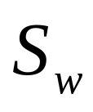
Definition
: the tree automaton lexicalized to the word w
  Identified with a string automaton
  Alphabets are the trees in T and a string of the elementary trees are identified by joining the elementary trees in a bottom-up manner
: a set of root nonterminal symbols associated with the word w as the tree accepted

Slide 9
X-bar theory
Specifier
  XP -> (specifier), x’
Adjunct
  X’ -> X’, adjunct
Complements
  X’ -> X, (complement…)

Slide 10
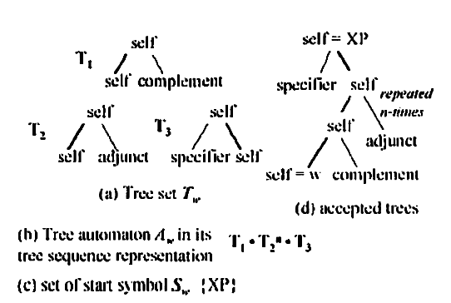
Examples

Slide 11
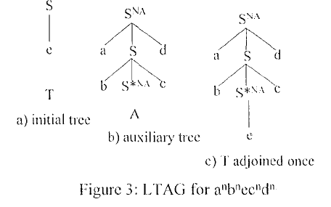
Example

Slide 12
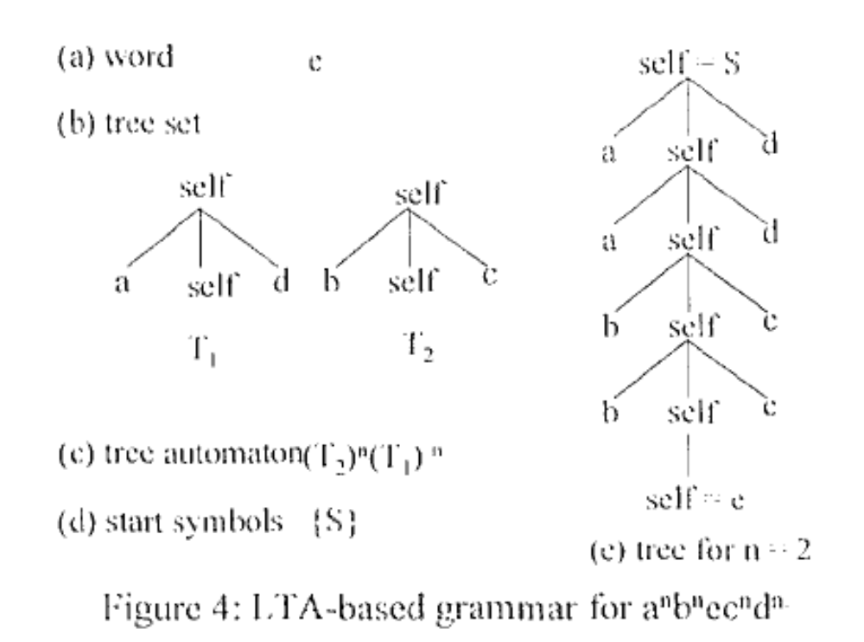
Example

Slide 13
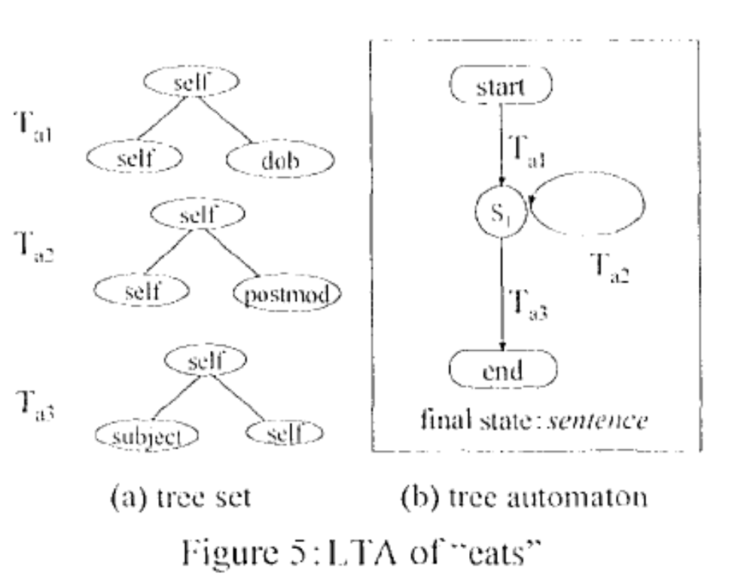
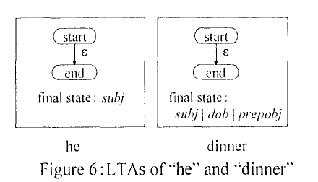
Parsing LTA-based Grammars

Slide 14
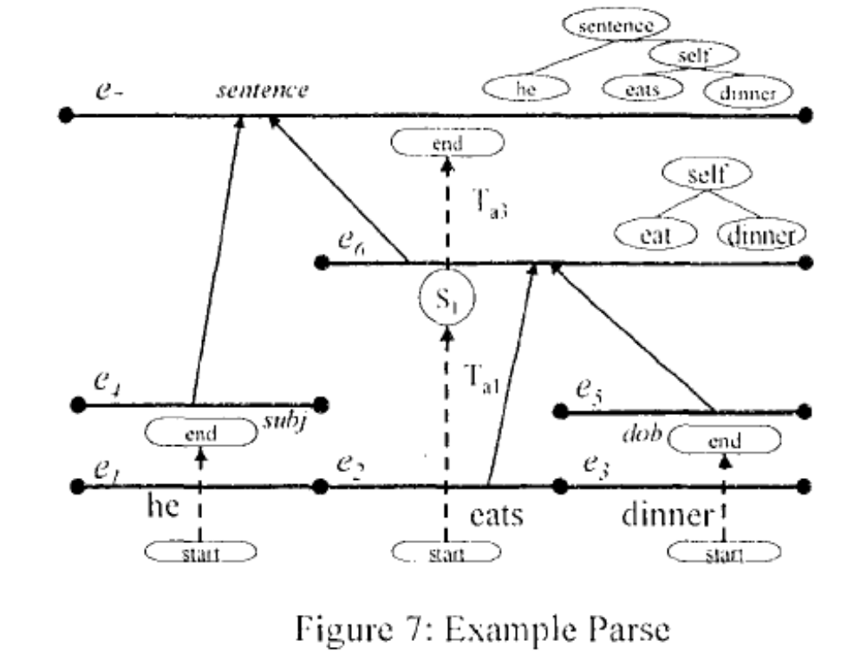
Parsing LTA-based Grammars

Slide 15
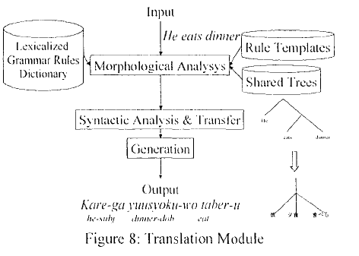
Translation Module

Slide 16
Translation Module
Rule templates: share T, A, S
Shared tree: share the elementary trees
Language conversion method
  Basically by Aho and Ullman (1969) and by Shieber and Schabes (1990)
Grammars and Dictionaries
  General grammar rules (global grammar): X-bar theory
  Nonterminals: Link Grammar(Sleator,1991)
  Domain-specific rules (local grammar) : pattern-like rules with special attention to aspects that are important for carrying conversations
  Dictionary: E-J about 70,000 words

Slide 17
Implementation
60 MB memory and 200 MB DISK SPACE
English to Japanese
  evaluate 500 sentences from 40,000 sentences
  4 levels: natural, good, understandable and bad
    “natural” increased about 45% compared to the reference system
    “bad” decreased about 40%

