Slide 1
An Automatic Speech Translation System on PDAs for Travel Conversation
Author: Ryosuke Isotani, Kiyoshi Yamabana, et al.
Reporter:江欣倩
Professor:陳嘉平

Slide 2
Outline
Introduction
System overview
Speech recognition module
Translation module
System integration module
Discussion and Conclusion

Slide 3
Introduction
Automatic speech translation during travel
  Main problem
    The limitation in a variety of acceptable situations and expressions
On PDAs
  Compact implementation

Slide 4
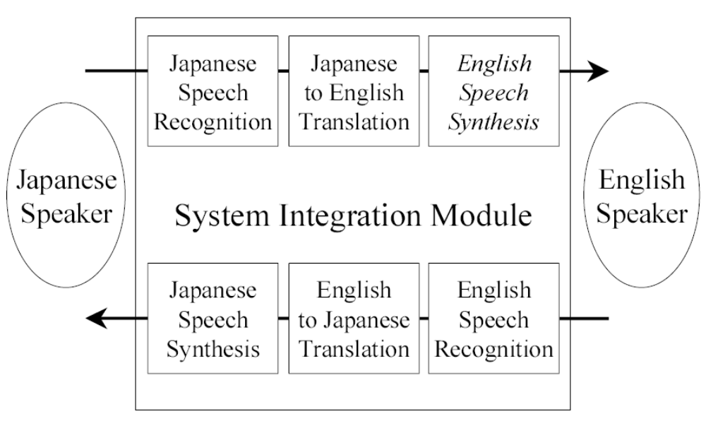
System overview
Pocket PC 2002, CPU: StrongARM 206MHz, RAM: 64MB,
The process address space with various restrictions on memory map: 32MB

Slide 5
Translation module
Characters of travel conversation
  Colloquial expressions
  Idiomatic expressions
Translation
  Input: a recognized expression from the speech recognition
  Output: a sentence in target language
  Deal with Instance-specific example-like knowledge and abstract rule-like knowledge simultaneously

Slide 6
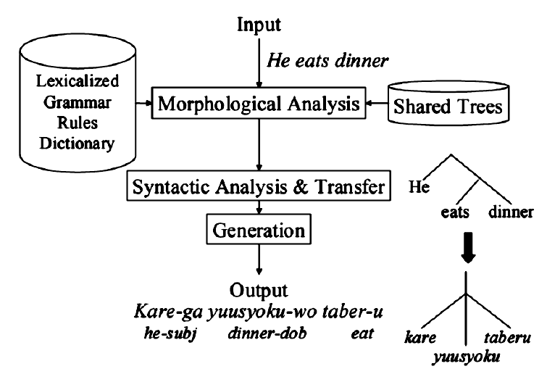
Translation module

Slide 7
Lexicalized Tree AutoMata-based Grammars
LTAM Grammars: Lexicalize Tree AutoMata-based Grammars
  Advantages
    Satisfy requirements in this paper
    A simple bottom-up chart-parsing algorithm
  Each word has its own tree automaton
    Reduce the cost and size of the grammar by a static sharing mechanism of the tree automata and the constituent trees

Slide 8
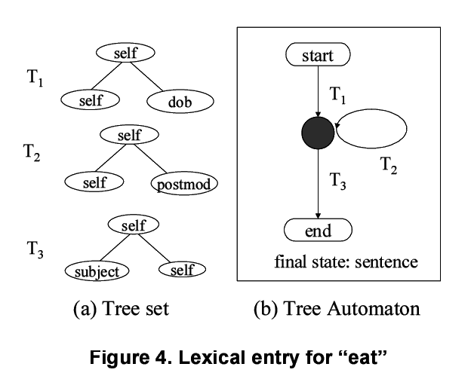
Lexicalized Tree AutoMata-based Grammars

Slide 9
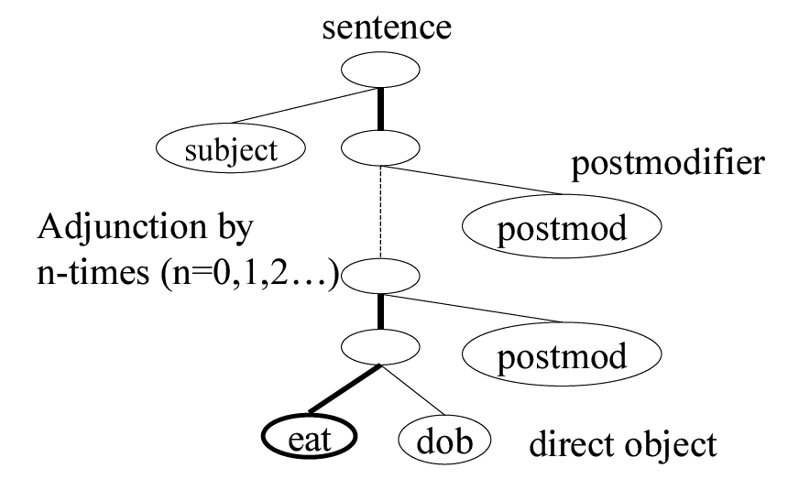
Lexicalized Tree AutoMata-based Grammars

Slide 10
Reinforced bilingual lexical knowledge
Translation Dictionary
  Japanese-English
    150,000 words
  English-Japanese
    70,000 words
Grammars
  Japanese-English
    General bilingual grammar rules
    Conversational expressions
  English-Japanese
    General grammar rules
      Aim to achieve high quality in the travel domain by covering a wide variety of conversational expressions

Slide 11
Compact translation engine
perform morphological analysis to build an initial word lattice
The feature structure and the tree automata are loaded from the dictionary
Parser
  Left-to-right and bottom-up chart parsing in a breadth-first manner
  Edge score
    Calculate from the lexical, syntactic, and semantic information
Generation steps
  Top-down manner

Slide 12
Translation module

Slide 13
Compact translation engine
Advantage for compact implementation reducing the resource requirement
  Localized
  Dynamic calculation of Shared Packed Forest
  Beam-search
  Lazy-copy
Memory requirement: 8MB
Work memory: 1-4MB

Slide 14
System integration module
Interfaces communicate with the system integration module through shared memory-mapping objects
Pass information module from speech recognition module to the translation module
  Text
  For homograph disambiguation
    Word segmentation
    Reading
    duration

Slide 15
Discussion and conclussion
Experiments
  Speech recognition
    Test data 1800 utterances by 10 male speakers for Japanese and English
    Word accuracy
      Japanese: 95%
      English: 87%
  Translation
    500 randomly sentences from travel conversation corpus
    Evaluation
      3 categories: Good, Understandable, Bad
      J-E Good: 66% (+Understandable: 88%)
      E-J Good: 74% (+Understandable: 90%)
Memory requirement
  About 27MB
  Work memory: around 1-4MB

Slide 16
Conclusion
An automatic speech translation system for PDA on J-E and E-J
Work system with limited computation resources using several techniques to reduce computational cost and memory usage

