Slide 1
Parsing Strategies with ‘Lexicalized’ Grammars: Application to Tree Adjoining Grammars
Authors: Yves SCHABES, Anne ABEILLE and Aravind K. JOSHI
Reporter: 江欣倩
Professor: 陳嘉平

Slide 2
Lexicalized grammar
a finite set of structures to be associated with lexical items, which usually will be heads of these structures
an operation or operations for composing the structures.
  The finite set of structures define the domain of locality over which constraints are specified and these are local with respect to their lexical heads.

Slide 3
Lexicalization of CFGs
One extends the domain of locality of CFGs
  Tree rewriting grammar
    Using only substitution (non-terminal node)
not give the freedom to choose the head of each structure
  Adjuction

Slide 4
Lexicalization of CFGs
Recursive chain rules are disallowed since they introduce unbounded structures with no lexical items attached to them.
Although a CFG can be 'lexicalized' by using trees, it is not possible to choose freely the lexical item that plays the role of the head for each structure.

Slide 5
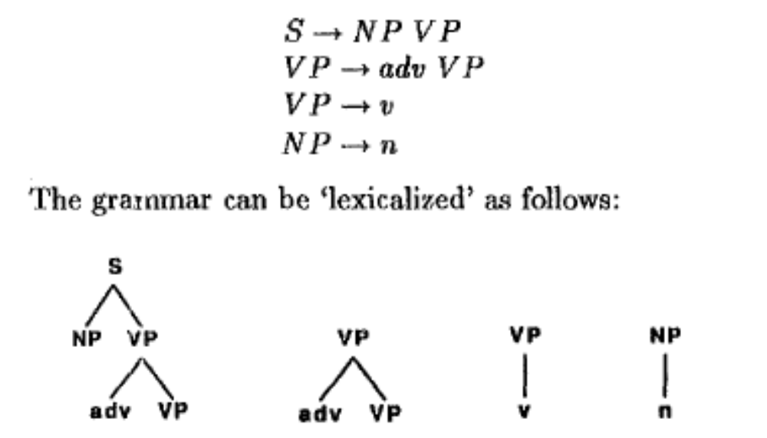
Example

Slide 6
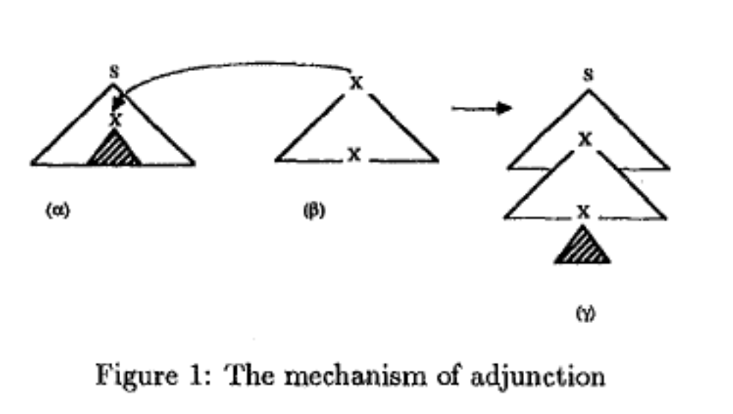
Tree adjoining grammars
Major composition operation
  Adjoining or adjunction

Slide 7
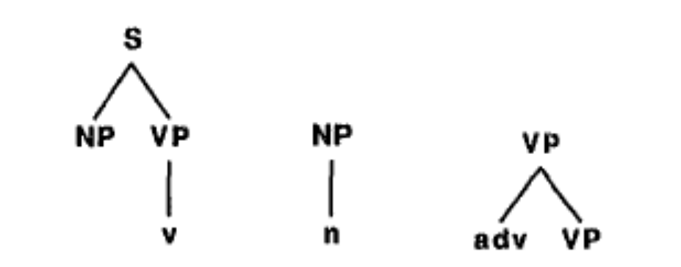
lexicalized CFG with adjunction

Slide 8
TAGs
A tree-based system consists of three finite sets of trees
  I: initial trees
  A: auxiliary trees
    internal nodes are labeled by non-terminals
    leaf nodes are labeled by terminals or by non-terminal nodes to be substituted except for exactly one node (called the foot node) labeled by a non-terminal on which only adjunction can apply; furthermore the label of the foot node is the same as the label of the root node.

Slide 9
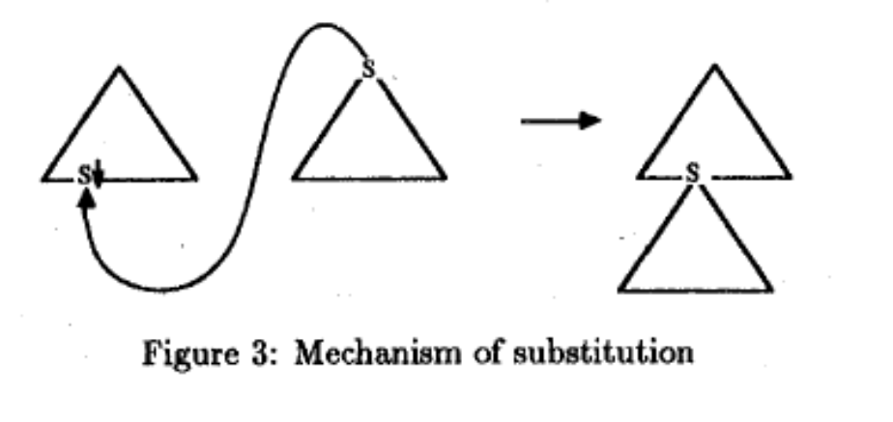
TAGs
L: lexical trees
Substitute
Only trees derived from initial trees can be substituted

Slide 10
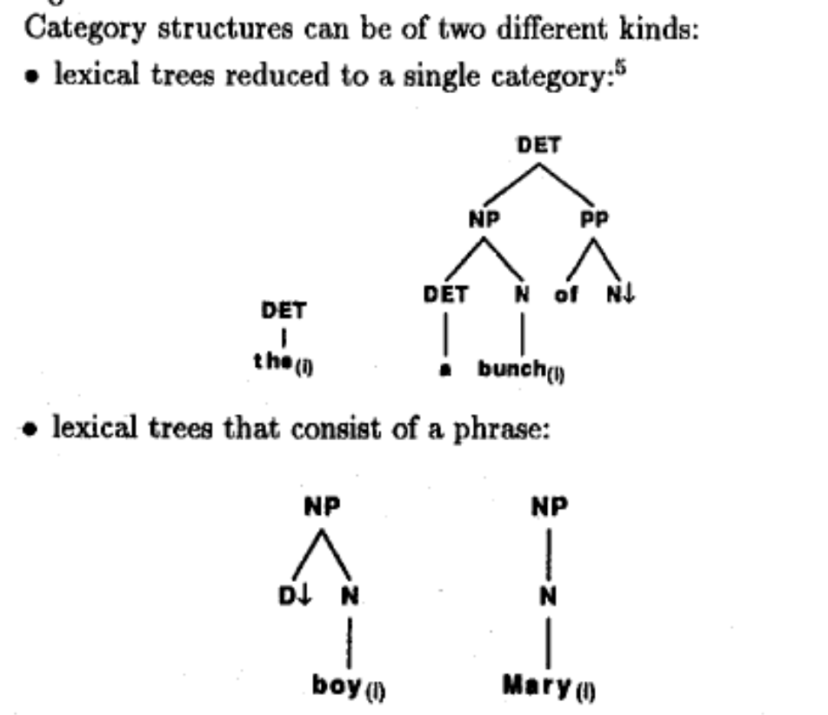
Category structure
a lexical tree that is not necessarily reduced to a single category.

Slide 11
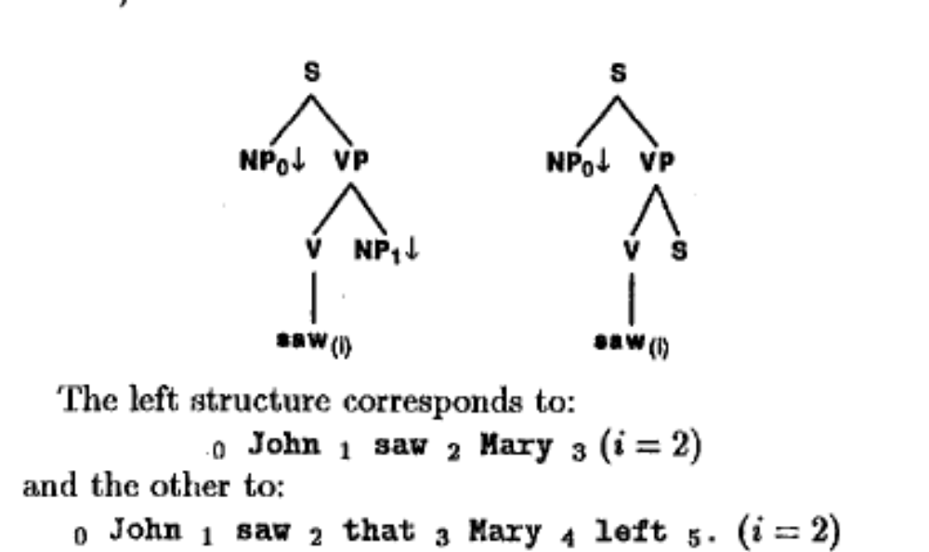
Argument structure
The argument structure for a predicate is its maximal structure.

Slide 12
Parsing lexicalized grammars
First produce the set of structures corresponding to each word in the sentence. This step performs the role of an expanded morphological analysis (or tagging).
Then put the argument structures into the predicate structures. This step performs a modified syntactic analysis.

Slide 13
Parsing lexicalized grammars
By assuming that the number of structures associated with a lexical item is finite, since each structure has a lexical item attached to it, we implicitly make the assumption that an input string of finite length cannot be syntactically infinitely ambiguous.

