Slide 1
Data from Stanford parser into XTAG

Slide 2
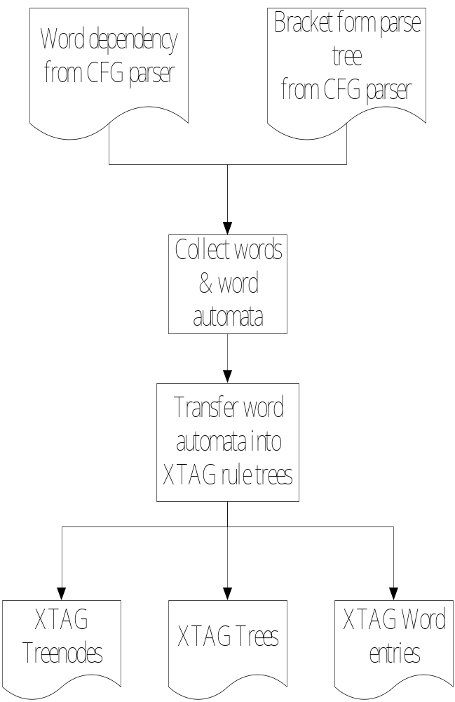
Rule Extraction

Slide 3
Chinese Word Dependency Tag
[acomp]:adjectival complement
[advmod]:adverbial modiﬁer
[amod]:adjectival modiﬁer
[asp]:aspect marker*
[assm]:associative marker*
[assmod]:associative modiﬁer*
[attr]:attributive
[ba]:ba*
[cc]:coordination
[ccomp]:clausal complement with internal subject
[clf]:classifier modifier*
[clmpd]:clause modifier*
[comod]:coordinated verb compound*
[conj]:conjunct
[cop]:copula
[cpm]:complementizer*
[dep]:dependent
[det]:determiner
[dobj]:direct ob ject
[dvpm]:dvp marker*
[dvpmod]:dvp modifier*
[etc]:ETC*
[lccomp]:localizer complement*
[lobj]:localizer object*
[mmod]:modal modiﬁer*
[neg]:negation modiﬁer
[nmod]:noun modiﬁer*
[npsubj]:nominal passive subject*
[nsubj]:nominal subject
[numod]:numeric modiﬁer*
[ordmod]:odnumeric modifier*
[partmod]:participial mo diﬁer
[pass]:passive*
[plmod]:prepositional localizer modifier*
[pobj]:object of a preposition
[prep]:prepositional modiﬁer
[prnmod]:parenthetical modifier*
[punct]:punctuation
[range]:range*
[rcmod]:relative clause modiﬁer
[rcomp]:resultative complement*
[sent]
[tclaus]:temporal clause*
[tcomp]:temporal complement*
[top]:topic*
[vmod]:verb modifier*
[xsubj]:controlling subject
self
Total: 48

Slide 4
Example
sentence:它 嚴重 嗎
encode:word1 word2 word3
word dependency
nsubj(嚴重，它)
ccomp(嚴重，嗎)
Tree (ROOT FOOT #SUB #ANCHOR #NA SUB ANCHOR NA)
0 -1 2 1 0 1 4 3
5 -1 0 1 1 5 5
6 -1 0 1 1 6 6

Slide 5
XTAG Grammar
Tree node
LEFTCHILD RIGHT FLAG LABEL SUBSCRIBE
Flag=1,RIGHT=PARENT; else RIGHT=sibling
Tree
ROOT FOOT #SUBST #ANCHOR #NA SUBST ANCHOR NA
SUBST: substitution node
ANCHOR: head node
NA: null adjoining node

Slide 6
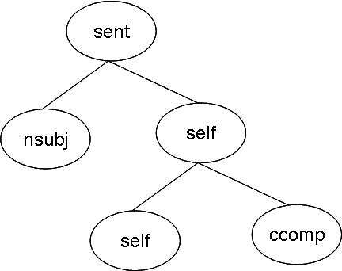
Example

Slide 7
Example
Treenaode (LEFTCHILD RIGHT FLAG LABEL SUBSCRIBE)
1 0 1 41 -1
-1 2 0 28 -1
3 0 1 47 -1
-1 4 0 47 -1
-1 2 1 9 -1
-1 5 1 28 -1
-1 6 1 9 -1

Slide 8
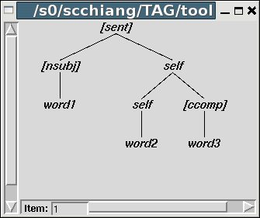
Example

Slide 9
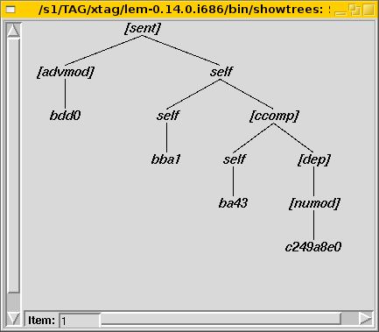
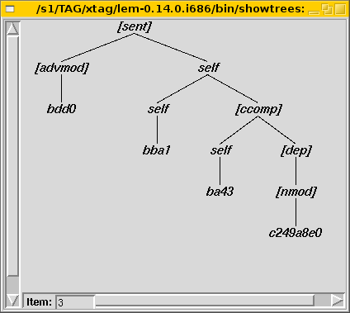
Result of N best Parser
sentence: 請 說 慢 點兒
encode sentence: bdd0 bba1 ba43 c249a8e0

Slide 10
Tree
說: [advmod] self ;;; [advmod] self ;;; (state:ccomp)
慢: self [dep] ;;; (state:ccomp)
請
說
慢
點兒

Slide 11
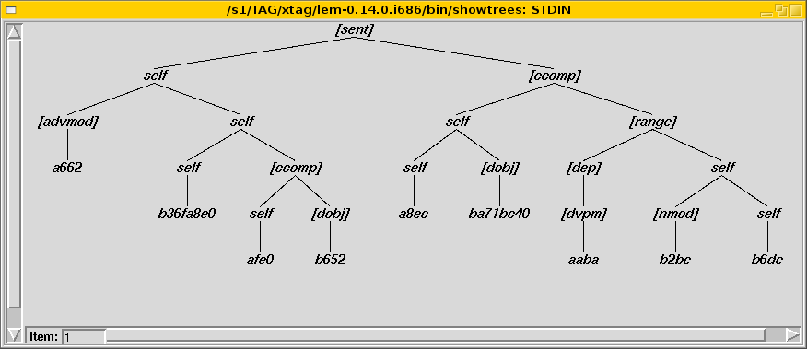
Result of N best Parser
Sentence: 在 這兒 能 買 到 歌劇 的 票 嗎 ?
encode sentence: a662 b36fa8e0 afe0 b652 a8ec ba71bc40 aaba b2bc b6bc

Slide 12
Trees for English
Sentence after tokenizing:
  When the pain has abated , you had better apply a hot compress .
Information from Stanford parser
  POS tree
    (S (SBAR (WHADVP (WRB When)) (S (NP (DT the) (NN pain)) (VP (VBZ has) (VP (VBN abated))))) (, ,) (NP (PRP you)) (VP (VBD had) (ADVP (RBR better)) (VP (VB apply) (NP (DT a) (JJ hot) (NNS compress)))) (. .))
  Word dependency
    advmod(abated-5, When-1)
    det(pain-3, the-2)
    nsubj(abated-5, pain-3)
    aux(abated-5, has-4)
    dep(apply-10, abated-5)
    nsubj(apply-10, you-7)
    aux(apply-10, had-8)
    advmod(apply-10, better-9)
    det(compress-13, a-11)
    amod(compress-13, hot-12)
    dobj(apply-10, compress-13)
  Word tree
  abated: [aux] self ;;; [nsubj] self ;;; [advmod] self ;;; (state:dep)

Slide 13
Problems
Efficiency
Decide the best parsing tree
  Probability

