Slide 1
Progress Report
Reporter: 江欣倩
Professor: 陳嘉平

Slide 2
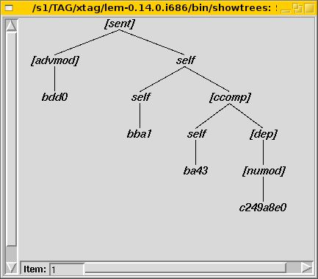
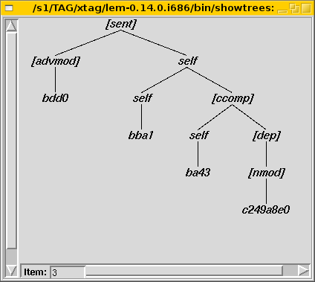
Result of N best Parser
sentence: 請 說 慢 點兒
encode sentence: bdd0 bba1 ba43 c249a8e0

Slide 3
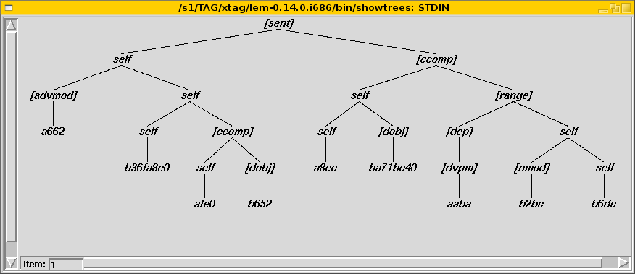
Result of N best Parser
Sentence: 在 這兒 能 買 到 歌劇 的 票 嗎 ?
encode sentence: a662 b36fa8e0 afe0 b652 a8ec ba71bc40 aaba b2bc b6bc

Slide 4
Problems
Efficiency
Decide the best parsing tree
  Probability

Slide 5
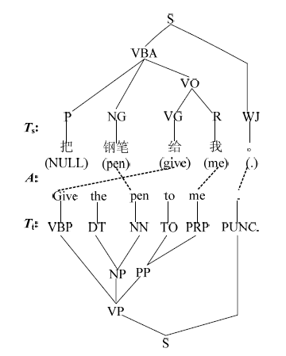
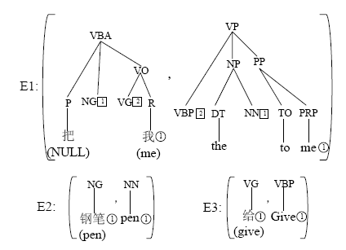
Build Synchronous TAG
A tree-to-tree alignment-based model

