Slide 1
Synchronous Tree-Adjoining Grammars
Authors: Stuart M. Shieber and Yves Schabes
Reporter: 江欣倩
Professor: 陳嘉平

Slide 2
Introduction
Advantage of TAG (Tree-adjoining grammar)
  The domain of locality
  The statements of dependencies and recursion possibilities in a tree are factored
Synchronous TAGs
  Characterize correspondences between languages

Slide 3
Synchronous TAGs
The two TAGs are synchronous in the sense that adjunction and substitution operations are applied simultaneously to related nodes in pairs of trees, one for each language.
  two languages: source and target languages (nondirectional)
    English and French
  Example

Slide 4
A derivation step
A derivation step from a pair of trees (α₁, α₂)
  Nondeterministically choose a link in the pair connecting two nodes (n₁ in α₁ and n₂ in α₂)
  Nondeterministically choose a pair of trees (β₁, β₂) in the grammar.
  Form the resultant pair (β₁(α₁,n₁), β₂(α₂,n₂))

Slide 5
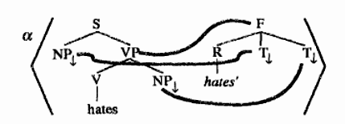
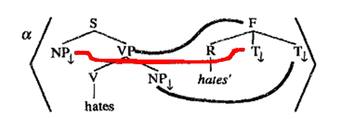
Example
The tree pair α
Nondeterministically choose a link in the pair connecting two nodes

Slide 6
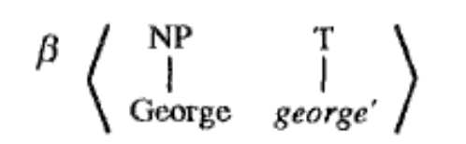
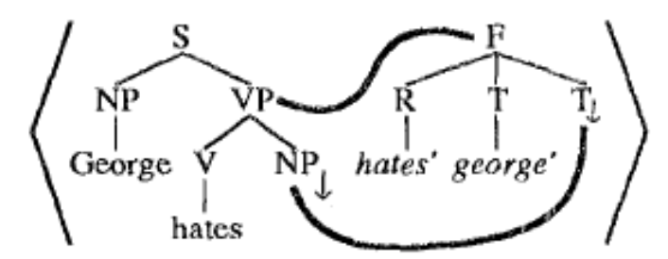
Example
Nondeterministically choose a pair of trees (β₁, β₂) in the grammar
Form the resultant pair (β₁(α₁,n₁), β₂(α₂,n₂))

Slide 7
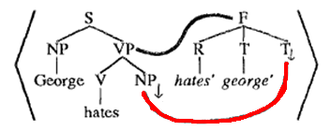

Example
Nondeterministically choose a link in the pair connecting two nodes
Nondeterministically choose a pair of trees (γ₁, γ₂) in the grammar

Slide 8
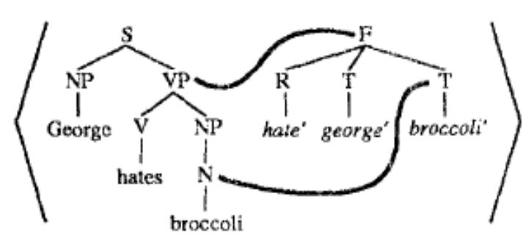


Example
Form the resultant pair (γ₁(α₁,n₁), γ₂(α₂,n₂))
Nondeterministically choose a pair of trees (δ₁, δ₂) and (ε₁, ε₂) in the grammar

Slide 9
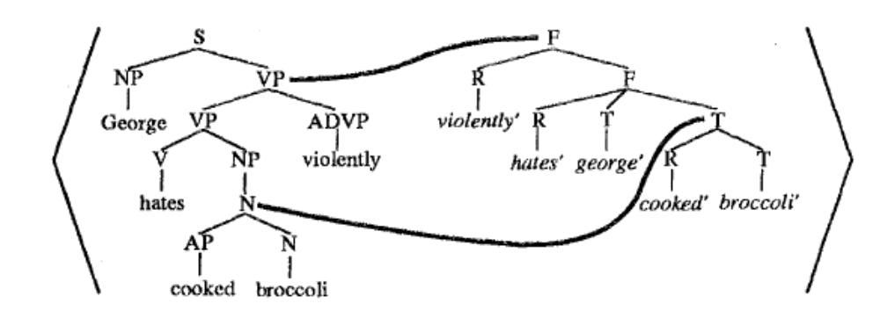
Example
Form the resultant pair (δ₁(α₁,n₁), δ₂(α₂,n₂)) and (ε₁(α₁,n₁), ε₂(α₂,n₂))

Slide 10
Synchronous TAGs
The arguments for factoring recursion and dependencies as TAGs do for the syntax of natural language have their counterparts in the semantics.
the use of the synchronous TAG augmentation allows an even more radical reduction in the role of features in a TAG grammar.

Slide 11
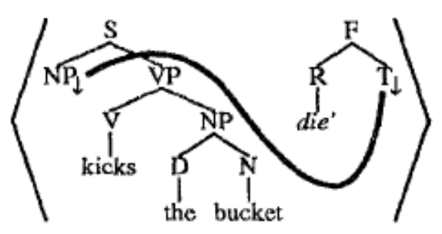
Applications: Idioms
Discontinuous syntactic constituents can be semantically localized.
Nonstandard long-distance dependencies are statable without resort to reanalysis.
Both frozen and flexible idioms can be easily characterized.

Slide 12
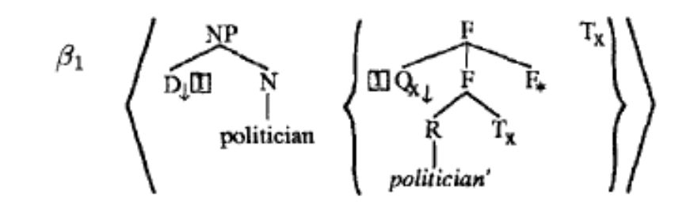
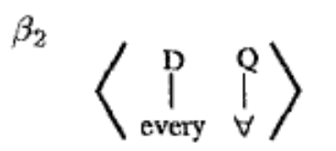
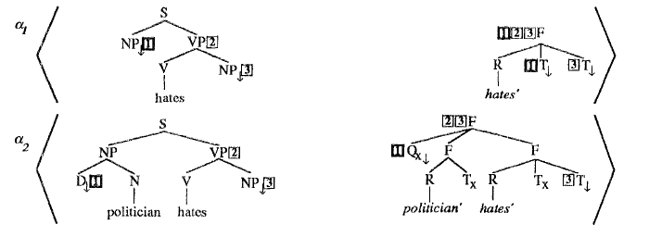
Applications: Quantifiers

Slide 13
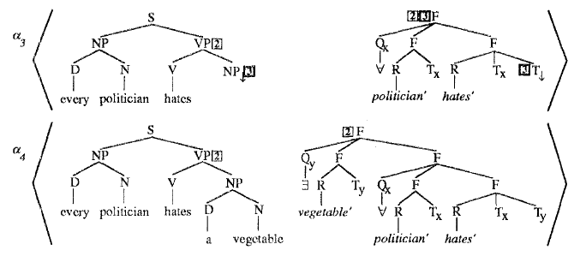
Applications: Quantifiers

Slide 14
Using Synchronous TAGs
Synchronous TAGs are inherently semantically monotonic.
LTAG allow for more efficient parsing according to the semantic grammar and more efficient generation.
  Context free grammars are not possible to require nontrivial semantics to be associated with each lexical item.
Lexicalization of the syntactic grammar aids parsing, so lexicalization of the semantic grammar aids generation.

Slide 15
Conclusion
Synchronous TAGs provide a simple mechanism that can be used to graft such an ability onto a base TAG formalism.

