Slide 1
A Tree Sequence Alignment-based Tree-to-Tree Translation Model
Authors: Min Zhang, Hongfei Jiang, Aiti Aw, et al.
Reporter: 江欣倩
Professor: 陳嘉平

Slide 3
Introduction
Phrase-based modeling method cannot handle long-distance reorderings properly and does not exploit discontinuous phrases and linguistically syntactic structure features.
A model combine the strengths of phrase-based and syntax-based methods.
  The model adopts tree sequence as the basic translation unit

Slide 4


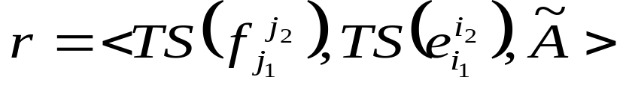
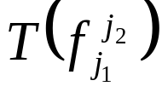
Tree Sequence Translation Rule
The pairs of source parse trees and target parse trees with word alignments
A tree sequence translation rule
    is a source tree sequence, covering
    the span [j₁, j₂] in

Slide 5
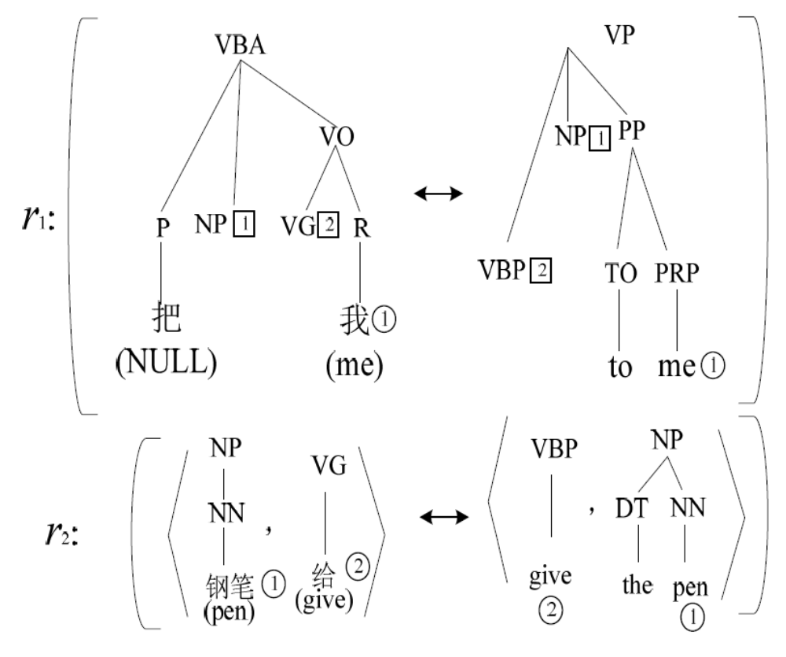
Tree Sequence Translation Rule

Slide 6
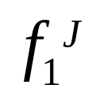
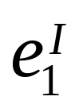
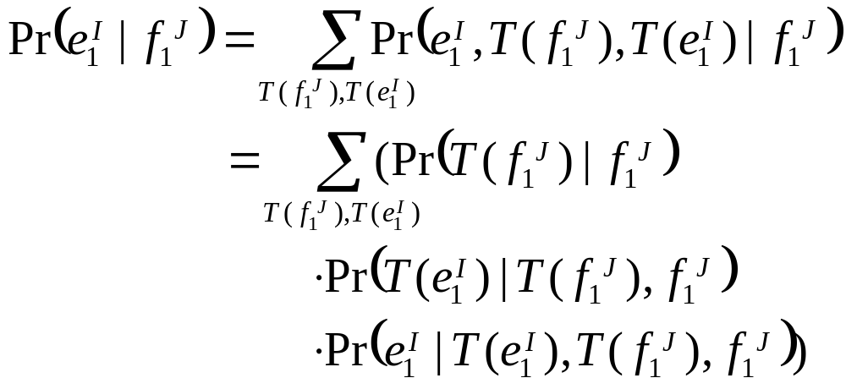
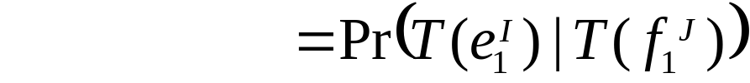
Tree Sequence Translation Model
Given the source and target sentences: and
and their parse trees: and
The tree sequence-to-tree sequence translation model
1
1

Slide 7
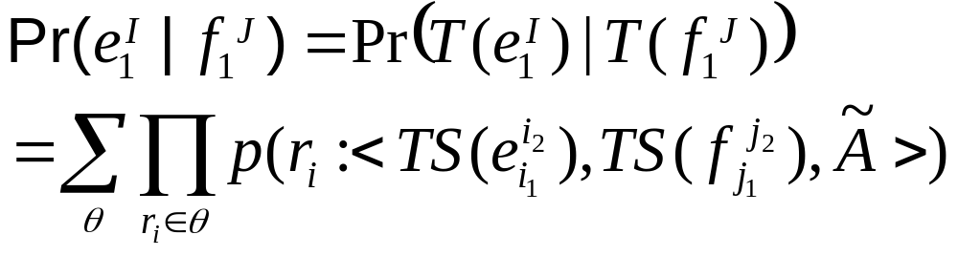
Tree Sequence Translation Model
The probability of each derivation θ is given as the product of the probabilities of all the rules p(r_{i}) used in the derivation

Slide 8
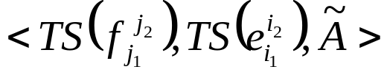

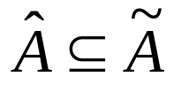
Rule Extraction
Rules are extracted from word-aligned, bi-parsed sentence pairs
  initial rule
    If all leaf nodes of the rule are terminals
  abstract rule
    Otherwise
sub initial rule
  An initial rule

Slide 9
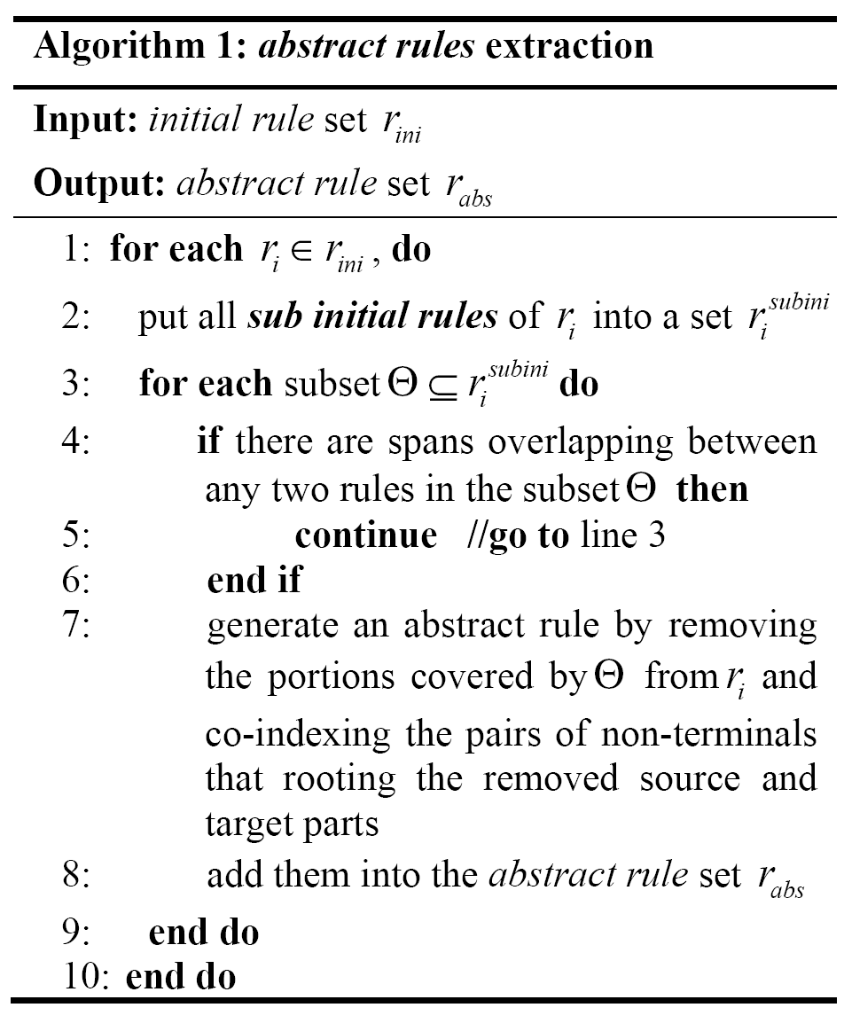
Rule Extraction
Extracting initial rules
Extracting abstract rules

Slide 10
Three constraints for rules
The depth of a tree in a rule is not greater than h
The number of non-terminals as leaf nodes is not greater than c
The tree number in a rule is not greater than d
Initial rules have at most seven lexical words as leaf nodes

Slide 11


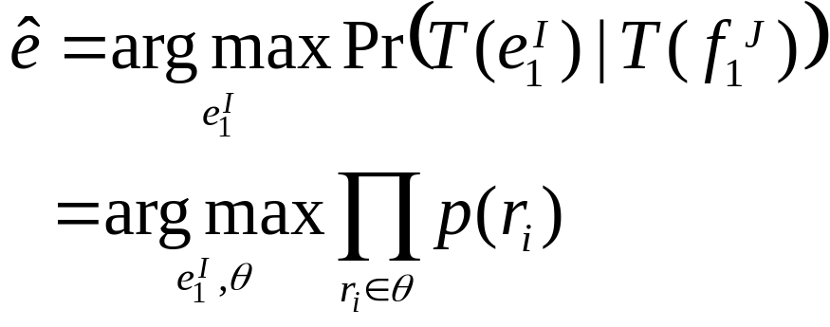
Decoding
Given , the decoder is to find the best derivation θ that generates
Thresholds
  α: the maximal number of rules used
  β: the minimal log probability of rules
  γ: the maximal number of translations yield

Slide 12
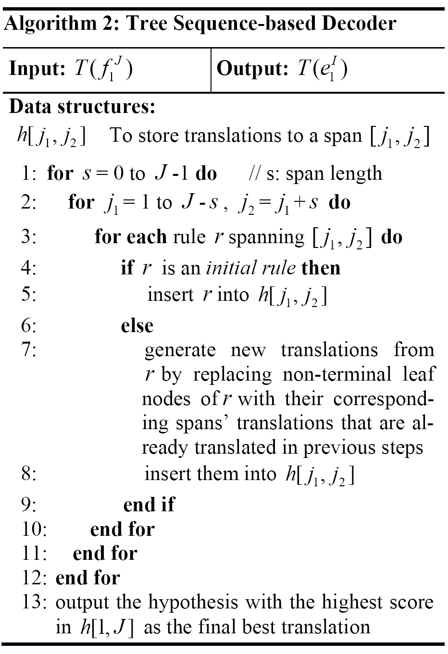
Decoding Algorithm

Slide 13
Experimental Settings
Chinese-to-English translation
  Translation model
    FBIS corpus (7.2M+9.2M words)
  4-gram LM
    Xinhua portion of the English Gigaword corpus (181M words)
  Development set
    NIST MT-2002 test set
  Test set
    NIST MT-2005 test set
Baseline systems
  Moses
  SCFG-based tree-to-tree translation models
  STSG-based tree-to-tree translation models
Threshold
  d=4, h=6
  α=20, β=-100, γ=100

Slide 14
Experimental Results
Compare the model with the three baseline systems
The model’s expressive ability by comparing the contributions made by different kinds of rules
The impact of maximal sub-tree number and sub-tree depth in the model

Slide 15
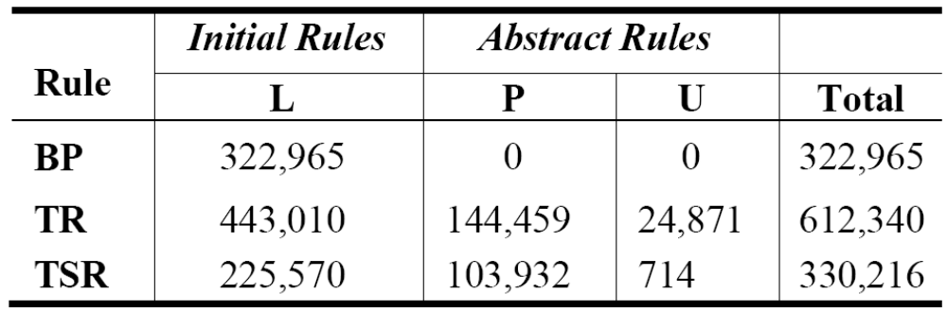
Experimental 1
BP: bilingual phrase (used in Moses)
TR: tree rule (only 1 tree)
TSR: tree sequence rule (> 1 tree),
L: fully lexicalized, P: partially lexicalized, U: unlexicalized

Slide 16
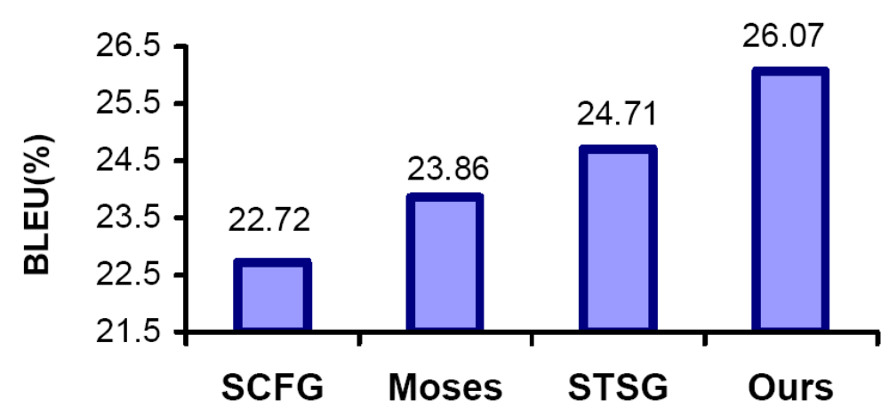
Experiment 1
SCFG: d=1, h=2
STSG: d=1, h=6
The model: d=4, h=6

Slide 17
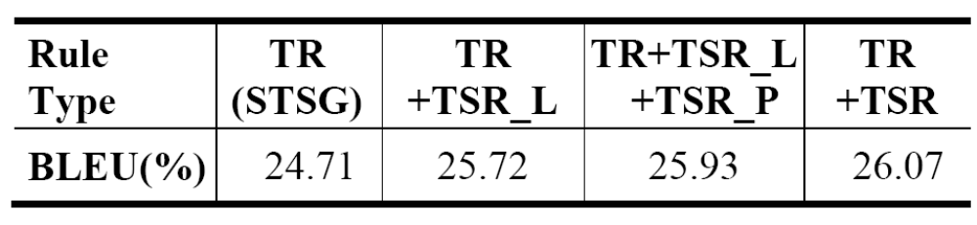
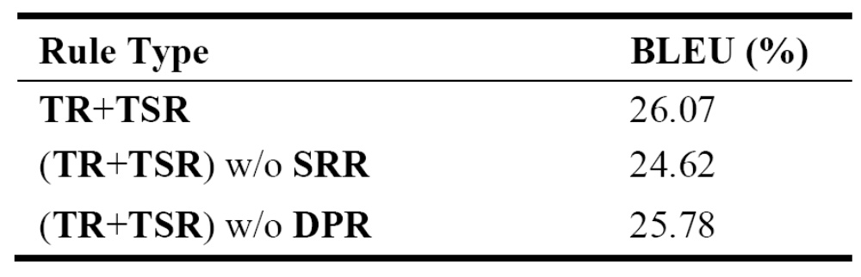
Experiment 2
Structure Reordering Rules (SRR): refers to the structure reordering rules that have at least two non-terminal leaf nodes with inverted order in the source and target sides, which are usually not captured by phrase-based models.
Discontinuous Phrase Rules (DPR): refers to these rules having at least one non-terminal leaf node between two lexicalized leaf nodes

Slide 18
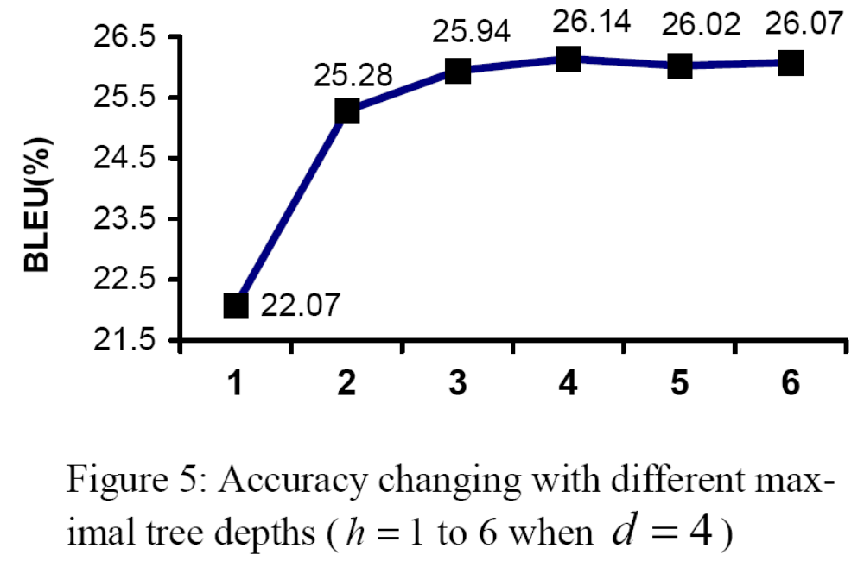
Experiment 3

Slide 19
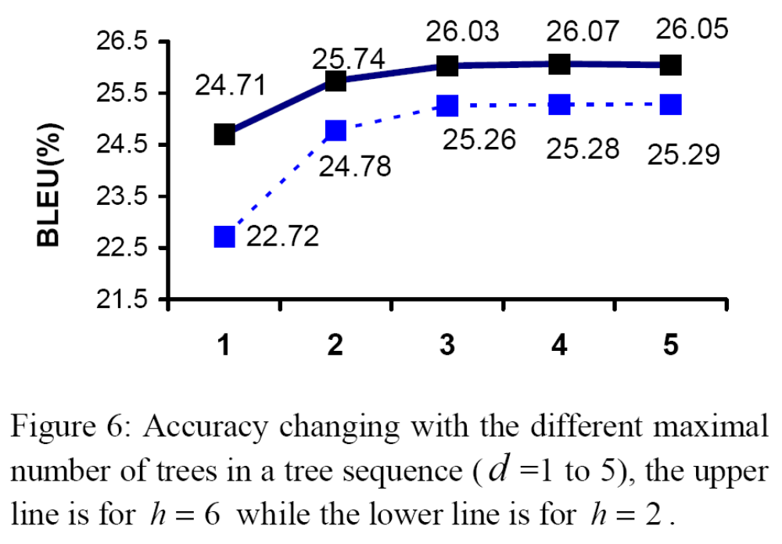
Experiment 3

Slide 20
Conclusions and Future Work
A tree sequence alignment-based translation model combine the strengths of phrase-based and syntax-based methods
Rule optimization and pruning algorithms in future

