Slide 1

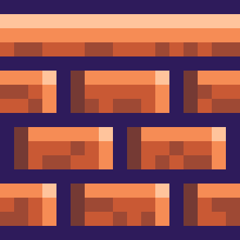

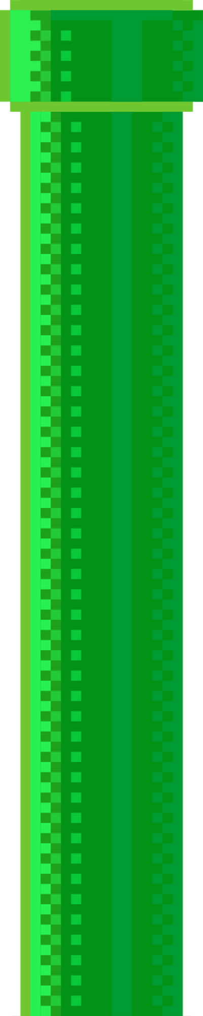
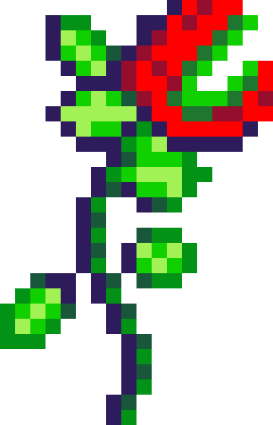

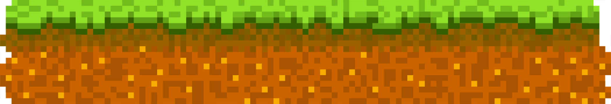
3LLAN

Slide 2



What is our main objective?
A "Super Mario" themed game where the enemies are AI based.
The user is recommended to clear the enemies – otherwise he loses.

Slide 3
Maintaining collaborative work – creating the main idea
Forming the environment for the player – implementing the physics
Adding the recommended AI for the enemies,quality of life changes

Slide 4
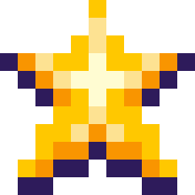







USED PROGRAMS

Slide 5
LETS HEAD TOWARDS THE PROGRAM!

