Slide 1
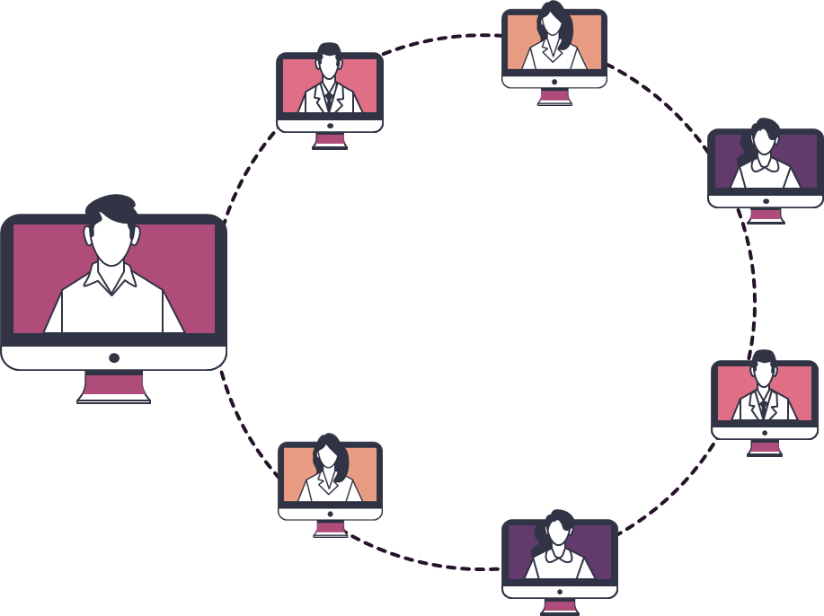
ZenTorrent
A miniature torrent with advanced features

Slide 2
Contents of this template
Here’s what you’ll find in this Slidesgo template:
A slide structure based on a meeting presentation, which you can easily adapt to your needs. For more info on how to edit the template, please visit Slidesgo School or read our FAQs.
An assortment of pictures/illustrations that are suitable for use in the presentation can be found in the alternative resources slide.
A thanks slide, which you must keep so that proper credits for our design are given.
A resources slide, where you’ll find links to all the elements used in the template.
Instructions for use.
Final slides with:
The fonts and colors used in the template.
A selection of illustrations. You can also customize and animate them as you wish with the online editor. Visit Stories by Freepik to find more.
More infographic resources, whose size and color can be edited.
Sets of customizable icons of the following themes: general, business, avatar, creative process, education, help & support, medical, nature, performing arts, SEO & marketing, and teamwork.
You can delete this slide when you’re done editing the presentation.

Slide 3







About the project
•We are going to implement a torrent-like file sharing with improvements of advancements like
•Piece selection Algorithms :
- Weimplement algorithms for selecting which pieces of the file to download first (rarest-first.).
•
•Choking and Unchoking Algorithms:
-Implementing strategies for optimally allocating bandwidth among peers (Tit-for-tat strategy).

Slide 4



Features of the Torrent
P2P Network
Torrents operate on a peer-to-peer network, meaning that users connect directly to each other to share files, rather than relying solely on a central server.
Metadata
A torrent file contains metadata about the files and folders to be shared, including their names, sizes, and the directory structure.
Tracker
We use a tracker, which helps us to coordinate the transfer of files among users. It keeps track of which parts of the file each user has and facilitates communication between them.

Slide 5



Features of the Torrent
Pieces
The files being shared are divided into smaller pieces. Each piece is usually a few kilobytes or megabytes in size. Peers download and upload these pieces individually.
Hashing
Each piece and the overall file have associated hash values. Hashing is used to verify the integrity of the downloaded pieces. If a piece is corrupted or incomplete, its hash won't match the expected value.
Seeder and Leecher
A seeder is a user who has downloaded the complete file and is sharing it. A leecher is a user who is downloading the file but hasn't finished downloading the entire content.

Slide 6
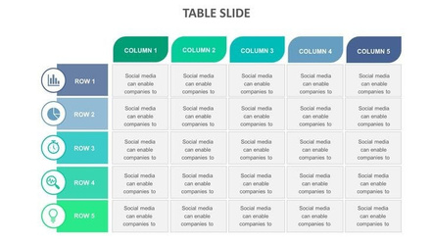


Pieces of the shared file, which are indexed
#1
#2
MetaData
Leecher
Leecher
Leecher
#1
#2
#3
R
Shared
File
Leecher
Seeder
#1
#3
#4
#5
Leecher
Leecher
#2
#3
#6

Slide 7

Piece-Selection Algorithm
When the seeder is on high demand, other leechers that have downloaded pieces of the file can act as potential source of that piece, until it exits the network.
This algorithm helps us in selecting which pieces of the file to download first (rarest-first.).
Rarest First: The client prioritizes downloading pieces that are least available across the network. This strategy helps in ensuring that rare pieces are more widely distributed, preventing bottlenecks.

Slide 8
Pieces of the shared file, which are indexed
#1
#2
MetaData
Leecher
Leecher
Leecher
#1
#2
#3
R
Shared
File
Leecher
Seeder
#1
#3
#4
#5
In this case, we can see that pieces with hash 4,5,6 are rare, so they would be shared first among the network
Leecher
Leecher
#2
#3
#6

Slide 9
Choking and Unchoking Algorithms
Choking and unchoking algorithms manage resource allocation by controlling data transfer speeds between peers.
They ensure fair sharing of available bandwidth, preventing some users from monopolizing resources.
Implementing strategies for optimally allocating bandwidth among peers (Tit-for-tat strategy), like managing upload and download bandwidth.
Tit-for-Tat Strategy: A peer unchokes a limited number of other peers that provide it with the best download rates. This encourages peers to share more actively, as they are rewarded with higher download speeds in return, while choking discourages free-riding or greedy leeching.

Slide 10
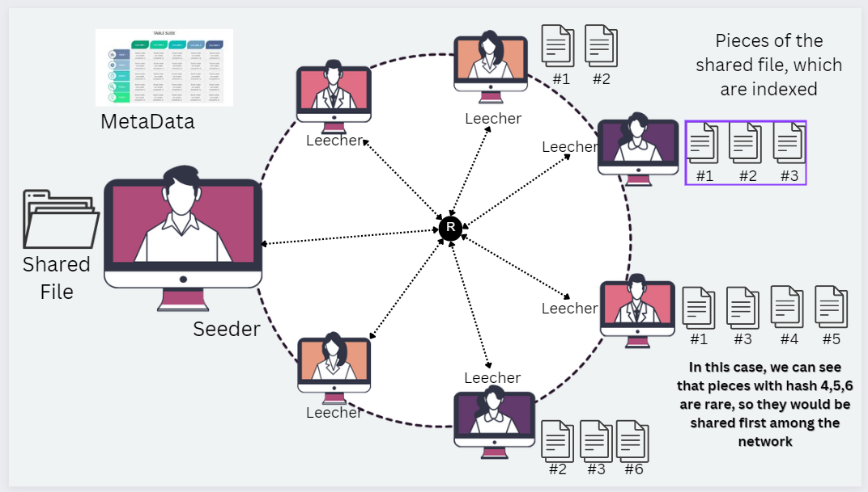


Greedy leacher:
Not willing to share his resources
In this case we can choke the leecher, and punish him for not sharing resources that he has
While we can also unchoke other peers, thereby increasing their download speeds
This is just one such instance, we can use these algorithms for many other purposes

Slide 11







Meeting objectives
Lists help you make your point clearer because:
They’re simple
Organize your ideas
Be specific
Venus
Saturn
Mars
…it’s hot
…it’s big
…it’s cold

