Slide 1
SDN Security
/20

Slide 2
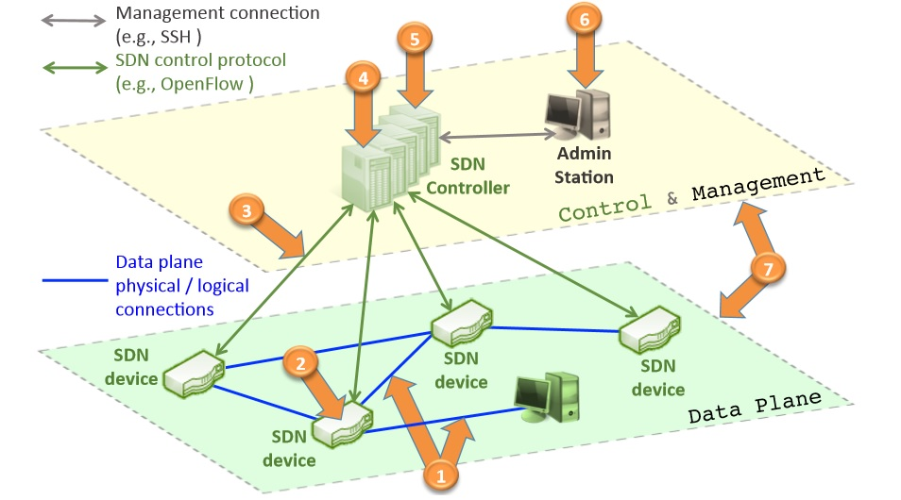
SDN main threat vectors map
/20

Slide 3
SDN main threat vectors
Threat vector 1: forged or faked traﬃc ﬂows
Attacker can use network elements (e.g., switches, servers, or personal computers) to launch a DoS attack against OpenFlow switches
A simple authentication mechanism could mitigate the problem, but if an attacker assumes the control of an application server that stores the details of many users, it can easily use the same authenticated ports and source MAC addresses to inject authorized, but forged, ﬂows into the network.
Possible solutions: The use of Intrusion Detection Systems could help identify abnormal ﬂows
/20

Slide 4
SDN main threat vectors
Threat vector 2: attacks on vulnerabilities in switches
One single switch could be used to drop or slow down packets in the network, or even inject traﬃc or forged requests to overload the controller or neighboring switches.
Possible solutions: The use of mechanisms of software attestation, such as Trust Management Solutions for software components, is a possible mitigating factor. Mechanisms to Monitor and Detect Abnormal behavior of network devices can also be useful to defeat this kind of threats.
/20

Slide 5
SDN main threat vectors
Threat vector 3: attacks on control plane communications
which can be used to generate DoS attacks.
using TLS/SSL does not per se guarantee secure communication, and that compromises the controller–device link.
Moreover, TLS/SSL model is not enough to establish and assure trust between controllers and switches. Once an attacker gains access to the control plane, it may be capable of aggregating enough power force (in terms of the number of switches under its control) to launch DDoS attacks.
Possible solutions:
oligarchic trust models
securing communication with threshold (where the switch will need at least n shares to get a valid controller message).
/20

Slide 6
SDN main threat vectors
Threat vector 4: attacks on and vulnerabilities in controllers
A faulty or malicious controller could compromise an entire network.
Possible solutions: Several techniques can be used, such as Replication, employing Diversity (of controllers, protocols, programming languages, software images, etc.), and Recovery. It is also important to Secure all the Sensitive Elements Inside the Controller (e.g., crypto keys/secrets). Furthermore, Security Policies enforcing correct behavior, restricting what kind of rules an application can generate
/20

Slide 7
SDN main threat vectors
Threat vector 5: lack of mechanisms to ensure trust between the controller and management applications
whereby similarly to threat number 3 (attacks to control plane communications), controllers and applications lack the ability to establish trusted relationships.
Possible solutions: Mechanisms for trust management could be used to guarantee that the application is trusted during its lifetime.
/20

Slide 8
SDN main threat vectors
Threat vector 6: attacks on and vulnerabilities in administrative stations
which, as it is also common in traditional networks, are used in SDNs to access the network controller. These machines are already an exploitable target in current networks, the diﬀerence being that the threat surface as seen from a single compromised machine increases dramatically in SDNs. It becomes easy to reprogram the network from a single location.
Possible solutions: The use of protocols requiring double credential veriﬁcation (e.g., requiring the credentials of two diﬀerent users to access a control server). Also, the use of assured recovery mechanisms to guarantee a reliable state after reboot.
/20

Slide 9
SDN main threat vectors
Threat vector 7: lack of trusted resources for forensics and remediation
which would allow to understand the cause of a detected problem and proceed to a fast and secure mode recovery. we need reliable information from all components and domains of the network for this purpose.
Furthermore, this data will only be useful if its trustworthiness (integrity, authenticity, etc.) can be assured.
Similarly, remediation requires safe and reliable system snapshots to guarantee a fast and correct recovery of network elements to a known working state.
Possible solutions: Logging and tracing are the common mechanisms in use, and are needed both in the data and control planes. However, in order to be eﬀective, they should be indelible (a log that is guaranteed to be immutable and secure). Furthermore, logs should be stored in remote and secure environments.
/20

Slide 10
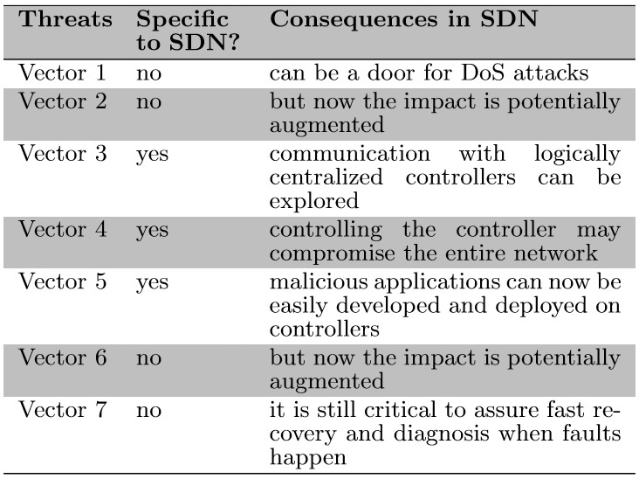
SDN speciﬁc vs non-speciﬁc threats
/20

Slide 11
Secure and Dependable Control Platform
Replication.
Replication makes it possible to mask failures and to isolate malicious or faulty applications and/or controllers. Moreover, in case of a network partition, a replicated application A, with the proper consistency algorithms, will still be able to program all network switches, contrary to not replicated application B.
/20

Slide 12
Secure and Dependable Control Platform
Diversity.
Replication with diverse controllers is a good starting case. The basic principle behind this mechanism is to avoid common-mode faults (e.g., software bugs or vulnerabilities
/20

Slide 13
Secure and Dependable Control Platform
Self-healing mechanisms.
-replacing compromised components, and keep it working virtually forever.
-also we should explore diversity in the recovery process, strengthening the defense against attacks targeting speciﬁc vulnerabilities in a system.
/20

Slide 14
Secure and Dependable Control Platform
Dynamic device association.
If a switch is associated with a single controller, its control plane does not tolerate faults. Once the controller fails, the control operation of the switch fails and the switch will need to associate with another controller.
a switch should be able to dynamically associate with several controllers in a secure way (e.g., by using threshold cryptography to detect malicious controllers and authentication, which would hinder man-in-the-middle attacks, for instance). A switch associated with diﬀerent controllers would be able to automatically tolerate faults.
Other advantages include increasing control plane throughput (several controllers could be used for load balancing) and reducing control delay by choosing the quickest-responding controller.
/20

Slide 15
Secure and Dependable Control Platform
Trust between devices and controllers.
Establishing trust between devices and controllers is an important requirement for overall control plane trustworthiness.
A simple approach would be to have authenticated white lists of known trusted devices, kept at controllers. However, this lacks the ﬂexibility desired in a SDN.
Another option is therefore to trust all switches until its trustworthiness is questioned. Malicious or abnormal behavior could be reported by other switches or controllers, based on anomaly or failure detection algorithms.
/20

Slide 16
Secure and Dependable Control Platform
Trust between applications and controllers software.
As software components present changing behavior due to aging, bugs, or attacks, a dynamic trust model is required ( based on quality attributes, such as availability, reliability, integrity, safety, maintainability, and conﬁdentiality ).
/20

Slide 17
Secure and Dependable Control Platform
Security domains.
Security domains in SDN control platforms can be explored using techniques such as sandboxing and virtualization. These techniques enable the design of strong isolation modes, through well-deﬁned interfaces that allow minimal (only restricted and strictly necessary) set of operations and communication between diﬀerent domains.
/20

Slide 18
Secure and Dependable Control Platform
Secure components.
Secure elements can be used, to provide trusted computing bases (TCB) to assure security properties such as conﬁdentiality.
A TCB is a tamper-proof device that can be used to store sensitive security data (e.g., crypto private keys) and execute basic operations on it. Thus, even if the system is compromised, sensitive data will have its conﬁdentiality assured.
/20

Slide 19
Secure and Dependable Control Platform
Fast and reliable software update and patching.
fast and reliable software patching and update is essential to reduce the window of vulnerabilities.
a control platform should be deployed with mechanisms to assure a smooth and secure way of doing updates.
/20

Slide 20
Thank you!
/20

