Slide 1
Docker

Slide 2
What is docker?
Docker containers wrap up a piece of software in a single file system. This file system includes everything that the software need to run, code, run time, system libraries- anything you can install on a server.
This guarantees that it will always run the same, regardless of the environment it is running in.
Notes:
Docker allows you to package an application with all of its dependencies into a standardized unit for software development.

Slide 3

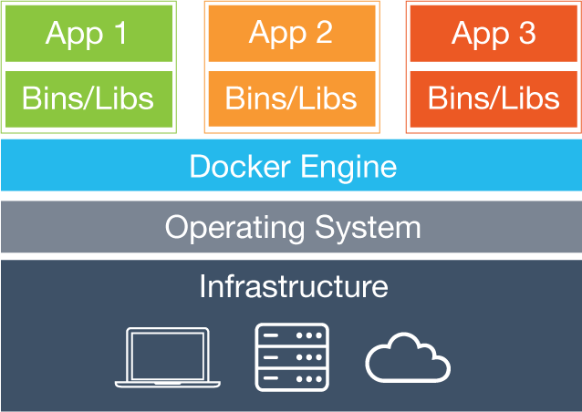
Virtual Machines vs Docker
Virtual Machine
Docker
Notes:
In a way, Docker is a bit like a virtual machine. But unlike a virtual machine, rather than creating a whole virtual operating system, Docker allows applications to use the same Linux kernel as the system that they're running on and only requires applications be shipped with things not already running on the host computer.

Slide 4
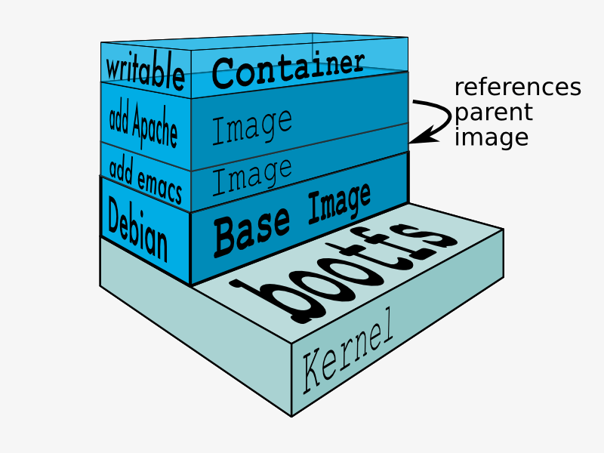
  Basic Docker components
  Docker client
  Images
  Registry
  Containers

Slide 5
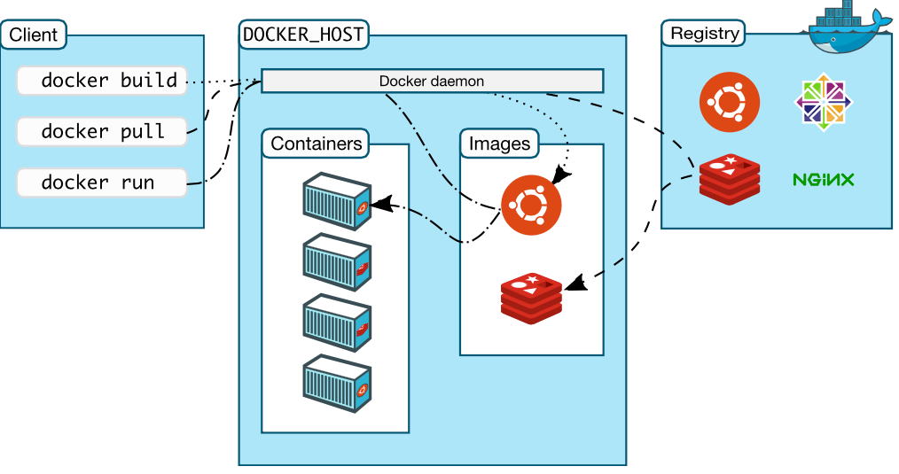

Slide 6
Container
Containers include the application and all of its dependencies, but share the kernel with other containers.
They run as an isolated process in userspace on the host operating system.
They’re also not tied to any specific infrastructure – Docker containers run on any computer, on any infrastructure and in any cloud.
Notes:
Runtime instances of a Docker Image

Slide 7
Docker images
Templates from which containers are created
Layered using union filesystems
Each change to the system is a layer
Typically created with Dockerfiles/instructions
Stored in a docker registry (public/private)

Slide 8
install Docker
run a software image in a container
browse for an image on Docker Hub
create your own image and run it in a container
create a Docker Hub account and an image repository
create an image of your own
push your image to Docker Hub for others to use

Slide 9
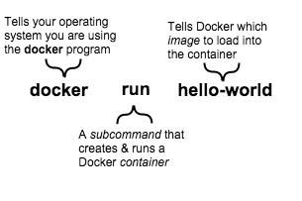
Install Docker
$ wget -qO- https://get.docker.com/ | sh
$ docker run hello-world
Notes:
A container is a stripped-to-basics version of a Linux operating system. An image is software you load into a container. When you ran the command, the Docker software:
checked to see if you had the hello-world software image
downloaded the image from the Docker Hub (more about the hub later)
loaded the image into the container and “ran” it

Slide 10
Run a software image in a container
docker run docker/whalesay cowsay boo
docker images
Notes:
When you run an image in a container, Docker downloads the image to your computer. This local copy of the image saves you time. Docker only downloads the image again if the image’s source changes on the hub. You can, of course, delete the image yourself.

Slide 11
create your own image and run it in a container
Write a Dockerfile and write these lines :
  FROM docker/whalesay:lates
  RUN apt-get -y update && apt-get install -y fortunes
  CMD /usr/games/fortune -a | cowsay
$ docker build -t docker-whale .
$ docker run docker-whale
Notes:
The FROM keyword tells Docker which image your image is based on
Then, Docker installs the new fortunes software.
Finally, Docker finishes the build and reports its outcome.

Slide 12
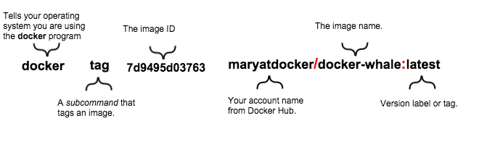
Tag, push, and pull your image
$ docker tag 7d9495d03763 nadeeshani/docker-whale:latest
Notes:
This will create a copy of docker-whale image in nadeeshani
You can group your images together using names and tags, and then upload them to Share Images via Repositories.

Slide 13
$ docker login --username=nadeeshani --password=password --email=pnadeeshani65@gmail.com
$ docker push nadeeshani/docker-whale
Then image will be on the docker hub
$ docker rmi -f 7d9495d03763
# remove images
$ docker pull yourusername/docker-whale
Notes:
docker login command to log into the Docker Hub from the command line.
docker push command to push your image to your new repository.

Slide 14
  Run a Hello world
  $ docker run ubuntu:14.04 /bin/echo 'Hello world'
  Hello world
So what happened to our container after that? Well Docker containers only run as long as the command you specify is active. Here, as soon as Hello world was echoed, the container stopped.

Slide 15
  An interactive container
$ docker run -t -i ubuntu:14.04 /bin/bash
root@af8bae53bdd3:/#
root@af8bae53bdd3:/# pwd
/
root@af8bae53bdd3:/# ls
bin boot dev etc home lib lib64 media mnt opt proc root run sbin srv sys tmp usr var
Notes:
Here we’ve again specified the docker run command and launched an ubuntu:14.04 image. But we’ve also passed in two flags: -t and -i. The -t flag assigns a pseudo-tty or terminal inside our new container and the -i flag allows us to make an interactive connection by grabbing the standard in (STDIN) of the container.
We’ve also specified a new command for our container to run: /bin/bash. This will launch a Bash shell inside our container.
So now when our container is launched we can see that we’ve got a command prompt inside it:
oot@af8bae53bdd3:/# exit
As with our previous container, once the Bash shell process has finished, the container is stopped.

Slide 16
Commands
docker ps - Lists containers.
docker logs - Shows us the standard output of a container.
docker stop - Stops running containers.
Notes:
The docker ps command queries the Docker daemon for information about all the containers it knows about.
To see this we’re going to look inside the container using the docker logs command. Let’s use the container name Docker assigned.
The docker stop command tells Docker to politely stop the running container. If it succeeds it will return the name of the container it has just stopped.

Slide 17
Controlling containers
# Start a new container
$ JOB=$(docker run -d ubuntu /bin/sh -c "while true; do echo Hello world; sleep 1; done")
# Stop the container
$ docker stop $JOB
# Start the container
$ docker start $JOB
# Restart the container
$ docker restart $JOB
# SIGKILL a container
$ docker kill $JOB
# Remove a container
$ docker stop $JOB # Container must be stopped to remove it
$ docker rm $JOB

