Slide 1
Application Owner

Slide 2
Creating Application
Application Owners in the organization can create a applications.
Then he would automatically subscribe to the FREE tier.
So he can choose t2. Type container Specs.

Slide 3
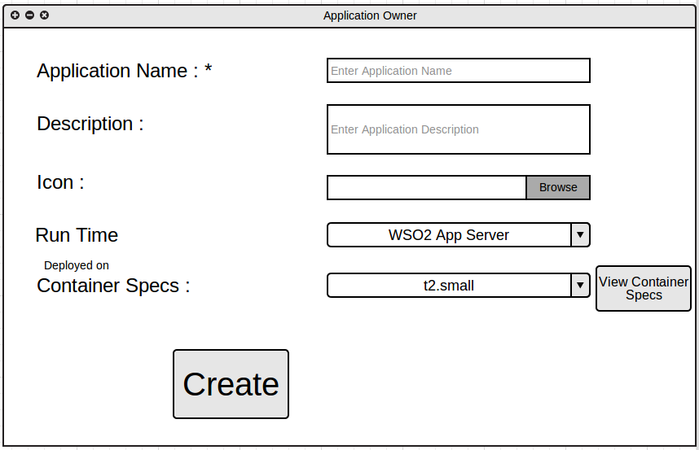

Slide 4
Upgrade Plan
Then Application Owners can upgrade to another subscription plans in the application level.

Slide 5
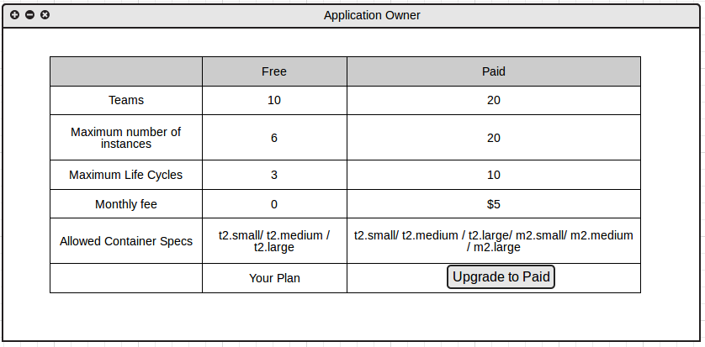

Slide 6
Select container specs for the application
Then the Application Owner can select the container Specs for the Application.
As an example if he is in PAID tier, then he can use any container Spec. But he can restrict some container specs for the Application, considering the pricing plan and the requirements for the application.

Slide 7
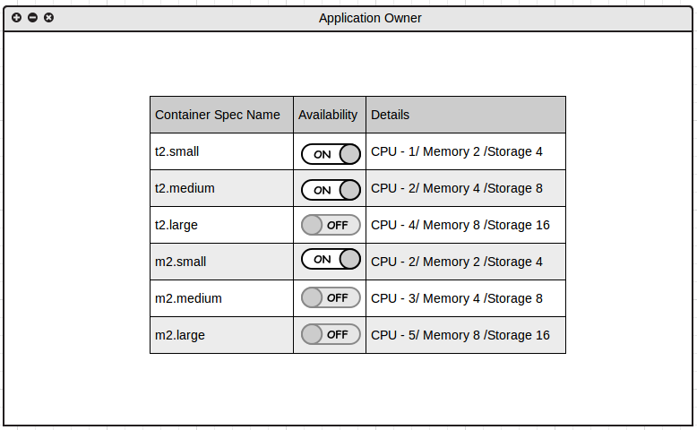

Slide 8
Users (Developers/Testing/Production)

Slide 9
Choose container spec for the Application stage
Then the Users of that Application can choose container specs from the allowed types.
As an example , if the application allowed only t2.small.t2.medium and t2.large then the user can choose the suitable spec from those specs.

Slide 10
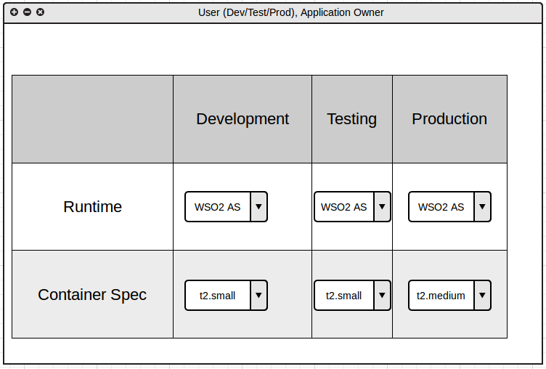

Slide 11
Overview Tab
Then, there would have an Run Time details on Build and Deploy in the overview tab

Slide 12
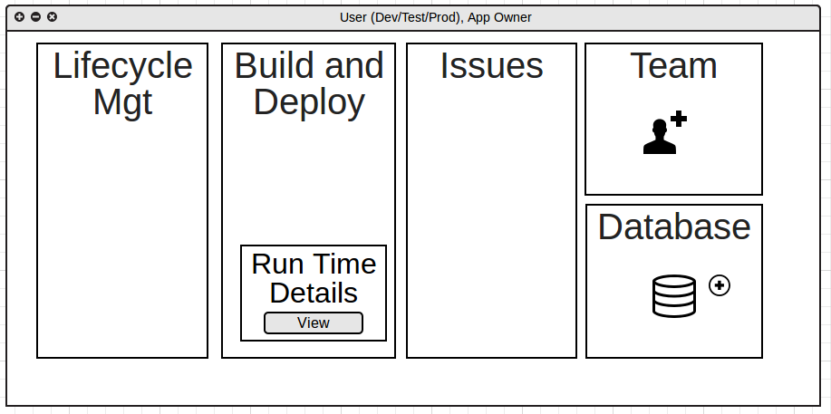

Slide 13
Life Cycle Tab
Then in the Life Cycle tab we can see the Runtime Details for each stage.

Slide 14
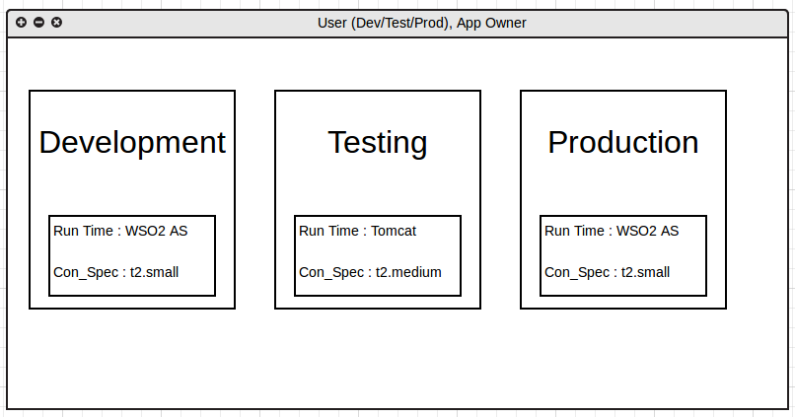

Slide 15
Application Details
Then the Organization admin can view the details of the every application.

Slide 16
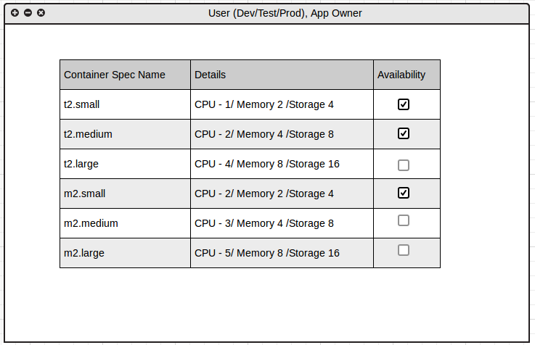

Slide 17
App Factory Configuration Engineer

Slide 18
APP Cloud
Define Subscription Plans
Define Container Specs

Slide 19
???
Monthly fee??

