Slide 1
MYSQL DATABASE TO
DISTRIBUTED NOSQL DATABSE MIGRATION
PRESENTATION BY :
203IT001 | Shankaranarayan N(M.Tech Research IT)
IT701 | Project Presentation | 23 Jan 2021

Slide 2
Content
Problem Statement
Environment Details
What is Cassandra /
Methodology and Implementation
Result and Suggestion

Slide 3

Problem Statement
Relational databases (RDBMS) have been around for a long time and is being widely used. Relational databases and the methodologies used to represent it is a result of decades of development and improvement. Despite their plentiful advantages, relational databases falls behind when it comes to SCALABILITY. To solve this issue NoSql Databases were introduced.
Currently major tech companies are shifting towards NoSql Databases as it tends to be a better option for modern applications that have more complex, constantly changing data sets, requiring a flexible data model that doesn’t need to be immediately defined.
ATTRIBUTE 1 | ATTRIBUTE 2 | ATTRIBUTE 3 | ATTRIBUTE 4
ATTRIBUTE 5
CAN’T HAPPEN

Slide 4
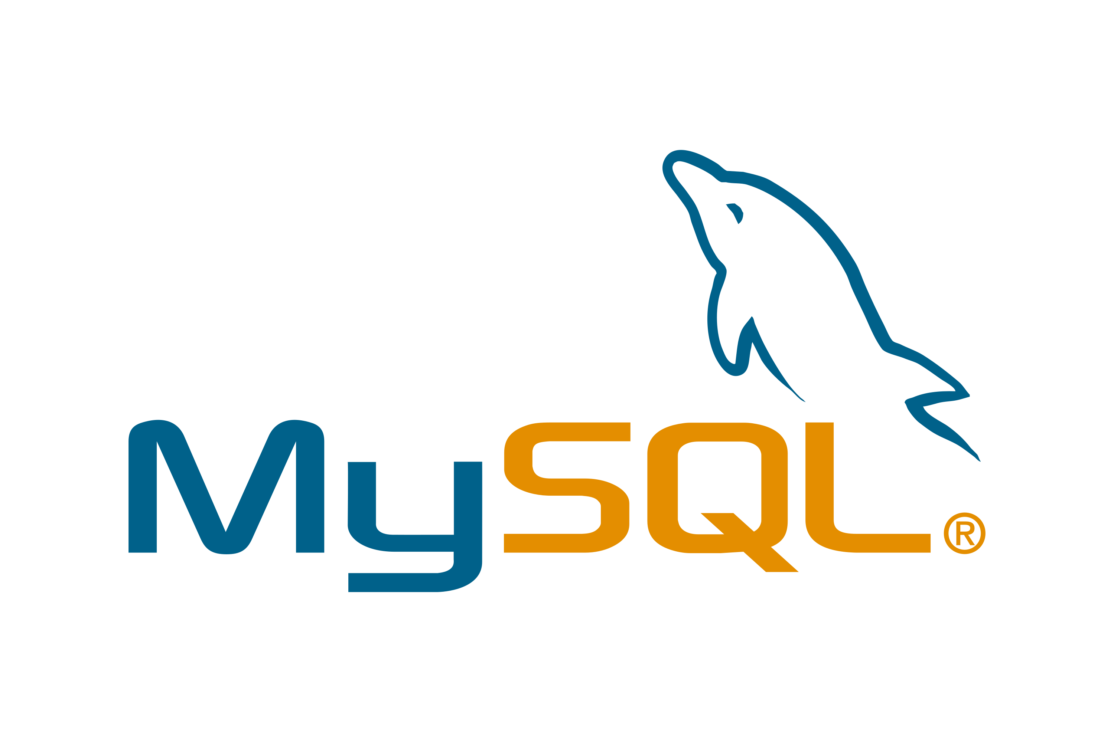


Environment
RELATIONAL DATABASE
We are using MySql
Database for RDBMS
PYTHON CODE
NoSQL DATABASE
We are using Cassandra
For NoSql Database

Slide 5
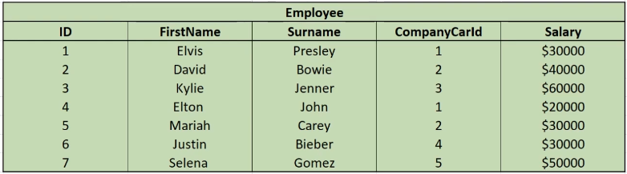
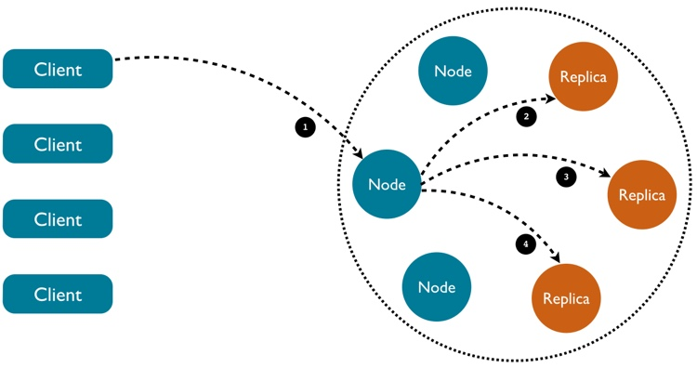
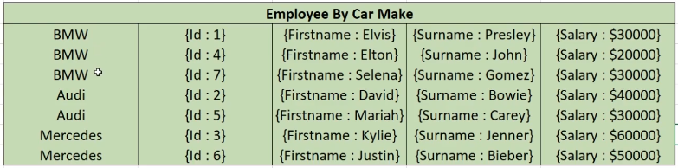
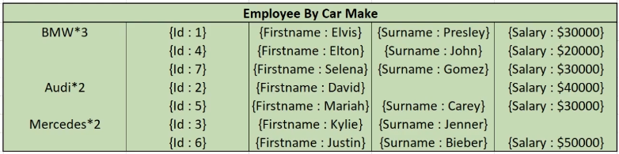
What is Cassandra ?

Slide 6

Methodology and Implementation
CONNECT TO MYSQL DB
IMPORT FUNCTION TO IMPORT DATA INTO
CASSANDRA WITH THE HELP OF
GENERATED QUERY
EXPORT DATA
GENERATE QUERY BASED ON THE DATA

Slide 7
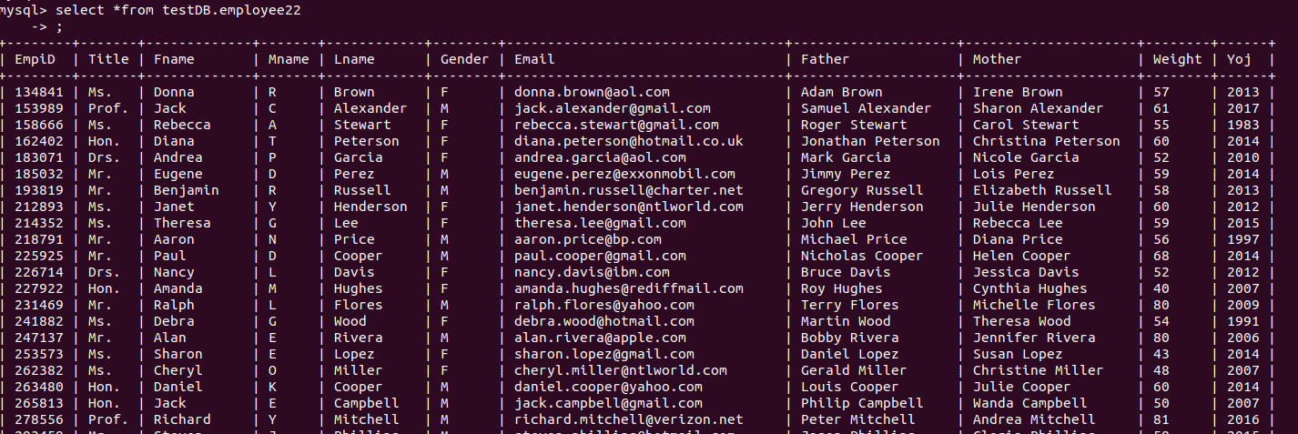
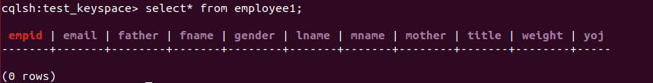
Result
DATA TO BE MIGRATED [LOCATED AT MYSQL DB]
EMPLY TABLE AT TARGET LOCATION [CASSANDRA]

Slide 8
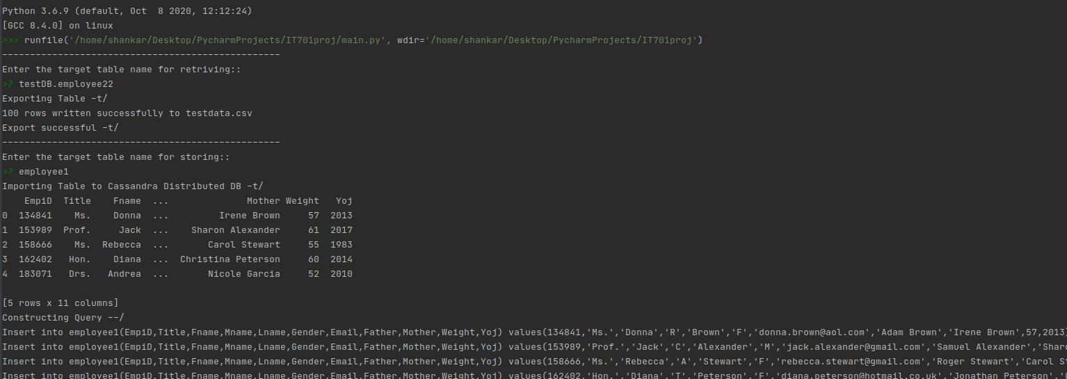
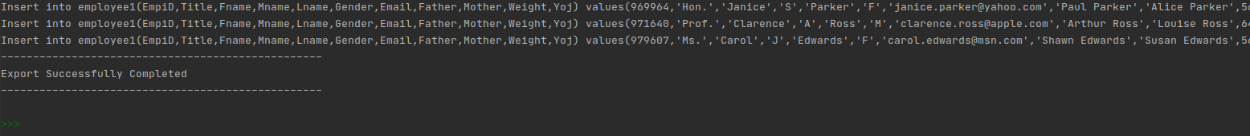
Result

Slide 9
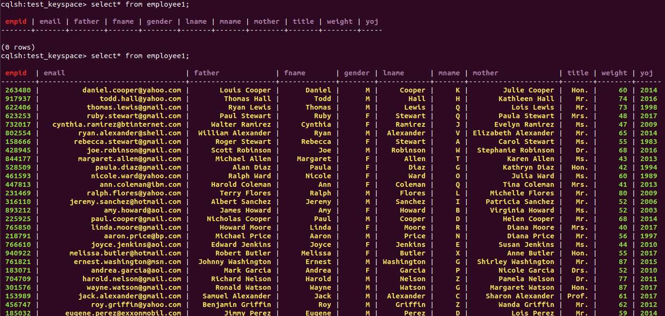
Result
TARGET TABLE AFTER SUCCESSFUL MIGRATION

Slide 10

Suggestions [Introducing custom fragmentation techniques]

