Slide 1
Lightweight yet Powerful: Edge-Cloud Cooperative LoRA-MoE
Faculty Mentor: Prof. Ian G. Harris
By: Monish N S

Slide 2








Cloud/Server
Edge Devices
Notes:
Background:
Resource Constraints: Limited Computation and Memory
Data Constraints: Personalized and Decentralized Data
Current Approach - Federated Learning:
Incapable with SOTA LLMs (large!) due to its nature of deploying the entire model on edge
Problem Statement: How can we enable efficient fine-tuning on edge devices without degrading overall performance?

Slide 3
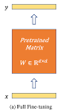
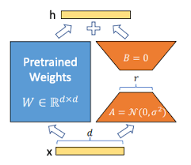
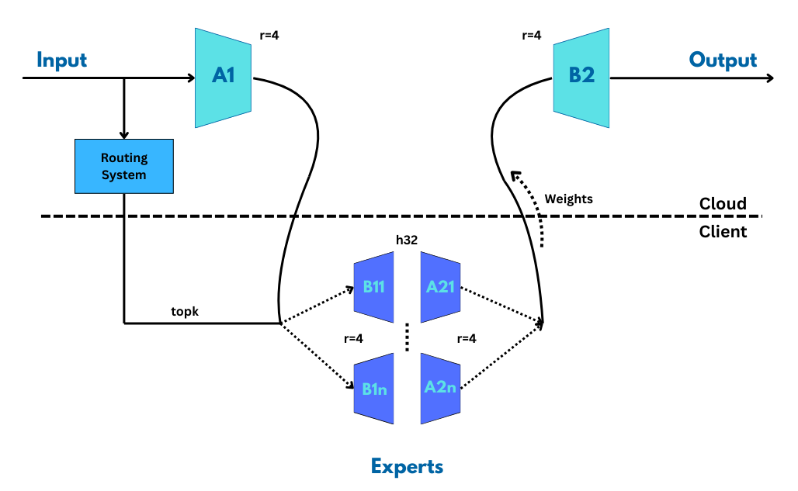
Fine-Tuning
Full Fine-Tuning:
100% Trainable parameters
Memory and Resource Consuming
LoRA Matrices:
<1% Trainable parameters
Memory and Resource efficient
Not edge-friendly
Proposed Structure
<0.1% Trainable parameters on edge
Time and Resource efficient
Edge-friendly
Notes:
Background:
Resource Constraints: Limited Computation and Memory
Data Constraints: Personalized and Decentralized Data
Current Approach - Federated Learning:
Incapable with SOTA LLMs (large!) due to its nature of deploying the entire model on edge
Problem Statement: How can we enable efficient fine-tuning on edge devices without degrading overall performance?

Slide 4
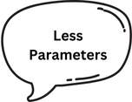



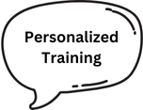
Edge-Aware LoRA: Structure
Notes:
Key Features
Incorporation of Mixture of Experts (MoE) on Edge
Detached LoRA Design: Allows rank shrinkage in/out the edge
Benefits
SOTA Performance
Lightweight on Edge
Weight Privacy

Slide 5
Results and Evidence
Models | Epochs | Rank | Params | Accuracy (Best Epoch) | Accuracy (Median) | Precision | Recall | F1
LoRA | 10 | r = 8 | 0.22% | 0.9070 | 0.9059 | 0.9068 | 0.9061 | 0.9063
DetachedLoRA – h64 |  |  | 0.23% | 0.9064 | 0.9057 | 0.9058 | 0.9051 | 0.9053
EdgeAwareLoRA – h32 |  | r/k = 4 | 0.18% | 0.9081 | 0.9048 | 0.9048 | 0.9041 | 0.9043
Dataset: MNLI, Model: RoBERTa Large
All experiments has 5 seeds (42, 123, 7, 99, 101)

Slide 6
Conclusion
Makes computation using LLMs on edge devices possible
Addresses the challenges of limited computation and efficient memory usage
Enables usage personalized data for training while preserving weight privacy
Achieves State of the Art (SOTA) performance and metrics similar or better to existing works

Slide 7
Thank you!

