Slide 1

DDoS attack detection with Machine Learning

Slide 2




Library Used

Slide 3
DATASET AND OERVIEW
The dataset has taken from The Canadian Institute for Cybersecurity (CIC) generate the dataset in collaboration with The Communications Security Establishment (CSE) of network events, some benign and other malicious.
By using CICFlowMeter-V3, around 80 network traffic features were extracted from each attack.
The goal of this project is to use this dataset to identify cybersecurity threats and furthermore to classify threat with as much accuracy as possible using machine learning
https://github.com/AsimGull/Data-Science-Projects/blob/main/Machine%20learning/Natural%20language%20processing/DDoS%20Attack%20Classification/data/DDos.csv
Original dataset
https://www.unb.ca/cic/datasets/index.html

Slide 4
Why is this valuable
This product is valuable in a variety of cybersecurity scenarios. It can be used by companies who wish to monitor their own machines, or those of clients, for malicious activity. In addition to being able to identify malicious activity, users will be able to determine which types of attacks are occuring in order to implement countermeasures tailored to those attacks.

Slide 5
Project flow
Loading data
Data Visualization
Data shape
Data type
Data Cleaning
Null values
Duplicates
Threat distribution
Data splitting
Model training
Model evaluation
Model comparison
Model Optimization

Slide 6

Loading Data

Slide 7
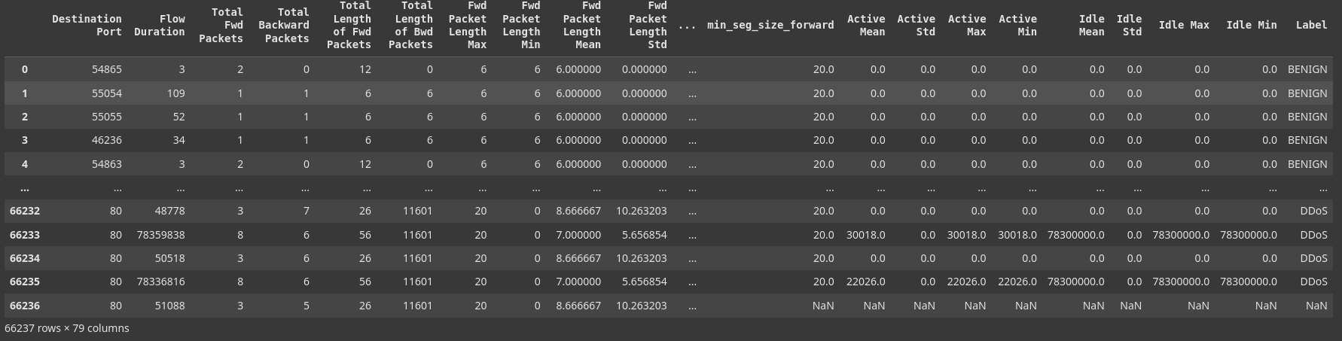
The original dataset includes 400+ GB of event log (evtx.) files. These files have been processed into 9 CSV files spanning nine different days worth of attacks.
Among those 9 CSV file using one of those files, the size of dataset is 22.5 MB with 66237 rows and 79 columns, including 79 network traffic features along with attacker's port, Protocol name and timestamp for the attack.

Slide 8
Data Visualization

Slide 9

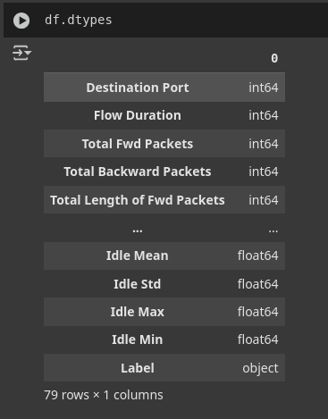
Data shape
Data type

Slide 10
Data Cleaning

Slide 11
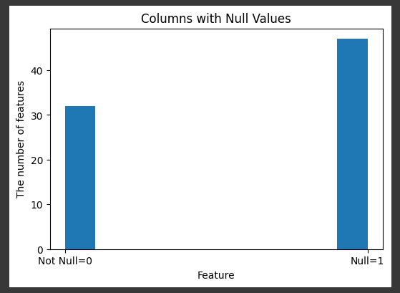
Null Values

Slide 12
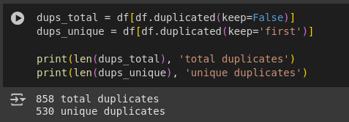
Duplicates

Slide 13
Threat distribution

Slide 14
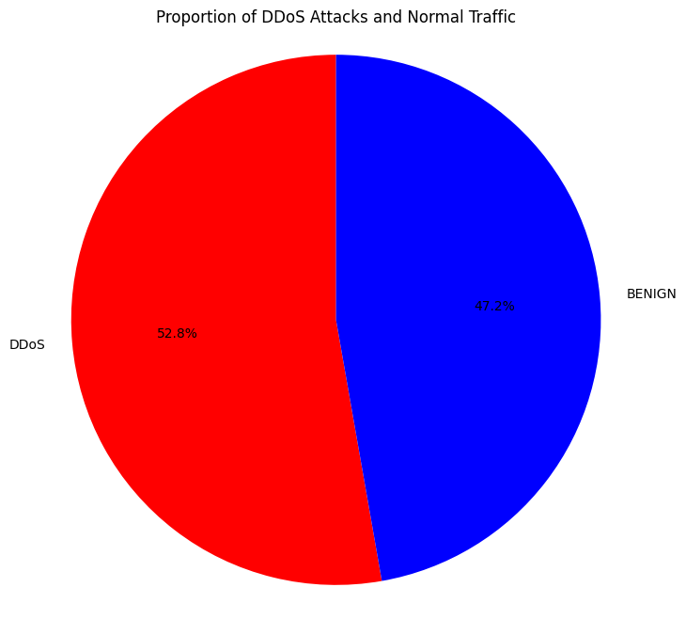

Slide 15
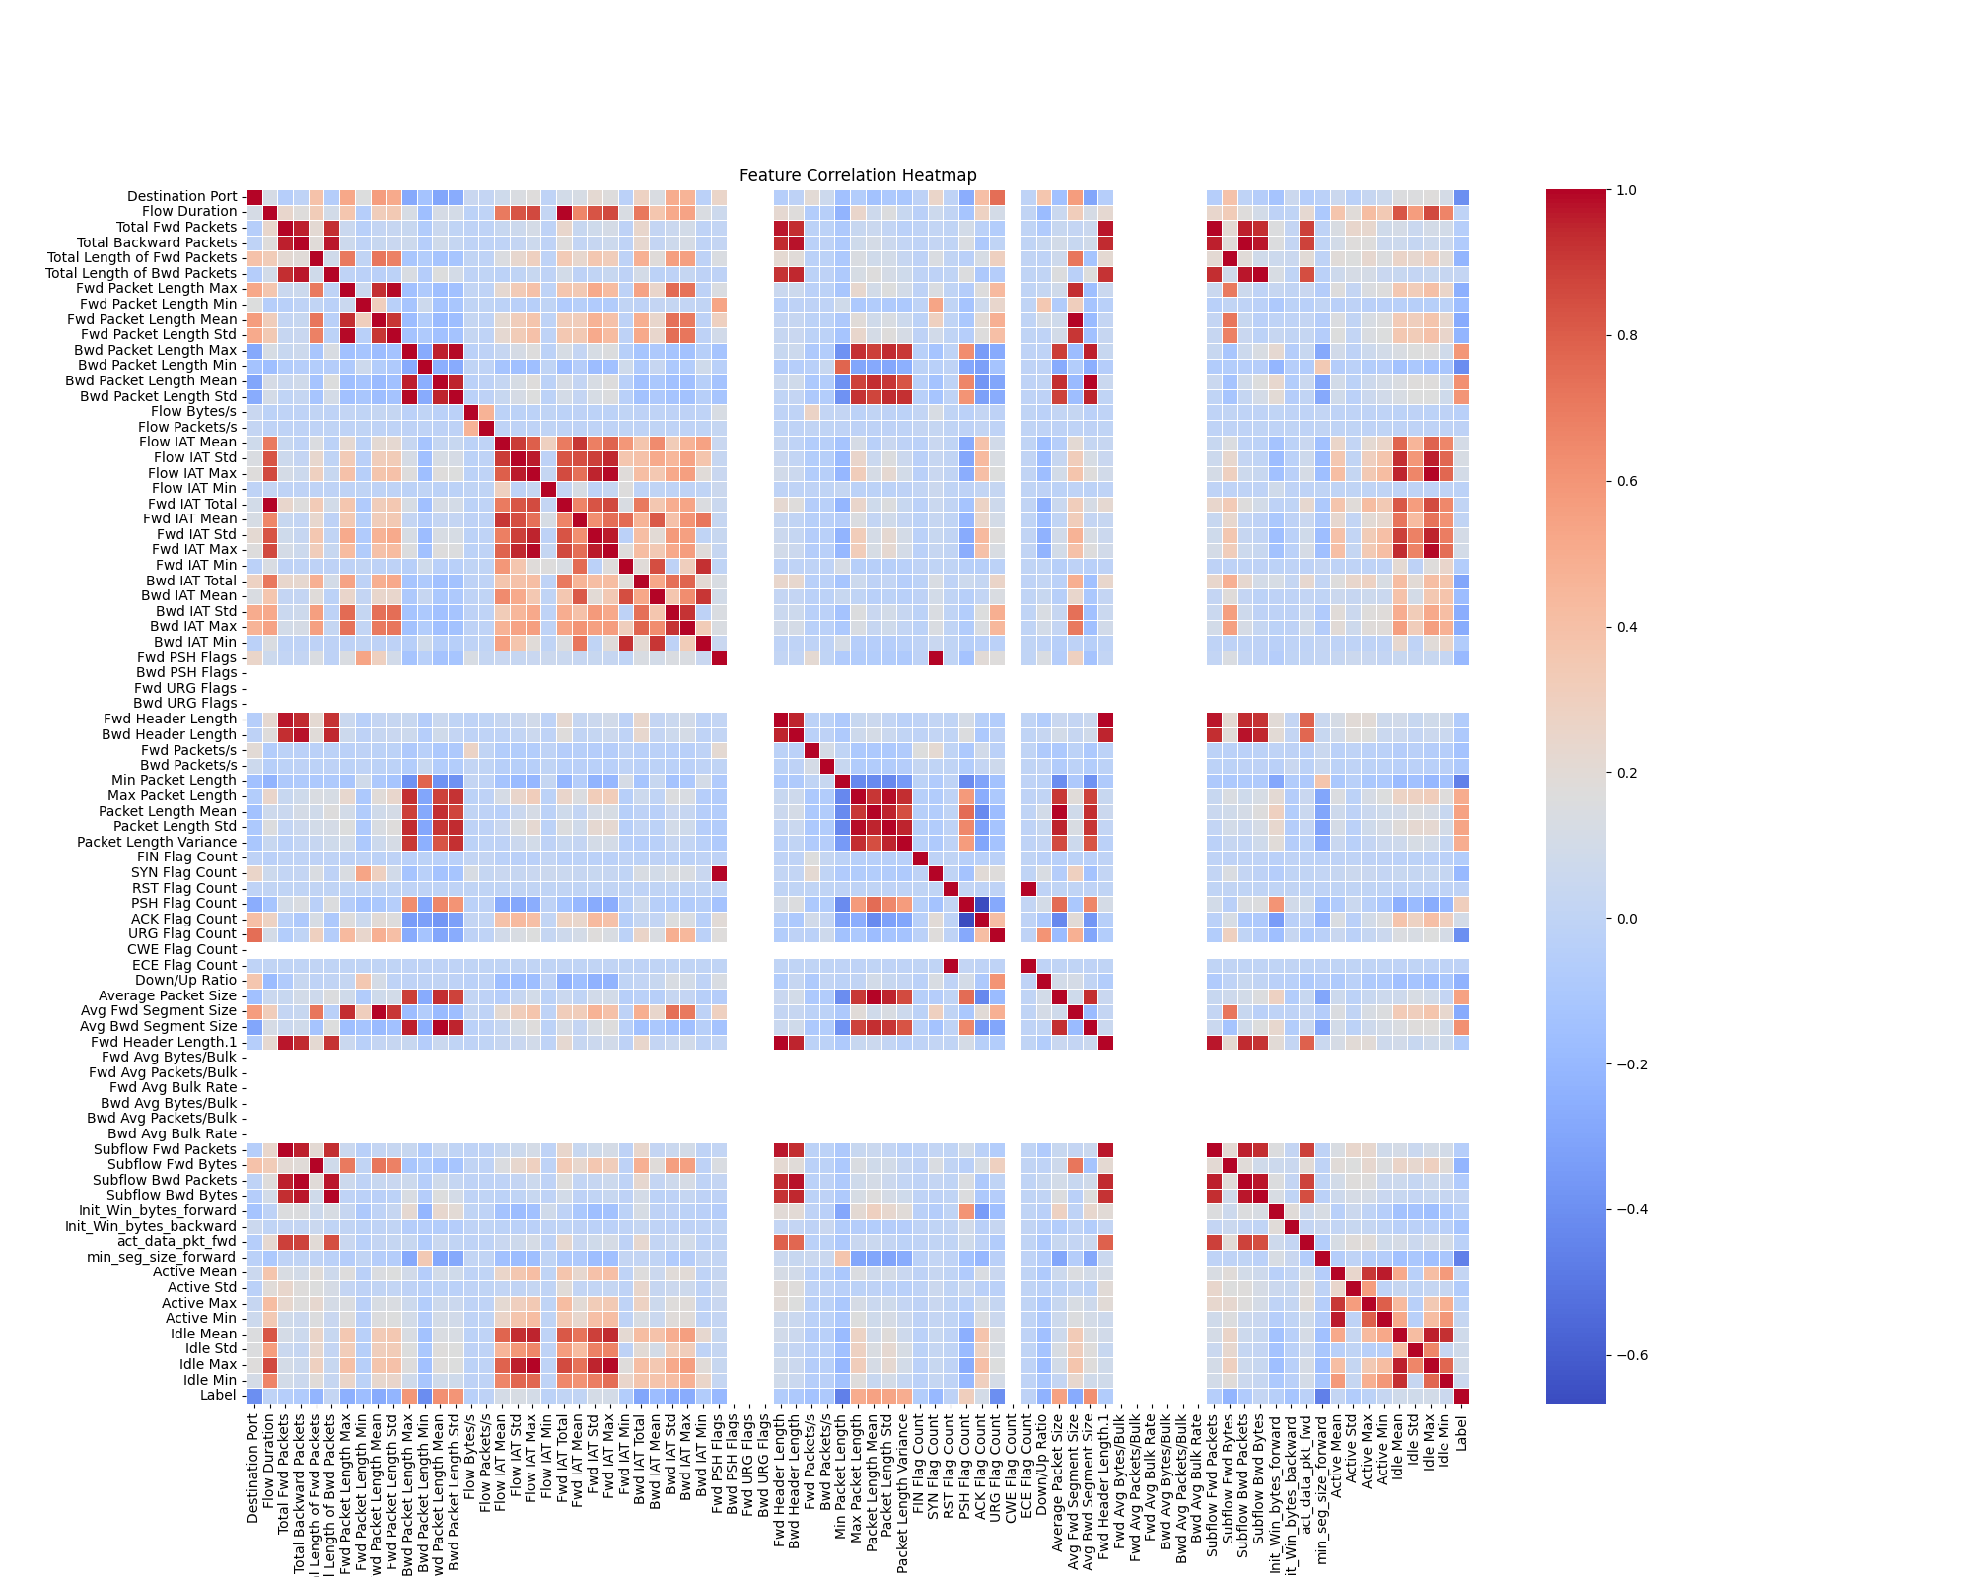

Slide 16
Data Splitting

Slide 17
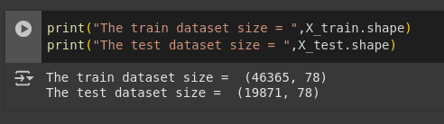

Slide 18
Model Training

Slide 19
Model Used
Random Forest
Logistic Regression
SVM
Neural network

Slide 20
Model Evaluation

Slide 21
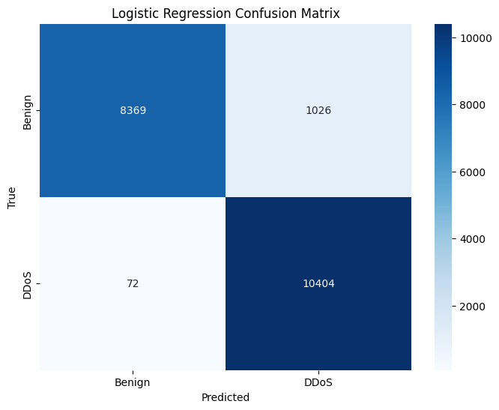

Slide 22
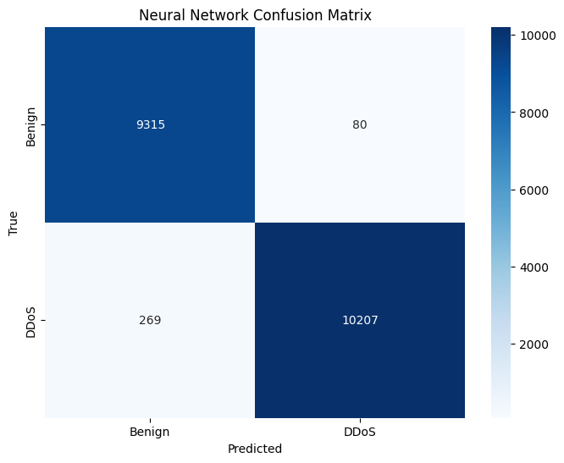

Slide 23


Slide 24
ROC curve

Slide 25
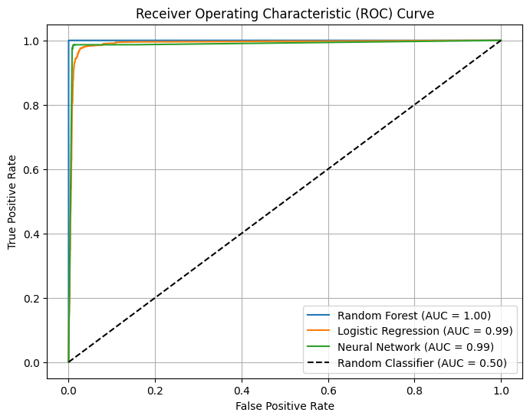

Slide 26

Summary Table

Slide 27
Model | Accuracy | Precision | Recall | F1 Score | AUC
Random Forest | 0.999497 | 1.000000 | 0.999045 | 0.999522 | 1.000000
Logistic Regression | 0.944744 | 0.910236 | 0.993127 | 0.949877 | 0.990428
Neural Network | 0.982437 | 0.992223 | 0.974322 | 0.983191 | 0.988108
SVM | 0.951688 | 0.956797 | 0.951317 | 0.954049 | 0.979258

Slide 28
Model Optimization

Slide 29
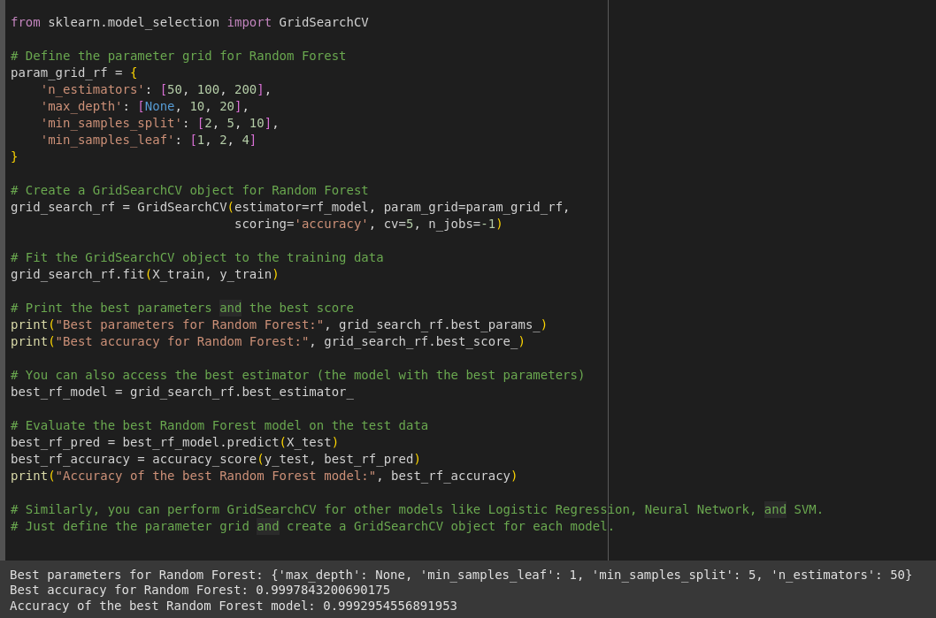

Slide 30

Thank you

