Slide 1
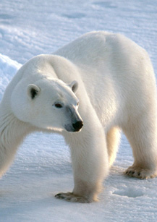
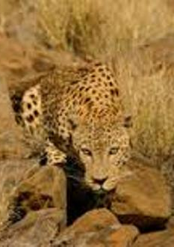
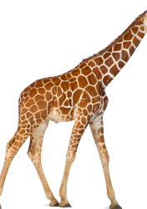
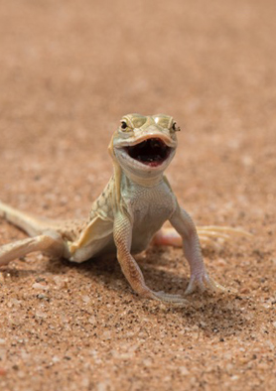
Variation and Evolution

Slide 2
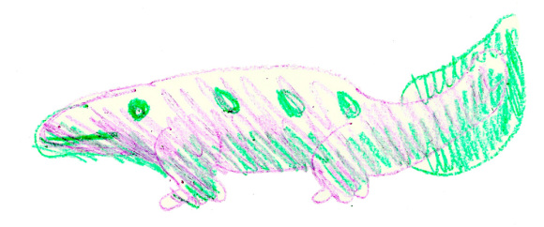
Starter - Lizards
Copy the lizard
You have 10 minutes

Slide 3

Are all the lizards the same?

Slide 4
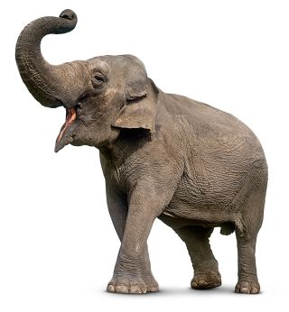
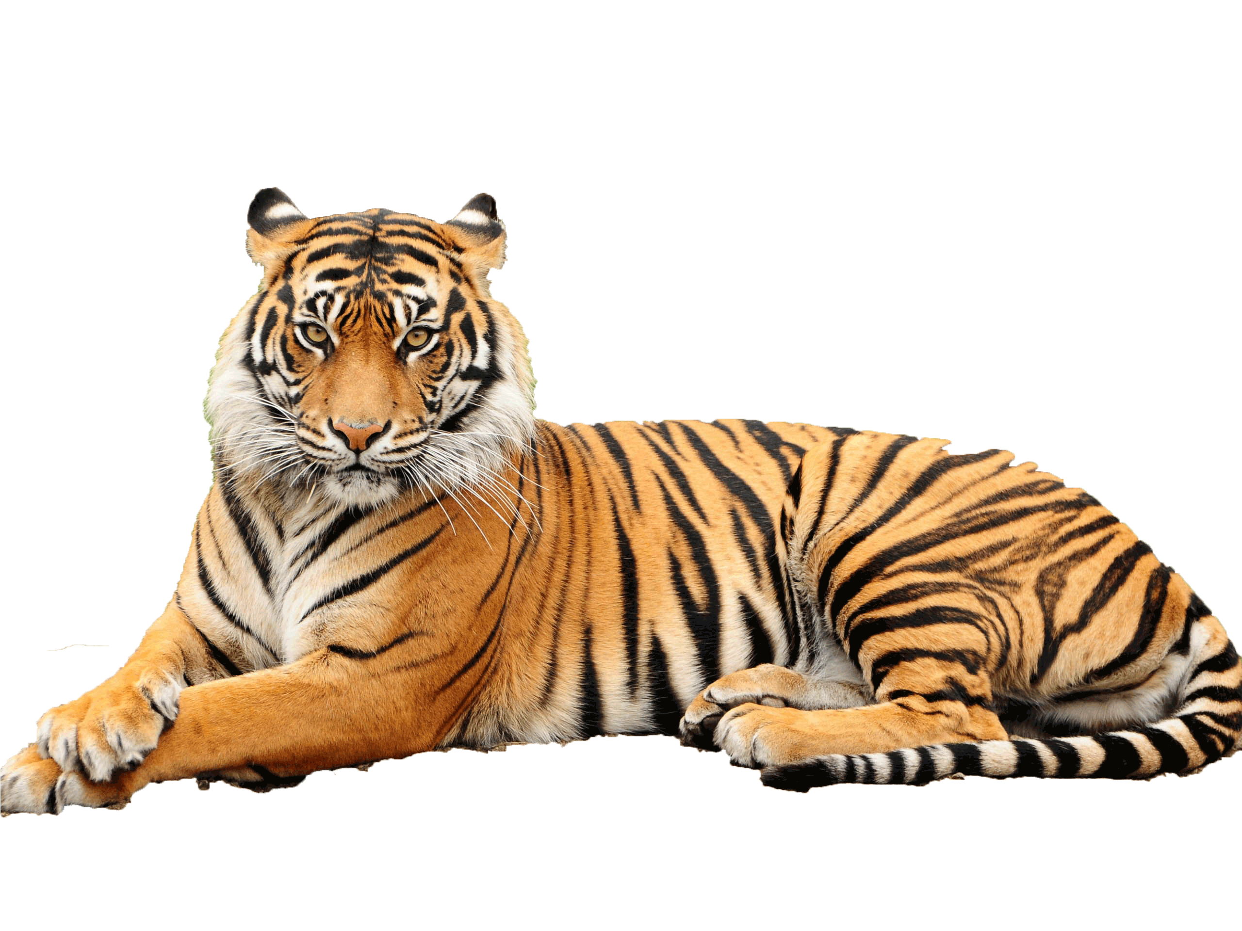
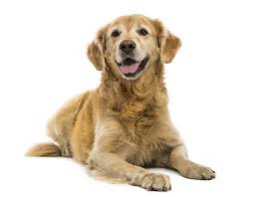
Variation – Difference in size, colour, presence of a characteristic within a species/population

Slide 5
Activity
In each half, compare all of your lizards
Decide which lizard would be most likely to survive in the given scenario
The chosen lizard from each half will be pinned on the board

Slide 6
Activity
Copy the lizard you chose on your paper

Slide 7
Activity
Once again choose the lizard most suited to the scenario in your half and pin it on the board
For the final time copy the drawing of this lizard, choose the best suited and pin it up

Slide 8
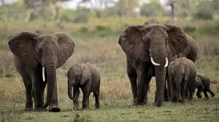
Generation – animals all born in a certain time period
Notes:
What has happened to the original lizard image I show you compared to the final lizard drawing?
List some differences

Slide 9
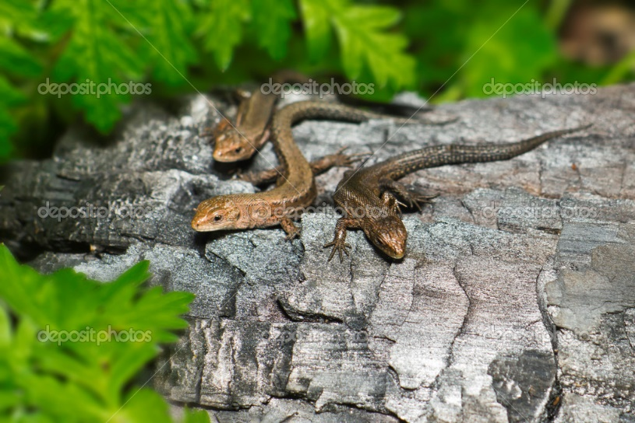
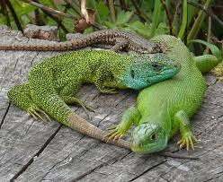
Lizard generations
Our lizards have only changed a little bit over the 3 generations
But over many generations large amounts of change can be observed
Over millions of years animals can change enough that they become a different animal altogether

Slide 10
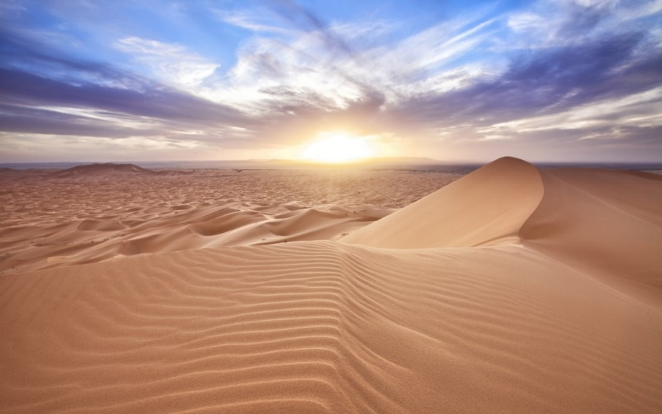
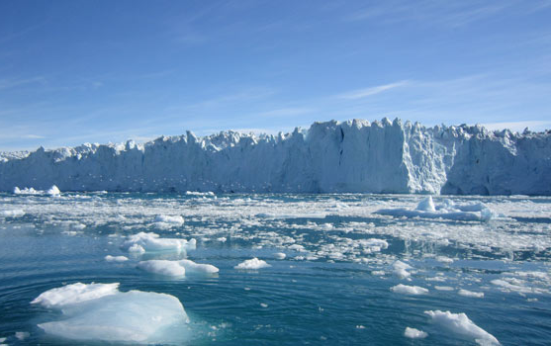
Habitat The natural home or environment of a plant or animal
Natural selection the process where organisms better adapted to their habitat tend to survive and produce more offspring
Notes:
The population of animals is said to have evolved (changed over time) towards having characteristics that improve survival. This is happening over thousands of years, and not within one lizard’s lifetime!
Tell story of black peppered moth

Slide 11
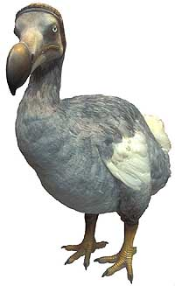
Natural Selection
Natural selection operates for a long time
Slowly the organism will get positive characteristics that makes it very successful in the environment that it lives in
Sometimes adaptation might cause organisms to become so specialized to the environment that they live in, that they cannot survive in other environments or if the climate where they live changes.
Extinction – where there are no living members of a species left
Notes:
Put into context of Dodo and black peppered moth
And discuss with pupils the examples on the previous slides

Slide 12
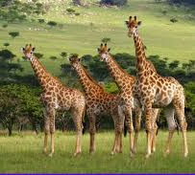
Adaption - a characteristic that has become common in a population because it provides improved success under the given environmental conditions.
Notes:
Lizards that survived (chosen in each round) have characteristics that help them to survive and reproduce
They are best suited (adapted) to their habitat. What is a habitiat?

Slide 13
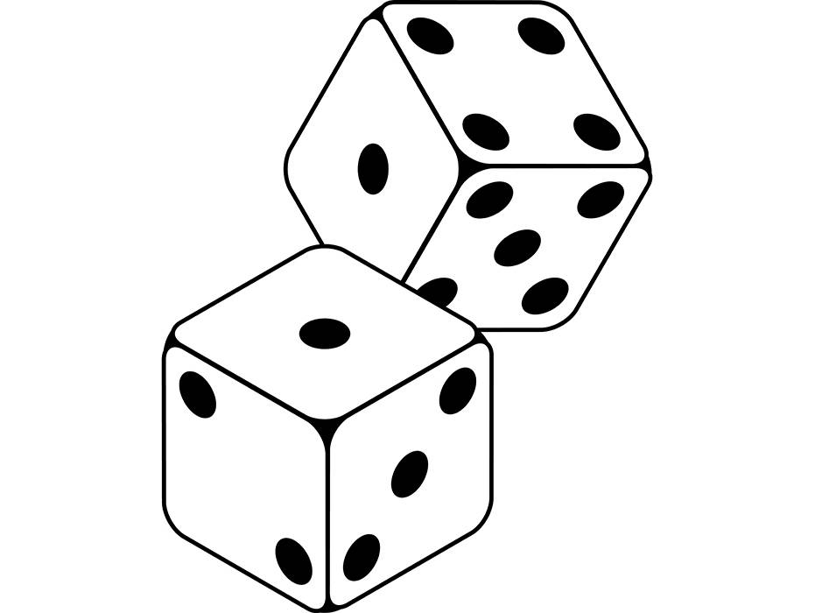
TOP TRUMPS

Slide 14

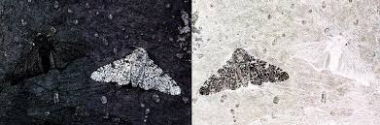
Summary
Organisms change a small amount over generations
It is only over thousands of generations that large changes can be observed
Natural selection is when an organism becomes better suited to an environment and occurs over a long period of time
The changes can happen by inheritance from their parents or random mutations
Adaptions are characteristics that has become common in a population because it provides improved success under the given environmental conditions

Slide 15


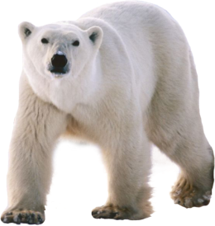
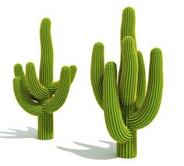
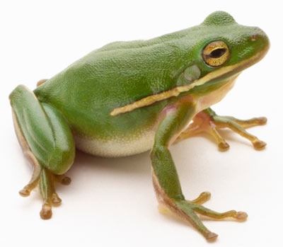
Which environments can/can’t each of these live in?
How could it survive if the world gets warmer?
Notes:
What environment can it live in?
Which environment can’t it live in
How could it survive if the world gets warmer

