Slide 1
ADAPTATION AND CHANGE OVER TIME

Slide 2
Starter
How many circles can you pick up with a pair of tweezers in 20 seconds?
Double what’s left, switch roles and go again!

Slide 3
Starter
Do you have more white or black circles left?
Why do you think this is?

Slide 4
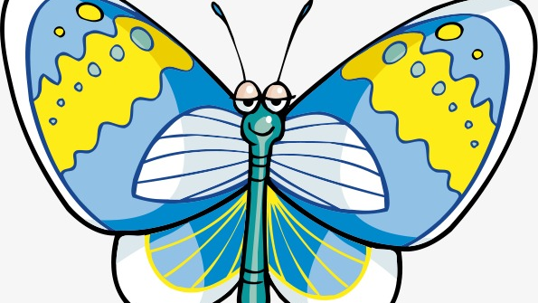
Activity
You have 10 minutes to design 10 moths in pairs!
Think about camouflage…

Slide 5
Activity
Place your moths on the background given to your table.
Which of the moths do you think will survive? Why?

Slide 6
Activity
One person from your table should go and be a predator for another table. You have 10 seconds to pick up as many moths as possible with your tweezers.

Slide 7
Activity
Why did some moths survive?
Some were better camouflaged and therefore better adapted.
This is natural selection.

Slide 8
Activity
Repeat the experiment swapping backgrounds.

Slide 9
Activity
Whose tactics worked best for their moths to survive?
Should they all be the same or have some variety?

Slide 10


Why do we need variation in a population?

