Slide 1
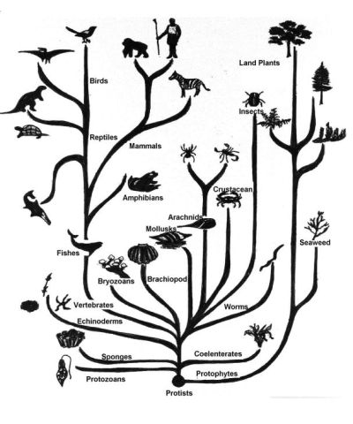
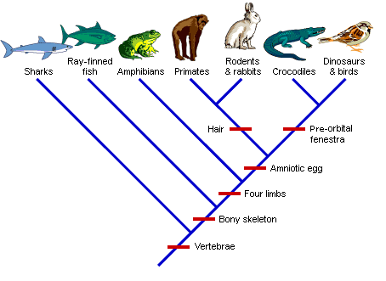
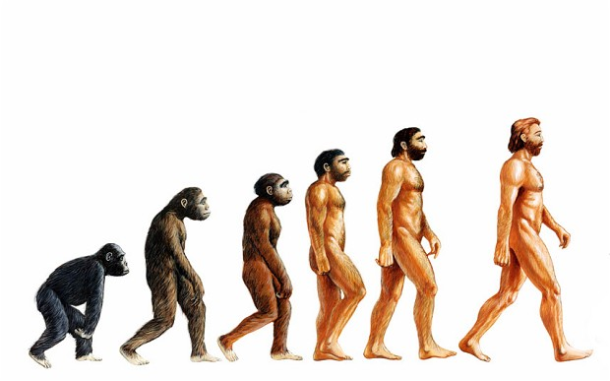
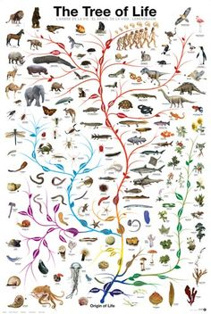
EVOLUTIONARY
TREES

Slide 2

Family Tree

Slide 3

Starter - Family Tree
Create a family tree of the Simpson family

Slide 4
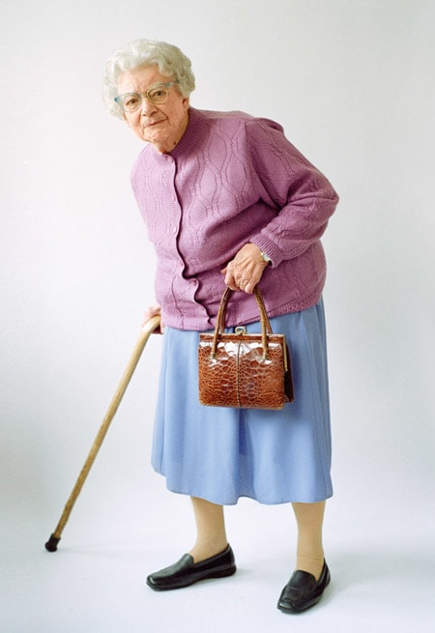
Ancestor –an organism which others have evolved from

Slide 5
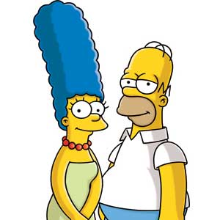
Who are Bart and Lisa’s common ancestors?
Common ancestor –an organism that is the ancestor of two different living species

Slide 6
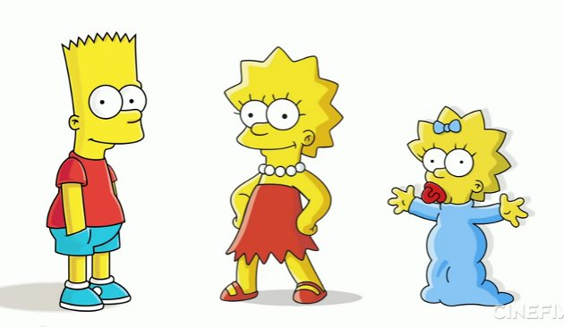
Name one descendant of Grandpa Simpson.
Descendant –an organism that is related to you and lives after you (e.g. grandchildren!)

Slide 7
Evolutionary tree – is a branching diagram or “tree” showing the relationships among between biological species.
Notes:
the same way we display the relationship between family members, we can display the relationship between different species using an evolutionary tree
evolutionary tree shows the relatedness of animals over time and can provide us with information about the past, similar to a family tree.

Slide 8
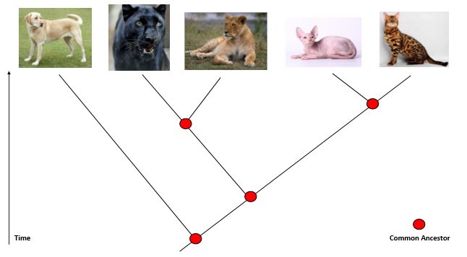
Draw lines to complete the evolutionary tree below
Common ancestor of domestic cats
Common ancestor of all cats
Common ancestor of all 5 animals
Notes:
Domestic cats are most related
Panther and lion are closely related
Dog is least related
Point out common ancestors for each
Explain what the time arrow means

Slide 9
About evolutionary trees
Evolutionary trees show time
The most recent animals are at the top
The older, extinct animals are at the bottom
A common ancestors is the last ancestor of a group of species
Common ancestors share common characteristics
There are lots of different common ancestors on an evolutionary tree
Shows change over millions of years
Helps us understand the changes that have happened at begin of earth

Slide 10
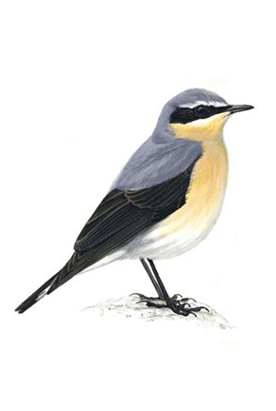
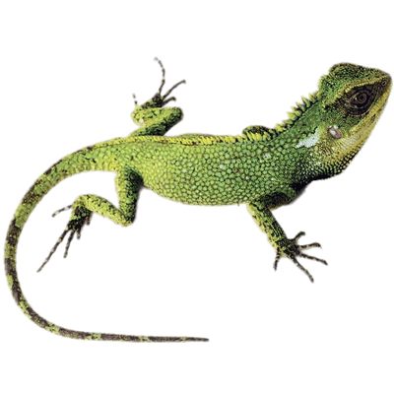

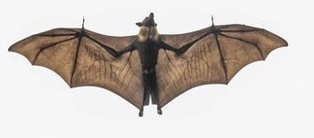
What can you see that is different?
They are all vertebrates
What is similar?

Slide 11
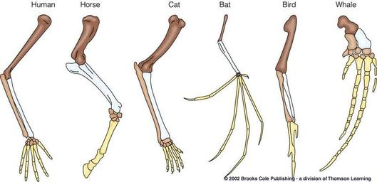
Pentadactyl Lmib
Has 5 digits on the hand and foot and a specific pattern of bones. The pentadactyl limb is common to humans, other mammals, birds, dinosaurs, and other reptiles and amphibians.
It is evidence of humans’ common ancestry with amphibians, reptiles and other mammals.

Slide 12
Activity – Pentadactyl limb
Colour yours in!

Slide 13
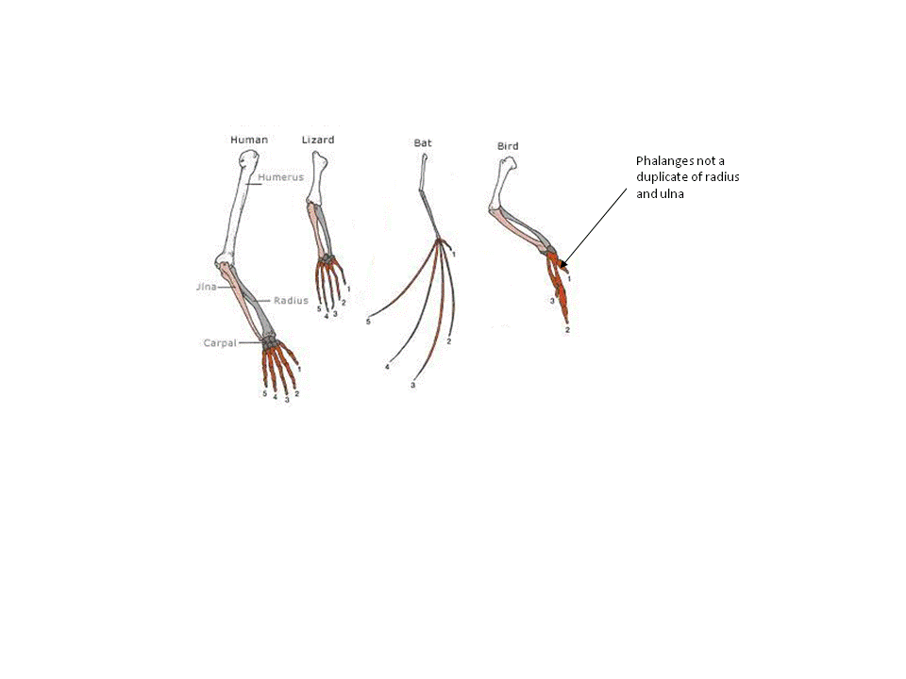
Does yours look like this?

Slide 14
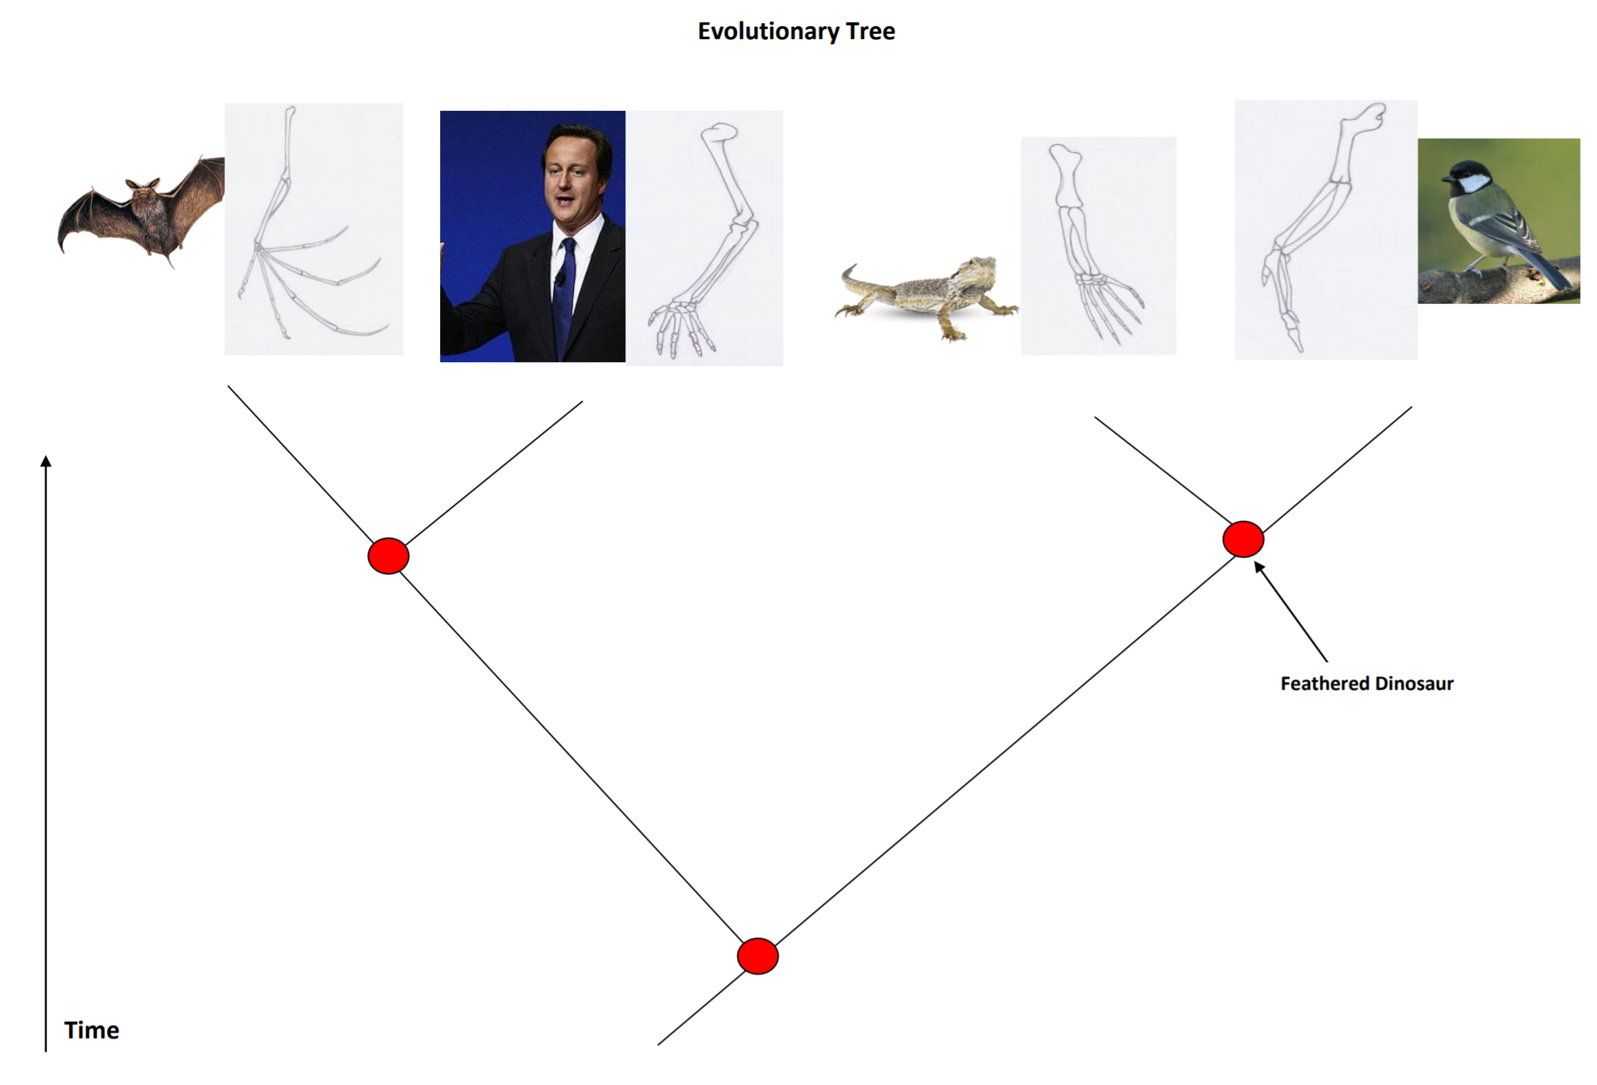

Slide 15
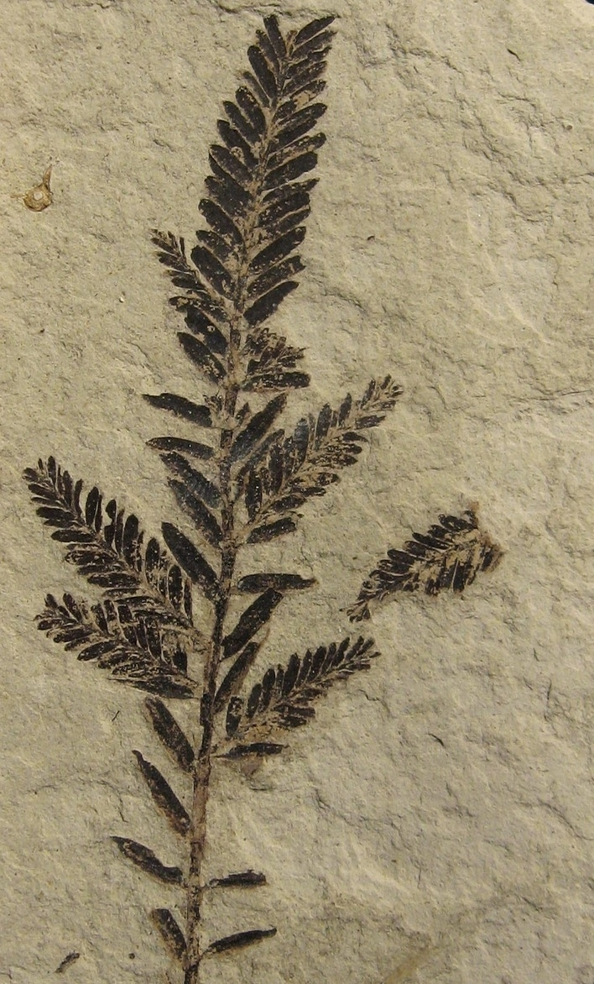
Fossils
the remains of ancient animals and plants, the traces or impressions of living things from past ages, or the traces of their activities.

Slide 16
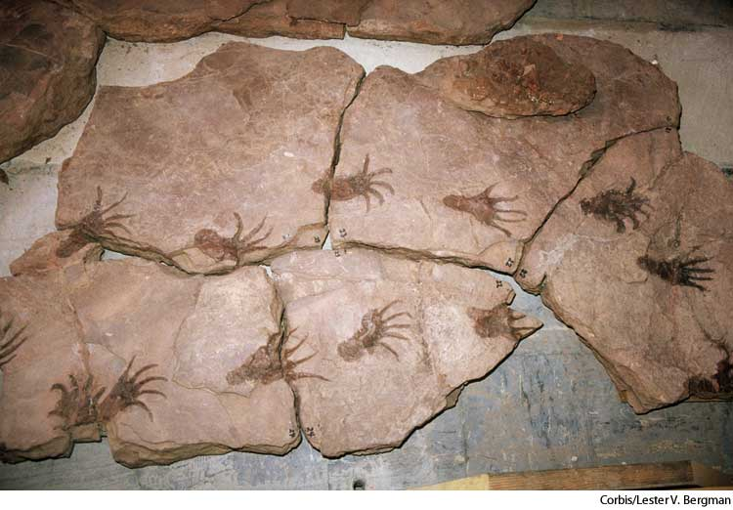
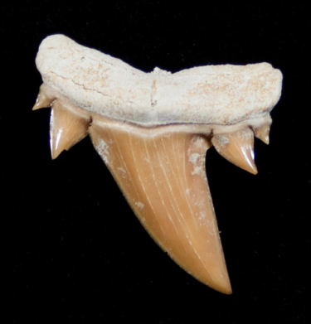
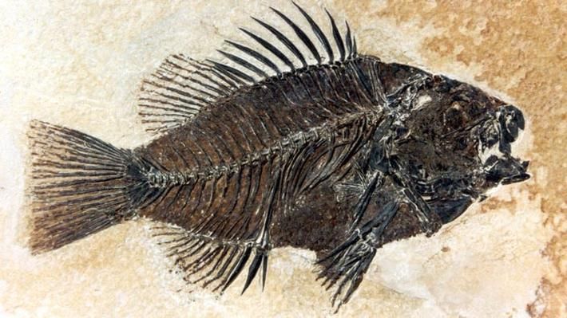
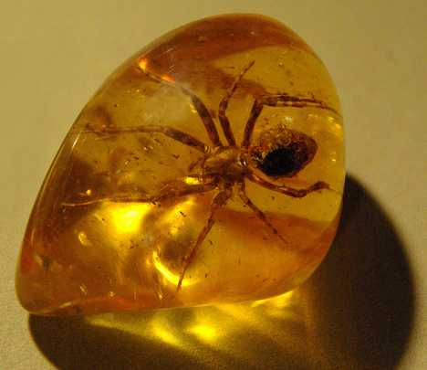
Example of fossils
Parts of living things which have not changed over time
Trace fossils are imprints, track or trails like footprints or worm burrows
Shapes of living things in rocks
Living things preserved in amber

Slide 17
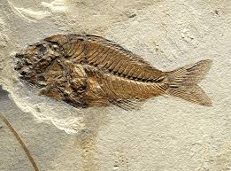
Important points of how fossils form:
Burial
Hard parts eg. Bone/shell
Where they live
The natural minerals in the sediment
Erosion and exposure
Found by palaeontologists
Notes:
Hard parts best. Got hard parts? Bones or shells? Then you are more likely to become a fossil because soft bits rot away quickly.
Where do you live? If there is sediment like mud or sand being laid down then you have a chance to be buried by it and fossilised.
The recipe for success. Once buried there is a chance minerals can start to fill gaps in your remains or even replace them, basically turning them into stone. This is when fossilisation really happens and depends a great deal on what natural minerals are in the sediment.
And finally… with luck the rock layer you are preserved in will be eroded and your fossilised remains
exposed, ready for the chance to be discovered.

Slide 18
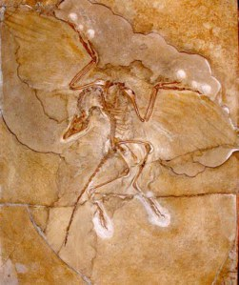
Archeopteryx
Does it have feathers?
What about the feet, claws and its facial shape?
What creatures does it remind you off?
A bird and a reptile!

Slide 19
FOSSILS SNAP

Slide 20


How long would it take you to become a fossil?
At least 10,000 years!

