Slide 1
Unit-IV Logistic Regression
Logistic Regression: Binary Logistic Regression, Estimation of Parameters, Interpretation of Parameters, Model Diagnostics, Classification Table, Sensitivity, and Specificity.
From: Business Analytics by Dr Dinesh Kumar

Slide 2
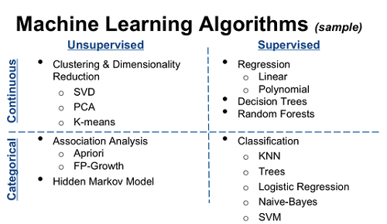
Types of Machine learning Algorithms

Slide 3
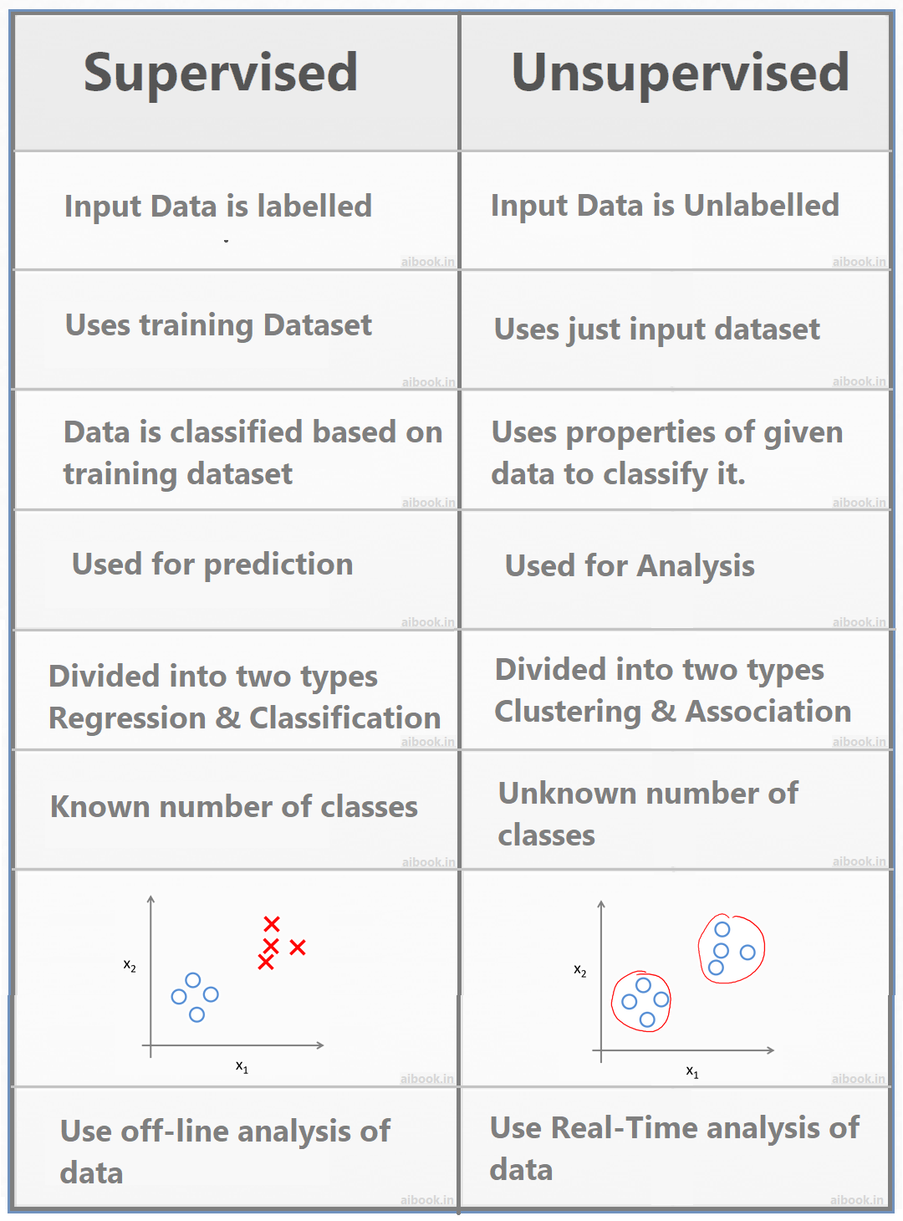
Supervised vs Unsupervised learning

Slide 4
Logistic Regression
Logistic regression is one of the most popular Machine Learning algorithms, which comes under the Supervised Learning technique. It is used for predicting the categorical dependent variable using a given set of independent variables.
Logistic regression predicts the output of a categorical dependent variable. Therefore, the outcome must be a categorical or discrete value. It can be either Yes or No, 0 or 1, true or False, etc. but instead of giving the exact value as 0 and 1, it gives the probabilistic values which lie between 0 and 1.
Logistic Regression is much similar to the Linear Regression except that how they are used. Linear Regression is used for solving Regression problems, whereas Logistic regression is used for solving the classification problems.
In Logistic regression, instead of fitting a regression line, we fit an "S" shaped logistic function, which predicts two maximum values (0 or 1).

Slide 5
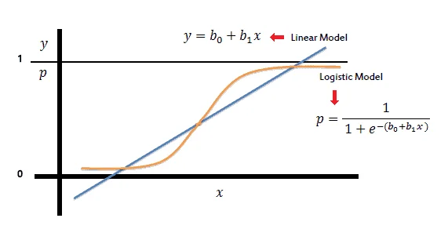
Logistic Function (Sigmoid Function):
The sigmoid function is a mathematical function used to map the predicted values to probabilities.
It maps any real value into another value within a range of 0 and 1.
The value of the logistic regression must be between 0 and 1, which cannot go beyond this limit, so it forms a curve like the "S" form. The S-form curve is called the Sigmoid function or the logistic function.
In logistic regression, we use the concept of the threshold value, which defines the probability of either 0 or 1. Such as values above the threshold value tends to 1, and a value below the threshold values tends to 0.

Slide 6
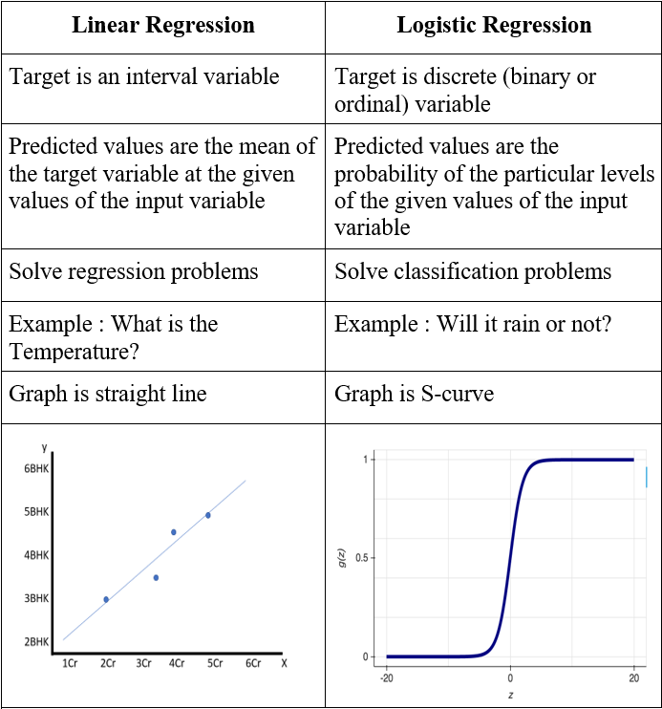
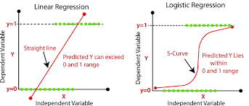
Linear Regression vs Logistic regression

Slide 7
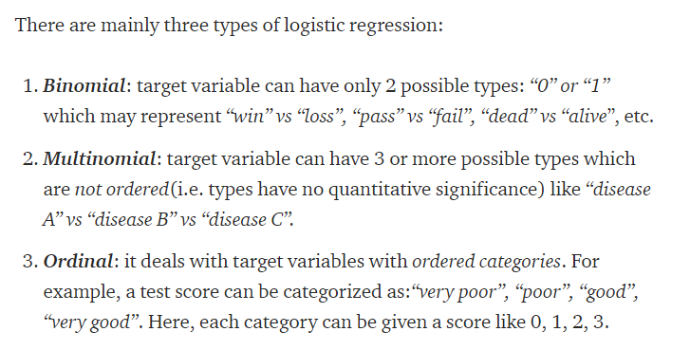
Types of Logistic Regression

Slide 8
Logistic Regression –Classification Problems
Classification problems are an important category of problems in analytics in which the response variable (Y) takes a discrete value.
A bank may like to classify their customers based on risk such as low-, medium- and high-risk customers under loan portfolio. Here the response variable Y takes 3 values (e.g., Y = 1 for low risk, Y = 2 for medium risk and Y = 3 for high risk).
Health service providers based on diagnostic tests may classify the patients as positive, that is presence of a disease (Y = 1) or negative, that is absence of a disease (Y = 0).
Movie production houses may like to predict whether a movie will be a hit or not at the box office.

Slide 9
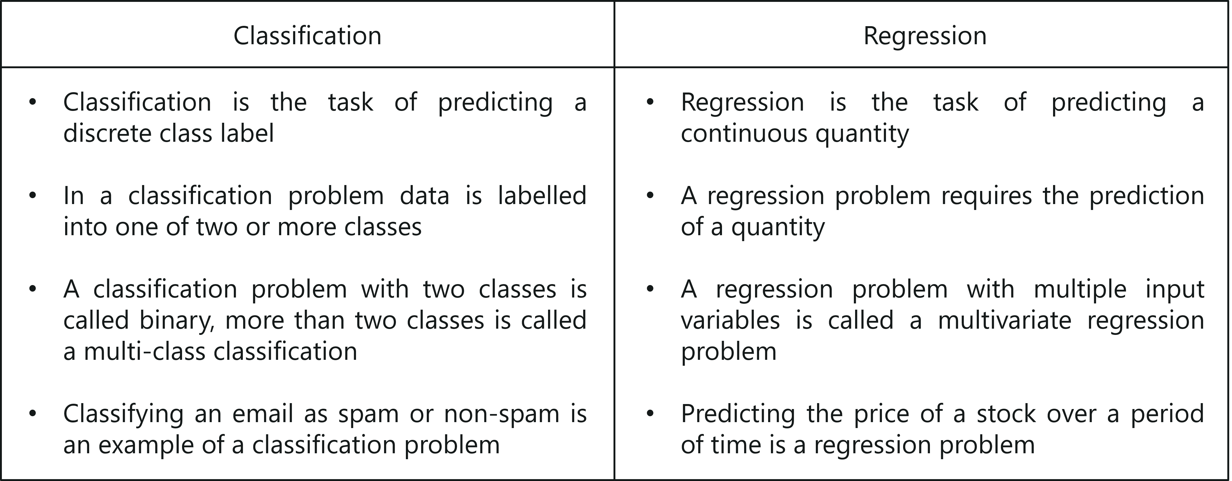
Regression vs Classification

Slide 10
Applications of Logistic Regression
Image Segmentation and Categorization.
Geographic Image Processing.
Handwriting recognition.
Healthcare .
Prediction whether a person is depressed or not based ,etc.

Slide 11
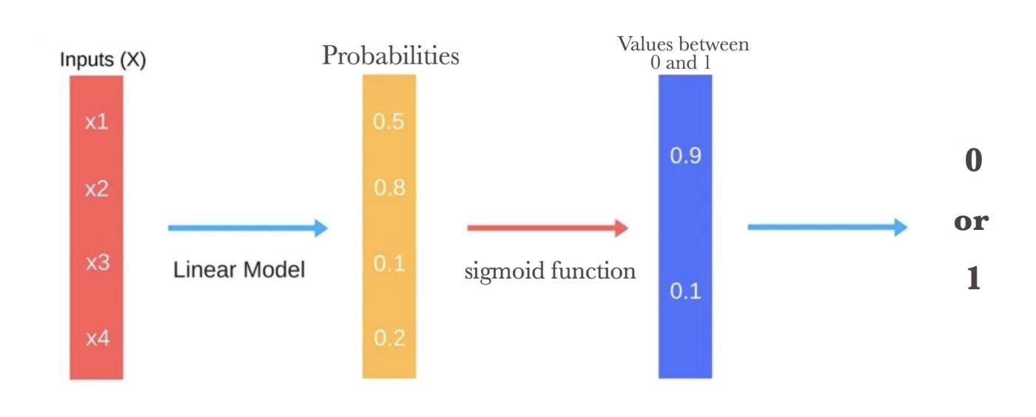
Flow sequence of Logistic Regression

Slide 12
Terminologies involved in Logistic Regression:
Logistic function: The logistic function transforms the input variables into a probability value between 0 and 1, which represents the likelihood of the dependent variable being 1 or 0.
Odds: The proportion of an event’s chances of happening to its chances of not happening. The chances are used in logistic regression to model the connection between the independent and dependent variables.
Log-odds: The logistic regression model’s calculation is made simpler by using the logarithm of the odds.
Coefficient: The logistic regression model’s estimated parameters, which show how the independent and dependent variables relate to one another.
Intercept: A constant term in the logistic regression model, which represents the log-odds when all independent variables are equal to zero.
Maximum likelihood estimation: The method used to estimate the coefficients of the logistic regression model, which maximizes the likelihood of observing the data given the model.

Slide 13
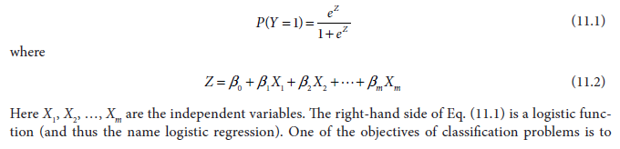
INTRODUCTION TO BINARY LOGISTIC REGRESSION
Logistic regression is a statistical model in which the response variable takes a discrete value and the explanatory variables can either be continuous or discrete.
Logistic regression is one of the supervised learning algorithms.
We are discussing binary logistic regression in which the response variable takes only two values.
For example, assume that the value of Y is either 1 (conventionally known as positive outcome) or 0 (conventionally known as negative outcome).
When there are more than two values of Y, then multinomial logistic regression model is used.
The binary logistic regression model is given by

Slide 14
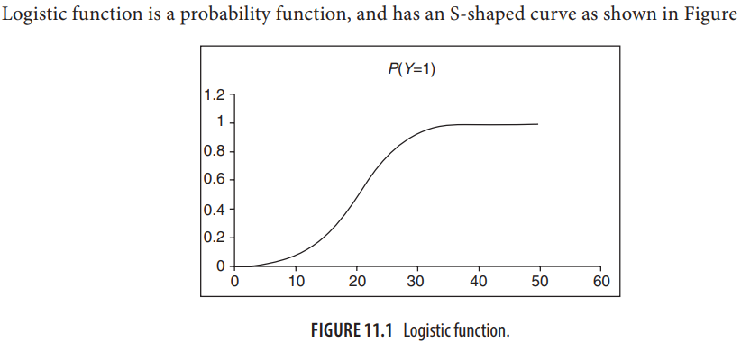
Logistic function

Slide 15
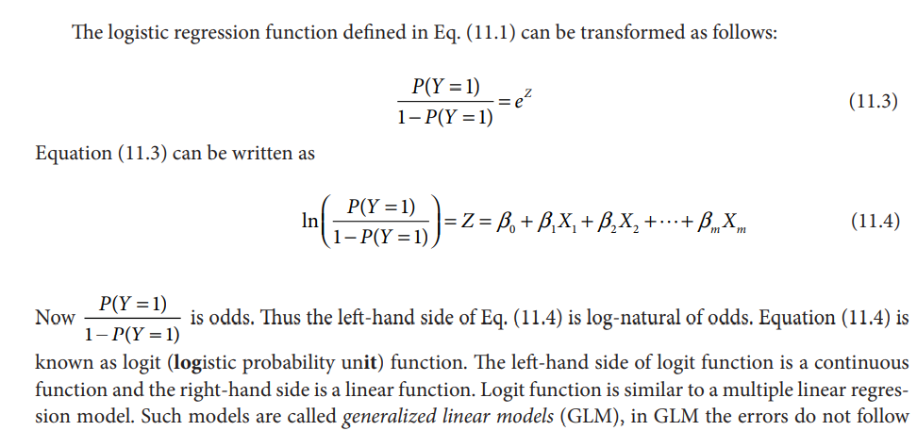
Logistic Regression model

Slide 16
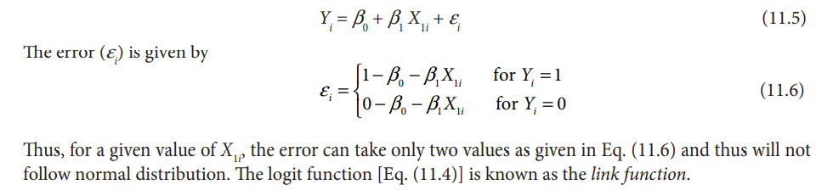
Logistic Regression model

Slide 17
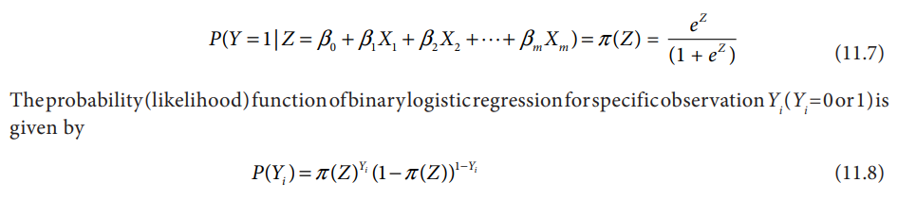
ESTIMATION OF PARAMETERS IN LOGISTIC REGRESSION
One of the major assumptions of multiple linear regression model is that the residuals follow a normal distribution (or approximate normal distribution). However, the residuals in logistic regression will not a follow normal distribution and thus we cannot use method of ordinary least squares (OLS) to estimate the regression parameters
The errors in LR are inherently heteroscedastic. Regression parameters in the case of logistic regression are estimated using Maximum Likelihood Estimator (MLE).
In binary logistic regression, the response variable Y takes only two values (Y = 0 and 1).
Let

Slide 18
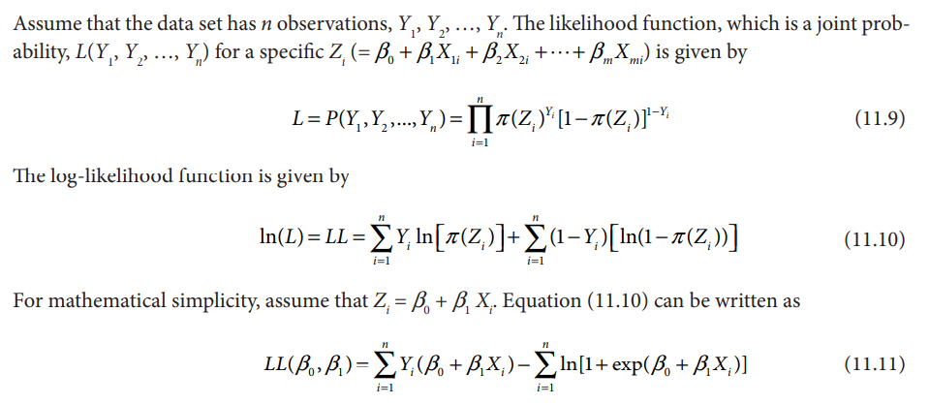

Slide 19
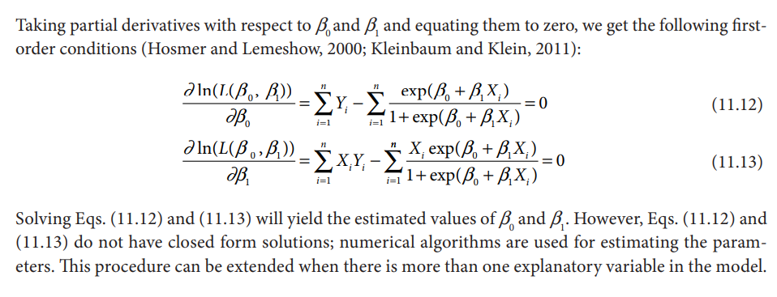
Estimation of parameters in LR

Slide 20
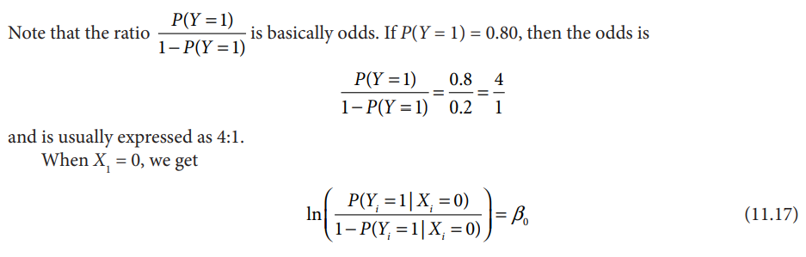
INTERPRETATION OF LOGISTIC REGRESSION PARAMETERS
Let logit function

Slide 21
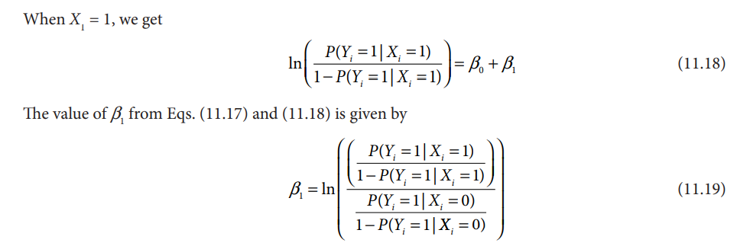
Interpretation of LR parameters

Slide 22
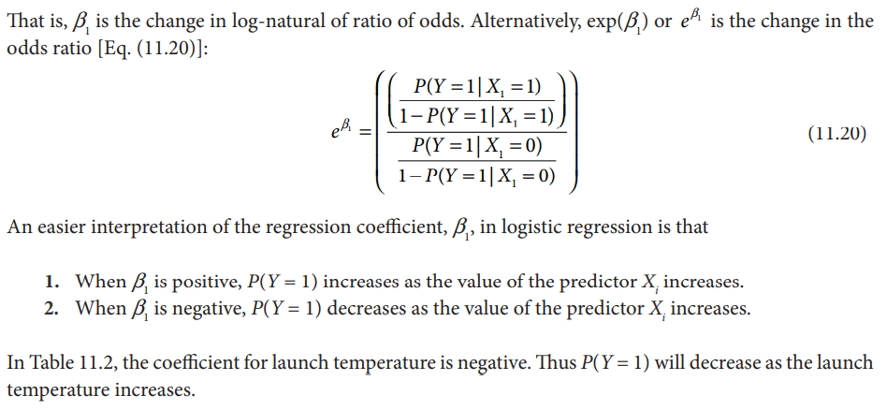
Interpretation of LR parameters

Slide 23
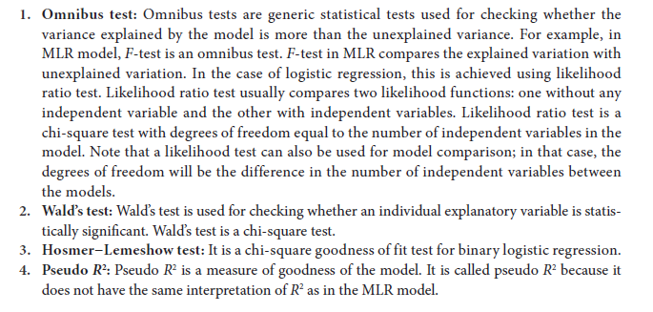
LOGISTIC REGRESSION MODEL DIAGNOSTICS

Slide 24
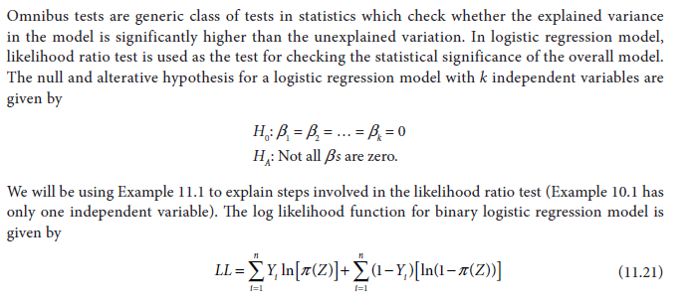
Omnibus Test (Likelihood Ratio Test)

Slide 25
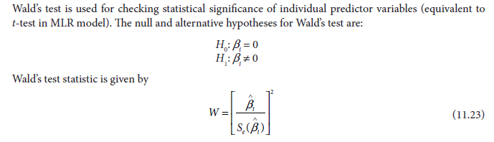
Wald’s test

Slide 26
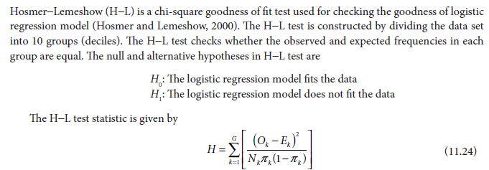
Hosmer−Lemeshow Test

Slide 27
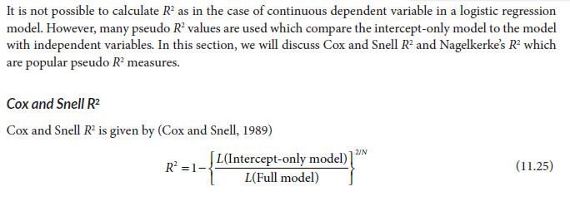
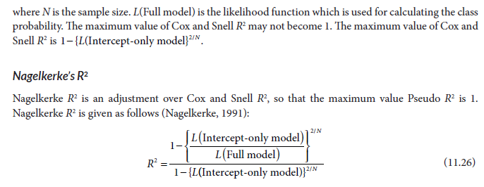
Pseudo R2

Slide 28
CLASSIFICATION TABLE, SENSITIVITY, AND SPECIFICITY

