Slide 1
Data Science Unit-IV
Support Vector Machine (SVM)
Classifier
The Support Vector Machine (SVM) classifier was invented by Vladimir Vapnik and his colleague Alexey Chervonenkis in the 1960s while working at the Institute of Control Sciences in Moscow.

Slide 2

Support Vector Machine
It is Supervised Learning algorithms, which is used for Classification as well as Regression problems.
The goal of the SVM algorithm is to create the best line or decision boundary that can segregate n-dimensional space into classes so that we can easily put the new data point in the correct category in the future. This best decision boundary is called a hyperplane.
SVM chooses the extreme points/vectors that help in creating the hyperplane. These extreme cases are called as support vectors, and hence algorithm is termed as Support Vector Machine.

Slide 3
Hyperplane and Support Vectors in the SVM algorithm:
Hyperplane: There can be multiple lines/decision boundaries to segregate the classes in n-dimensional space, but we need to find out the best decision boundary that helps to classify the data points. This best boundary is known as the hyperplane of SVM.
The dimensions of the hyperplane depend on the features present in the dataset, which means if there are 2 features (as shown in image), then hyperplane will be a straight line. And if there are 3 features, then hyperplane will be a 2-dimension plane.
Goal: Always create a hyperplane that has a maximum margin, which means the maximum distance between the data points.
Support Vectors:
The data points or vectors that are the closest to the hyperplane and which affect the position of the hyperplane are termed as Support Vector. Since these vectors support the hyperplane, hence called a Support vector.

Slide 4
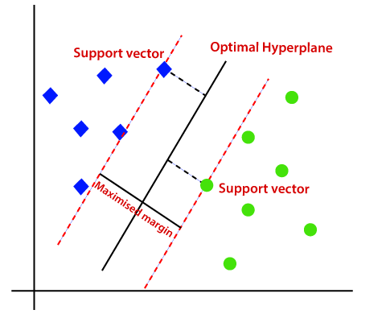
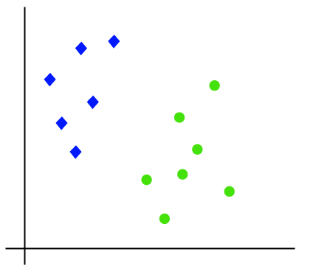
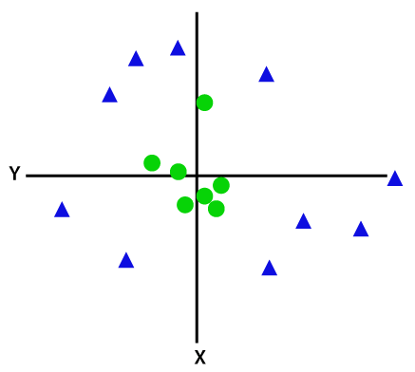
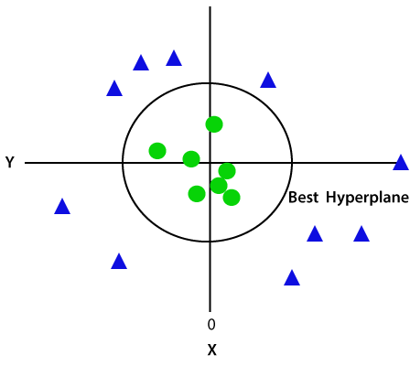
Support Vector Machine-Types
Linear SVM: Linear SVM is used for linearly separable data, which means if a dataset can be classified into two classes by using a single straight line, then such data is termed as linearly separable data, and classifier is used called as Linear SVM classifier.
Non-linear SVM: Non-Linear SVM is used for non-linearly separated data, which means if a dataset cannot be classified by using a straight line, then such data is termed as non-linear data and classifier used is called as Non-linear SVM classifier.

Slide 5
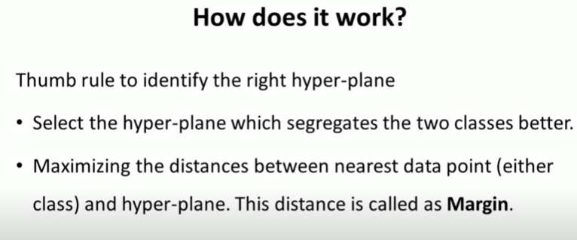
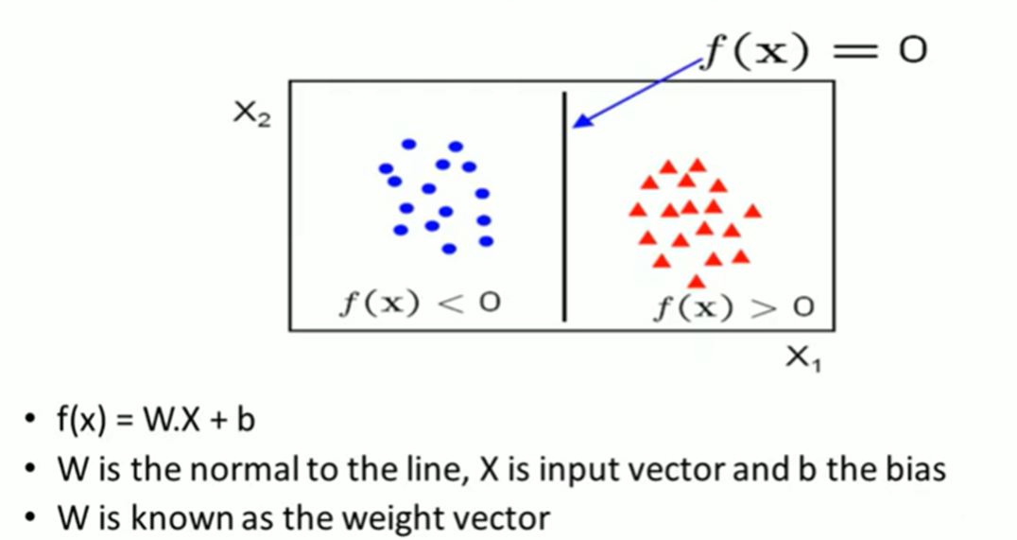
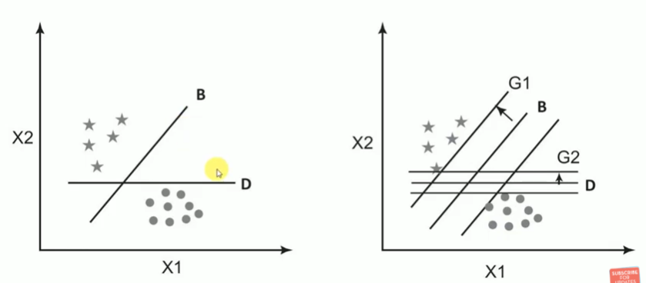
SVM How it works?

Slide 6
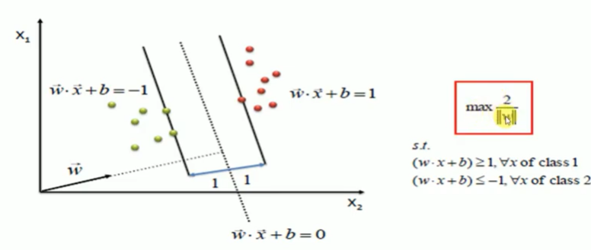
SVM Model

Slide 7
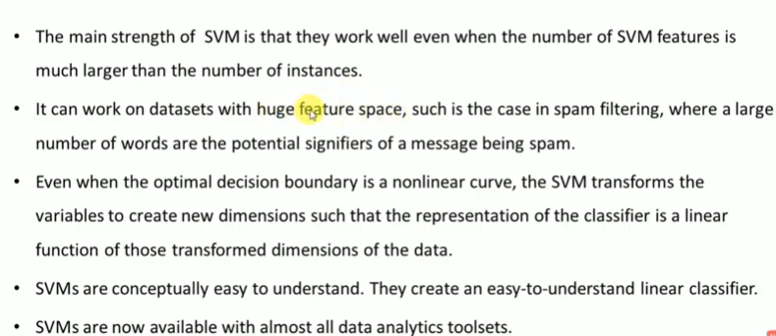
Advantages

Slide 8
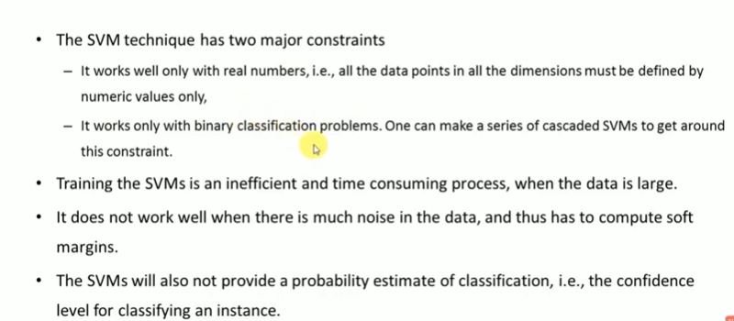
Disadvantages

Slide 9
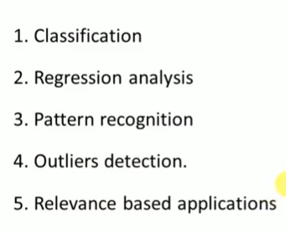
Applications

Slide 10
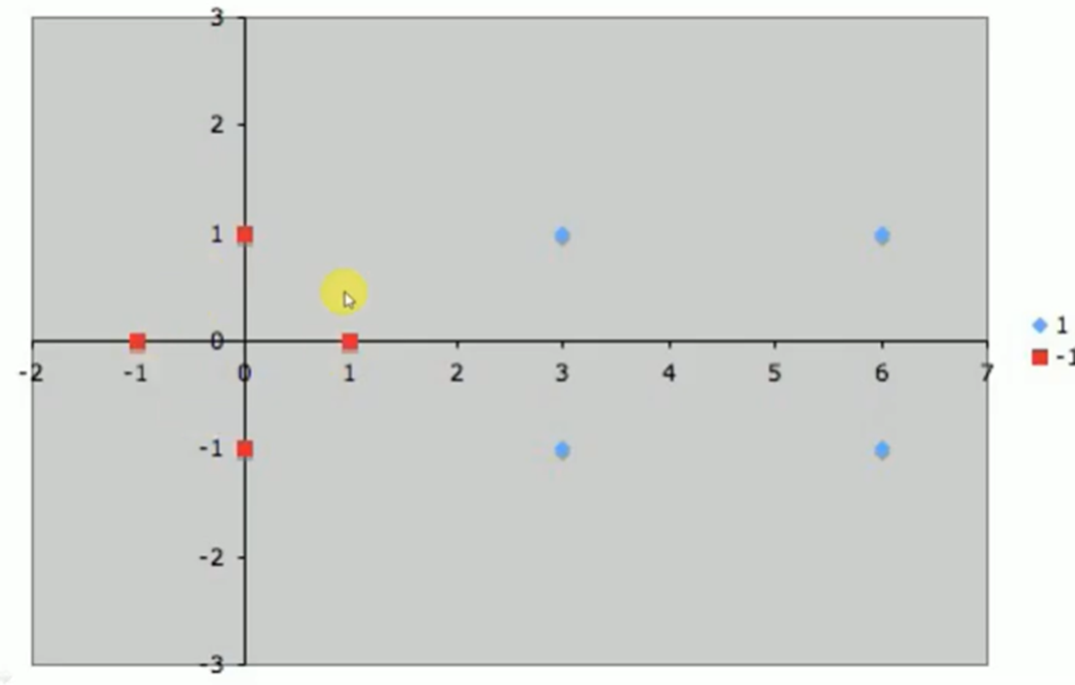
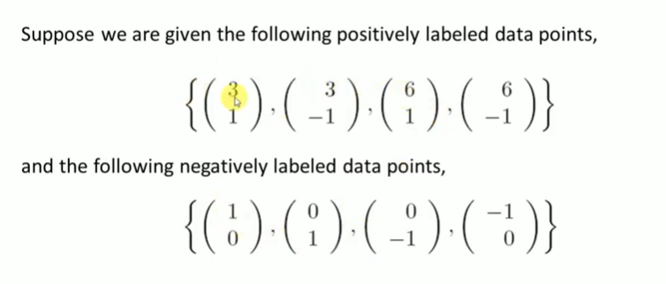
Linear SVM : Example
3 | 1 | +
3 | -1 | +
6 | 1 | +
6 | -1 | +
1 | 0 | -
0 | 1 | -
0 | -1 | -
-1 | 0 | -
Design SVM classifier to classify the following dataset as positive and negative class.

Slide 11
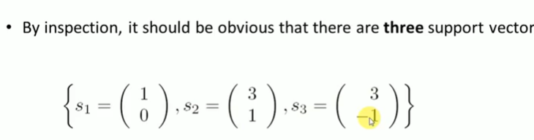
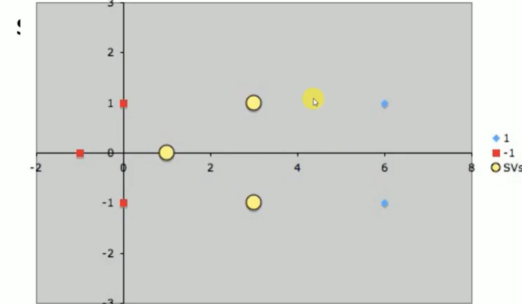
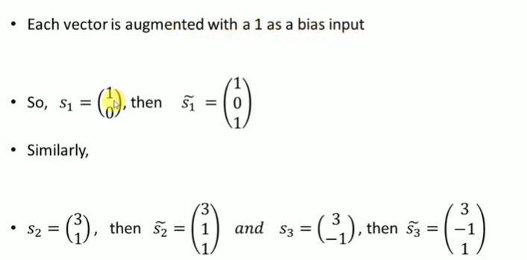
Example

Slide 12
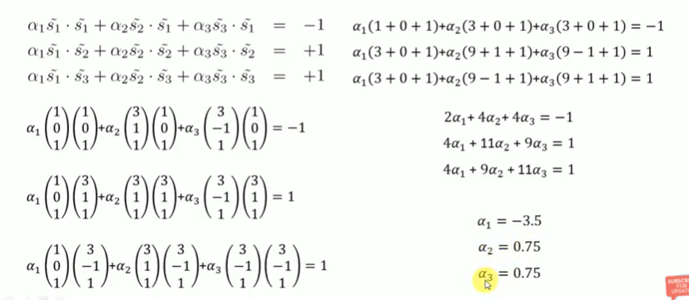
Example

Slide 13
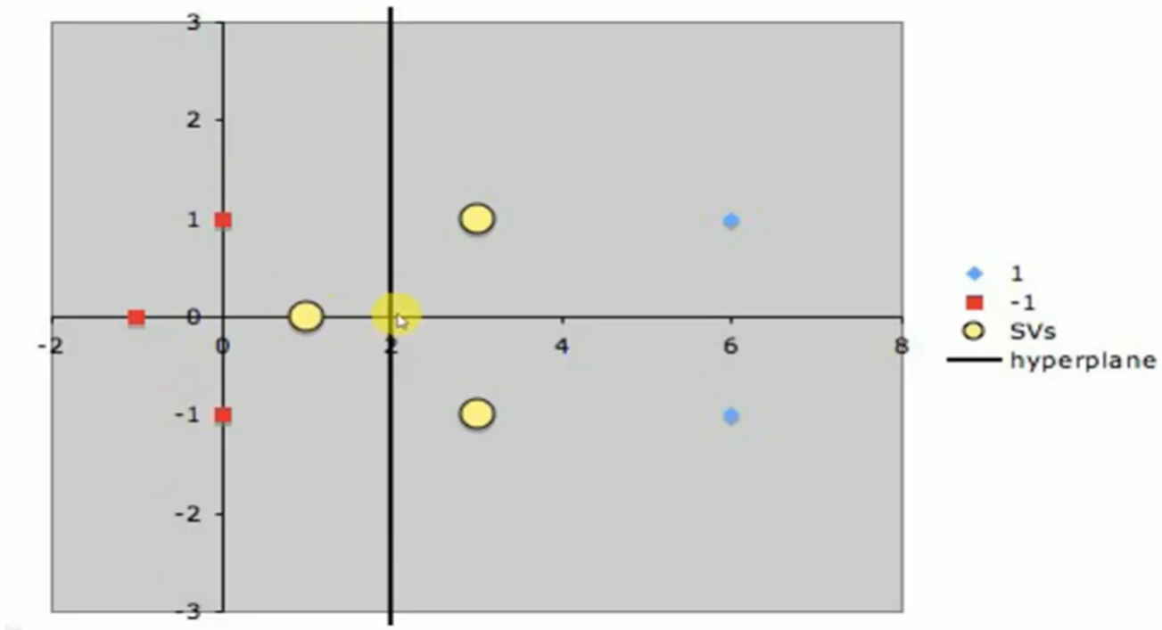
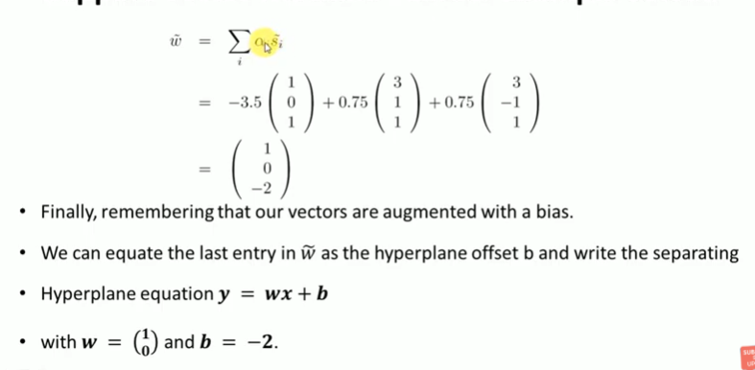
Example:

Slide 14
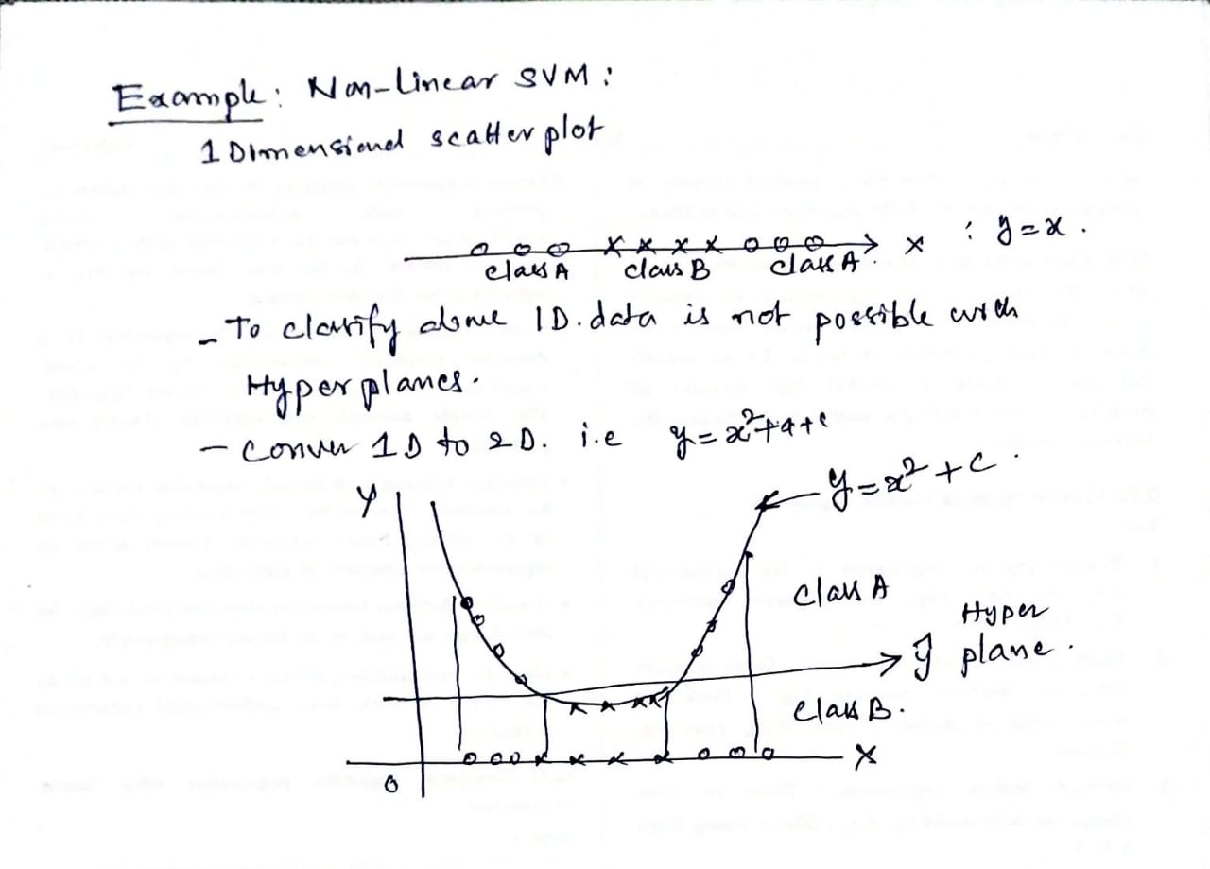
Non-Linear SVM : Example 1

Slide 15
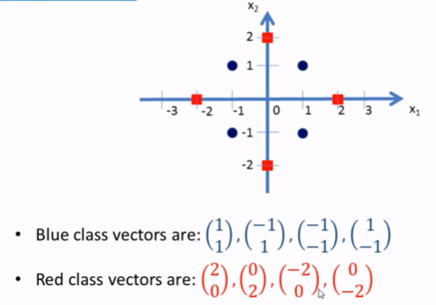
Non-Linear SVM : Example 2
1 | 1 | B
-1 | 1 | B
-1 | -1 | B
1 | -1 | B
2 | 0 | R
0 | 2 | R
-2 | 0 | R
0 | -2 | R
Design Non-Linear SVM classifier to classify the following dataset as Blue and red class.

Slide 16
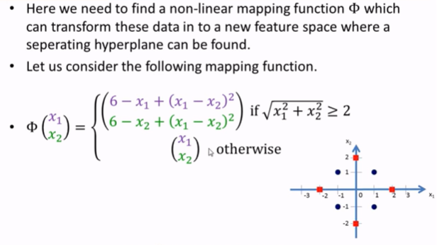
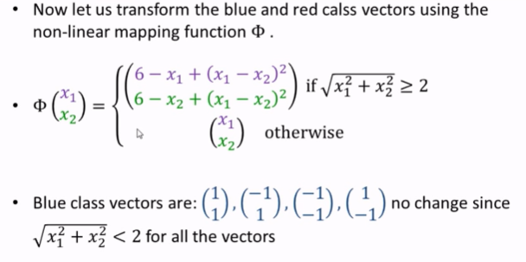
Non-Linear SVM : Example 2

Slide 17
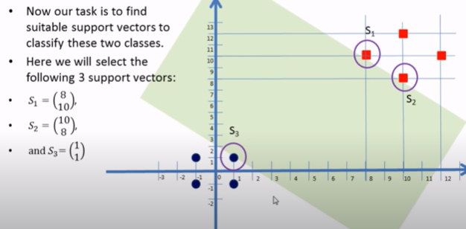
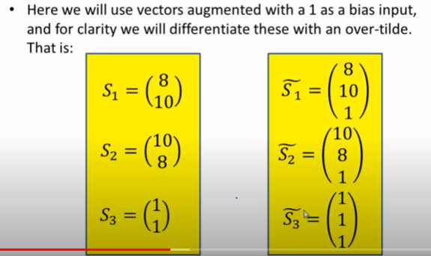
Non-Linear SVM : Example 2

Slide 18
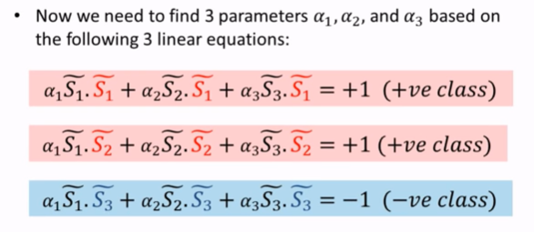
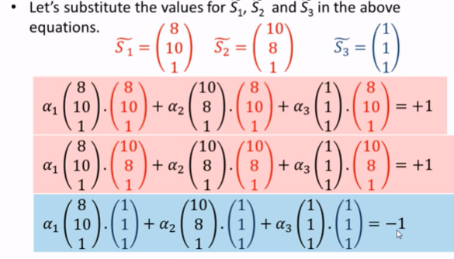
Non-Linear SVM : Example 2

Slide 19
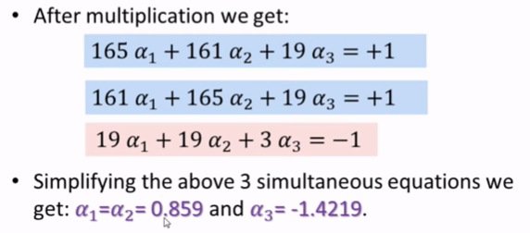
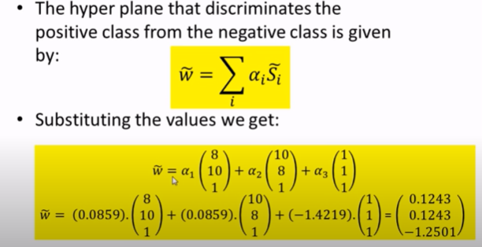
Non-Linear SVM : Example 2

Slide 20
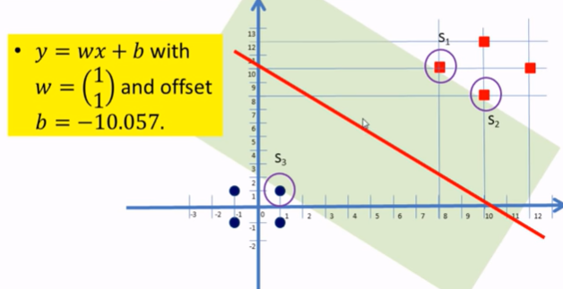
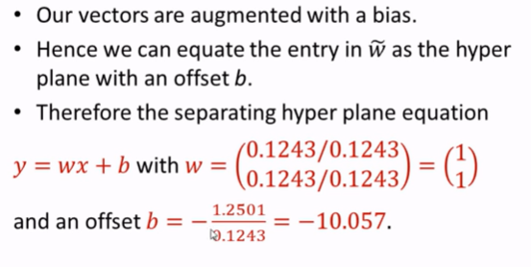
Non-Linear SVM : Example 2

Slide 21
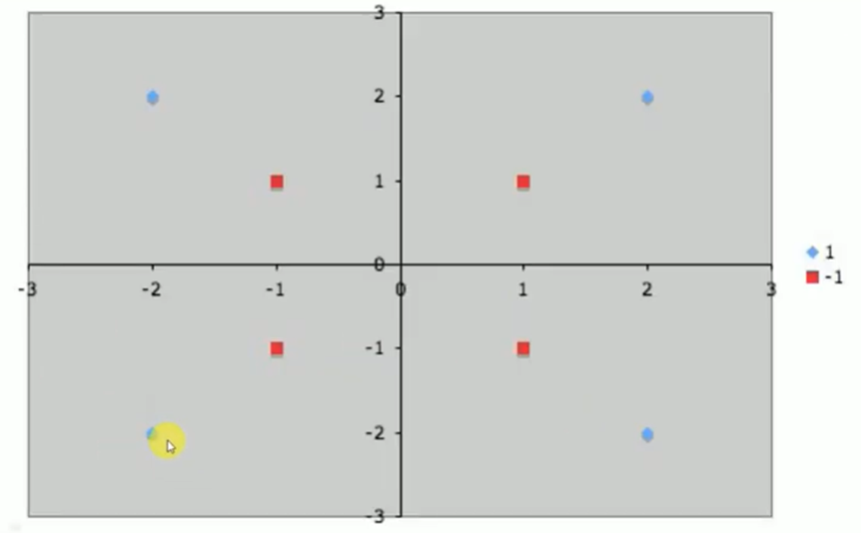
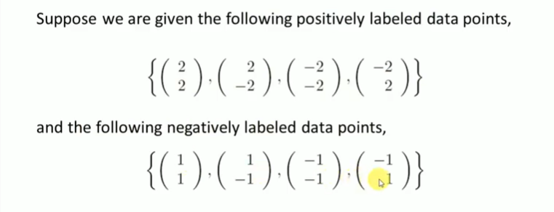
Non-Linear SVM : Example 3

Slide 22
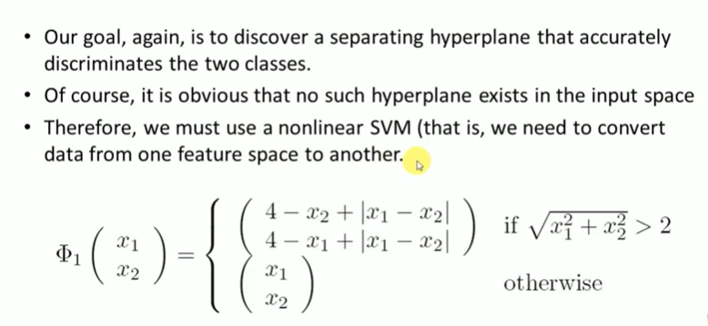
Example

Slide 23
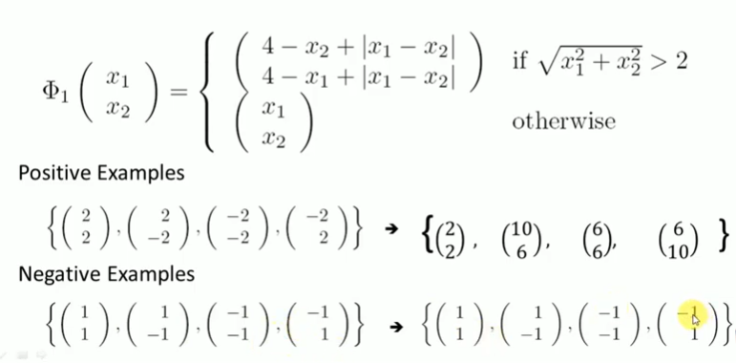
Example

Slide 24
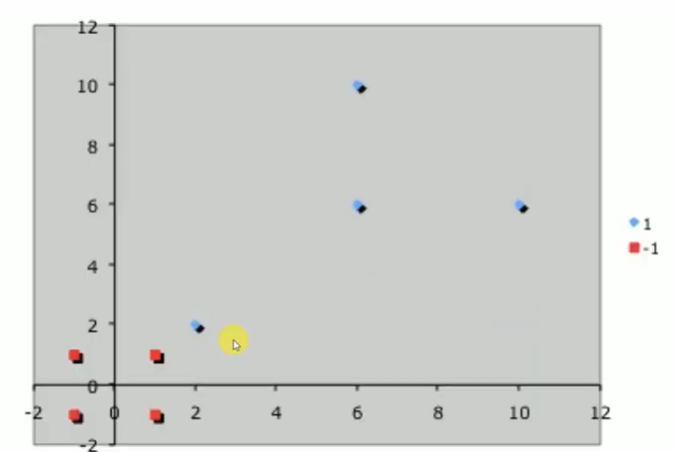
Example

Slide 25
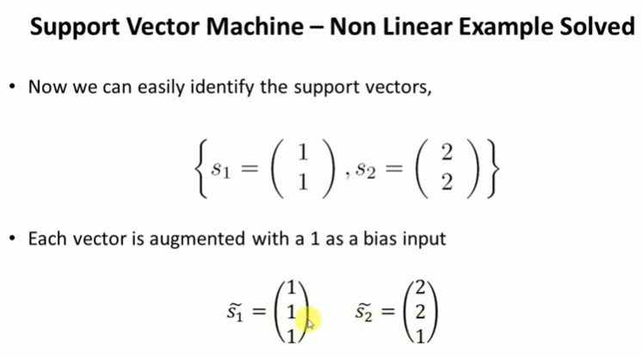
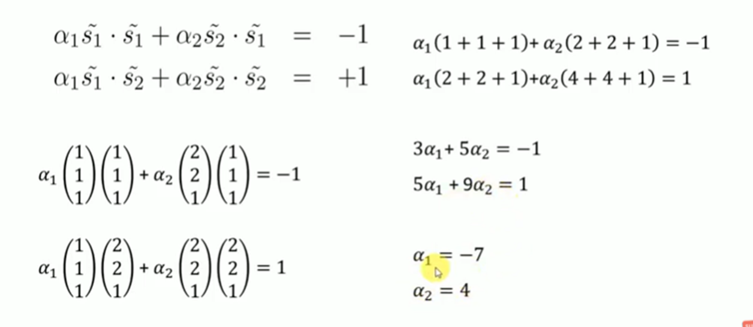
Example

Slide 26
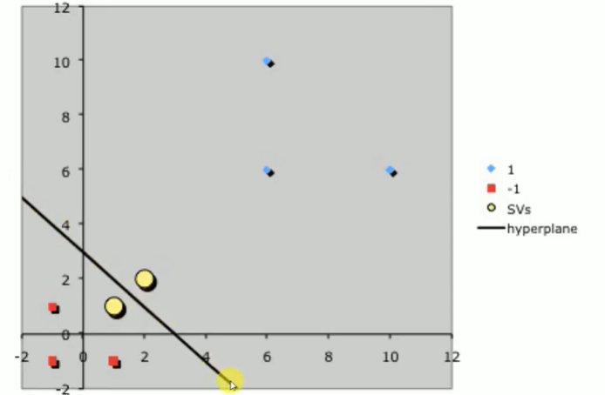
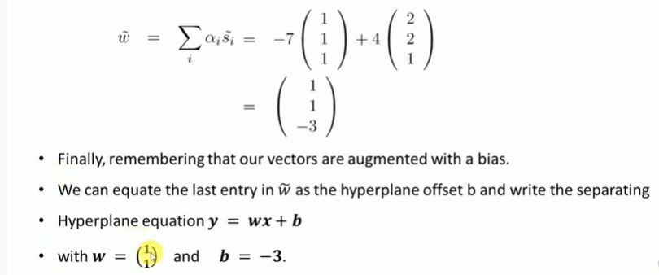
Example

Slide 27
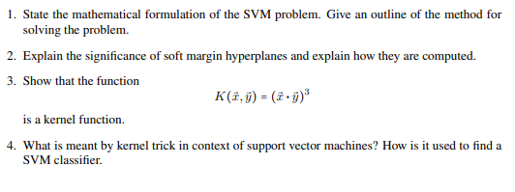
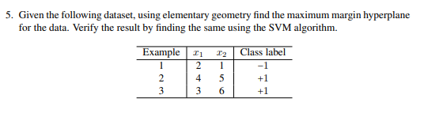
Exercise

Slide 28
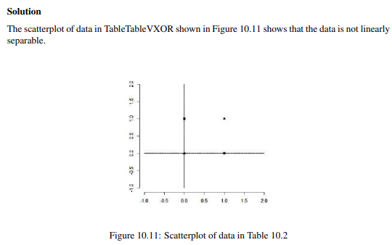
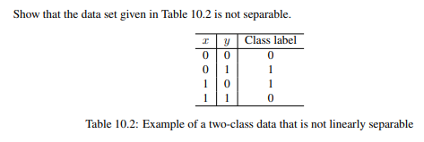
Exercise

