Slide 1
Data Sciences
Unit-IV
Classification Basic concepts,
K-Nearest Neighbor Classifier

Slide 2
Supervised vs. Unsupervised Learning
Supervised learning (classification)
Supervision: The training data (observations, measurements, etc.) are accompanied by labels indicating the class of the observations
New data is classified based on the training set
Unsupervised learning (clustering)
The class labels of training data is unknown
Given a set of measurements, observations, etc. with the aim of establishing the existence of classes or clusters in the data

Slide 3
Prediction Problems: Classification vs. Numeric Prediction
Classification
predicts categorical class labels (discrete or nominal)
classifies data (constructs a model) based on the training set and the values (class labels) in a classifying attribute and uses it in classifying new data
Numeric Prediction
models continuous-valued functions, i.e., predicts unknown or missing values
Typical applications
Credit/loan approval:
Medical diagnosis: if a tumor is cancerous or benign
Fraud detection: if a transaction is fraudulent
Web page categorization: which category it is

Slide 4
Classification—A Two-Step Process
Model construction: describing a set of predetermined classes
Each tuple/sample is assumed to belong to a predefined class, as determined by the class label attribute
The set of tuples used for model construction is training set
The model is represented as classification rules, decision trees, or mathematical formulae
Model usage: for classifying future or unknown objects
Estimate accuracy of the model
The known label of test sample is compared with the classified result from the model
Accuracy rate is the percentage of test set samples that are correctly classified by the model
Test set is independent of training set (otherwise overfitting)
If the accuracy is acceptable, use the model to classify new data
Note: If the test set is used to select models, it is called validation (test) set

Slide 5
Process (1): Model Construction
Classification
Algorithms
Training
Data
Classifier
(Model)
IF rank = ‘professor’
OR years > 6
THEN tenured = ‘yes’

Slide 6
Process (2): Using the Model in Prediction
Classifier
Testing
Data
Unseen Data
(Jeff, Professor, 4)
Tenured?

Slide 7
Classification Algorithm
The Classification algorithm is a Supervised Learning technique that is used to identify the category of new observations on the basis of training data.
In Classification, a program learns from the given dataset or observations and then classifies new observation into a number of classes or groups. Such as, Yes or No, 0 or 1, Spam or Not Spam, cat or dog, etc.
Classes can be called as targets/labels or categories.
Unlike regression, the output variable of Classification is a category, not a value, such as "Green or Blue", "fruit or animal", etc.
Since the Classification algorithm is a Supervised learning technique, hence it takes labeled input data.
In classification algorithm, a discrete output function(y) is mapped to input variable(x).

Slide 8
Types of Classifications
There are two types of Classifications:
1. Binary Classifier: If the classification problem has only two possible outcomes, then it is called as Binary Classifier.
Examples: YES or NO, MALE or FEMALE, SPAM or NOT SPAM, CAT or DOG, etc.
2. Multi-class Classifier: If a classification problem has more than two outcomes, then it is called as Multi-class Classifier.
Example: Classifications of types of crops, Classification of types of music.
Types of Models:
Linear Models
Logistic Regression
Support Vector Machines
Non-linear Models
K-Nearest Neighbours
Kernel SVM
Na�ve Bayes
Decision Tree Classification
Random Forest Classification

Slide 9
Types of Learners in Classification
Lazy Learners :
Lazy learners simply store the training data and wait until a testing data appears.
The classification is done using the most related data in the stored training data.
They take more predicting time compared to eager learners.
Eg – k-nearest neighbour, case-based reasoning.
Eager Learners :
Eager learners construct a classification model based on the given training data before getting data for predictions.
It must be able to commit to a single hypothesis that will work for the entire space.
Due to this, they take a lot of time in training and less time for a prediction.
Eg– Decision Tree, Naive Bayes, Artificial Neural Networks.

Slide 10
K-Nearest Neighbor Classifier
In 1951, Evelyn Fix and Joseph Hodges developed a non-parametric method for pattern classification, which was later expanded by Thomas Cover. Later on, this came to be known as the K-Nearest Neighbor algorithm. It is one of the simplest supervised machine learning algorithms used for classification and regression.

Slide 11
KNN Classifier
K-nearest neighbours (KNN) algorithm is a type of supervised ML algorithm.
It is used for both classification as well as regression predictive problems.
The following two properties would define KNN well
Lazy learning algorithm − KNN is a lazy learning algorithm because it does not have a specialized training phase and uses all the data for training while classification.
Non-parametric learning algorithm − KNN is also a non-parametric learning algorithm because it doesn’t assume anything about the underlying data.

Slide 12
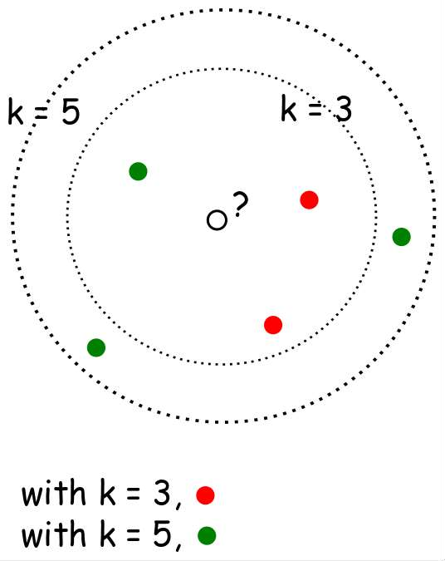
What is k- NN??
When k=3 or k=5??
Nearest-neighbor classifiers are based on learning by analogy, that is, by comparing a given test tuple with training tuples that are similar to it.
The training tuples are described by n attributes.
When k = 1, the unknown tuple is assigned the class of the training tuple that is closest to it in pattern space.

Slide 13
Distance Measures
𝐸𝑢𝑐𝑙𝑖𝑑𝑒𝑎𝑛 𝑑𝑖𝑠𝑡𝑎𝑛𝑐𝑒 ∶ 𝑑 𝑥, 𝑦
= ∑ 𝑥_{𝑖} − 𝑦𝑖
2
𝑆𝑞𝑢𝑎𝑟𝑒𝑑 𝐸𝑢𝑐𝑙𝑖𝑑𝑒𝑎𝑛 𝑑𝑖𝑠𝑡𝑎𝑛𝑐𝑒 ∶ 𝑑 𝑥, 𝑦
= ∑ 𝑥_{𝑖} − 𝑦𝑖
2
𝑀𝑎𝑛ℎ𝑎𝑡𝑡𝑎𝑛 𝑑𝑖𝑠𝑡𝑎𝑛𝑐𝑒 ∶ 𝑑 𝑥, 𝑦
= ∑ |(𝑥𝑖 − 𝑦𝑖)|
Which distance measure to use?
We use Euclidean Distance as it treats each feature as equally important.

Slide 14
How to choose K?
If infinite number of samples available, the larger is k, the better is classification.
k = 1 is often used for efficiency, but sensitive to “noise”
Larger k gives smoother boundaries, better for generalization, but only if locality is preserved. Locality is not preserved if end up looking at samples too far away, not from the same class.
Interesting relation to find k for large sample data :
k = sqrt(n)/2 where n is # of examples
Can choose k through cross-validation

Slide 15
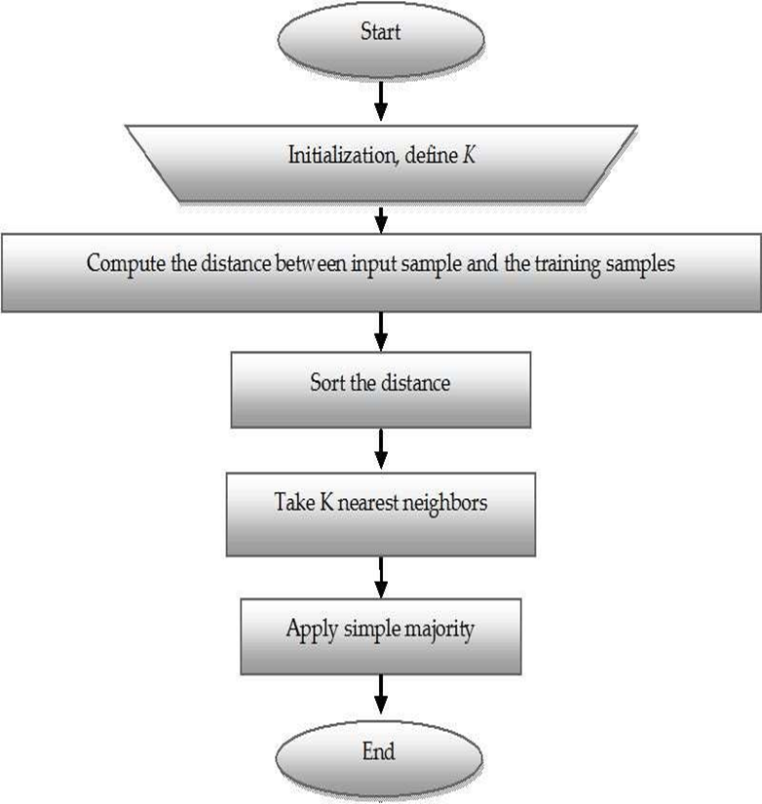
K-NN Algorithm
KNN working with the help of following steps :
Step 1 − Load the training as well as test data.
Step 2 − Choose the value of K i.e. the nearest data points. K can be any integer.
Step 3 − For each point in the test data do the following −
3.1 − Calculate the distance between test data and each row of training data with the help of any of the method namely: Euclidean, Manhattan or Hamming distance. The most commonly used method to calculate distance is Euclidean.
3.2 − Now, based on the distance value, sort them in ascending order.
3.3 − Next, it will choose the top K rows from the sorted array.
3.4 − Now, it will assign a class to the test point based on most frequent class of these rows.
Step 4 − End

Slide 16
Example
We have data from the questionnaires survey and objective testing with two attributes (acid durability and strength) to classify whether a special paper tissue is good or not. Here are four training samples :
X1 = Acid Durability (seconds) | X2 = Strength (kg/square meter) | Y = Classification
7 | 7 | Bad
7 | 4 | Bad
3 | 4 | Good
1 | 4 | Good
Now the factory produces a new paper tissue that passes the laboratory test with X1 = 3 and X2 = 7. Classify this paper is good or not .

Slide 17
Step 1 : Initialize and Define k.
Lets say, k = 3
(Always choose k as an odd number if the number of attributes is even to avoid a tie in the class prediction)
Step 2 : Compute the distance between input sample and training sample
Co-ordinate of the input sample is (3,7).
Instead of calculating the Euclidean distance, we
calculate the Squared Euclidean distance.
X1 = Acid Durability (seconds) | X2 = Strength (kg/square meter) | Squared Euclidean distance
7 | 7 | (7-3)² + (7-7)² = 16
7 | 4 | (7-3)² + (4-7)² = 25
3 | 4 | (3-3)² + (4-7)² = 09
1 | 4 | (1-3)² + (4-7)² = 13

Slide 18
Step 3 : Sort the distance and determine the nearest neighbours based of the K^{th} minimum distance :
X1 = Acid Durability (seconds) | X2 = Strength (kg/square meter) | Squared Euclidean distance | Rank minimum distance | Is it included in 3-Nearest Neighbour?
7 | 7 | 16 | 3 | Yes
7 | 4 | 25 | 4 | No
3 | 4 | 09 | 1 | Yes
1 | 4 | 13 | 2 | Yes

Slide 19
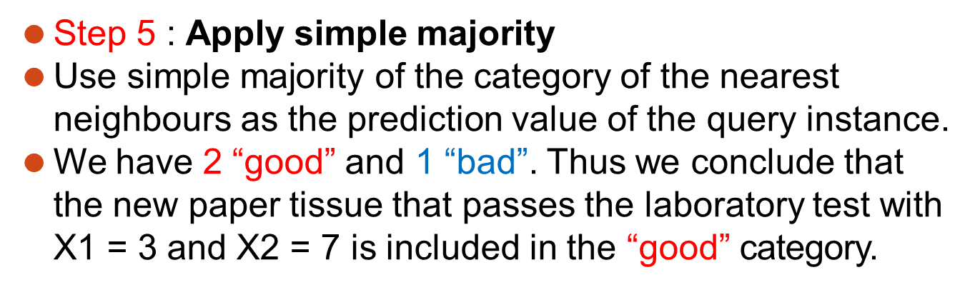
Step 4 : Take 3-Nearest Neighbours:
Gather the category Y of the nearest neighbours.
X1 = Acid Durability (seconds) | X2 = Strength (kg/square meter) | Squared Euclidean distance | Rank minimum distance | Is it included in 3-Nearest Neighbour? | Y = Category of the nearest neighbour
7 | 7 | 16 | 3 | Yes | Bad
7 | 4 | 25 | 4 | No | -
3 | 4 | 09 | 1 | Yes | Good
1 | 4 | 13 | 2 | Yes | Good

Slide 20
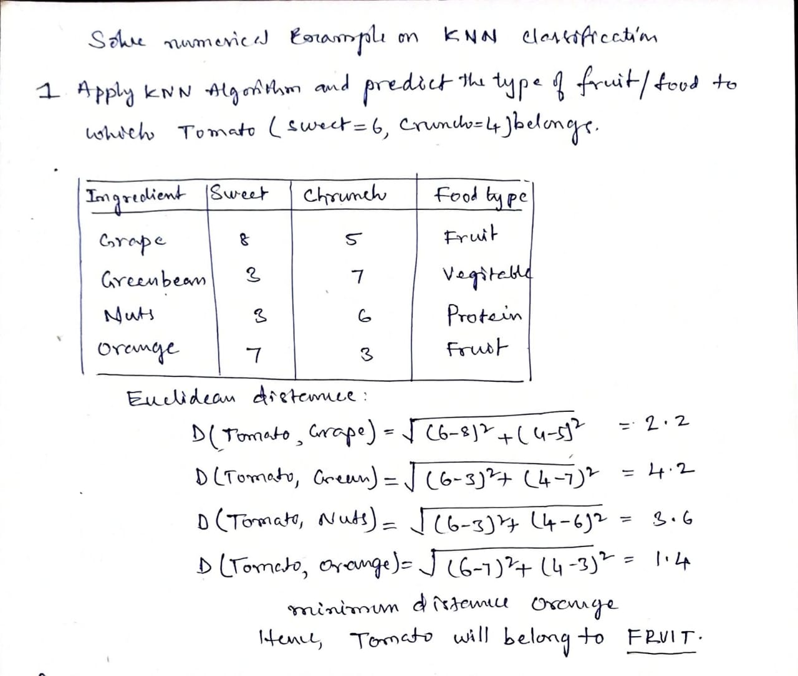
Example

Slide 21
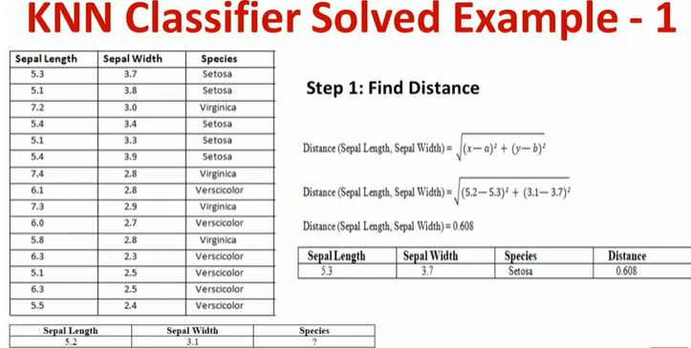

Slide 22
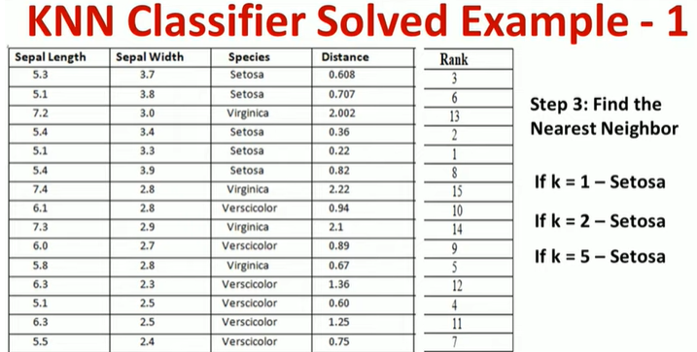

Slide 23
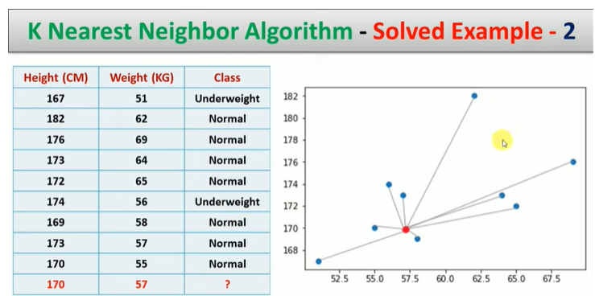

Slide 24
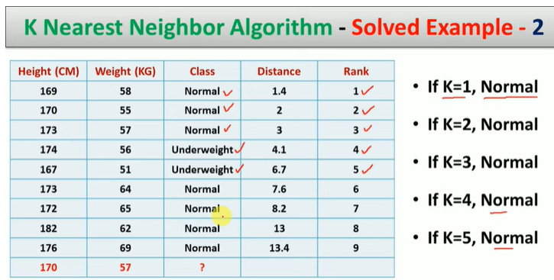

Slide 25
Complexity
O(d) to compute distance to one examples
O(nd) to computed distances to all examples
Plus O(nk) time to find k closest examples
Total time: O(nk+nd)
Very expensive for a large number of samples
But we need a large number of samples for kNN to to work well!!

Slide 26
Advantages of KNN classifier :
Can be applied to the data from any distribution for example, data does not have to be separable with a linear boundary
Very simple and intuitive
Good classification if the number of samples is large enough
Disadvantages of KNN classifier :
Choosing k may be tricky
Test stage is computationally expensive
No training stage, all the work is done during the test stage
This is actually the opposite of what we want. Usually we can afford training step to take a long time, but we want fast test step

Slide 27
Applications of KNN Classifier
Used in classification
Used to get missing values
Used in pattern recognition
Used in gene expression
Used in protein-protein prediction
Used to get 3D structure of protein
Used to measure document similarity

