Slide 1
Unit-5
NP hard and NP Complete problems Basic Concepts
Dr.N.Subhash Chandra
1

Slide 2
NP –HARD AND NP – COMPLETE PROBLEMS
Basic Concepts

Slide 3
NP –HARD AND NP – COMPLETE PROBLEMS
Basic Conepts
Decision Problems
To keep things simple, we will mainly concern ourselves with decision problems. These problems only require a single bit output:
``yes'' and ``no''.
How would you solve the following decision problems?
-Is this directed graph acyclic?
-Is there a spanning tree of this undirected graph with total
weight less than w?
-Does this bipartite graph have a perfect (all nodes matched) matching?
-Does the pattern p appear as a substring in text t?

Slide 4
NP –HARD AND NP – COMPLETE PROBLEMS
BASIC CONCEPTS
• The computing times of algorithms fall into two groups.
• Group1– consists of problems whose solutions are bounded by the polynomial of small degree.
Example – Binary search o(log n) , sorting o(n log n), matrix multiplication 0(n ^{2.81}).

Slide 5
NP –HARD AND NP – COMPLETE PROBLEMS
• Group2 – contains problems whose best known algorithms are non polynomial.
• Example –Traveling salesperson problem 0(n²2^{n}), knapsack problem 0(2^{n/2}) etc.
• There are two classes of non polynomial time problems
1) NP- hard
2) NP-complete
• A problem which is NP complete will have the property that it can be solved in polynomial time iff all other NP – complete problems can also be solved in polynomial time.

Slide 6
NP –HARD AND NP – COMPLETE PROBLEMS
Basic Concepts
The class NP (meaning non-deterministic polynomial time) is the set of problems that might appear in a puzzle magazine: ``Nice puzzle.''
What makes these problems special is that they might be hard to solve, but a short answer can always be printed in the back, and it is easy to see that the answer is
correct once you see it.
Example... Does matrix A have an LU decomposition? No guarantee if answer is ``no''.

Slide 7
NP –HARD AND NP – COMPLETE PROBLEMS
Basic Concepts
Another way of thinking of NP is it is the set of problems that can solved efficiently by a really good guesser.
The guesser essentially picks the accepting certificate out of the air (Non-deterministic Polynomial time). It can then convince itself that
it is correct using a polynomial
time algorithm. (Like a right-brain, left-brain sort of thing.)
Clearly this isn't a practically useful characterization: how could we build such a machine?

Slide 8
NP –HARD AND NP – COMPLETE PROBLEMS
Basic Conepts
Exponential Upperbound
Another useful property of the class NP is that all NP problems can be solved in exponential time (EXP).
This is because we can always list out all short certificates in exponential time and check all O(2nk) of them.
Thus, P is in NP, and NP is in EXP. Although we know that P is not equal to EXP, it is possible that NP = P, or EXP, or neither. Frustrating!

Slide 9
NP –HARD AND NP – COMPLETE PROBLEMS
Basic Conepts
NP-hardness
As we will see, some problems are at least as hard to solve as any problem in NP. We call such problems NP-hard.
How might we argue that problem X is at least as hard (to within a polynomial factor) as problem Y?
If X is at least as hard as Y, how would we expect an algorithm that is able to solve X to behave?

Slide 10
NP –HARD AND NP – COMPLETE PROBLEMS
• If an NP-hard problem can be solved in polynomial time, then all NP-complete problems can be solved in polynomial time.
• All NP-complete problems are NP-hard, but all NP- hard problems are not NP-complete.
• The class of NP-hard problems is very rich in the sense that it contain many problems from a wide variety of disciplines.
10

Slide 11
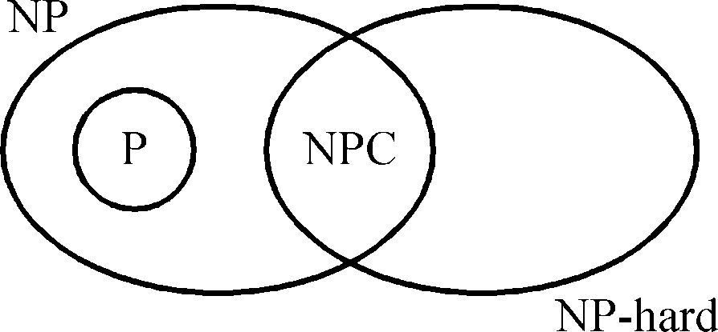
• P: the
class of problems which can be solved by a
deterministic polynomial algorithm.
• NP : the class of decision problem which can be solved by a non-deterministic polynomial algorithm.
• NP-hard: the class of problems to which every NP problem reduces.
• NP-complete (NPC): the class of problems which are NP- hard and belong to NP.
8-11

Slide 12
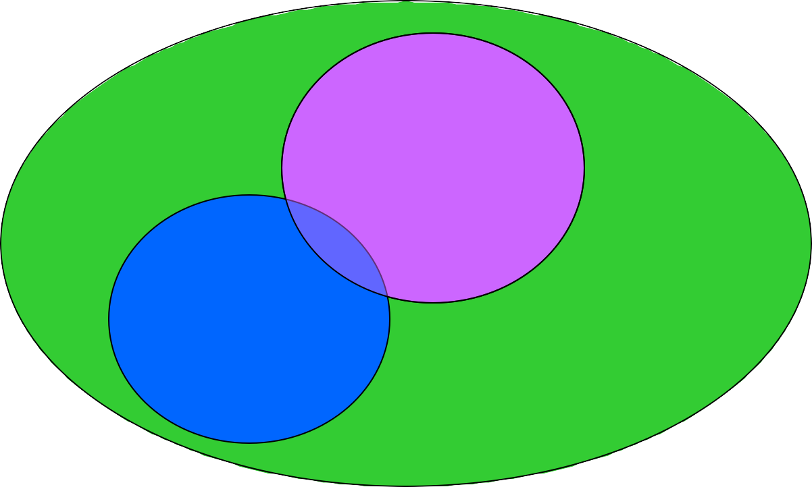
NP-Completeness
• How we would you define NP-Complete?
• They are the “hardest” problems in NP
NP-Complete
P
NP

Slide 13
DETERMINISTIC and NONDETERMINISTIC ALGORITHMS
• Algorithms with the property that the result of every operation is uniquely defined are termed deterministic.
• Such algorithms agree with the way programs are executed on a computer.
• In a theoretical framework, we can allow algorithms to contain operations whose outcome is not uniquely defined but is limited to a specified set of possibilities.

Slide 14
Deterministic and Nondeterministic algorithms
• The machine executing such operations are allowed to choose any one of these outcomes subject to a termination condition.
• This leads to the concept of non deterministic algorithms.
• To specify such algorithms in SPARKS, we introduce three statements
i) choice (s) ……… arbitrarily chooses one of the elements of the set S.
ii) failure …. Signals an unsuccessful completion.
iii) Success : Signals a successful completion.

Slide 15
Deterministic and Nondeterministic algorithms
• Whenever there is a set of choices that leads to a successful completion then one such set of choices is always made and the algorithm terminates.
• A nondeterministic algorithm terminates unsuccessfully if and only if there exists no set of choices leading to a successful signal.
• A machine capable of executing a non deterministic algorithm is called a non deterministic machine.
• While non-deterministic machines do not exist in practice they will provide strong intuitive reason to conclude that certain problems cannot be solved by fast deterministic algorithms.¹⁵

Slide 16
Nondeterministic algorithms
• A nondeterminstic algorithm consists of phase 1: guessing
phase 2: checking
• If the checking stage of a nondeterministic algorithm is of polynomial time-complexity, then this algorithm is called an NP (nondeterministic polynomial) algorithm.
• NP problems : (must be decision problems)
– e.g.
searching, MST sorting
satisfiability problem (SAT)
traveling salesperson problem (TSP)
8- 16

Slide 17
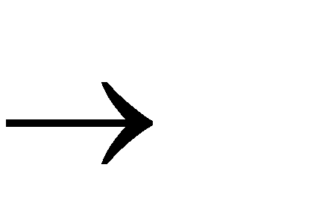

Example of a non deterministic algorithm
// The problem is to search for an element x //
// Output j such that A(j) =x; or j=0 if x is not in A // j choice (1 :n )
if A(j) =x then print(j) ; success endif
print (‘0’) ; failure complexity 0(1);
- Non-deterministic decision algorithms generate a zero or one as their output.
- Deterministic search algorithm complexity. (n)

Slide 18

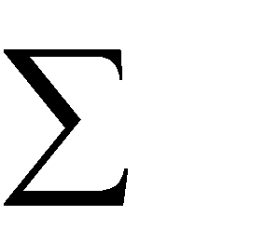

Deterministic and Nondeterministic algorithms
• Many optimization problems can be recast into decision problems with the property that the decision problem can be solved in polynomial time iff the corresponding optimization problem can .
EXAMPLE : [0/1 knapsack] :
• The decision is to determine if there is a 0/1 assignment of values to
x_{i} 1 | i n such that | p_{i}x_{i} | R, and | w_{i}x_{i} | M, R, M are given numbers
p_{i}, w_{i} | 0, 1 i n.
• It is easy to obtain polynomial time non deterministic algorithms for many problems that can be deterministically solved by a systematic search of a solution space of exponential size.

Slide 19
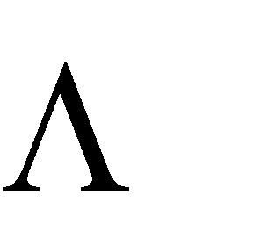
SATISFIABILITY
• Let x₁,x₂,x₃….x_{n} denotes Boolean variables.
_
• Let x_{i} denotes the relation of x_{i}.
• A literal is either a variable or its negation.
• A formula in the prepositional calculus is an expression that can be constructed using literals and the operators and or v.
• A clause is a formula with at least one positive literal.
• The satisfiability problem is to determine if a formula is true
for some assignment of truth values to the variables.
19

Slide 20
SATISFIABILITY
• It is easy to obtain a polynomial time non determination algorithm that terminates successfully if and only if a given prepositional formula E(x₁,x₂……x_{n}) is satiable.
• Such an algorithm could proceed by simply choosing (non deterministically) one of the 2^{n} possible assignments of truth values to (x₁,x₂…x_{n}) and verify that E(x₁,x₂…x_{n}) is true for that assignment.
20

Slide 21
The satisfiability problem
• The satisfiability problem
– The logical formula : x₁ v x₂ v x₃
& - x₁ & - x₂
the assignment :
x₁ ← F , x₂ ← F , x₃ ← T
will make the above formula true .
(-x₁, -x₂ , x₃) represents x₁ ← F , x₂ ← F , x₃ ← T
8- 21

Slide 22
The satisfiability problem
• If there is at least one assignment which satisfies a formula, then we say that this formula is satisfiable; otherwise, it is unsatisfiable.
• An unsatisfiable formula :
x₁ v x₂ & x₁ v -x₂ & -x₁ v x₂
& -x₁ v -x₂
8- 22

Slide 23

The satisfiability problem
• Definition of the satisfiability problem:
Given a Boolean formula, determine whether this formula is satisfiable or not.
• A literal : x_{i} or -x_{i}
• A clause : x₁ v x₂ v -x₃ C_{i}
• A formula : conjunctive normal form (CNF)
C₁& C₂ & … & C_{m}
8- 23

Slide 24
NP-HARD GRAPH AND SCHEDULING PROBLEMS
Some NP-hard Graph Problems :
The strategy to show that a problem L₂ is NP-hard is
(i) Pick a problem L₁ already known to be NP-hard.
(ii)
Show how to obtain an instance I¹ of L₂ from any instance I of L₁ such that from the solution of I¹
- We can determine (in polynomial deterministic time) the solution to instance I of L₁.

Slide 25
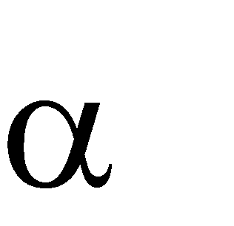

(iii) Conclude from (ii) that L₁ L₂.
NP-HARD GRAPH AND SCHEDULING PROBLEMS
(iii) Conclude from (i),(ii), and the transitivity of Satisfiability L₁
L₁ L₂
Satisfiability L₂ L₂ is NP-hard
that

Slide 26

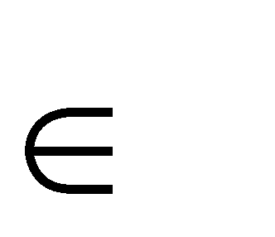


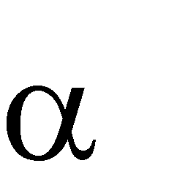

NP-HARD GRAPH AND SCHEDULING PROBLEMS
1. Chromatic Number Decision Problem (CNP)
• A coloring of a graph G = (V,E) is a function f : V → { 1,2, …, k} i V .
• If (U,V) E then f(u) f(v).
• The CNP is to determine if G has a coloring for a given K.
• Satisfiability with at most three literals per clause
chromatic number problem.
CNP is NP-hard.

Slide 27
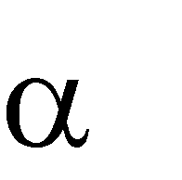

NP-HARD GRAPH AND SCHEDULING PROBLEMS
2. Directed Hamiltonian Cycle (DHC)
• Let G = (V,E) be a directed graph and length n = 1V1
• The DHC is a cycle that goes through every vertex exactly once and then
returns to the starting vertex.
• The DHC problem is to determine if G has a directed Hamiltonian Cycle.
Theorem : CNF (Conjunctive Normal Form) satisfiability DHC DHC is NP-hard.

Slide 28

NP-HARD GRAPH AND SCHEDULING PROBLEMS
3. Travelling Salesperson Decision Problem (TSP) :
• The problem is to determine if a complete directed graph G = (V,E) with edge costs C(u,v) has a tour of cost at most M.
Theorem : Directed Hamiltonian Cycle (DHC) TSP
• But from problem (2) satisfiability DHC Satisfiability TSP
TSP is NP-hard.

Slide 29
NP-HARD SCHEDULING PROBLEMS
1. Sum of subsets
• The problem is to determine if A={a₁,a₂,…….,a_{n}} (a₁,a₂,………,a_{n} are positive integers) has a subset S that sums to a given integer M.
2. Scheduling identical processors
• Let P_{i} 1≤i≤m be identical processors or machines P_{i}.
• Let J_{i} 1≤i≤n be n jobs.
• Jobs J_{i} requires t_{i} processing time.

Slide 30
NP-HARD SCHEDULING PROBLEMS
• A schedule S is an assignment of jobs to processors.
• For each job J_{i} ,S specifies the time intervals and the processors on
which this job is to be processed.
• A job can not be processed by more than one processor at any given
time.
• The problem is to find a minimum finish time non-preemptive schedule.
• The finish time of S is FT(S) = max{Ti}
• Where T_{i} is the time at which processor P_{i} finishes processing all jobs
1≤i≤m
(or job segments) assigned to it.

Slide 31
SOME SIMPLIIFIED NP-HARD PROBLEMS
• An NP-hard problem L cannot be solved in deterministic polynomial time.
• By placing enough restrictions on any NP hard problem, we can
arrive at a polynomial solvable problem.
Examples.
(i) CNF- Satisfiability with at most three literals per clause is NP-hard.
(ii) If each clause is restricted to have at most two literals then CNF- satisfiability is polynomial solvable.

Slide 32
SOME SIMPLIIFIED NP-HARD PROBLEMS
(iii)Generating optimal code for a parallel assignment statement is NP-hard,
- however if the expressions are restricted to be simple variables, then optimal code can be generated in polynomial time.
(iv)Generating optimal code for level one directed a- cyclic graphs is NP-hard but optimal code for trees can be generated in polynomial time.
(v)Determining if a planner graph is three colorable is NP- Hard
- To determine if it is two colorable is a polynomial complexity problem. (We only have to see if it is bipartite)

