Slide 1
UNIT-II-Divide and Conquer
Convex hull
Material prepared by
Dr. N. Subhash Chandra
From Web resources, Computer Algorithms , Horowitz, Sahni & Rajasekaran

Slide 2
Convex hull
Introduction: Background & Definition of convex hull
Three algorithms
Graham’s Scan
Quick hull
Divide and Conquer
Applications

Slide 3
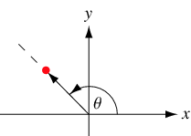
Prerequisites: Polar angle
In the plane, the polar angle θ is the counter clockwise angle from x-axis at which a point in the x-y plane lies.

Slide 4

Orientation
b
Calculating Orientation
Three kinds of orientation for three points (a, b, c)
Clockwise (CW): right turn
Counterclockwise (CCW): left turn
Collinear (COLL): no turn
CW
a
c
c
CCW
a
b
The orientation can be characterized by the sign of the determinant △(a,b,c)
If △(a,b,c)<0 ⇒ clockwise
If △(a,b,c)=0 ⇒ collinear
If △(a,b,c)>0 ⇒ counterclockwise
c
b
COLL
a

Slide 5
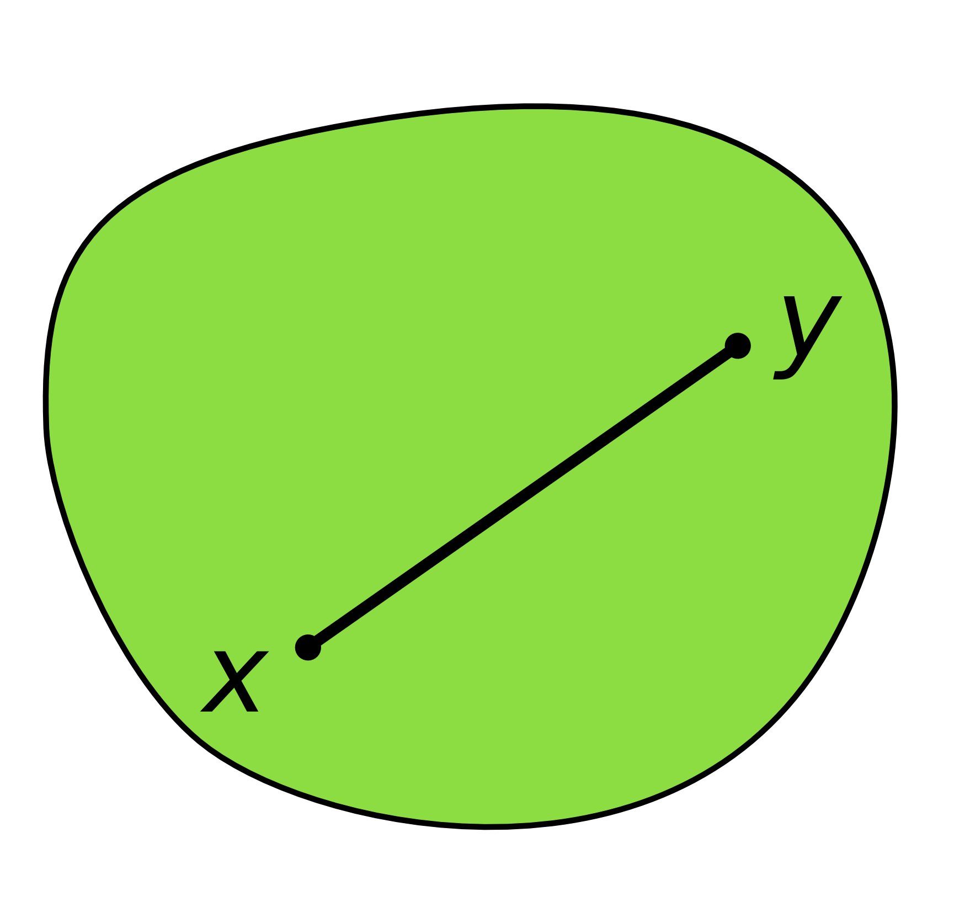
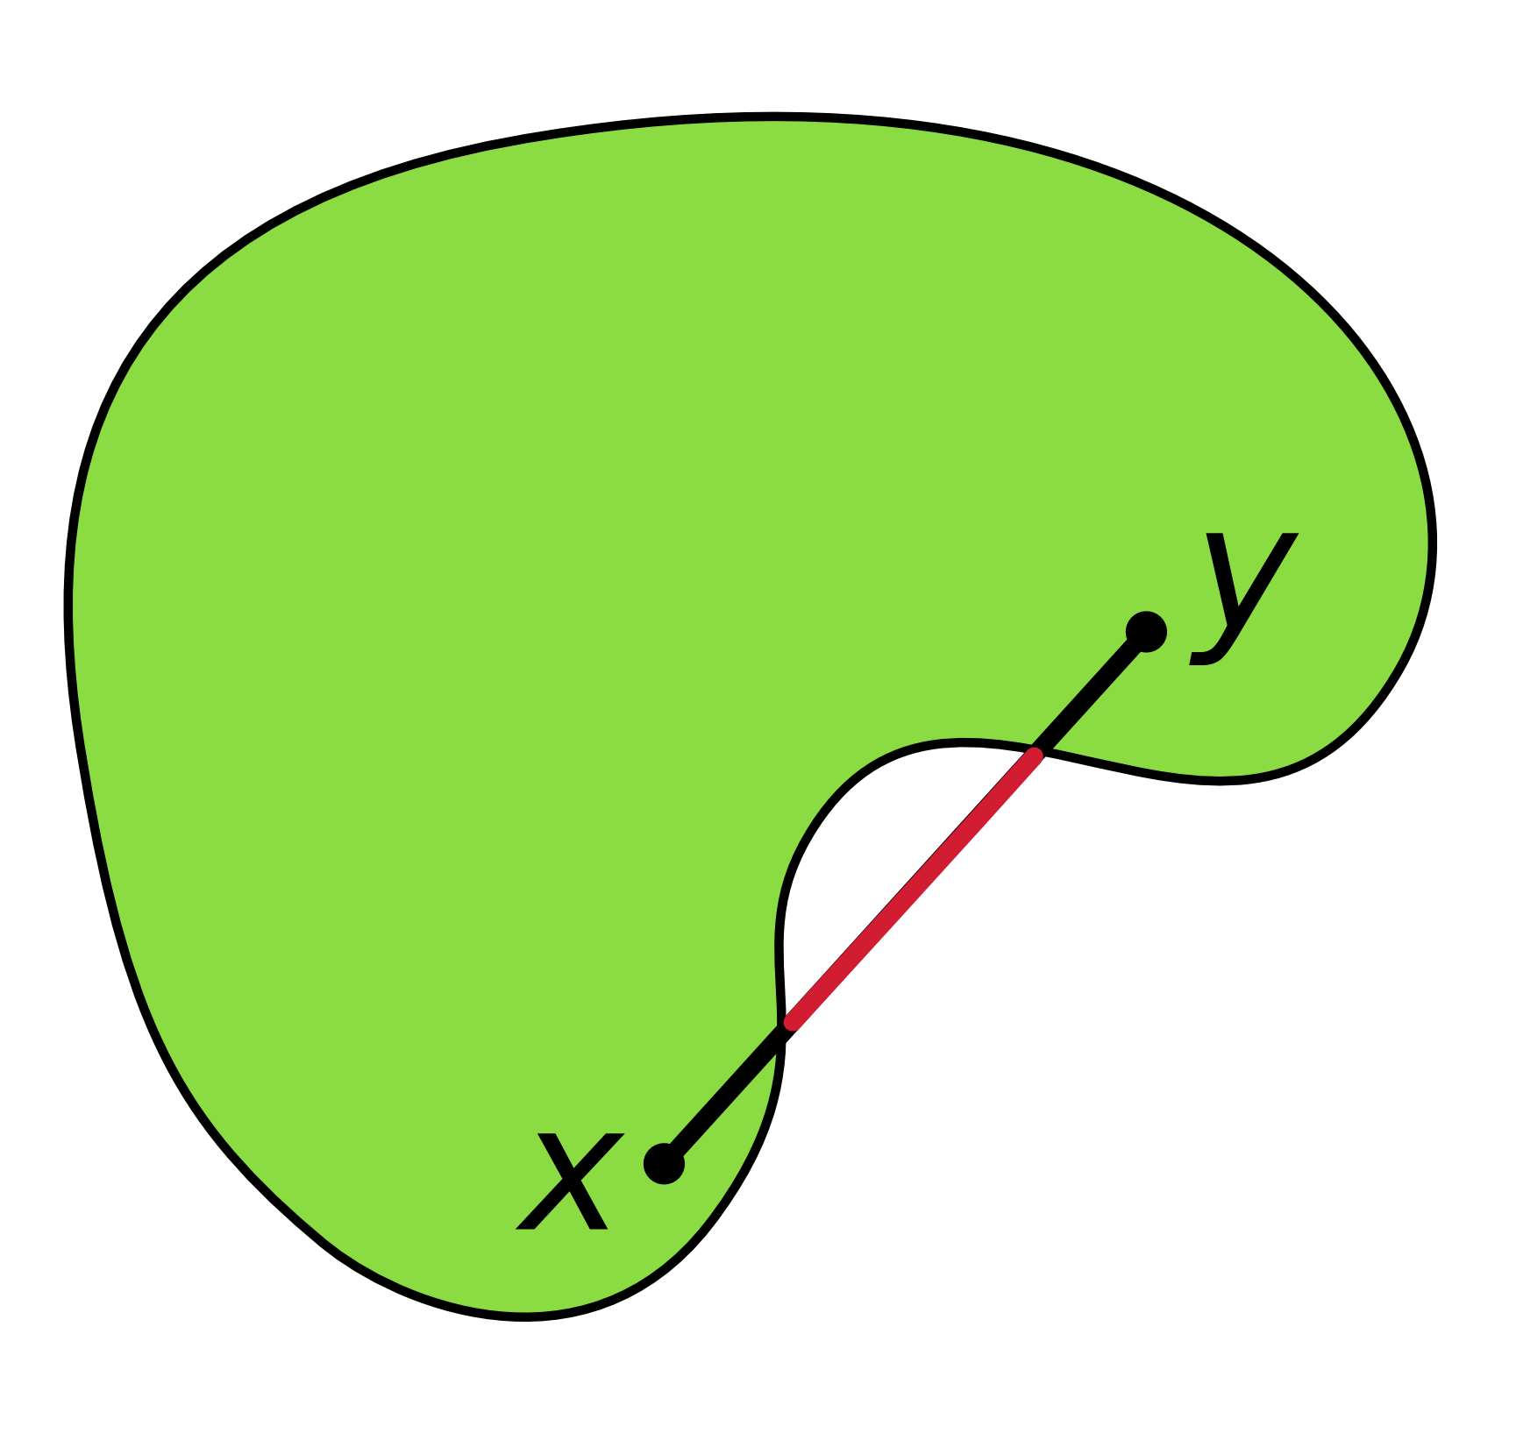
Convexity
A shape or set is convex :
If for any two points that are part of the shape, the whole connecting line segment is also part of the shape.
convex
non-convex

Slide 6
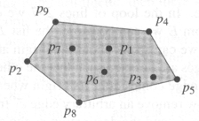
Convex hull
The Convex Hull is the subset of points that forms the smallest convex polygon which encloses all points in the set.
Give an algorithm that computes the convex hull of any given set of n points in the plane efficiently.
Inputs: location of n points
Outputs: a convex polygon ⇒ a sorted sequence of the points, clockwise (CW) or counterclockwise (CCW) along the boundary
inputs= a set of point
p₁,p₂,p₃,p₄,p₅,p₆,p₇,p₈,p₉
outputs= representation of the convex hull
p₄,p₅,p₈,p₂,p₉

Slide 7
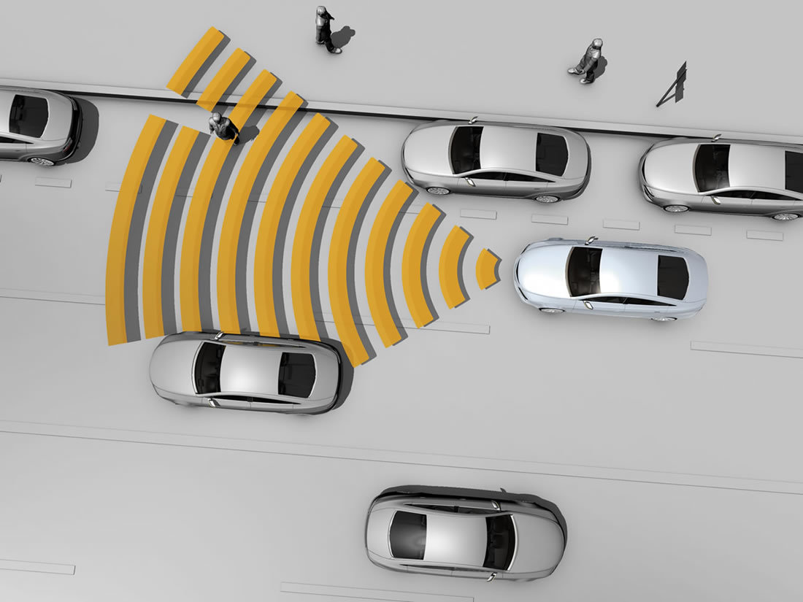
Convex hull Applications
1. Computer visualization, ray tracing
(e.g. video games, replacement of bounding boxes)
● Path finding
(e.g. embedded AI of Mars mission rovers)
● Geographical Information Systems (GIS)
(e.g. computing accessibility maps)
● Visual pattern matching
(e.g. detecting car license plates)
● Verification methods
(e.g. bounding of Number Decision Diagrams)
● Geometry
(e.g. diameter computation)

Slide 8
Quick hull Algorithm

Slide 9
Quick hull Algorithm
Quick hull is a method of computing the convex hull of a finite set of points in the plane.
It uses a divide and conquer approach similar to that of quicksort, from which its name derives.
Quick Hull was published by C. Barber and D. Dobkin in 1995.

Slide 10
Quick Hull Algorithm
Quick hull Algorithm:
Step 1. Assume points are sorted by x-coordinate values
Identify extreme points P₁ and P₂ (part of hull)
Step 2. The set S of points is divided in two subsets S₁ and S₂ Compute Convex Hull
for S₁ Compute Convex Hull for S₂ in a similar manner
P_{max}
P₂
P₁

Slide 11
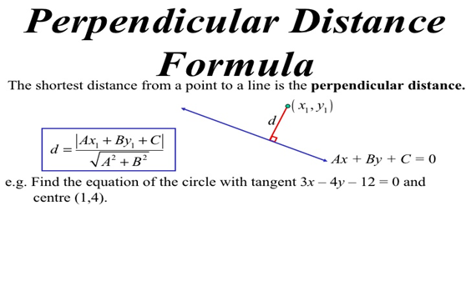
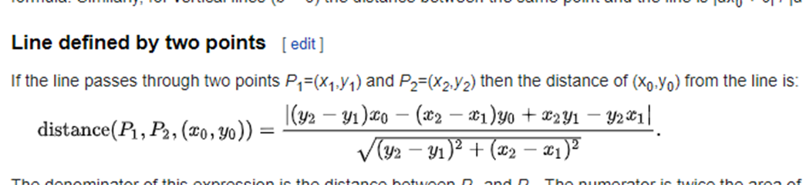
Quick Hull Algorithm
Step 3. How to compute the Convex (upper) Hull for S₁
find point P_{max} that is farthest away from line P₁P₂
compute the hull of the points to the left of line P₁P_{max}
compute the hull of the points to the left of line P_{max}P₂
Step 4. How to find the P_{max} point
P_{max} maximizes the area of the triangle P_{max}P₁P₂
if tie, select the P_{max} that maximizes the angle P_{max}P₁P₂
The points inside triangle P_{max}P₁P₂ can be excluded from further consideration
How to find geometrically the point P_{max} and the points to the left of line P₁P_{max}

Slide 12
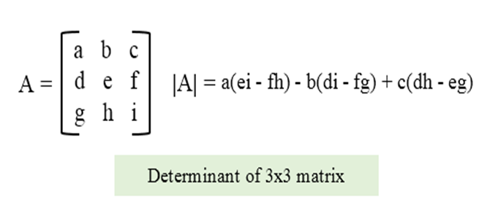
Quick Hull Algorithm
How to find geometrically the point P_{max} and the points to the left of line P₁P₂
Given points P₁(x₁,y₁), P₂(x₂,y₂), P_{max}(x_{max},y_{max})
The area of the triangle is half of the magnitude of the determinant
=x₁y₂+x_{max}y₁+x₂y_{max}–x_{max}y₂–x₂y₁-x₁y_{max}
The sign of the expression is positive if and only if the point P_{max} is to the left of the line P₁P₂
x₁ | y₁ | 1
x₂ | y₂ | 1
x_{max} | y_{max} | 1

Slide 13
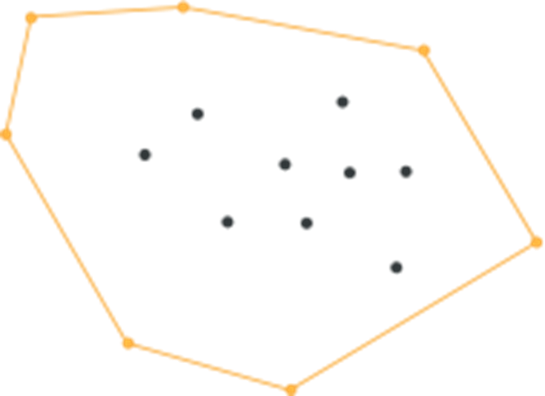
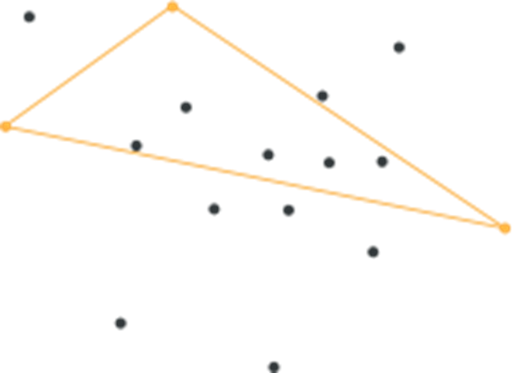
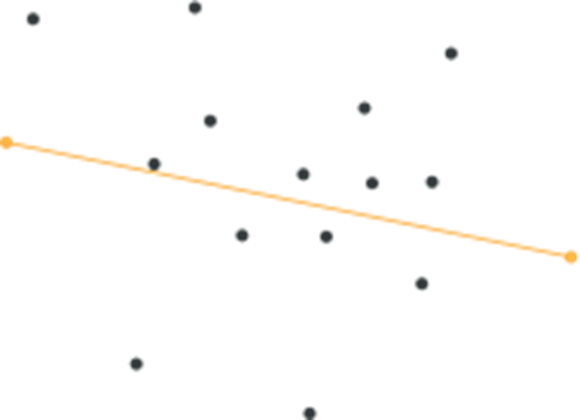
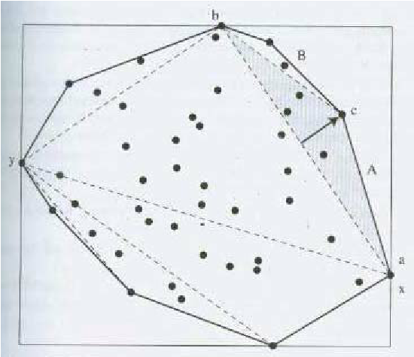
Example
Step 1
Step 2-5
Step 6

Slide 14
Quick hull Algorithm Pseudocode
FindHull (Sk, P, Q)
{
// Find points on convex hull from the set Sk of points
// that are on the right side of the oriented line from P to Q
If Sk has no point, then return.
From the given set of points in Sk, find farthest point, say C, from segment PQ
Add point C to convex hull at the location between P and Q .
Three points P, Q and C partition the remaining points of Sk into 3 subsets: S0, S1, and S2 , where S0 are points inside triangle PCQ,
S1 are points on the right side of the oriented line from P to C
S2 are points on the right side of the oriented line from C to Q
FindHull(S1, P, C)
FindHull(S2, C, Q)
}
Output = Convex Hull
Input = a set S of n points
Assume that there are at least 2 points in the input set S of points
QuickHull (S)
{
// Find convex hull from the set S of n points
Convex_Hull := {}
Find left and right most points, say P1 & P2 Add P1 & P2 to convex hull
Segment P1 P2 divides the remaining (n-2) points into 2 groups S1 and S2 where S1 are points in S that are on the right side of the oriented line from P1 to P2 , and S2 are points in S that are on the right side of the oriented line from P2 to P1
FindHull (S1, P1, P2)
FindHull (S2, P2, P1)
}

Slide 15
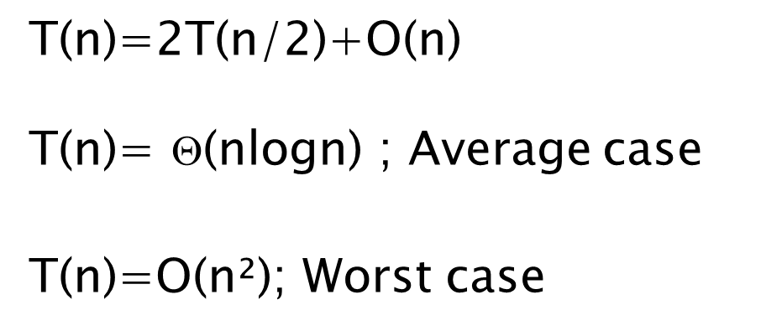
Efficiency of Quick Hull algorithm
Finding point farthest away from line P₁P₂ can be done in linear time
This gives same efficiency as quicksort:
If points are not initially sorted by x-coordinate value, this can be accomplished in Θ(n log n) no increase in asymptotic efficiency class

Slide 16
Graham's Scan Algorithm

Slide 17
Graham's Scan Algorithm
Graham's Scan Algorithm is an efficient algorithm for finding the convex hull of a finite set of points in the plane with time complexity O(N log N). The algorithm finds all vertices of the convex hull ordered along its boundary. It uses a stack to detect and remove concavities in the boundary efficiently.
Step 1. Find the lowest point p (guaranteed to be in)
Step 2. Sort points around p (in polar angle) in increasing angle
Step 3. Walk around to remove concave angle.
(keep points with left turns, & drop those with right turns)

Slide 18
Graham's Scan Algorithm
Graham scan is a method of computing the convex hull of a finite set of points in the plane with time complexity O(n logn).
The algorithm finds all vertices of the convex hull ordered along its boundary
Graham's scan solves the convex-hull problem by maintaining a stack S of candidate points. Each point of the input set Q is pushed once onto the stack.

Slide 19
Graham's Scan Algorithm
And the points that are not vertices of CH(Q) are eventually popped from the stack. When the algorithm terminates, stack S contains exactly the vertices of CH(Q), in counterclockwise order of their appearance on the boundary.
When we traverse the convex hull counter clockwise, we should make a left turn at each vertex.
Each time the while loop finds a vertex at which we make a non left turn ,the vertex is popped from the vertex.

Slide 20
Example Graham's Scan

Slide 21
Step1: Select a start point
Select a extreme point as a start point with the minimum y-coordinate.
If there are more than one points have minimum y-coordinate, select the leftmost one.
Start point: with minimum y-coordinate and leftmost

Slide 22
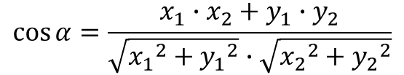
Step 2: Sort points by polar angle
Y
Sort the points by polar angle in counterclockwise order.
If more than one point has the same angle, remove all but the one that is farthest from the start point.
This algorithm will work in this sorting order.
Angle can be calculated by vector cosine law
6
7
4
5
3
2
1
0
X

Slide 23
Step3: Push first 3 points
Add first 3 points into the result set. Let S be the result set.
Push(p0, S)
Push(p1, S)
Push(p2, S)
6
7
4
5
3
2
1
0
Stack S: <p0, p1, p2>

Slide 24
Step4: Work around all points by sorting order
1->2->3 is left turn.
Push (p3, S)
6
7
4
5
3
top[S]
2
1
0
Next -to -top[S]
Stack S: <p0, p1, p2>

Slide 25
Step4: Work around all points by sorting order
Y
2->3->4 is left turn.
Push (p4, S)
6
7
4
5
3
2
1
0
Stack S: <p0, p1, p2, p3>

Slide 26
Step4: Work around all points by sorting order
Y
3->4->5 is left turn.
Push (p5, S)
6
7
4
5
3
2
1
0
Stack S: <p0, p1, p2, p3, p4>

Slide 27
Step4: Work around all points by sorting order
4->5->6 is non-left turn.
Pop (p5, S)
6
7
4
5
3
2
1
0
Stack S: <p0, p1, p2, p3, p4, p5>

Slide 28
Step4: Work around all points by sorting order
3->4->6 is non-left turn.
Pop (p4, S)
6
7
4
5
3
2
1
0
Stack S: <p0, p1, p2, p3, p4>

Slide 29
Step4: Work around all points by sorting order
Collinear
2->3->6 is non-left turn.
Pop (p3, S)
6
7
4
5
3
2
1
0
Stack S: <p0, p1, p2, p3>

Slide 30
Step4: Work around all points by sorting order
2->6->7 is left turn.
Push (p6, S)
6
7
4
5
3
2
1
0
Stack S: <p0, p1, p2>

Slide 31
Step4: Work around all points by sorting order
6->7->0 is left turn.
Push (p7, S)
6
7
4
5
3
2
1
0
Set S: <p0, p1, p2, p6, p7>

Slide 32
Finally, we get a Convex hull.
6
7
4
5
3
2
1
0

Slide 33



^{p}10
p₉
p₆
^{p}12
p₇
p₅
p₄
p₃
p
11
p₈
p₁
p
2
p₀

Slide 34

^{p}10
p₉
p₆
^{p}12
p₇
p₅
p₄
p₃
p
11
p₈
p₁
p
2
p₀

Slide 35
^{p}10
p₉
p₆
^{p}12
p₇
p₅
p₄
p₃
p
11
p₈
p
p₂
1
p₀

Slide 36
^{p}10
p₉
p₆
^{p}12
p₇
p₅
p₄
p₃
p
11
p₈
p₁
p
2
p₀

Slide 37
^{p}10
p₉
p₆
^{p}12
p₇
p₅
p₄
p₃
p
11
p₈
p₁
p
2
p₀

Slide 38
^{p}10
p₉
p₆
^{p}12
p₇
p₅
p₄
p₃
p
11
p₈
p₁
p
2
p₀

Slide 39
^{p}10
p₉
p₆
^{p}12
p₇
p₅
p₄
p₃
p
11
p₈
p₁
p
2
p₀

Slide 40
^{p}10
p₉
p₆
^{p}12
p₇
p₅
p₄
p₃
p
11
p₈
p₁
p
2
p₀

Slide 41
^{p}10
p₉
p₆
^{p}12
p₇
p₅
p₄
p₃
p
11
p₈
p₁
p
2
p₀

Slide 42
^{p}10
p₉
p₆
^{p}12
p₇
p₅
p₄
p₃
p
11
p₈
p₁
p
2
p₀
12/2/2015
39

Slide 43
^{p}10
p₉
p₆
^{p}12
p₇
p₅
p₄
p₃
p
11
p₈
p₁
p
2
p₀

Slide 44
^{p}10
p₉
p₆
^{p}12
p₇
p₅
p₄
p₃
p
11
p₈
p₁
p
2
p₀

Slide 45
^{p}10
p₉
p₆
^{p}12
p₇
p₅
p₄
p₃
p
11
p₈
p₁
p
2
p₀

Slide 46
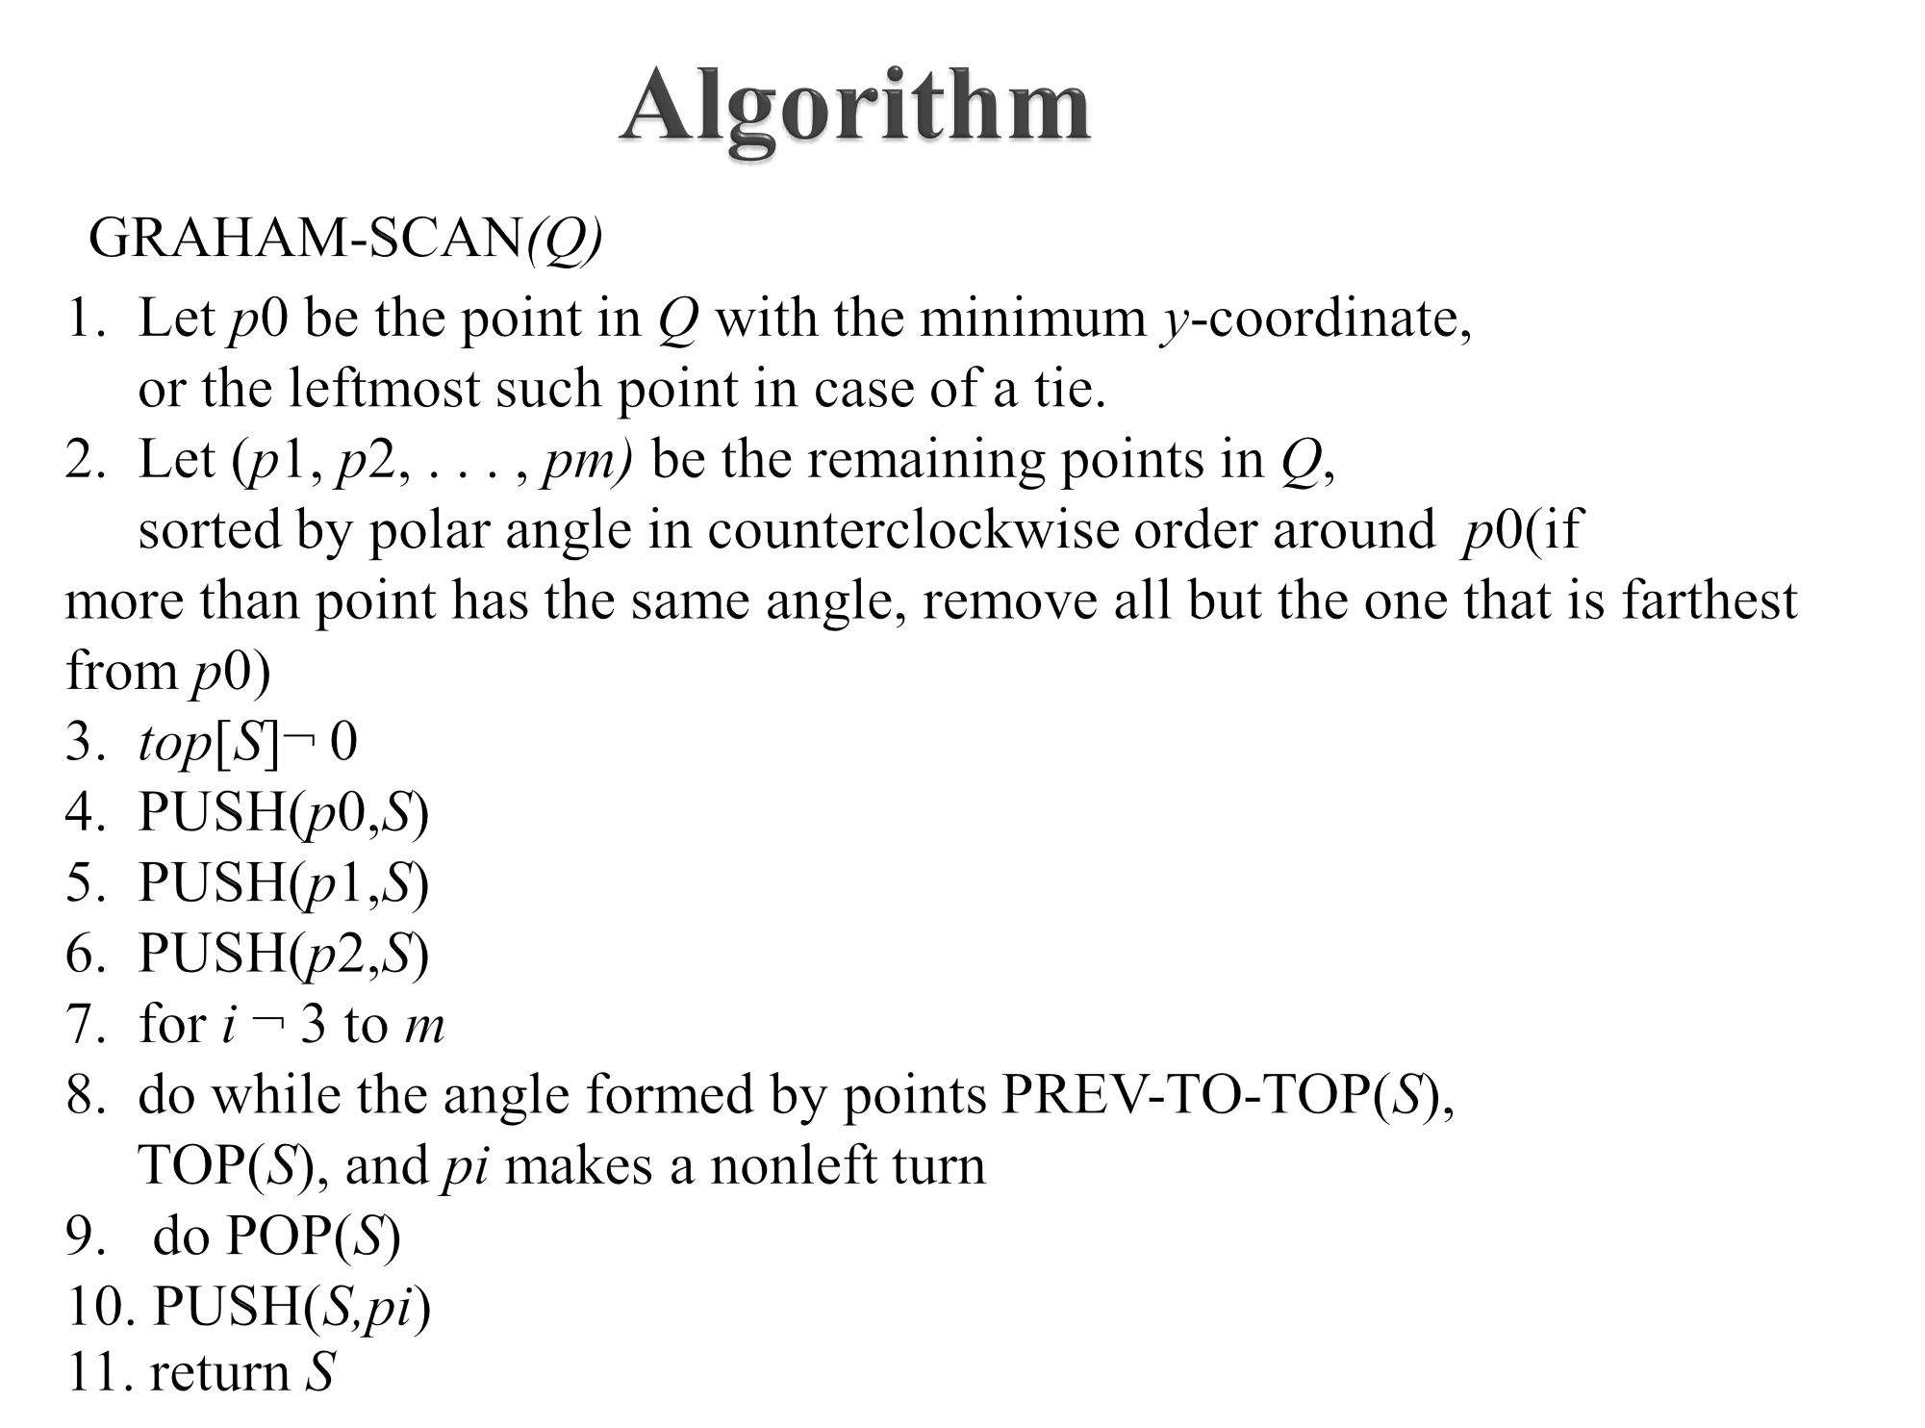

Slide 47
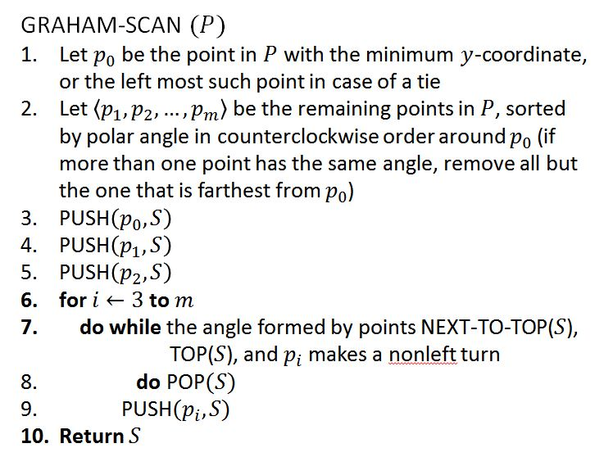
Complexity of Graham’s Scan
Phase 1: select a start point O(n)
Phase 2: Sorting
O(n*log n)
Phase 3: O(n)
Each point is inserted into the sequence exactly once, and
Each point is removed from the sequence at most once
O(n*logn)

Slide 48
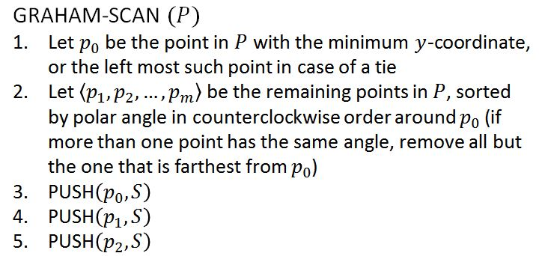
Correctness of Graham’s Scan
The correctness of Graham’s scan lies in two situations.
Part 1 deals with nonleft turns;
Part 2 deals with left turns.
Claim 1: The points on stack always form the vertices of a convex polygon.
Proof: The claim holds immediately after line 5.
Points p₀, p₁, and p₂ form a triangle.
p₂
p₁
p₀

Slide 49
Correctness of Graham’s Scan
Proof (cont’d): Note stack changes in two ways:
Case i: When points are popped from the stack S.
Case ii: When points are pushed onto the stack S.
Case i. Here we rely on the geometric property: If a vertex is removed from a convex polygon, then the resulting polygon is convex.
p_{i}
p_{k}
p_{j}
p_{j}
p_{k}
...
p₁
p₀
p_{k}
...
p₁
p₀
p₂
p₁
p₀

Slide 50
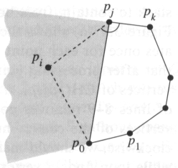
Correctness of Graham’s Scan
Proof (cont’d): Note stack changes in two ways:
Case i: When points are popped from the stack S.
Case ii: When points are pushed onto the stack S.
Case ii. If p_{i} is pushed onto the stack:
By the choice of p₀ and p₁, p_{i} lies above the extension of the line p₀p₁.
By the fact, a left turn occurs at p_{j}, p_{i} lies below the extension of the line joining p_{k} and p_{j}.
By the order of polar angle, p_{i} lies left of the line joining p₀ and p_{j}.
p_{i}
p_{j}
p_{k}
...
p₁
p₀
p_{j}
p_{k}
...
p₁
p₀

Slide 51
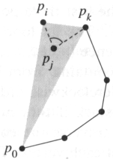
Correctness of Graham’s Scan
Claim 2: Each point popped from the stack is not a vertex of CH(P) and lies inside new convex hull.
Proof: Suppose that point p_{j} is popped from the stack because angle p_{k}p_{j}p_{i} makes a nonleft turn as shown in the figure.
Since points are ordered in increasing polar angle around anchor p₀, there exists a triangle Δp₀p_{i}p_{k} with p_{j} either in the interior of the triangle or on the line segment joining p_{i} and p_{k}. In either case, point p_{j} cannot be a vertex of CH(P).
p_{j}
p_{k}
...
p₁
p₀
p_{i}
p_{k}
...
p₁
p₀
p_{k}
...
p₁
p₀

Slide 52
Correctness of Graham’s Scan
Conclusion
Since each point popped from the stack is not a vertex of CH(P) (by Claim 2). And the points on stack always form the vertices of a convex polygon (by Claim 1). Therefore, Graham’s Scan is correct.

Slide 53
Divide and Conquer method

Slide 54
Convex Hull: Divide & Conquer
Preprocessing: sort the points by x-coordinate
Divide the set of points into two sets A and B:
A contains the left ⎣n/2⎦ points,
B contains the right ⎡n/2⎤ points
Recursively compute the convex hull of A
Recursively compute the convex hull of B
Merge the two convex hulls
A
B

Slide 55
Divide & Conquer pseudo code
hull(S) = smallest convex set that contains S (points are stored in ccw order)
Sort all points of S with increasing x-coordinates
Algorithm conv(S, n)
if n < 4, then trivially solved
else
DIVIDE: A & B
RECUR: conv(A, n/2), conv(B, n/2)
MERGE: combine hull(A) and hull(B)

Slide 56
Why n<4 ?
Algorithm conv(S, n)
if n < 4, then trivially solved
else
DIVIDE: A & B
RECUR: conv(A, n/2), conv(B, n/2)
MERGE: combine hull(A) and hull(B)

Slide 57
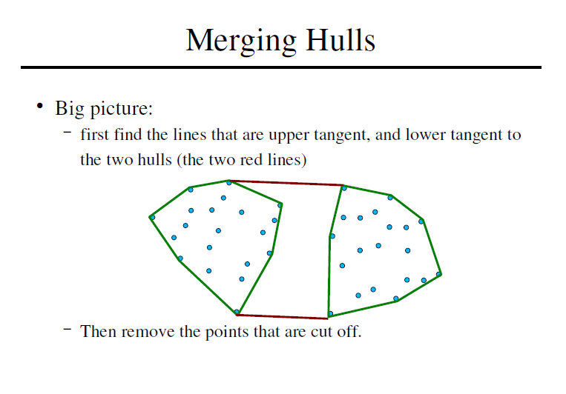
Merging hulls

Slide 58
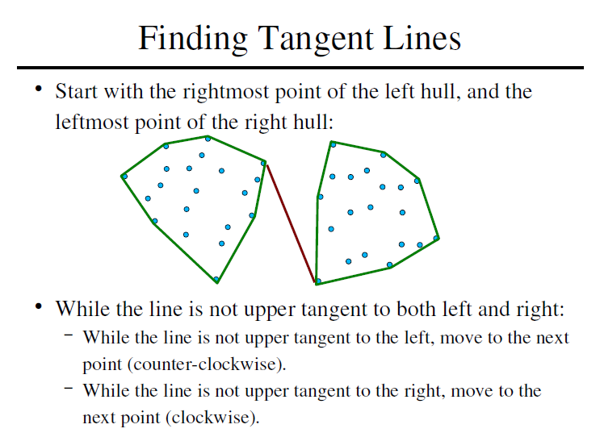
Finding Tangents

Slide 59
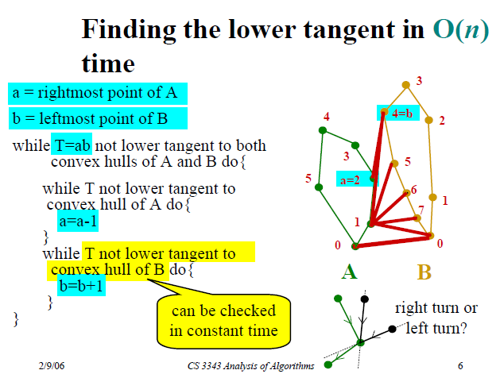

Slide 60
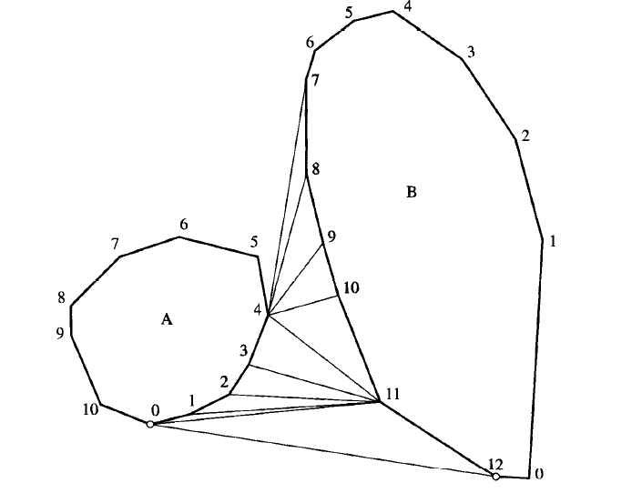
Lower Tangent Example
Initially, T=(4, 7) is only a lower tangent for A. The A loop does not execute, but the B loop increments b to 11.
But now T=(4, 11) is no longer a lower tangent for A, so the A loop decrements a to 0.
T=(0, 11) is not a lower tangent for B, so b is incremented to 12.
T=(0, 12) is a lower tangent for both A and B, and T is returned.

Slide 61
Complexity
Preprocessing: sort the points by x-coordinate
Divide the set of points into two sets A and B:
A contains the left ⎣n/2⎦ points,
B contains the right ⎡n/2⎤ points
Recursively compute the convex hull of A
Recursively compute the convex hull of B
Merge the two convex hulls
O(n log n) just once
O(1)
T(n/2)
T(n/2)
O(n)

Slide 62
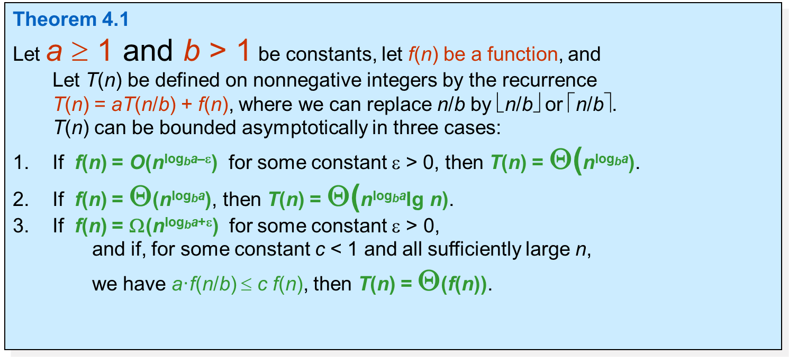
Complexity
T(n) = 2T(n/2) + cn
Using Masters theorem
a=2, b=2
f(n) = cn ∈ ⊝(n) d=1
T(n)=⊝(n log n) (a=b^{d} =2)
Best, Average, Worst case complexity O(n logn)
Space Complexity O(n)

