Slide 1

DYNAMIC PROGRAMMING
By
Dr. N.Subhash Chandra

Slide 2

DP Applications : 0/1 Knapsack Problem

Slide 3
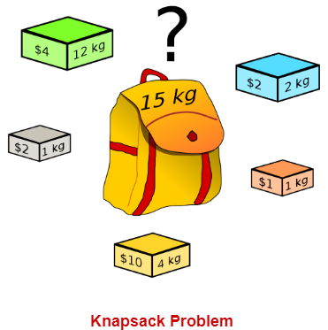
Concept
A knapsack (kind of shoulder bag) with limited weight capacity.
Few items each having some weight and value.
The problem states-
Which items should be placed into the knapsack such that-
The value or profit obtained by putting the items into the knapsack is maximum.
And the weight limit of the knapsack does not exceed.

Slide 4
Knapsack Problem Variants-
Knapsack problem has the following two variants
1. Fractional Knapsack Problem
2. 0/1 Knapsack Problem
In 0/1 Knapsack Problem,
As the name suggests, items are indivisible here.
We can not take the fraction of any item.
We have to either take an item completely or leave it completely.
It is solved using dynamic programming approach.

Slide 5
Methods to solve 0/1 Knapsack Problem 1. Tabular Method 2. Set Method

Slide 6
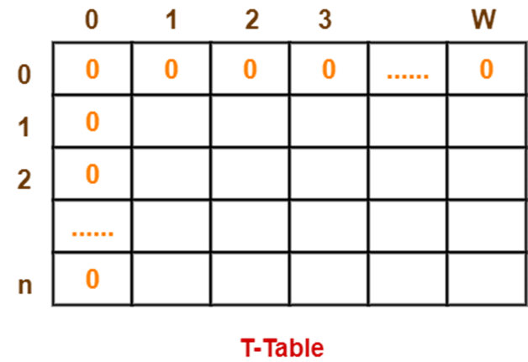
0/1 Knapsack Problem : Tabular Method
Consider-
Knapsack weight capacity = w
Number of items each having some weight and value = n
0/1 knapsack problem is solved using dynamic programming in the following steps-
Step-01:
Draw a table say ‘T’ with (n+1) number of rows and (w+1) number of columns.
Fill all the boxes of 0th row and 0th column with zeroes as shown-

Slide 7
0/1 Knapsack Problem : Tabular Method
Step-02:
Start filling the table row wise top to bottom from left to right.
Use the following formula-
T (i , j) = max { T( i-1 , j ) , value i +T( i-1 , j – weight i ) }
Here, T(i , j) = maximum value of the selected items if we can take items 1 to i and have weight restrictions of j.
This step leads to completely filling the table.
Then, value of the last box represents the maximum possible value that can be put into the knapsack.

Slide 8
0/1 Knapsack Problem : Tabular Method
Step-03:
To identify the items that must be put into the knapsack to obtain that maximum profit,
Consider the last column of the table.
Start scanning the entries from bottom to top.
On encountering an entry whose value is not same as the value stored in the entry immediately above it, mark the row label of that entry.
After all the entries are scanned, the marked labels represent the items that must be put into the knapsack.
Time Complexity-
Each entry of the table requires constant time θ(1) for its computation.
It takes θ(nw) time to fill (n+1)(w+1) table entries.
It takes θ(n) time for tracing the solution since tracing process traces the n rows.
Thus, overall θ(nw) time is taken to solve 0/1 knapsack problem using dynamic programming.

Slide 9
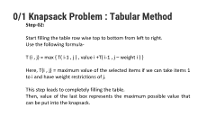
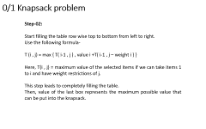
0/1 Knapsack Problem : Tabular Method
Problem-
For the given set of items and knapsack capacity = 5 kg, find the optimal solution for the 0/1 knapsack problem making use of dynamic programming approach.
Item Weight Value
1 2 3
2 3 4
3 4 5
4 5 6

Slide 10
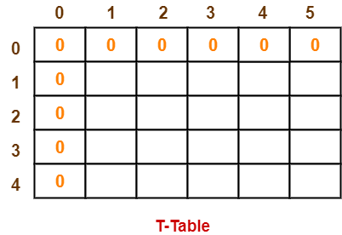
0/1 Knapsack Problem : Tabular Method
Given-
Knapsack capacity (w) = 5 kg
Number of items (n) = 4
Step-01:
Draw a table say ‘T’ with (n+1) = 4 + 1 = 5 number of rows and (w+1) = 5 + 1 = 6 number of columns.
Fill all the boxes of 0th row and 0th column with 0.

Slide 11
0/1 Knapsack Problem : Tabular Method
Step-02:
Start filling the table row wise top to bottom from left to right using the formula-
T (i , j) = max { T ( i-1 , j ) , value i + T( i-1 , j – weight i ) }
Finding T(1,1)-
We have,
i = 1,j = 1
(value)i = (value)1 = 3
(weight)i = (weight)1 = 2
Substituting the values, we get-
T(1,1) = max { T(1-1 , 1) , 3 + T(1-1 , 1-2) }
T(1,1) = max { T(0,1) , 3 + T(0,-1) }
T(1,1) = T(0,1) { Ignore T(0,-1) }
T(1,1) = 0

Slide 12
0/1 Knapsack Problem : Tabular Method
Finding T(1,2)-
We have,
i = 1
j = 2
(value)i = (value)1 = 3
(weight)i = (weight)1 = 2
Substituting the values, we get-
T(1,2) = max { T(1-1 , 2) , 3 + T(1-1 , 2-2) }
T(1,2) = max { T(0,2) , 3 + T(0,0) }
T(1,2) = max {0 , 3+0}
T(1,2) = 3
Finding T(1,3)-
We have,
i = 1
j = 3
(value)i = (value)1 = 3
(weight)i = (weight)1 = 2
Substituting the values, we get-
T(1,3) = max { T(1-1 , 3) , 3 + T(1-1 , 3-2) }
T(1,3) = max { T(0,3) , 3 + T(0,1) }
T(1,3) = max {0 , 3+0}
T(1,3) = 3

Slide 13
0/1 Knapsack Problem : Tabular Method
Finding T(1,4)-
We have,
i = 1
j = 4
(value)i = (value)1 = 3
(weight)i = (weight)1 = 2
Substituting the values, we get-
T(1,4) = max { T(1-1 , 4) , 3 + T(1-1 , 4-2) }
T(1,4) = max { T(0,4) , 3 + T(0,2) }
T(1,4) = max {0 , 3+0}
T(1,4) = 3
Finding T(1,5)-
We have,
i = 1
j = 5
(value)i = (value)1 = 3
(weight)i = (weight)1 = 2
Substituting the values, we get-
T(1,5) = max { T(1-1 , 5) , 3 + T(1-1 , 5-2) }
T(1,5) = max { T(0,5) , 3 + T(0,3) }
T(1,5) = max {0 , 3+0}
T(1,5) = 3

Slide 14
0/1 Knapsack Problem : Tabular Method
Finding T(2,1)-
We have,
i = 2
j = 1
(value)i = (value)2 = 4
(weight)i = (weight)2 = 3
Substituting the values, we get-
T(2,1) = max { T(2-1 , 1) , 4 + T(2-1 , 1-3) }
T(2,1) = max { T(1,1) , 4 + T(1,-2) }
T(2,1) = T(1,1) { Ignore T(1,-2) }
T(2,1) = 0
Finding T(2,2)-
We have,
i = 2
j = 2
(value)i = (value)2 = 4
(weight)i = (weight)2 = 3
Substituting the values, we get-
T(2,2) = max { T(2-1 , 2) , 4 + T(2-1 , 2-3) }
T(2,2) = max { T(1,2) , 4 + T(1,-1) }
T(2,2) = T(1,2) { Ignore T(1,-1) }
T(2,2) = 3

Slide 15
0/1 Knapsack Problem : Tabular Method
Finding T(2,3)-
We have,
i = 2
j = 3
(value)i = (value)2 = 4
(weight)i = (weight)2 = 3
Substituting the values, we get-
T(2,3) = max { T(2-1 , 3) , 4 + T(2-1 , 3-3) }
T(2,3) = max { T(1,3) , 4 + T(1,0) }
T(2,3) = max { 3 , 4+0 }
T(2,3) = 4

Slide 16
0/1 Knapsack Problem : Tabular Method
Finding T(2,4)-
We have,
i = 2
j = 4
(value)i = (value)2 = 4
(weight)i = (weight)2 = 3
Substituting the values, we get-
T(2,4) = max { T(2-1 , 4) , 4 + T(2-1 , 4-3) }
T(2,4) = max { T(1,4) , 4 + T(1,1) }
T(2,4) = max { 3 , 4+0 }
T(2,4) = 4
Finding T(2,5)-
We have,
i = 2
j = 5
(value)i = (value)2 = 4
(weight)i = (weight)2 = 3
Substituting the values, we get-
T(2,5) = max { T(2-1 , 5) , 4 + T(2-1 , 5-3) }
T(2,5) = max { T(1,5) , 4 + T(1,2) }
T(2,5) = max { 3 , 4+3 }
T(2,5) = 7

Slide 17
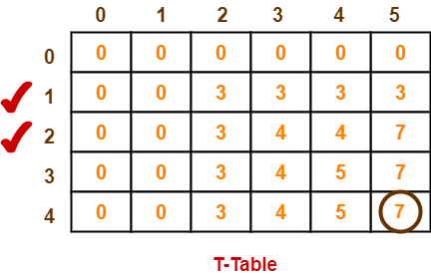
0/1 Knapsack Problem : Tabular Method
Similarly, compute all the entries.
After all the entries are computed and filled in the table, we get the following table-
The last entry represents the maximum possible value that can be put into the knapsack.
So, maximum possible value that can be put into the knapsack = 7.
Identifying Items To Be Put Into Knapsack-
Following Step-04,
We mark the rows labelled “1” and “2”.
Thus, items that must be put into the knapsack to obtain the maximum value 7 are-
Item-1 and Item-2

Slide 18
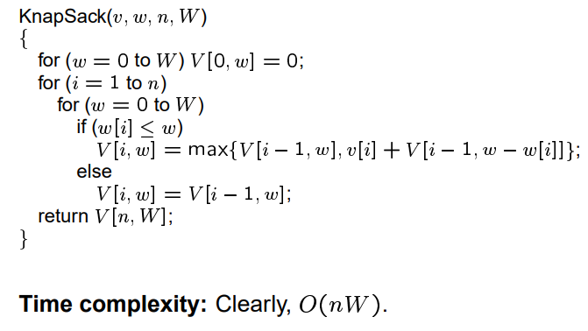
0/1 Knapsack Problem : Tabular Method algorithm

Slide 19
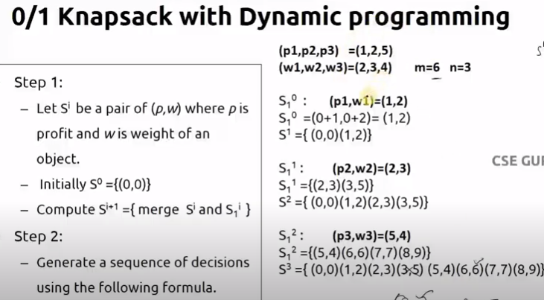
0/1 Knapsack Problem : Set Method
Example 1:
Consider the knapsack instance n = 3,
(w1, w2, w3) = (2, 3, 4),
(P1, P2, P3) = (1, 2,5) and M = 6.

Slide 20
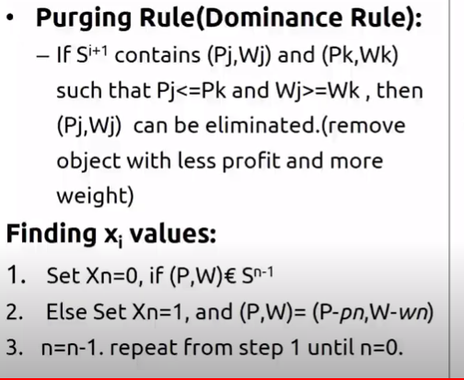
0/1 Knapsack Problem : Set Method

Slide 21
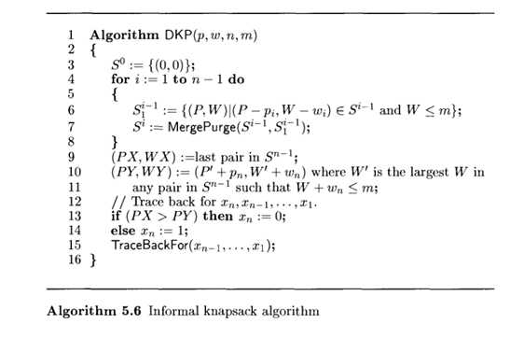
0/1 Knapsack Problem : Set method Algorithm

Slide 22
0/1 Knapsack Problem : Exercise

